Slide 1
Explaining Social Factors for Community Risk of Severe Wind Damage
Team 3:
Josh Melton, Rezaur Rashid, and Sai Bharadwaj Reddy

Slide 2
Project Background
Interpreting the socio-technical interactions within a wind damage artificial neural network model for community resilience
Uses graph theory to explain neural network models for predicting structural damage due to severe wind events. (Damage divided into 5 classes of increasing severity)
Graph metrics such as Shortest Path and Centrality are used to explain relationships between attributes, treating neural networks as DAGs
A dataset for the state of Missouri was created for this study which consists of both Structural and Social characteristics for a set of buildings
[Stephanie F. Pilkington and Hussam N. Mahmoud, 2020]

Slide 3
Project Background
Node centrality measures are a poor substitute for causal inference
This work focuses on explaining on why graph centrality metrics can be a poor metrics for determining causal relationships
The authors conduct a number of simulations with various network graphs, comparing node rankings based on graph centrality metrics and cause-effect node rankings
They show that nodes ranked with centrality-measure and nodes ranked by cause-effect are only moderately correlated and become negative as network size and density of the graph increases.
[Fabian Dablander & Max Hinne, 2019]

Slide 4
Project Motivation
Machine learning models have been increasing applied to understand and predict structural damage from severe weather events
Several themes are widely accepted
How wind pressure translates to extreme structural load
How debris can affect this loading
How social characteristics affect overall population risk
Social factors are notoriously difficult to model cohesively
Models have primarily focused on physical damage models
Use of ANNs raises concerns over the ‘black box’ nature
of such models

Slide 5
Project Goals
Compare and contrast two model variants:
One model using only wind hazard and building structure features
Another model including additional features related to building use and potential debris
Analyze feature importance in ANNs using graph theory
Understand the importance of features and neurons w.r.t to connectivity and centrality in ANNs
Compare against Shapley value importances
Construct a causal model using CausalNex and doWhy

Slide 6
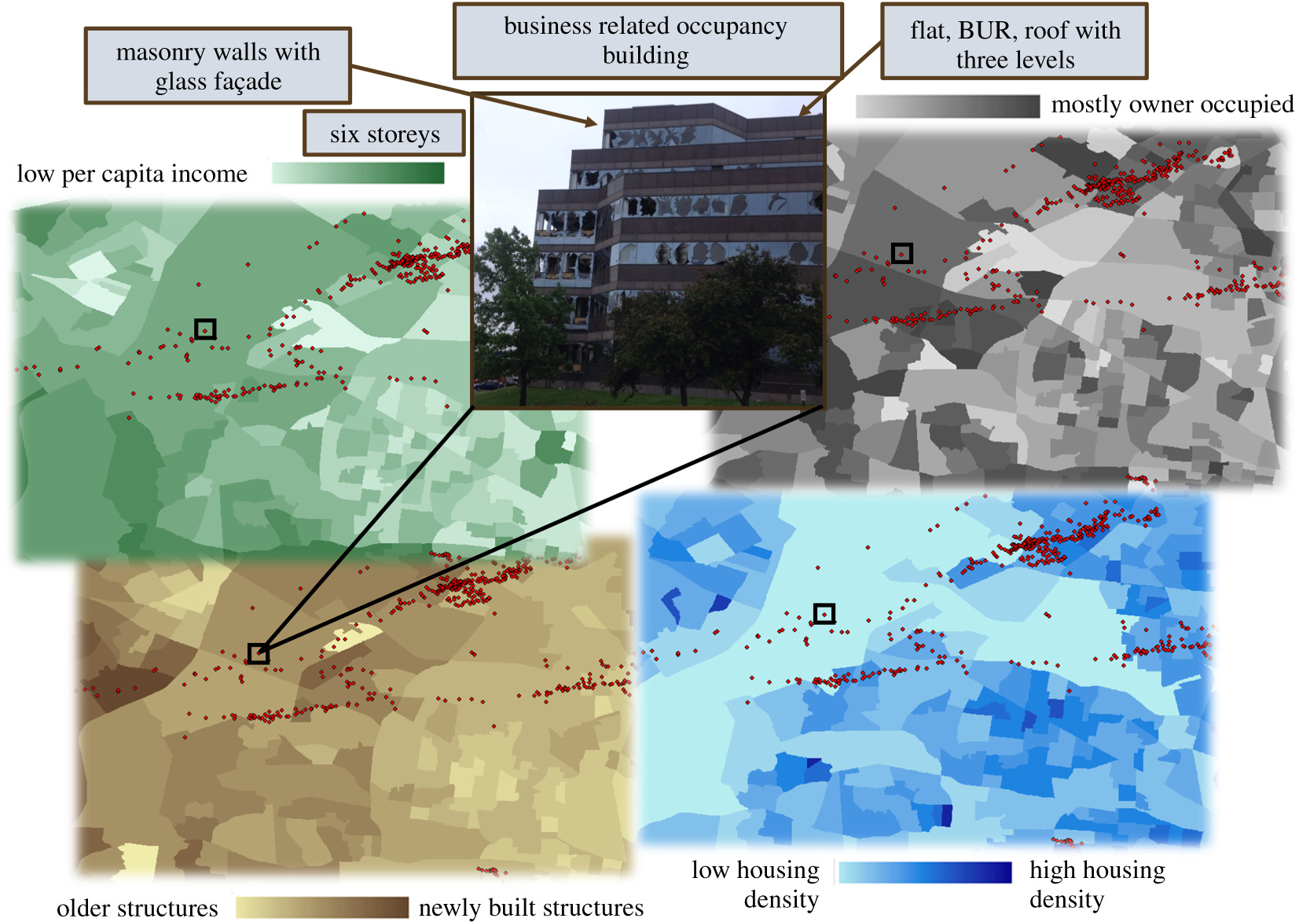
Dataset Description
National Weather Service data consisting of damage surveys related to wind events
US Census Bureau data consisting of population characteristics spatially organized in census blocks
117 building data points from Missouri
Chosen due to its location in Tornado Alley
Validation against records from the 2011 Joplin Tornado

Slide 7
Analysis of ANNs as Graphs
Analyze neuron contributions to information flow through the ANN using graph properties and metrics
Shortest Path
Examine the shortest path between two neurons
Connection weights are considered as travel times
Degree Centrality
The sum of the incoming or outgoing weights for a given neuron
Closeness Centrality
How “close” a node is to all other reachable nodes
The inverse sum of the length of shortest paths between a given
node and all other nodes in the graph

Slide 8
Experiment
Models
MLP
Gradient Boosting Trees (XGBoost)
Experimental Environment
Target (5 classes)
117 Different data points
70% in training, 15% in validation and 15% in testing

Slide 9
Explainability
Shapley Additive Value (SHAP):
Shapley value is a method developed for distributing payout to players depending on their contribution towards total payout (Shapley, 1953).
Used SHAP Explainer:
DeepShap
TreeShap
Gives exact SHAP values

Slide 10
Causal Model
CausalNex
Causal Structure Learning
Allows Domain Expert to augment causal relationships
DoWhy

Slide 11
Questions?
Thank you.

