Slide 1
Vrinda Store Data Analysis
Excel Project by [Mohammad Rashid]

Slide 2
Project Introduction
This Excel project analyzes sales and customer data of Vrinda Store.
The goal is to generate useful insights using Pivot Tables and Dashboards.
It focuses on trends, gender-based analysis, channels, and product categories.

Slide 3
Tools Used
- Microsoft Excel
- Pivot Tables
- Charts (Pie, Bar, Line)
- Slicers for interactivity
- Data Cleaning and Processing and Analyzing
and Transformation.

Slide 4
Insights Covered
- Monthly Sales Trends
- Top 5 States by Sales
- Order Status Breakdown
- Gender and Age Analysis
- Sales Distribution by Channel

Slide 5
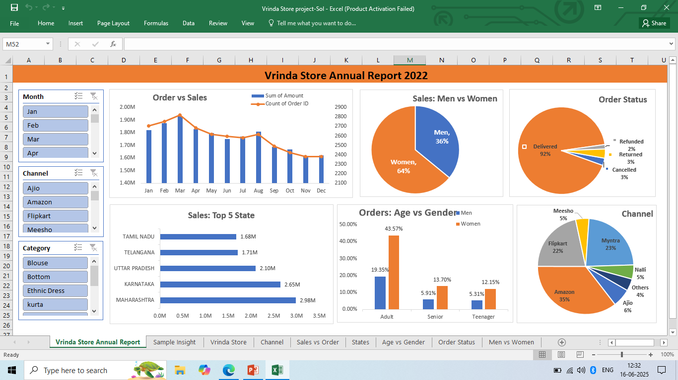
Dashboard Overview

Slide 6
Conclusion
This project showcases practical Excel skills in data analysis.
It demonstrates how to turn raw data into a professional dashboard.
It is useful for business decisions and real-world reporting.
Thank you!

