Slide 1

Customer Relationship Management
RASHID KALEEM (23)
MD FAKHRUDDIN (24)
DEVRAJ BHANU (22)
SAMAR SINGH (14)
KUNJ MARKEN MAM
Faculty of Artificial Intelligence
GROUP – 6
SECTION – K18RH

Slide 2
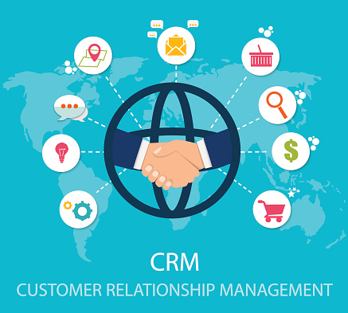
INTRODUCTION
A Customer relationship management (CRM) is an approach to managing a company's interaction with current and potential customers.

Slide 3
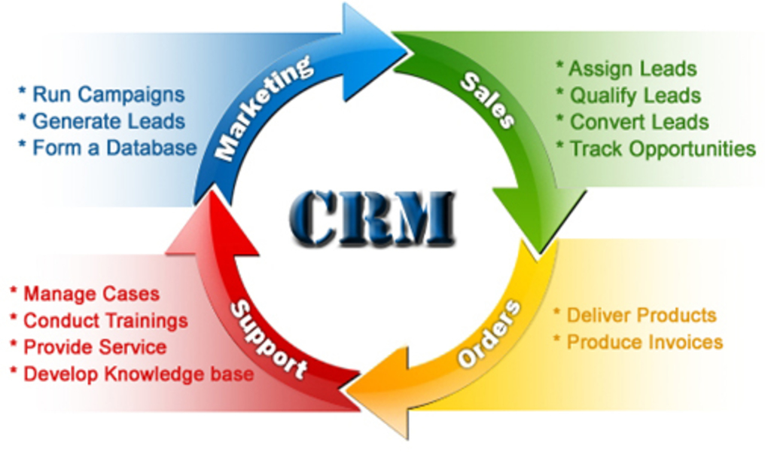
BENEFIT OF CRM

Slide 4
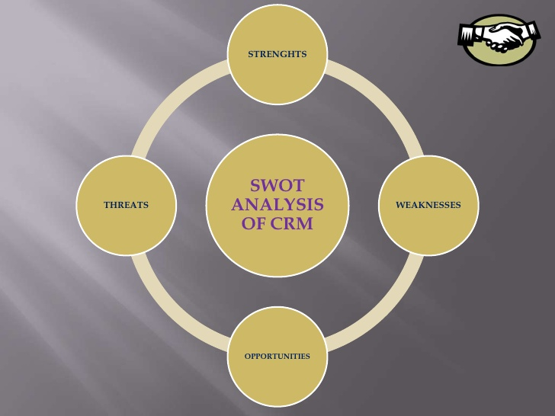
INTRODUCTION
SWOT ANALYSIS OF CRM

Slide 5
VIEWS OF CRM
Marketing Automation
Sales Automation
Customer self - service
E- Commerce

