Slide 1
AI Solution Development Bootcamp | Team 4
Customer
Retention
Predictor
10k
bank customers
ML + LLM
Bank churn prediction using machine learning and an LLM-powered retention advice layer
01

Slide 2
The solution predicts who may leave before the bank loses them
Business problem
1. Predict churn risk
Customer churn is expensive because the bank only sees the loss after the customer has already left. A useful AI solution must flag risk early and turn that signal into a concrete retention action.
2. Compare model trade-offs
3. Generate retention advice
02

Slide 3
The dataset contains 10,000 bank customers and a clear churn target
Each row describes a customer profile; Exited is the target variable.
10,000
10
20.4%
customer records
usable model features
customers churned
Feature group | Examples
Demographic | Geography, Gender, Age
Relationship | Tenure, IsActiveMember
Financial | CreditScore, Balance, Salary
Product | NumOfProducts, HasCrCard
03

Slide 4
Preprocessing turned raw customer records into model-ready features
The cleaning kept all customer rows while removing identifiers and encoding categorical inputs.
01
Drop identifiers
02
Encode categories
Surname, RowNumber, CustomerId, and the exported index are excluded from modelling.
Gender is binary encoded; Geography is label encoded.
03
Keep complete rows
04
Export clean set
No missing values were found across the raw dataset.
The modelling view is 10 features plus the Exited target.
04

Slide 5
The class imbalance made recall and F1 more meaningful than accuracy alone
Because only 20.4% of customers churned, a model can look accurate while still missing many churners.
Decision choice
Do not downsample and lose thousands of majority-class rows.
Training response
Use class_weight='balanced' and tune thresholds for the retention objective.
05

Slide 6
Four classifiers were tuned through the same evaluation pipeline
The split preserved class proportions, and GridSearchCV compared candidate hyperparameters.
Model | Core setup | Reason tested
Logistic Regression | Scaler + polynomial features | Linear baseline with feature interaction
SVM | Scaler + probability output | Margin-based classifier
Decision Tree | Depth and class-weight search | Interpretable non-linear baseline
Random Forest | Trees, depth, class weight | Strong ensemble candidate
70 / 15 / 15
train / validation / test
5-fold
GridSearchCV
06

Slide 7
A preprocessing fix changed training from unfinished to 19.6 seconds
The first training attempt ran for more than 130 minutes without finishing. Investigation pointed to scaling as the missing step for distance- and optimization-sensitive models.
Before
Root cause
After
>130 min
no scaling
64 s
training did not finish
optimization/search became too slow
all training completed
Lesson: model performance is not only about metrics; pipeline design can decide whether training is even practical.
07

Slide 8
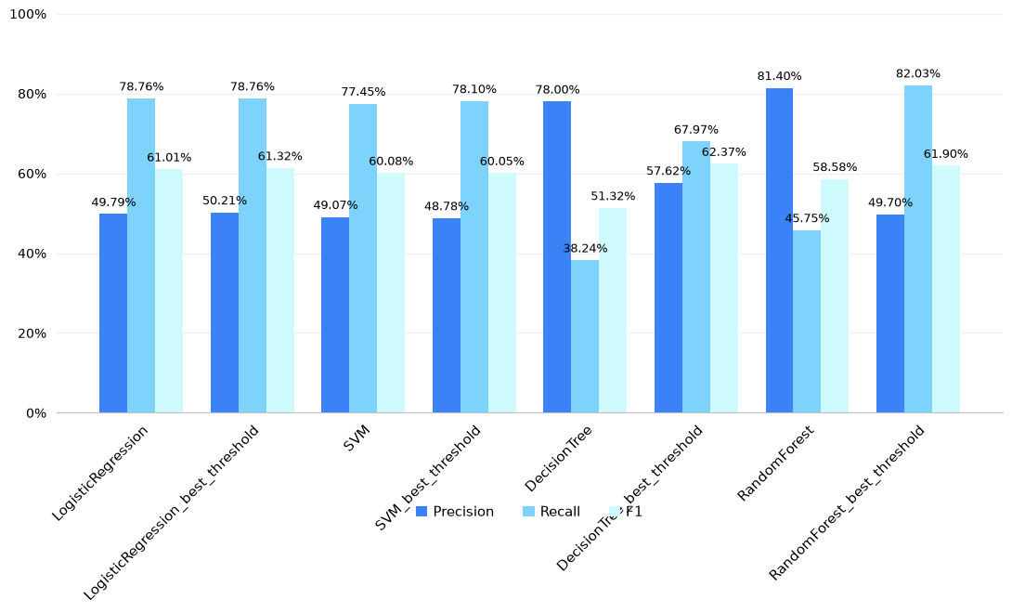
Validation results show the accuracy versus recall trade-off
86.9%
highest validation accuracy: Random Forest
But
default Tree and Forest missed more than half of churners on validation recall.
08

Slide 9
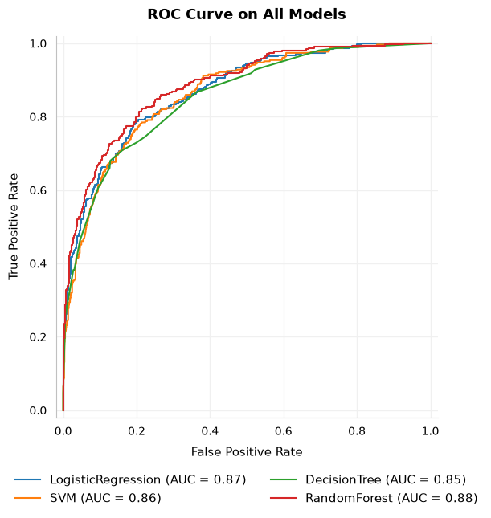
Validation results show the accuracy versus recall trade-off
86.9%
highest validation accuracy: Random Forest
But
default Tree and Forest missed more than half of churners on validation recall.
08

Slide 10
Threshold tuning changed which model looked most useful for retention
For retention, catching churners can matter more than preserving the highest overall accuracy.
Model | Threshold | Recall | F1-Score | Accuracy
Logistic Regression | 0.5000 (default) | 75% | 59% | 79%
Logistic Regression | 0.5000 (best) | 75% | 59% | 79%
SVM | 0.5000 (default) | 75% | 59% | 79%
SVM | 0.2137 (best) | 75% | 59% | 79%
Decision Tree | 0.5000 (default) | 40% | 55% | 87%
Decision Tree | 0.3077 (best) | 67% | 63% | 84%
Random Forest | 0.5000 (default) | 46% | 59% | 87%
Random Forest | 0.1988 (best) | 77% | 58% | 78%
Best balance
Decision Tree at 0.3077 improved F1 to 63% while keeping 84% accuracy.
Highest recall
Random Forest at 0.1985 caught 77% of churners, but accuracy dropped to 78%.
09

Slide 11
The completed LLM layer converts model output into retention advice
The notebook uses a real at-risk test customer and prompts an LLM to produce analyst-style guidance.
Model signal
Prompting modes
Retention action
Predicted churn probability
0.242
Customer facts
Age 40, balance 163,823
Tenure 10, inactive member
Zero-shot
Few-shot
Reasoning prompt
All produce retention analyst language from the same ML output.
Risk: medium
Recommended action: personalized outreach and financial advice to strengthen engagement.
This turns the classifier from a score into a decision-support workflow.
10

Slide 12
Final outcome: a working churn predictor with action-oriented advice
Built
A full preprocessing, training, tuning, and evaluation workflow.
Learned
Scaling and threshold tuning changed both runtime and business usefulness.
Delivered
A model-backed LLM layer that explains risk and suggests retention actions.
11

