Slide 1

Real-Time Environment Classification and Irrigation Monitoring System Using Edge AI
Advancing smart agriculture with real-time environmental insights for optimal plant growth.
Group Members: Rashid Latif 22-NTU-CS-1369
Hamza Latif 22-NTU-CS-1345
Sawaira Manzoor 22-NTU-CS-1372

Slide 2

Project Introduction
Motivation
Addressing water scarcity with intelligent agricultural solutions.
Objective
Predictive environment classification and live monitoring using edge AI on ESP32-S3.
Outcome
Real-time classification: Unfavorable, Moderate, Optimal environments with a dynamic dashboard.

Slide 3
Hardware Components
ESP32-S3 Microcontroller
MQ135 Gas Sensor
High performance
Measures air quality
Integrated AI capabilities
Soil Moisture Sensor
TFLite Micro support
Detects soil moisture level
DHT11 Sensor
Relay Module & Water Pump
Measures temperature
Automated irrigation control
Measures humidity
Future integration for full functionality
LDR (Light Dependent Resistor)
Measures light intensity

Slide 4





Software Components
Arduino IDE
TensorFlow Lite Micro
ESPAsyncWebServer
Development environment
Edge AI framework
Dashboard hosting
C++ Programming
Model Training (Python)
Embedded firmware
5-feature input

Slide 5





System Architecture Diagram
Sensor Data Collection
AI Model Inference
(On-device)
Prediction Output
Web Dashboard Update
Irrigation Trigger
(If Optimal)

Slide 6
Edge AI Model Details
Model Type
Output Classes
Classification
Class 0: Unfavorable 🌪️
Input Features
Class 1: Moderate 🌥️
Class 2: Optimal 🌿
Temperature
Humidity
Model Format
Light
.tflite embedded in firmware
Air Quality
Inference Time
Soil Moisture
Fast & Efficient (~ms delay)

Slide 7
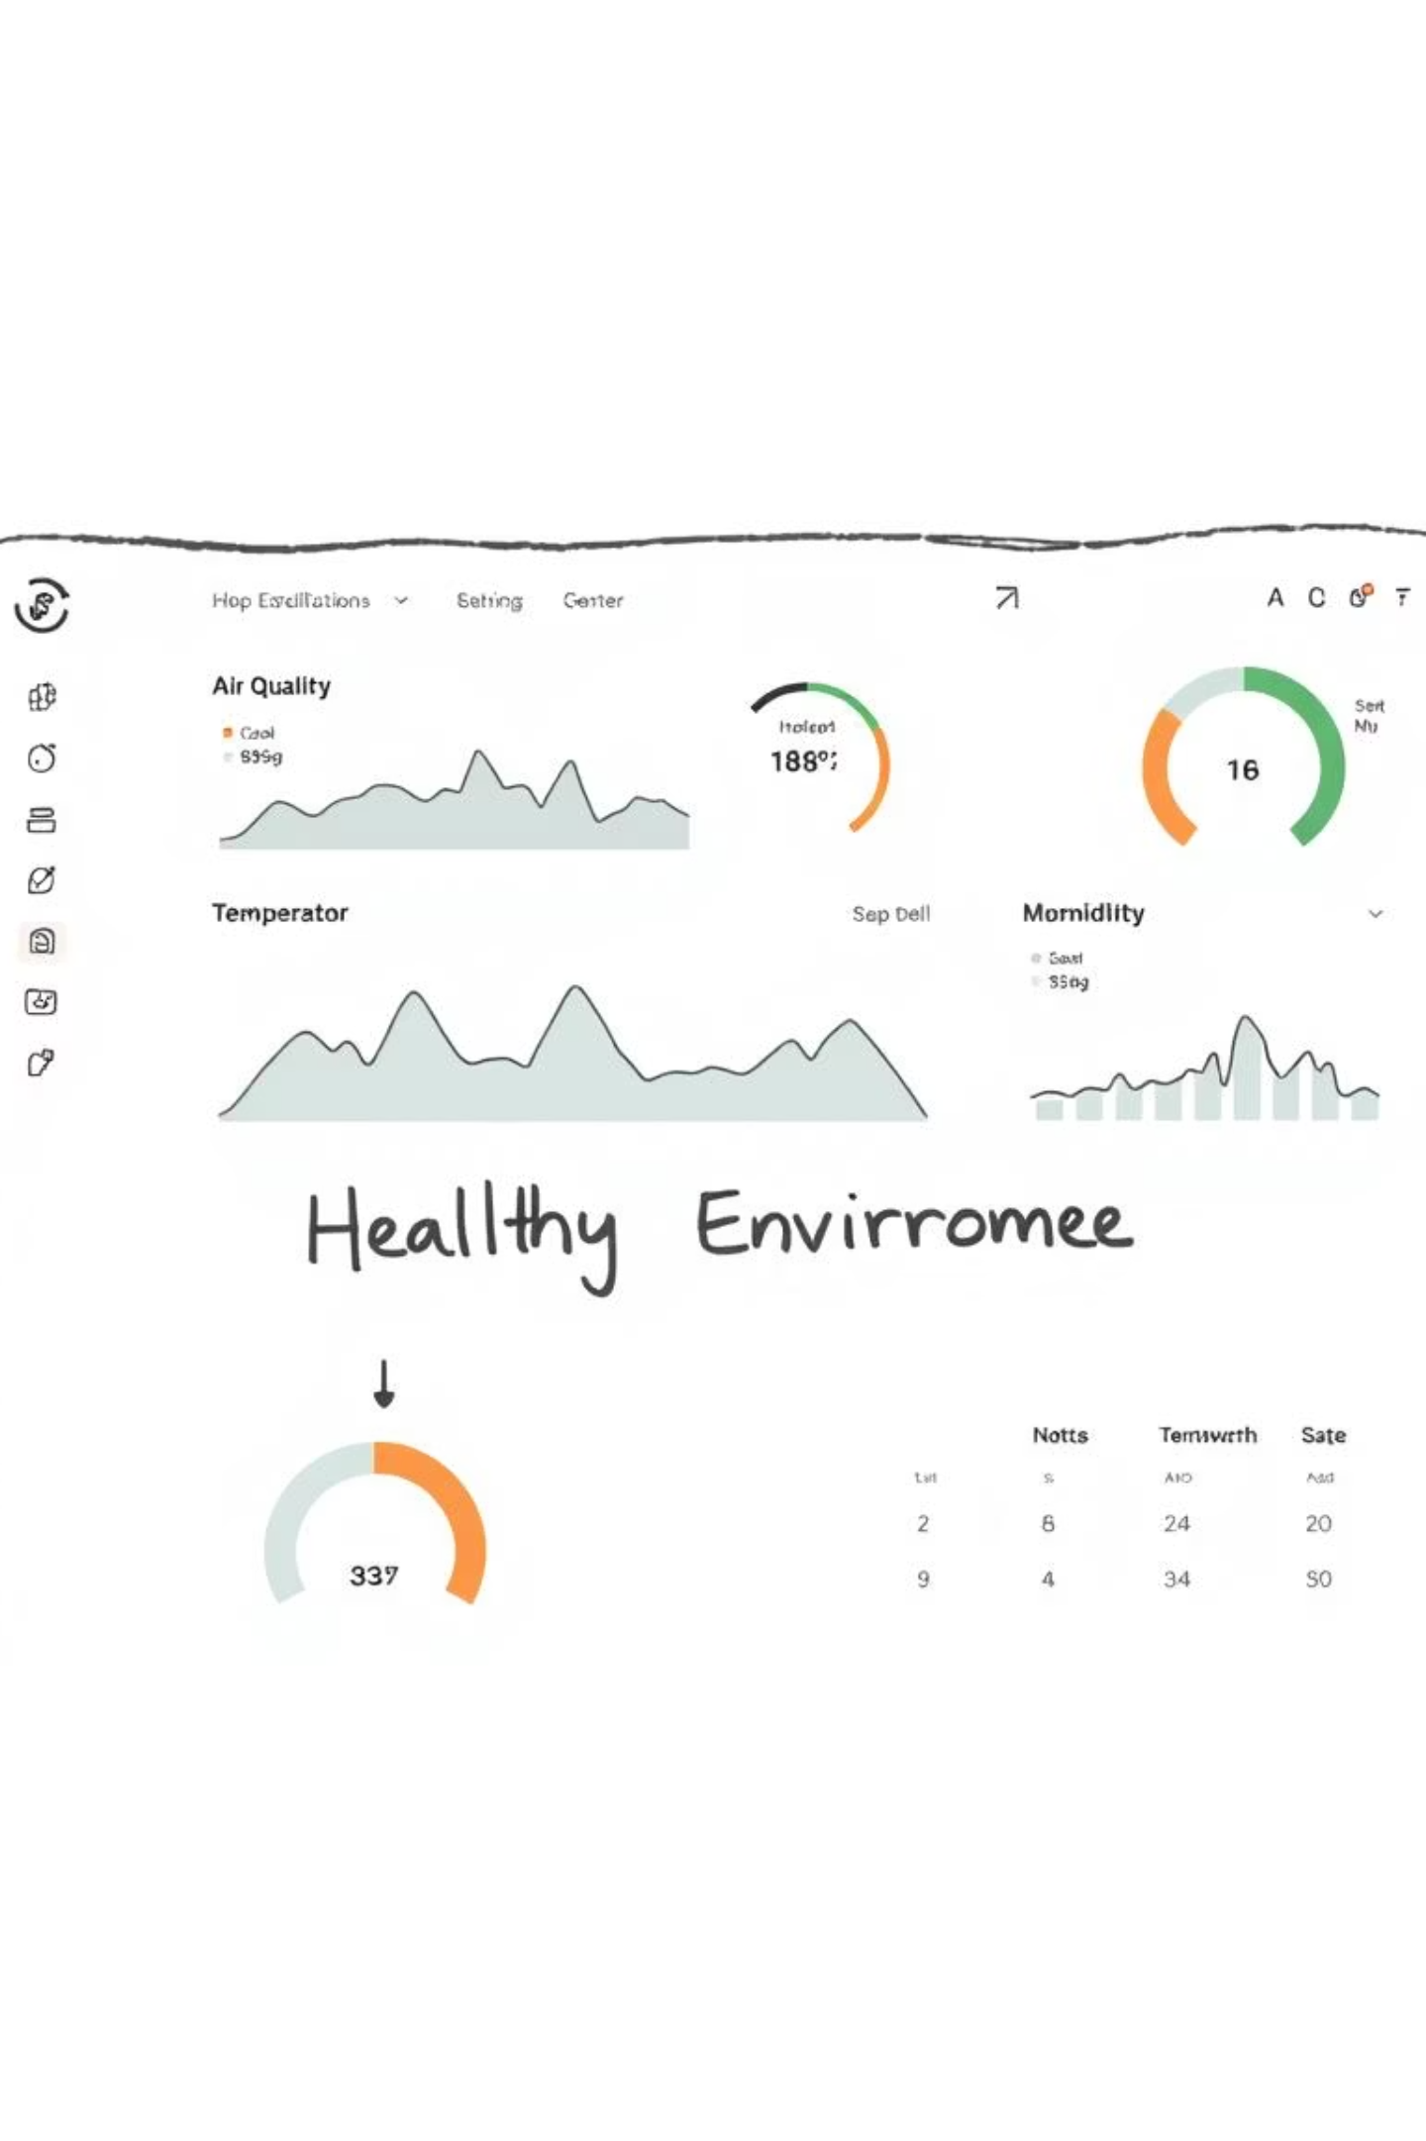
Web Dashboard Overview
Live Sensor Values
Temperature
Humidity
Light Intensity
Air Quality
Soil Moisture
Prediction Result
Clear, real-time display
Auto-Update
Every 5 seconds
User Interface
User-friendly, modern design

Slide 8
Irrigation Logic (Planned)
Relay Trigger Logic
Current Status
IF Class == Optimal (2)
Code logic fully implemented
AND Soil Moisture < Threshold
Power limitations prevented motor testing in current setup
THEN Activate Relay
→ Power Water Pump

Slide 9
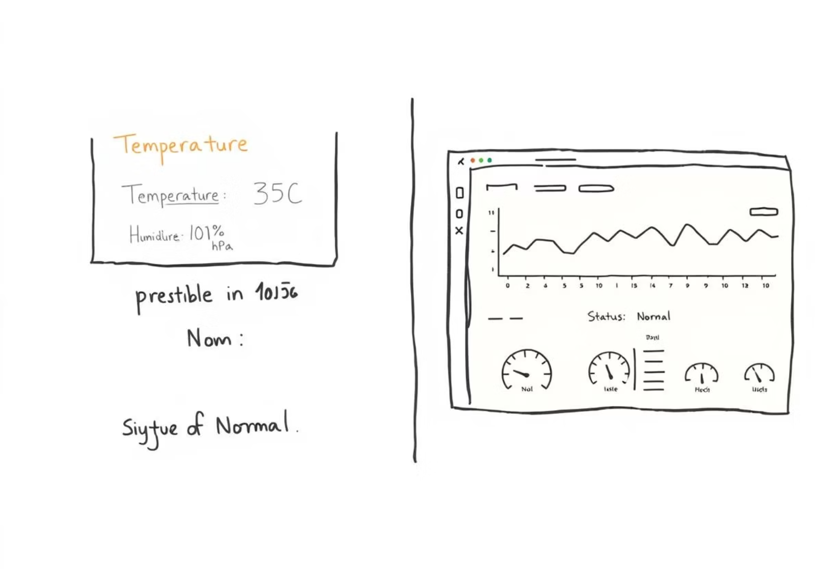
Output Sample
Serial Output
Dashboard Screenshot
[Sensor Readings]Temp: 25.00°CHum: 60.00%LDR: 500MQ135: 150Soil Moisture: 300[Model Prediction]Class: 2 (Optimal)

Slide 10
Challenges & Learnings
TFLite Integration
Optimizing for low-RAM microcontrollers.
Analog Sensor Noise
Techniques for accurate data acquisition.
External Device Power
Managing power for components like pumps.
Real-time Dashboard
Building dynamic interfaces in embedded environments.
Edge AI & Embedded Systems
Enhanced practical and theoretical understanding.

