Slide 1
Getting to know Testing in PHP
Rashid Khan

Slide 2
Hello
Master in Software Engg.
PHP, Drupal Developer
CodeIgniter
Laravel, Symfony
Github: rashidfawad
Twitter: rashid__khan
Web: www.rashidkhan.info
My first Presentation

Slide 3
Agenda
Testing
PHPUnit
-Installation
-Write tests
-Selenium Tests
-Mocks, Stubs
SimpleTest
-installation, Example
SimpleTest(Drupal)

Slide 4
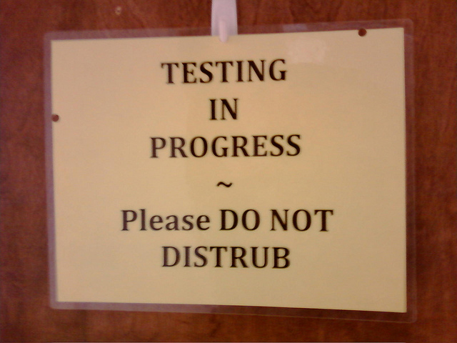

Slide 5


Slide 6
Testing
Software testing is a process of executing a program or application with the intent of finding the software bugs.

Slide 7
Excuses for not Testing
No Time
Not included in Budget
I don’t know how
I’ll test after finishing project
-like thats going to happen

Slide 8


Slide 9
Unit Testing
Unit: The smallest possible testable piece of code.
Test: A piece of code that checks other code.
Advantages:
Fixing Cost is low
Enforces best practices.
Faster development etc.

Slide 10
PHPUnit
A widely used testing framework
Created by Sebastian Bergman
Originally built as a port of jUnit
Part of xUnit family(sUnit, jUnit)
Now incredibly feature rich
Composer global require ”phpunit/phpunit=4.6.x”

Slide 11
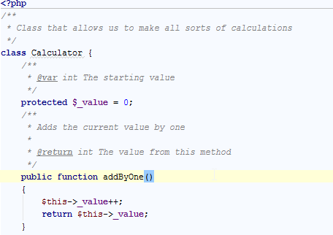
Example

Slide 12
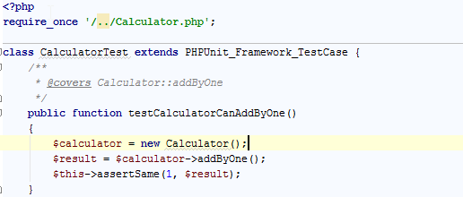
Test

Slide 13
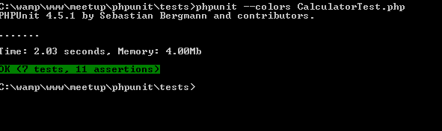
Run test

Slide 14
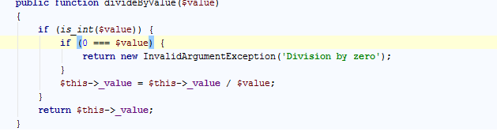
Divide By Zero

Slide 15
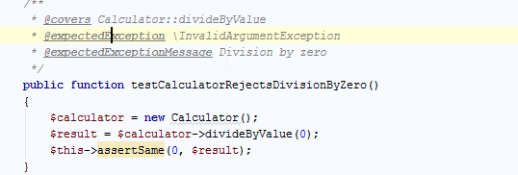
Divide by Zero Test

Slide 16
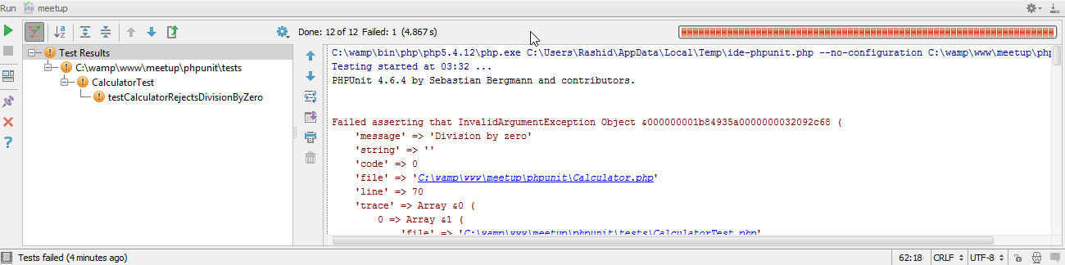
Run Test

Slide 17
PHPUnit Command line Chars
. – Printed when test succeeds.
E – Printed when some error occrus in test.
F – Printed when an assertion fails.
I – When a test is marked Incomplete.
S – When a test is skipped.

Slide 18
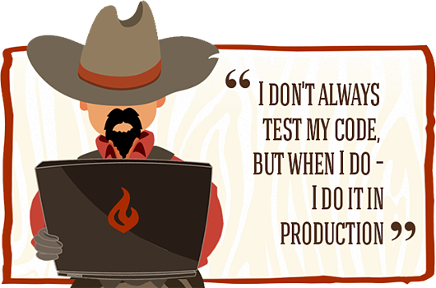

Slide 19
Assertions
Name | Name
assertClasshasAttribute() | assertGreaterThan()
assertGreaterThanorEqual() | assertInstanceOf()
assertCount() | assertEmpty()
assertEquals() | assertNull()
assertStringEndsWith() | assertRegExp()
assertArrayHasKey() | assertSame()
assertTrue() | assertFalse()
assertContains() | assertFileExists()
assertLessThan() | assertLessThanOrEqual()
assertXmlFileEqualsXmlFile() | assertXmlStringEqualsXmlFile()
assertJsonFileEqualsJsonFile() | assertJsonStringEqualsJsonFile()

Slide 20

Code Coverage
Degree to which source code is tested
Phpunit –coverage-html ./report CalculatorTest.php
Low: 0% - 50%
Medium: 50% - 89%
High: 90% - 100%

Slide 21
DB Testing
PHPUnit Database Extension
Installation
Pear: #pear install phpunit/DbUnit
Composer: # composer require phpunit/dbunit
Extend PHPUnit_Framework_Database_TestCase
Implement
getConnection()
getDataSet()

Slide 22
1 Million installations
Currently Supported Database
MySQL
PostgreSQL
Oracle
SQLite
Access IBM DB2 and Microsoft SQL Server through Zend Framework or Doctrine 2 integration.

Slide 23
Fixture
Four stages
SetUp Fixture
Execute System under Test
Verify Outcome
TearDown

Slide 24
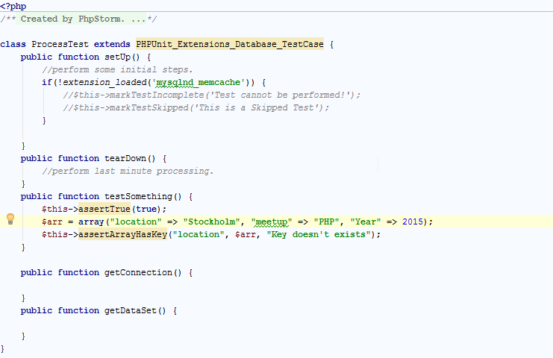

Slide 25
Test Double
Test double
Mocks
-$mockTester = $this->getMock(’class’, array());
$mockTester->expects($this->any())
->method(’method_name’)->will($this->returnValue($value));
Stubs: returns a known value.

Slide 26
Selenium Tests
Used for web testing
Focuses on Acceptance Testing rather than on Unit Testing
Selenium Server used
"phpunit/phpunit-selenium": ">=1.2“

Slide 27
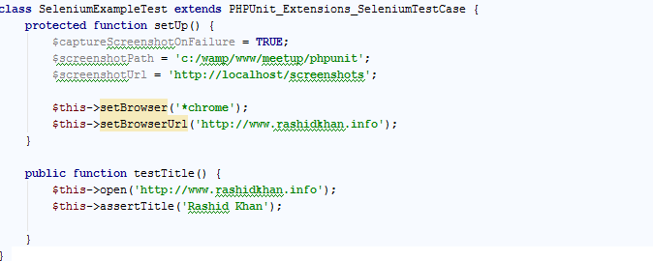
Selenium Tests

Slide 28
SimpleTest
Include the SimpleTest Library.
Extend WebTestCase
Write Assertions

Slide 29
Assertions
Assertion | Assertion
assertTrue() | assertFalse()
assertNull() | assertNotNull()
assertIdentical | assertNotIdentical
assertReference() | assertClone()
assertPattern() | assertNotPattern()
assertIsA() | assertIsNotA()
assertWithinMargin() | assertOutsideMargin()

Slide 30
Assertions
Assertions | Assertions
assertTitle($title) | assertResponse($codes)
assertText($text) | assertNoText($text)
assertLink($link) | assertNoLink($link)
assertCookie($name, $value) | assertNoCookie($name, $value)
assertLinkById($id) | assertNoLinkById($id)

Slide 31
Testing Drupal
Uses SimpleTest
PHPUnit added to Drupal8
In core
Extends DrupalWebTestCase extends WebTestCase
New Setup for each Test
admin/config/development/testing
Do not run all Tests

Slide 32
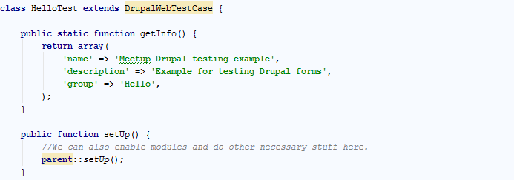

Slide 33
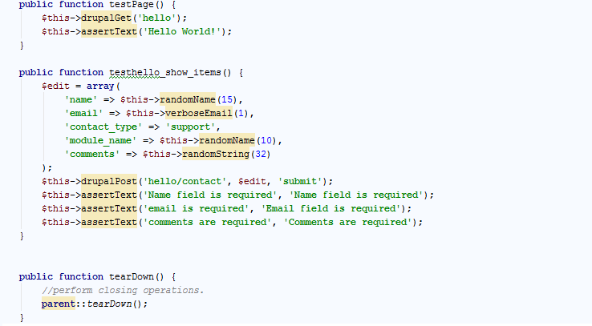
Write Tests

Slide 34
Useful Resources & References
https://phpunit.de/manual/current/en/index.html
https://phpunit.de/manual/current/en/selenium.html
http://docs.seleniumhq.org/download/
http://simpletest.org/en/unit_test_documentation.html
https://github.com/in2it
PHPUnit Essentials(By Zdenek Machek)
https://www.drupal.org/simpletest-tutorial-drupal7

Slide 35

Questions

