Slide 1
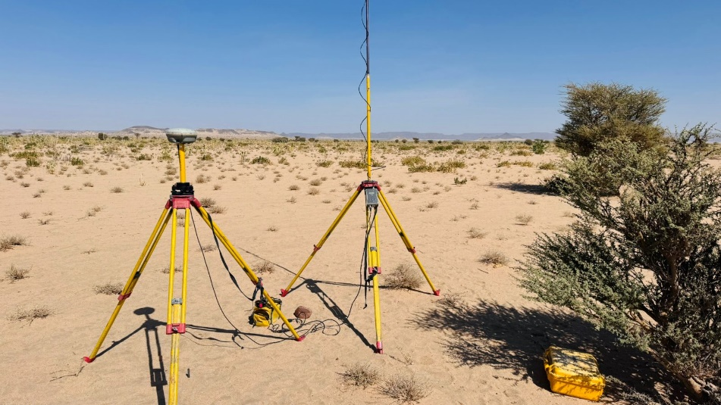





LAND SURVEYING SERVICES
MINOR WORKS
Project Owner : Diriyah Company
Kick-off Meeting
Task Order No. SW-FA24-113-N-20
Framework SW-FA24-113
October 2026
Consultant
Alqotr Consulting Company
Notes:
Kick-off meeting deck for Task Order SW-FA24-113-N-20. Date: fill in the meeting date.

Slide 2

Content
Introduction and Our Experience in Diriyah
Understanding and Scope of Work
Work Steps per Task Order
Methodology: Survey, Demarcation and Title Deed Services
Quality Assurance and Team Structure
Resources, Programme and Deliverables
HSE, Governance and Information Required

Slide 3
About Alqotr
Alqotr in brief
Our work in Diriyah
Saudi consulting company providing geospatial surveying, GIS, urban planning and engineering consultancy.
Cadastral and topographic surveys, 3D laser scanning, UAV and mobile mapping, and GIS data management.
Qualified survey, GIS and project-management teams, supported by a large fleet of GNSS receivers and Total Stations.
Detailed survey and 3D modeling of Historic Diriyah
1
2
Topographic survey project, Diriyah
3
3D modeling of terrain and tree vegetation, Diriyah
Geospatial and Surveying
GIS Services
Cadastral, topographic, LiDAR, UAV, utilities mapping
Data digitization, geodatabases, dashboards
4
Laser scanning and panoramic photography, Diriyah
5
Golf course relocation and tree survey, Al-Bujairi, Diriyah
Operational Support
Consulting and Feasibility
Qualified survey and GIS manpower
Land and property studies, due diligence
Land survey and boundary demarcation, Wadi Safar plots
6
Notes:
Diriyah experience taken from the company capability profile (T12). Wadi Safar plots: confirm the client name before presenting.

Slide 4
Understanding of the Task Order
Client
Diriyah Company
Location: Diriyah, Riyadh Region, Kingdom of Saudi Arabia
Task Order
SW-FA24-113-N-20, under Framework SW-FA24-113
Services
Land Surveying Services, Minor Works
Diriyah
Riyadh Region
Place of performance
Diriyah, Riyadh
Dammam
Madinah
Delivery model
Scope, location and programme confirmed for each Minor Work Task Order
Jeddah
Four service categories
Issuance of New Title Deeds: Main, Phase, Sub-Phase and Block
Issuance of Title Deeds: Plots and Units
Abha
Land Survey
Land Demarcation
Schematic location map, not to scale.
Notes:
Quantities and fee basis are intentionally not shown in this client-facing slide.

Slide 5
Scope of Work
Four services applied from the master plan down to the individual plot
Main / Phase / Sub-Phase
Block
Plot and Unit
1
2
Phase 1
Phase 2
Unit
Unit
Sub-Phase
Unit
Unit
4
3
Streets
Issuance of New Title Deeds: Main, Phase, Sub-Phase and Block
Issuance of Title Deeds: Plots and Units
LS
Land Survey
LD
Land Demarcation
Field survey, boundary survey and data acquisition with verification
Stake-out and marking of corners on the ground, where instructed
Notes:
Schematic illustration only. The four services follow the Task Order price schedule categories.

Slide 6
Work Steps per Task Order
Task Order Initiation
Planning and Mobilization
Field Execution
Processing and Deliverables
QA/QC and Submission
Review and Close-out
1
2
3
4
5
6
Receive and register the instruction
Review service, location and land area
Review Client information
Confirm scope and deliverables
Execution plan and methodology
Allocate personnel and equipment
Site access and coordination
Mobilize the survey team
Verify survey control
Land and boundary survey
Demarcation, where instructed
Field verification checks
Process field observations
Computations and verification
Drawings and documentation
Title deed support documents
Internal technical review
QA/QC of data and deliverables
Compile the submission package
Submit to Diriyah
Diriyah review and comments
Resolve comments
Authority coordination, where applicable
Acceptance and records handover
Diriyah + Alqotr
Alqotr + Diriyah
Alqotr
Alqotr
Alqotr
Diriyah + Alqotr + Authority
Key milestones for each Minor Work Task Order
1
2
3
4
5
6
7
8
9
10
Task Order Receipt
Programme Agreement
Mobilization
Field Survey Completion
Draft Deliverable
QA/QC Completion
Submission to Client
Comments Resolution
Final Submission
Task Order Close-out
M2: scope, resources, programme and deliverables confirmed with Diriyah for each assignment.
Notes:
Source: programme management approach (T8) and responsibility matrix (T4).

Slide 7
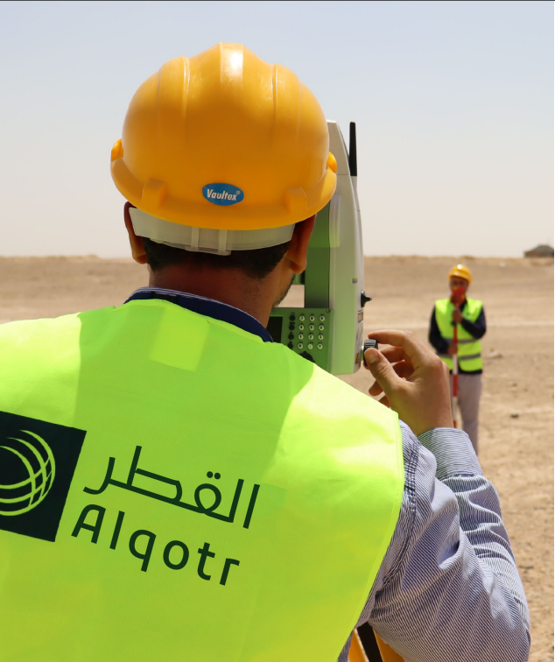

Methodology: Land and Boundary Survey
Survey based on approved information
1
Review the instruction and data
Title deeds, approved plans and existing records are reviewed for each plot.
2
Verify survey control
Control points and benchmarks are checked with GNSS against available control data; new control is established where required.
3
Boundary survey
Boundaries are surveyed with GNSS RTK and Total Stations based on the approved information.
4
Detail survey and site photos
Existing features are surveyed and documented with site photographs.
5
Field verification
Completeness and consistency checks in the field before leaving the site.
Notes:
Photos from previous Alqotr field work (equipment shots without client branding).

Slide 8
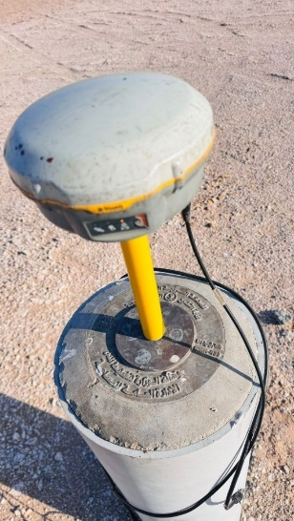
Methodology: Land Demarcation
From coordinates to marked corners on the ground
Schematic: plot corners and monuments
Site visit and reconnaissance
CP1
Corner 2
1
Access routes, terrain, existing boundary indicators and obstructions are identified.
Corner 1
2
Control verification
CP2
Existing control is located and verified; new control is established with GNSS or Total Station where needed.
Corner 3
3
Stake-out of corners
Corner positions are set out from verified control using Total Station or RTK GNSS.
Corner 4
Control point (triangle), stake-out line (dashed), corner marker (diamond)
4
Fixing boundary markers
Concrete or metal monuments are installed and referenced with unique IDs.
5
Photo documentation and report
Each corner and marker is photographed and recorded in the demarcation report.
Notes:
Stake-out and marker practice per previous demarcation work. Schematic diagram not to scale.

Slide 9
Title Deed Services: Workflow
Diriyah Company
1
2
6
Issue Task Order and define plot and service
Provide title deeds, approved plans and records
Review and comment
Alqotr
3
4
5
7
Review data, confirm programme and deliverables
Verify control, survey and demarcate
Prepare title deed support documents; QA/QC; submit
Resolve comments; coordinate with authorities
Statutory Authority
8
Review, approval and issuance
Final submission, acceptance and close-out follow incorporation of comments and authority review where applicable.
Notes:
Based on the responsibility matrix (T4). Authority steps apply only where statutory approval is required.

Slide 10
Quality Assurance and Control
Descriptive data
Title deed data
CAD drawing and layout
Internal review time
Boundaries against title deed, approved plan and field
Lengths of each boundary side
Area against approved calculations
Deed number and issue date
Owner name against official records
ID or commercial registration number
Geographic reference and coordinates
Point numbering clockwise from north
Scale, grid and annotations
Legend, north arrow and project data table
AutoCAD drawings
1 to 3 working days
Boundary plans
1 to 2 working days
Layouts
1 to 2 working days
Higher-precision work or work coordinated with external parties needs additional time.
Field data check record (per control or boundary point)
Point | X | Y | H | RMS | PDOP | Antenna height | Survey time | Status
Acceptance tolerances: to be agreed with Diriyah.
Notes:
Source: Alqotr quality control guide for surveying works (T15). Tolerances intentionally left blank.

Slide 11
Team and Project Structure
Diriyah Company
Project Manager
PMO Manager
Eng. Wael Abdulmajeed
Eng. Hatem Alajrami
Survey Manager
QA/QC Engineer
HSE Officer
Escalation path
[Name]
[Name]
[Name]
Project Manager
Senior Survey Engineer
Core team: Project Manager, Survey Manager, QA/QC Engineer.
Field crews, CAD and GIS scale with the active Task Orders.
Survey Manager
[Name]
Senior Survey Engineer
Survey Team 01
Survey Team 02
CAD Draftsman
GIS Specialist
Survey teams
Surveyor + assistants
Surveyor + assistants
[Name]
[Name]
Notes:
Names shown only where the role is confirmed in the CV submission (T10). Other names left blank.

Slide 12
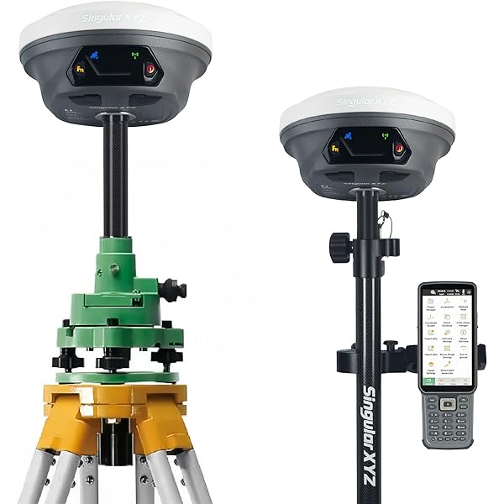

Resources and Equipment
76
18
GNSS receivers
Total Stations
Equipment | Model | Qty
GNSS | Trimble | 10
GNSS | Leica GS14 | 3
GNSS | CHC i90 | 29
GNSS | CHC i93 | 29
GNSS | GeoMAX Nautiz X8 | 5
Total Station | Leica TS06 Plus | 16
Total Station | Trimble | 2
Equipment is selected for each assignment according to methodology, accuracy and site conditions.
Notes:
Counts from the resources section of the technical proposal (T6). Core team plus scalable field crews.

Slide 13
Programme: First 30 Days
Each Minor Work Task Order has its own programme, agreed with Diriyah after the instruction. The plan below covers mobilization.
Key tasks | Week 01 | Week 02 | Week 03 | Week 04
Kick-off and confirmation of requirements | X | X
Data request: title deeds, approved plans, control data | X | X
Receipt of data from Diriyah |  | X | X
Site access and permits coordination | X | X
Programme agreed for the first Task Order |  | X
Team and equipment mobilization |  | X | X
Verification of survey control |  |  | X | X
First Task Order field work starts |  |  |  | X
First progress report |  |  |  | X
Dependencies
Data provided by Diriyah
Site access and permits
Diriyah review and acceptance periods
Statutory authority review, where applicable
Indicative. Durations and dependencies are to be agreed with Diriyah.
Notes:
Week plan is indicative and not taken from Diriyah documents.

Slide 14
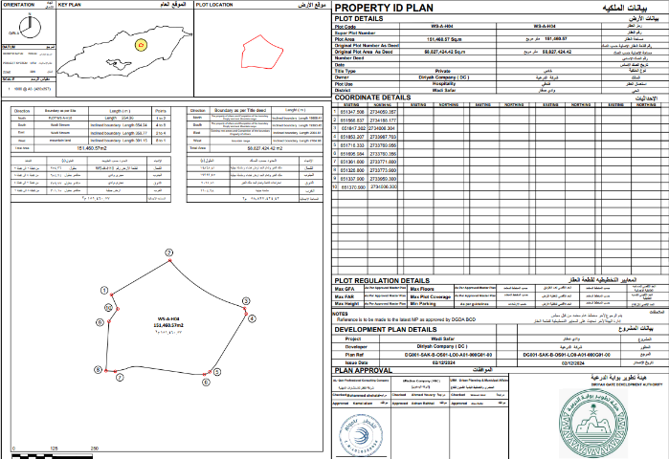
Deliverables and Reporting
For each Task Order
Sample deliverable format: Property ID Plan
1
Survey drawings and documentation
Prepared, checked and submitted for each assignment.
2
Title deed support documentation
Where applicable to the instructed service.
3
Survey and demarcation report
With corner coordinates and photo documentation.
4
Final survey records
Compiled and handed over at close-out.
File formats: [to be agreed]
Reporting frequency: [to be agreed]
Coordinate system and standards: [to be agreed]
Format used in previous demarcation work for Diriyah Company. The format for this Task Order will be confirmed with Diriyah.
Notes:
Sample taken from the Wadi Safar plots demarcation deck (owner shown as Diriyah Company). Confirm before presenting.

Slide 15
Health, Safety and Environment
Roles and responsibilities
Safe work practices
Training and toolbox talks
Alqotr is committed to implementing its HSE plan through an agreed HSE Management System in order to:
Execute all activities in compliance with the KSA legal EHSMS framework, local requirements, international best practice and contractual expectations.
Achieve the occupational health, safety and environmental objectives set by Diriyah Company.
Provide resources for training and monitoring, and keep open communication between employees, supervisors and management.
Protect the environment and use resources efficiently.
Task-specific PPE, no unauthorized equipment use, no work under the influence of drugs, smoke-free workplace.
Mandatory safety and fire-prevention training; daily start-up safety discussions.
Incident reporting
Emergency response
Every incident reported to the manager immediately and within 24 hours; investigation and corrective actions.
Emergency plan, fire and medical procedures; Civil Defense 998.
HSE Officer: [Name]
Notes:
Adapted from the HSE section of the technical proposal (T16); client name set to Diriyah Company.

Slide 16
Information Required and Points to Agree
Item | Alqotr proposal | Diriyah response
Task Order instruction | Written instruction defining the plot, service and required deliverables
Land information | Title deeds, approved plans and relevant existing records provided with each instruction
Survey control | Available control points and benchmarks, with verification by Alqotr
Site access and permits | Diriyah coordinates access; Alqotr provides the survey team details in advance
Programme per Task Order | Alqotr proposes within [ ] working days of the instruction
Review and acceptance | Diriyah review period and acceptance procedure
Statutory authority coordination | Authority contacts, submission route and fees
Reporting and meetings | Frequency and format of progress reports and meetings
Deliverable formats and standards | File formats, coordinate system and drawing standards
Points marked [ ] are left open for agreement in the meeting.
Notes:
Blank cells are intentional. Complete them live in the meeting.

Slide 17

v

