Slide 1
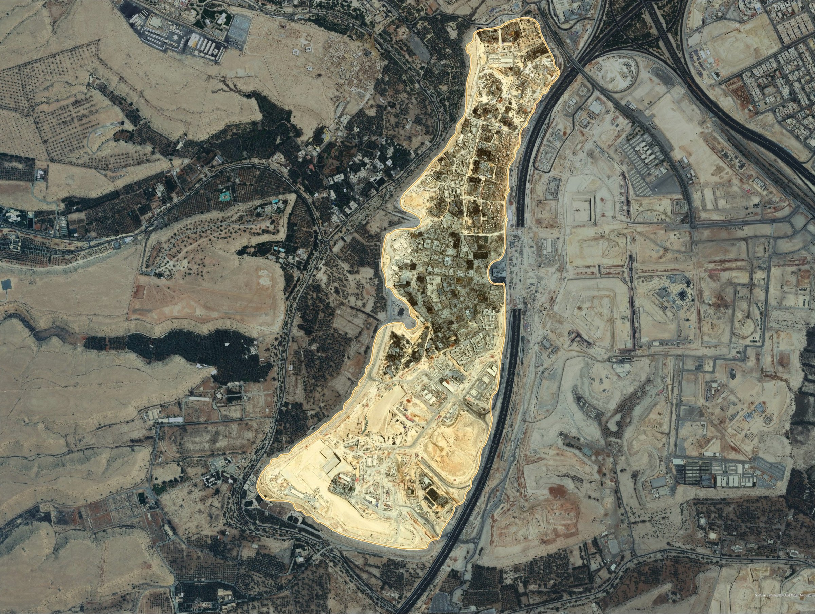





DIRIYAH DG1
LAND SURVEYING SERVICES
Project Owner : Diriyah Company
Kick-off Meeting
Task Order No. 4500009743
Consultant
Al Qotr Professional Consulting Company
Notes:
SOURCES: title, owner and consultant name from the signed Task Order (PR1913, p.1). Hero image is the DG1 GIS cover layout over Esri imagery; DG1 extent is indicative pending the official boundary.

Slide 2

Content
Introduction
Detailed scope of work
Methodology
Deliverables and reporting
Resource deployment
Schedule for work completion
HSE and Welfare Measures for the workmen during the Works
Notes:
Agenda kept identical to the Alqotr kick-off template.

Slide 3
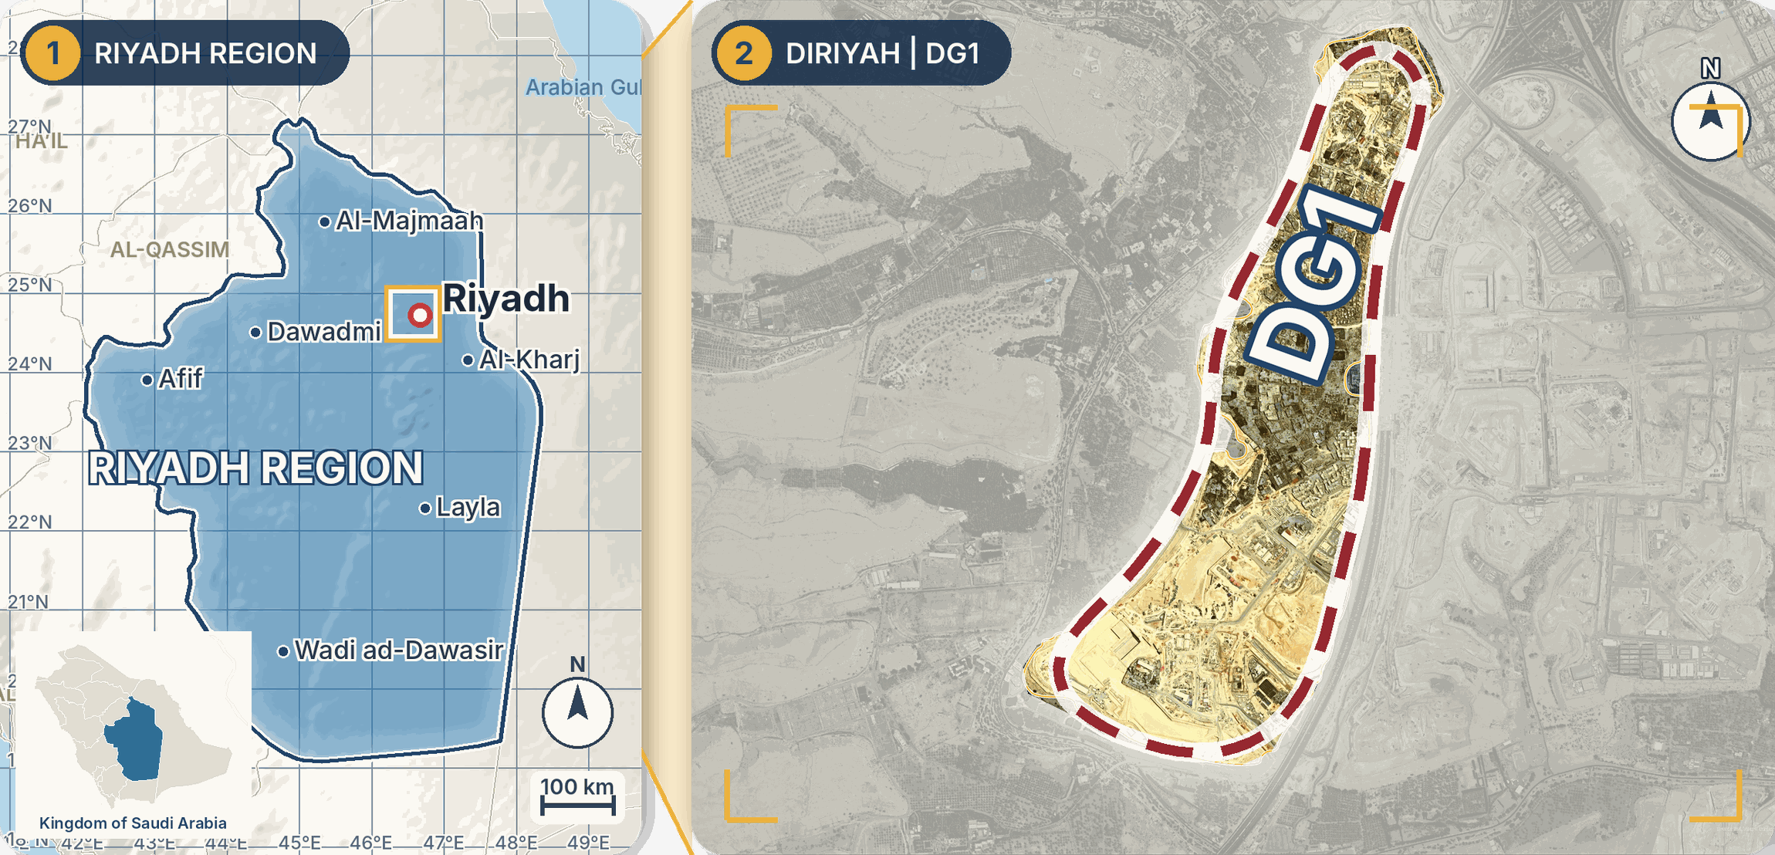
Introduction
The objective of this Task Order is to provide Diriyah Company with responsive and reliable land surveying support for its minor works in the DG1 area, Riyadh.
The services cover the issuance of new title deeds (Main, Phase, Sub-Phase and Block), title deeds for plots and units, land survey and land demarcation, each instructed as an individual Minor Work Task.
Client
Diriyah Company
Task Order
No. 4500009743
Place
DG1 area, Riyadh
Start
11 October 2026
Completion
09 November 2029
Satellite views: Riyadh Region (NASA Blue Marble) and DG1 with its surroundings (Esri). DG1 extent indicative.
Notes:
SOURCES: objective and services: Task Order PR1913.pdf page 1 and Appendix 2 / T4; the table: PR1913 page 1 (client, Task Order no. 4500009743, place of performance DG 1 area Riyadh KSA, commencement 11 Oct 2026, completion 09 Nov 2029). IMAGES (satellite, not a base map): panel 1 is NASA Blue Marble satellite imagery with relief shading, with the Riyadh Region outline from the @svg-maps/saudi-arabia province map (a generalized outline: checked that Riyadh, Al-Kharj, Al-Majmaah, Dawadmi, Wadi ad-Dawasir, Layla and Afif fall inside it and Buraydah, Hail, Najran, Dammam, Al-Hofuf, Makkah, Madinah, Taif, Jeddah and Abha fall outside; its area is about 366,000 km2), a real 1-degree graticule and a 100 km scale bar, and city positions and the Diriyah frame (approximate points); panel 2 is the Esri imagery of the Alqotr GIS cover layout with an indicative DG1 outline traced by eye (not an official boundary); the gold frame in panel 1 marks the Diriyah position (approximate). LIMIT: no satellite imagery or boundary of the whole of Diriyah is available in the project files or offline, so panel 2 shows the DG1 area with its surroundings as available;

Slide 4
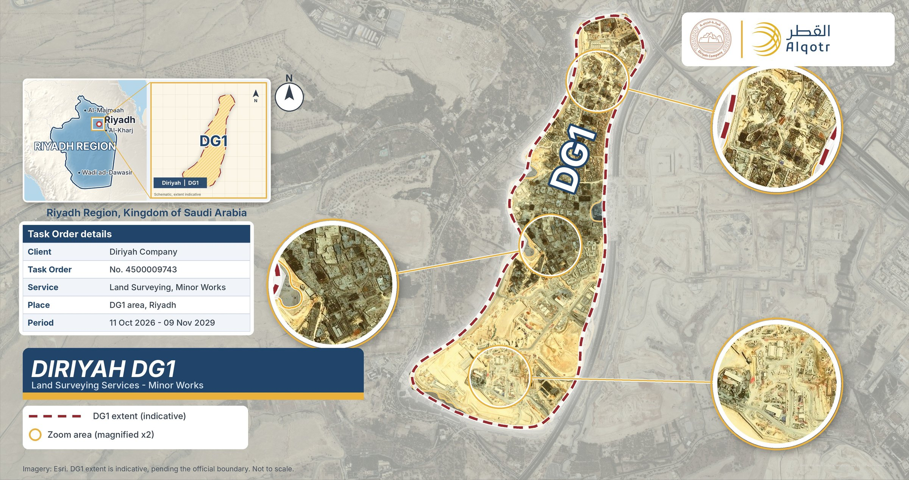
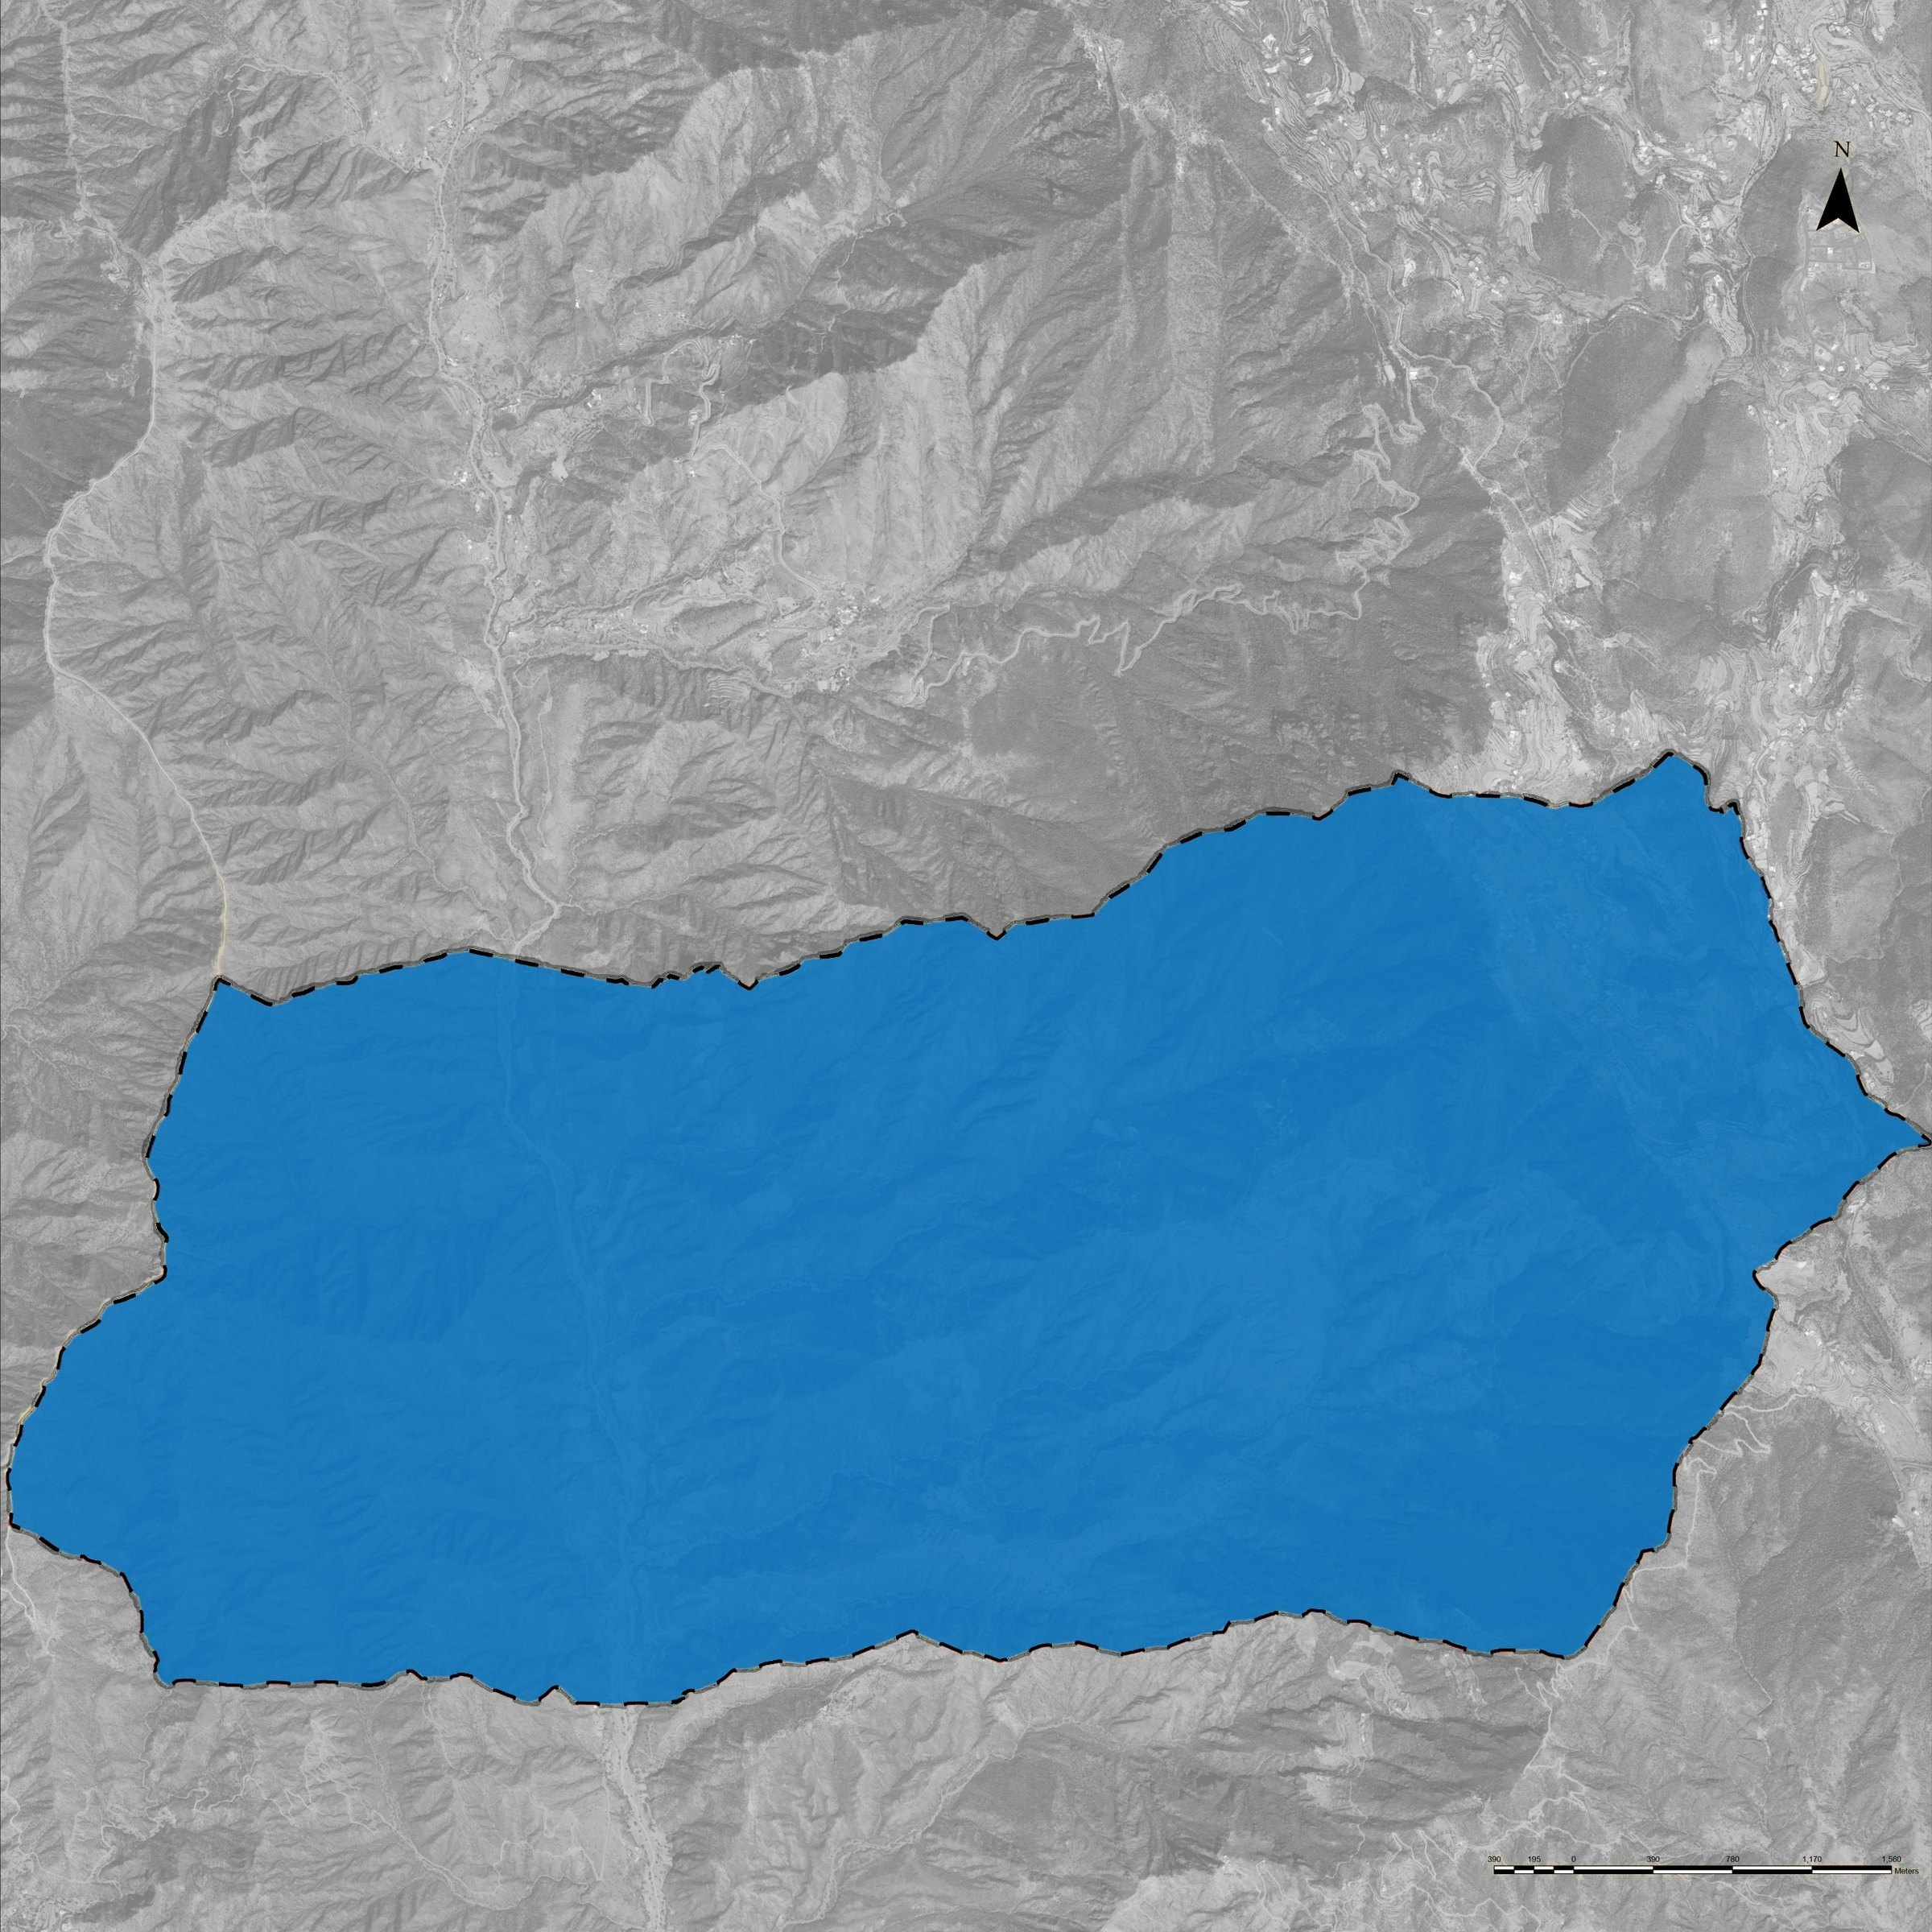
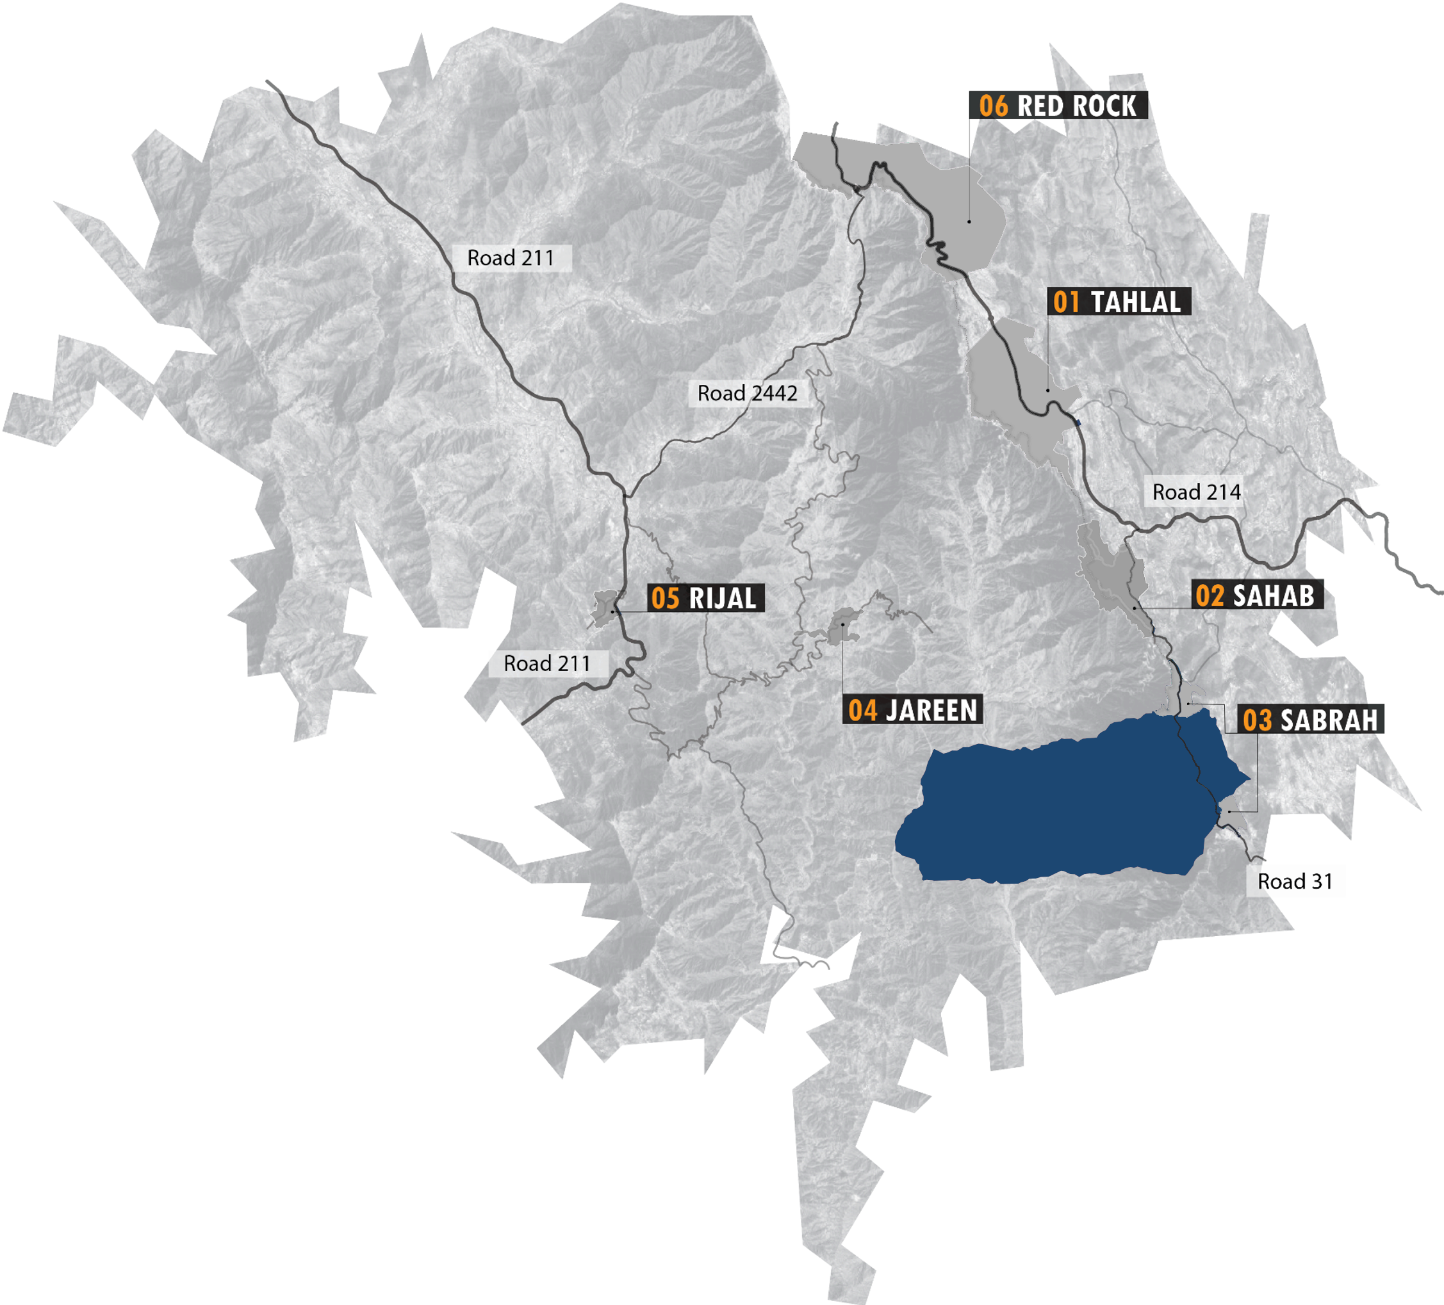
Introduction
Notes:
SOURCES. Client, Task Order no. 4500009743, service title, place of performance (DG1 area, Riyadh) and the period 11 Oct 2026 to 09 Nov 2029: Task Order PR1913.pdf, page 1 (checked in the uploaded file: Task Order No. 4500009743, Agreement C205-V3/4600001652, dated 06 Oct 2026, Place of Performance DG 1 area Riyadh KSA, commencement 11 Oct 2026, completion 09 Nov 2029; Appendix 1 names the DG1 Land Surveying Services Minor Task Order). AREA REMOVED from the map: the earlier figure (1,750,332.47 m2, attributed to T14) has no valid source, because T14 (Bidder Current Workload) is unrelated to DG1. It must be found in a project file before it is shown again. The DG1 = Diriyah 1 equivalence is also unverified. MAP (full screen): satellite imagery and DG1 outline come from the Alqotr GIS cover layout (Esri imagery). The three round magnifiers A, B and C show the area inside each marked circle on the map, magnified 2x, rendered from the same imagery with the same indicative outline, so each lens matches its location. The top-left locator shows Riyadh Region and a schematic of DG1. The outline is NOT an official boundary: it was traced by eye from that layout and is indicative. The coordinate system line was removed because it is not stated in any project file.

Slide 5
Methodology
Phase 1:
Initiation and Planning:
Task Order received.
Phase 2:
Field Survey:
Survey control, land and boundary survey, demarcation where instructed.
Phase 3:
Processing and Deliverables
Field data processed; drawings and title deed documentation prepared.
Phase 4:
QA/QC and Close-Out
Programme agreed.
Team mobilized.
QA/QC, submission, comments, authority approval if applicable, close-out.
Programme stages of each Task Order
Notes:
SOURCE: T8 Programme Management, section 8.2 Programme Stages and Activities: Stage 1 Task Order Initiation, Stage 2 Planning and Mobilization, Stage 3 Field Survey Execution, Stage 4 Data Processing and Deliverable Preparation, Stages 5-6 QA/QC, Submission, Review and Close-Out. Condensed into four phases; wording follows T8.

Slide 6
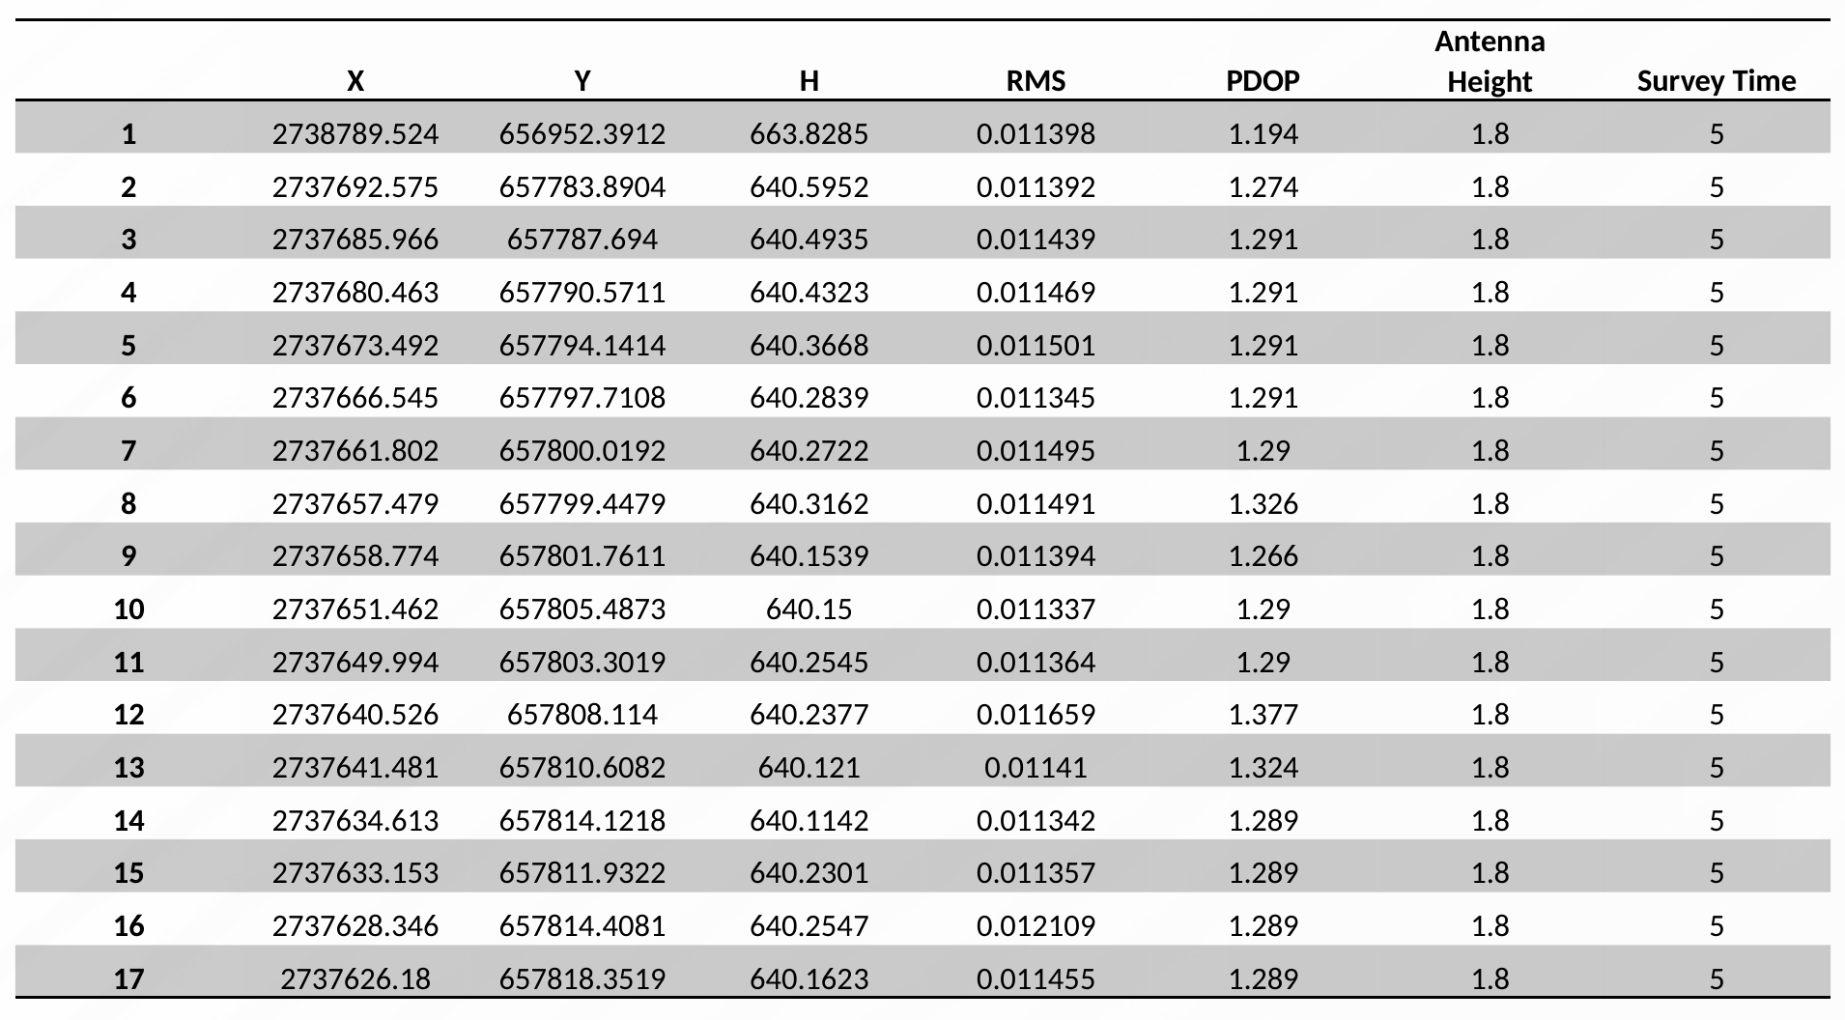
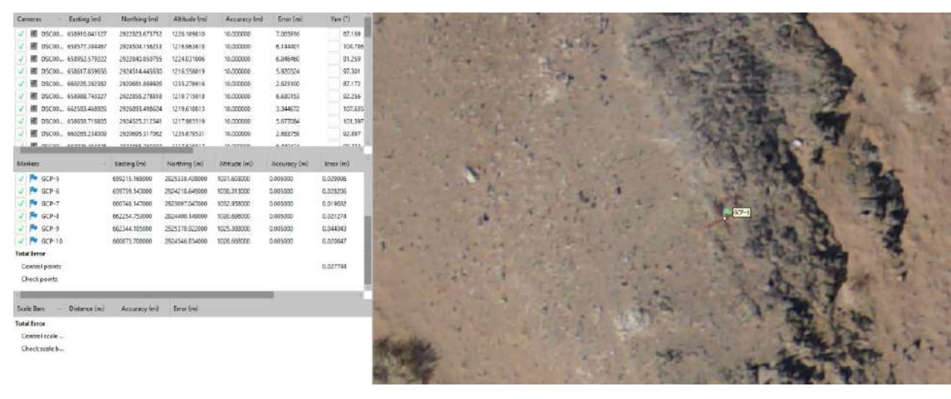
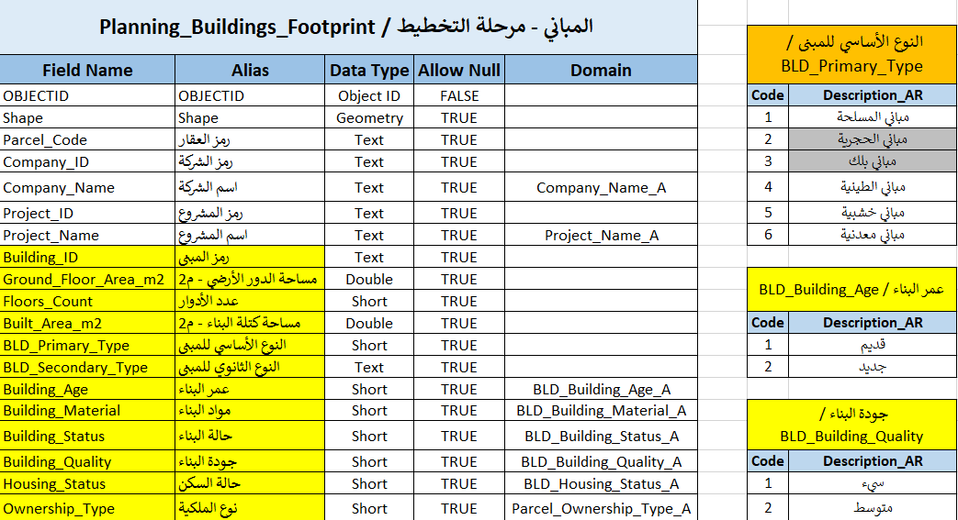
Methodology
Quality control of survey outputs:
Descriptive data
Deed data
CAD drawing
Field data QC record
Boundaries
Deed number
Coordinates
Lengths
Owner
Numbering
Area
ID number
Layout
Quality control at every step
Plan
Control
Survey
Demarcation
Deliverables
Close-out
Sample QC table from previous Alqotr work
QC
QC
QC
QC
QC
QC
Scope and data confirmed
Control verified
Field completeness check
Field verification
Computations and drawings checked
Review and acceptance
Checks run during every step, not only at the end.
Control point check: sample from the Alqotr quality guide
Notes:
SOURCES: T15 Quality Management Systems and Procedures (descriptive data p.6, deed data p.7, CAD drawing p.8). Sample QC table: the "Check Site Data (QC)" slide of the Alqotr Wadi Safar demarcation deck provided as a reference, shown unchanged (it contains the data of that earlier project). Quality control at every step: T8 8.2 (Stage 1 confirmation of scope and deliverables; Stage 3 verification of survey control, field verification and completeness checks; Stage 4 survey computations and technical verification; Stage 5 internal technical review and QA/QC; Stage 6 client review and acceptance) and T6 6.1 (centralized technical control and QA/QC). IMAGE: the control point check screenshot (GCP table with imagery) is page 15 of the same T15 Alqotr quality control guide (an earlier Alqotr project, not Diriyah), shown as an example of checking control points.

Slide 7
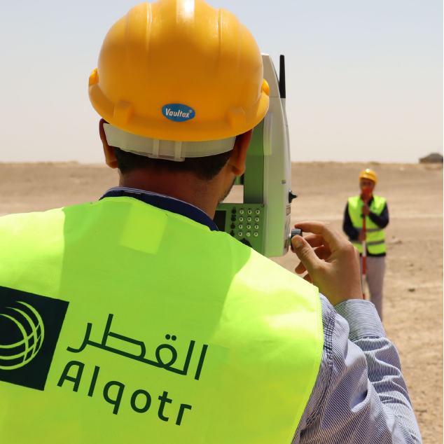
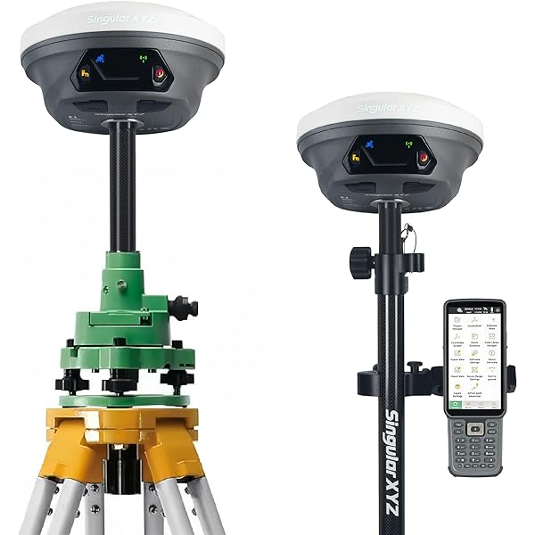
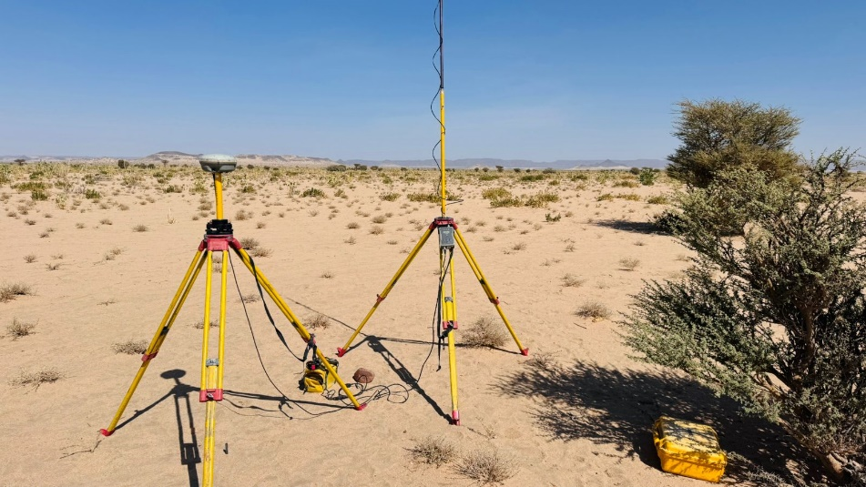
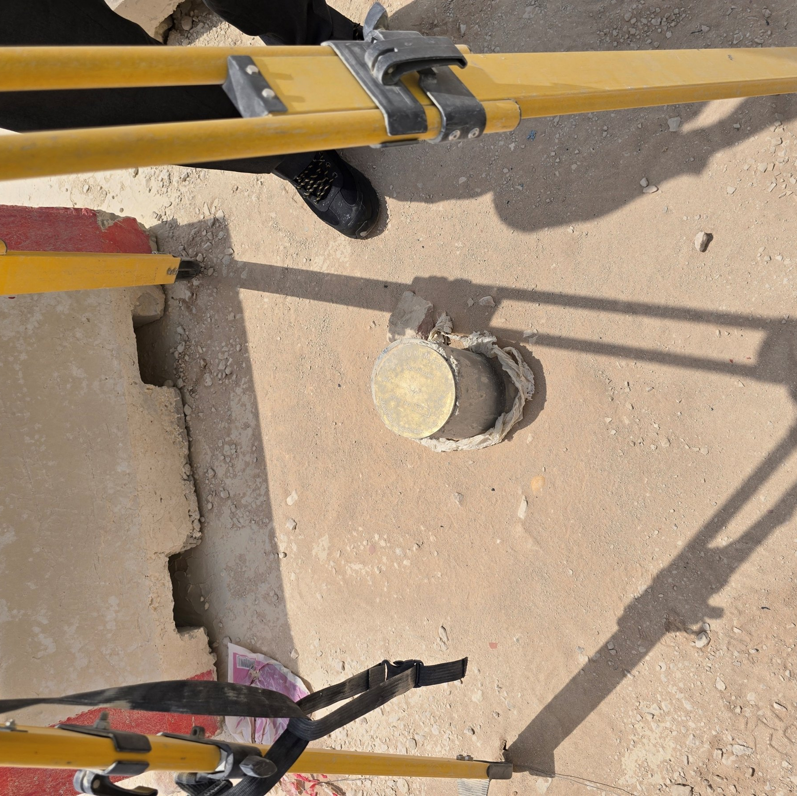
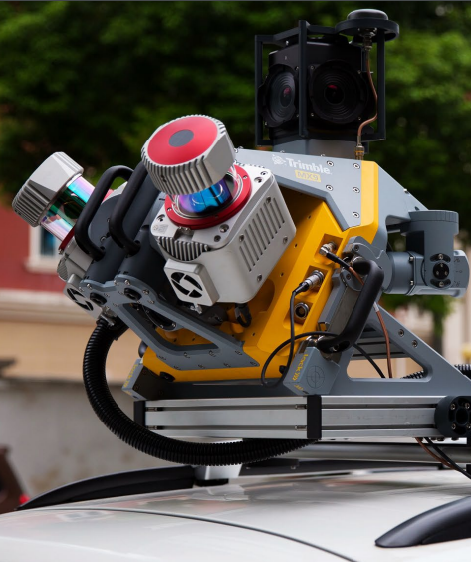
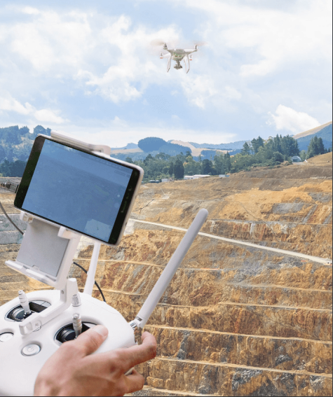
Methodology
Survey :
Survey control
Survey control is verified or established where required, before any field survey starts.
Land and boundary survey
Field data is acquired for the instructed land, based on the available approved information.
Field verification
Completeness checks are made in the field before data processing.
Notes:
SOURCES: T8 8.2 Stage 3 Field Survey Execution (verification / establishment of survey control where required; land and boundary survey as applicable; field data acquisition; field verification and completeness checks) and T4 (verification of survey control points / benchmarks; boundary survey based on available approved information). Photos: Alqotr library field photos (surveyor with total station, GNSS receivers, control monument), not from the Diriyah site. The drone and laser scanner (point cloud) photos of the template were removed because they are not part of this Task Order.

Slide 8
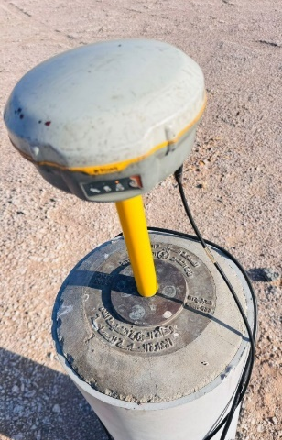

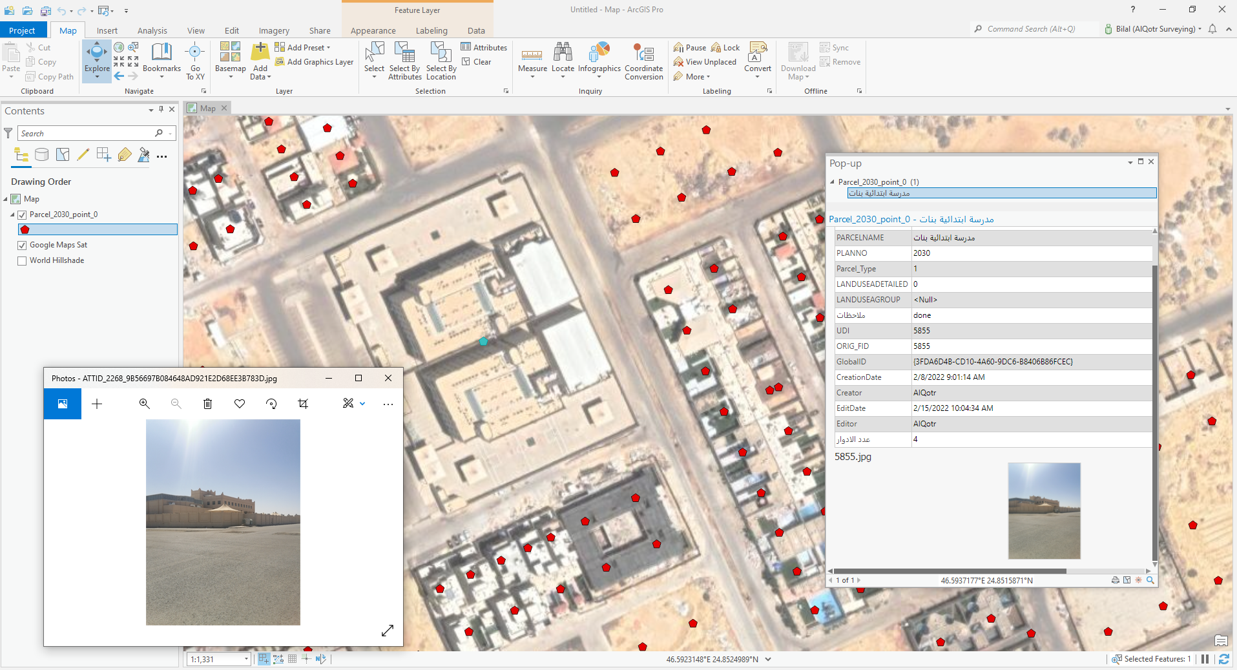
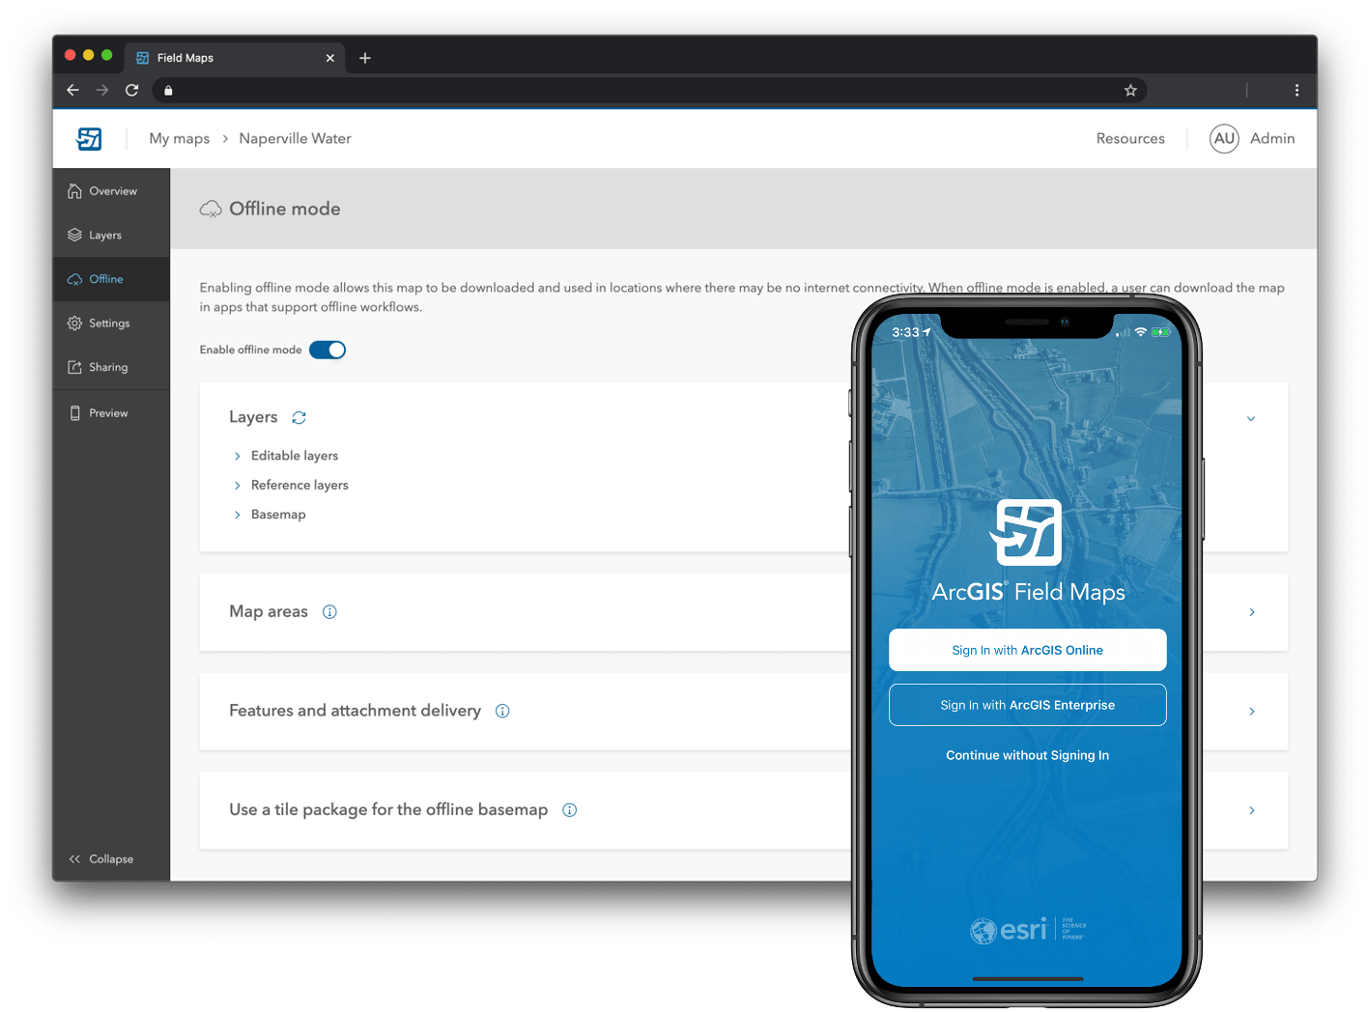
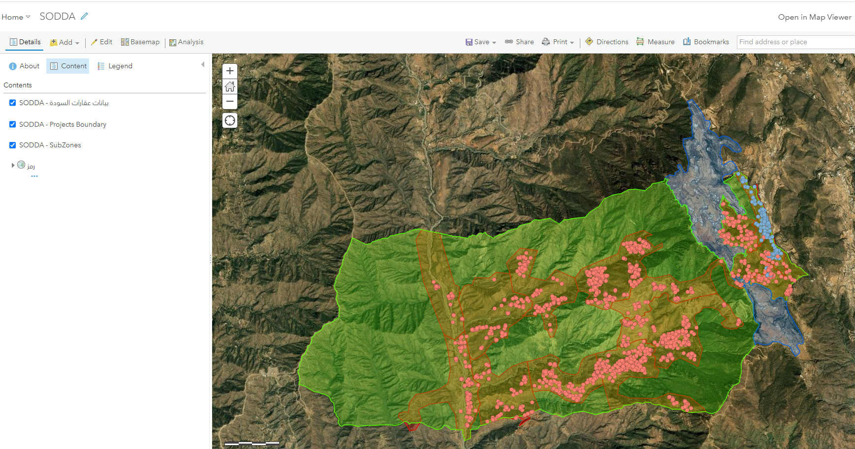
Methodology
Land Demarcation:
CP1
2
Land demarcation is carried out where instructed in the Task Order.
  Verify survey control points and benchmarks
  Stake out plot corners with Total Station or RTK GNSS
  Fix boundary markers and reference them with IDs
  Photograph each corner and marker
  Cross-check with the available approved information
  Corner coordinates
  Marker IDs
  Photo record
  Demarcation report
1
CP2
3
4
Schematic only. Control point (triangle), corner marker (diamond).
1
2
3
Control point
Stake-out
Boundary marker
Notes:
SOURCES: T4 and T8 8.2 Stage 3 (land demarcation, where instructed / applicable; verification of survey control). Step detail (stake-out with Total Station or RTK GNSS, boundary markers with unique reference, photo documentation, cross-check with approved data, demarcation report) follows Alqotr previous demarcation decks provided as references (Safar deck "Survey Activities" and "Prepare Survey and Demarcation Report"). IMAGES: the diagram is a generic schematic drawn for this deck, not the DG1 boundary. The three photos are generic Alqotr library photos (GNSS on a control monument, GNSS tripods in the field, a concrete boundary marker), not taken in Diriyah.

Slide 9

Methodology
Workflow and schedule:
Task Order period: 11 Oct 2026 to 09 Nov 2029
Approval before work starts: 6 working days
1
2
3
4
5
6
Plan
Control
Survey
Demarcation
Deliverables
Close-out
Task Order, programme
Verify survey control
Land and boundary survey
Stake-out and markers
Processing, drawings, QA/QC
Review, approval, final submission
Land Survey
Land Demarcation
Title Deeds
Plots and Units
where instructed
incl. authority approval
Title Deeds
Main, Phase, Sub-Phase, Block
where instructed
incl. authority approval
Milestones
1
2
3
4
5
6
7
8
9
10
M1 Receipt | M2 Programme agreed | M3 Mobilized | M4 Field survey done | M5 Draft ready | M6 QA/QC done | M7 Submitted | M8 Comments closed | M9 Final submission | M10 Close-out
Notes:
SOURCES: this slide merges the former workflow and schedule slides. Contract period and the 6 working day approval: signed Task Order PR1913.pdf (page 1 commencement 11 Oct 2026, completion 09 Nov 2029; Appendix 1 approval 2+2+2 working days). Stages and milestones: T8 8.2, 8.3 and 8.4 (M1 Task Order Receipt, M2 Programme Agreement, M3 Mobilization, M4 Field Survey Completion, M5 Draft Deliverable Completion, M6 QA/QC Completion, M7 Submission to Client, M8 Comments Resolution, M9 Final Submission, M10 Task Order Close-Out). Task differences from T4: land survey and boundary survey; land demarcation where instructed; title deed support documentation where applicable; statutory approval where applicable. Placing the milestones under the stages is Alqotr own grouping (M1-M3 under Plan, M4 between Survey and Demarcation, M5-M6 under Deliverables, M7-M10 under Close-out); confirm with the team. The duration of each task is not fixed in the contract: it is agreed per Minor Work Task Order (T8 8.3, RFP Programme for Services).

Slide 10

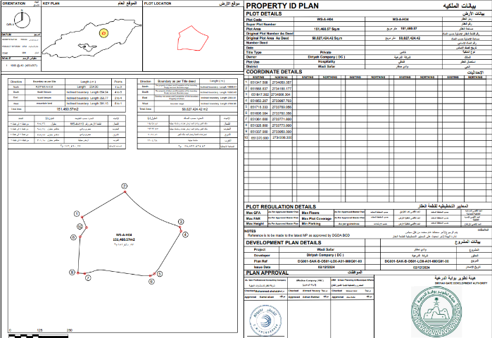
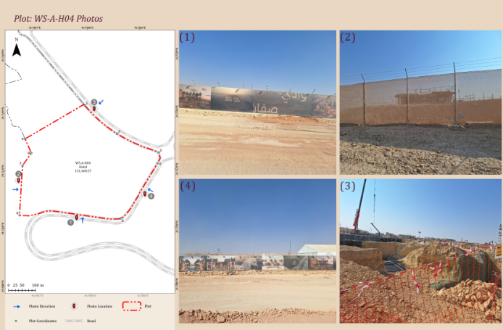
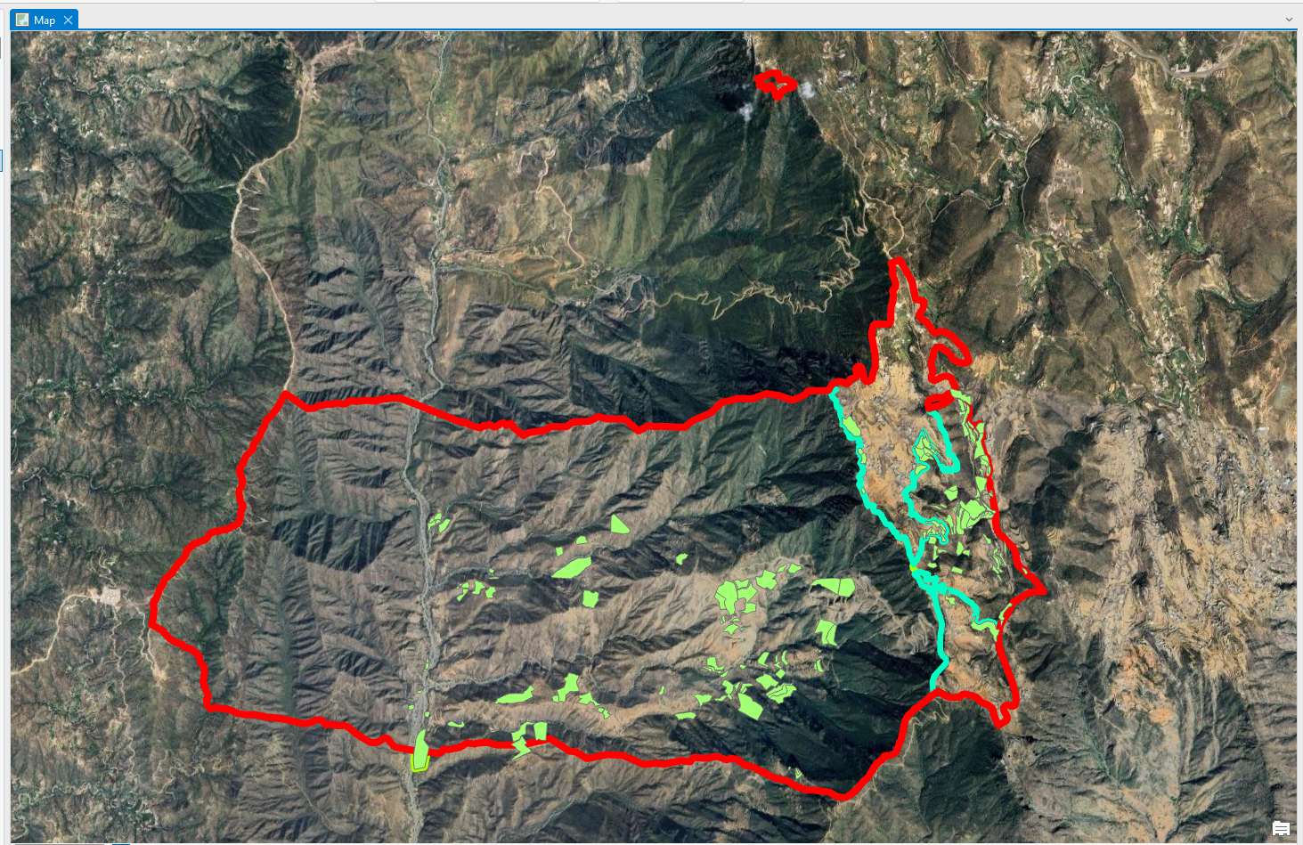
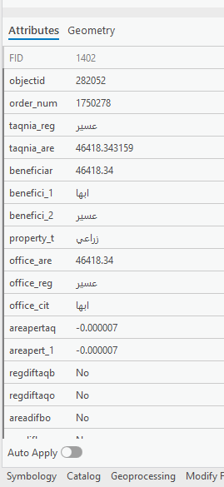
Deliverables
Plot photo record: sample from previous Alqotr work
Survey decision (Property ID Plan): sample from previous Alqotr work
Survey drawings
Title deed documents
Demarcation report
Final survey records
Notes:
SOURCES: deliverable types: T8 8.2 Stage 4 (survey drawings and documentation; title deed-related survey documentation where applicable) and T4 (compilation and handover of final survey records); demarcation report follows the Alqotr previous demarcation deck (Safar) as a reference. IMAGES: both are existing pages taken unchanged from the Alqotr Wadi Safar demarcation deck provided as a reference: the Property ID Plan survey decision (slide 7) and a plot photo record. They show the real data of that earlier project. Confirm before presenting that the project was for Diriyah Company and that showing it is allowed. Formats for this Task Order are not fixed in the project files, so they are to be agreed with Diriyah.

Slide 11

Resource deployment
Project Director
Project Manager
QA/QC Engineer
Survey Manager
HSE Officer
CAD Draftsman
Senior Survey Engineer
GIS Specialist
Surveyor(s)
Core Project Team
According to active Task Orders
Survey Assistant(s)
As required
Additional survey crews are mobilized as required.
Notes:
SOURCE: T6 Organisation, Management and Resources: the reporting lines of the table in section 6.3 (Project Manager reports to the Project Director; Survey Manager, QA/QC Engineer and HSE Officer report to the Project Manager; Senior Survey Engineer reports to the Technical Manager / Survey Manager; Surveyor to the Senior Survey Engineer / Survey Manager; Survey Assistant to the Surveyor; CAD Draftsman and GIS Specialist to the Technical Manager / Survey Manager) and 6.5 Proposed Resources (deployment: core team, according to active Task Orders, as required; additional survey crews mobilized as required). The Technical Manager line is shown as the Survey Manager to keep the chart simple. No individual names are shown.

Slide 12

Typical Task Programme
Step 1: before work starts
Our proposal
Diriyah review
Commercial review
6
Al Qotr
Diriyah team
Diriyah
working days to
written authorisation
2 working days
2 working days
2 working days
Step 2: delivery, duration agreed with Diriyah for each task
1
2
3
4
5
6
Plan and mobilize
Survey
Prepare
QA/QC and submit
Review
Close-out
Scope and data review
Control verification
Processing
Technical review
Diriyah review
Final submission
Resources
Field survey
Calculations
QA/QC
Comments resolved
Acceptance
Site access
Demarcation
Drawings
Submission
Authority, if any
Records handover
Al Qotr
Diriyah
Al Qotr
Al Qotr
Al Qotr
Diriyah
Al Qotr
Al Qotr
Diriyah
Duration of each step is agreed with Diriyah after the instruction
Notes:
SOURCES: Step 1 (proposal within 2 working days, Diriyah MP team review 2 working days, Commercial Team review 2 working days, 6 working days in total, then written authorisation to start): signed Task Order PR1913.pdf Appendix 1 and its Estimated Approval Timeline. Step 2: the activity sequence and responsibilities of T8 section 8.3 "Typical Minor Work Task Order Programme" (items 01-15: receipt, scope and data review, programme confirmation, survey planning and resource allocation, site access and mobilization, control verification, field survey / demarcation, data processing, drawings, internal review and QA/QC, submission, client review, comments resolution, authority approval if applicable, final submission and close-out), grouped into six cards. Responsibilities as in T8 (Al Qotr / Client / Relevant Authority). No durations are shown for Step 2 because the contract and T8 state that durations are agreed per Minor Work Task Order.

Slide 13
HSE
Roles and Responsibilities:
ALQOTR is fully committed to implementing this HSE Plan by establishing an agreed HSE Management System in order to:
- Execute all activities in compliance with KSA legal EHSMS framework, local requirements, international best practice, and contractual expectations.
- Provide leadership and guidance to middle management for the acceptance, maintenance and enforcement of the Loss Prevention Program.
- Achieve all occupational health, safety and environmental objectives set by Diriyah Company.
- Provide resources for training and monitoring the Loss Prevention Program.
- Maintain open lines of communication between employees, supervisors and management relative to the free exchange of safety suggestions and information.
- Protect the environment and utilize resources in the most efficient and effective manner.
- Promote and attend safety functions.
- Monitor the follow‐up on recommendations made to improve performance and prevent accidents.
Notes:
Standard Alqotr HSE text from the template. "DGDA" replaced by Diriyah Company; verb forms made consistent (Provide, Maintain, Promote, Monitor) and "safety functionalities" changed to "safety functions".

Slide 14

v
Notes:
Contact slide unchanged.

