Slide 1
ICELAB Eval Tool
Automated coefficient-of-friction evaluation for SRV tribometer tests: status and next steps
79
108
2
commits since May 2026
raw test files on hand to evaluate and label
ways to find the static peak: fixed window, speed pulse
October 2026
Notes:
The Eval Tool replaces the Excel/VBA workbook (Friction_Evaluation.xlsm) with a marimo web app. 108 files = 75 in data/collection, 21 Riga, 12 Schindler.

Slide 2
From raw tribometer file to CoF in one pass
1
2
3
4
5
6
Load
CoF per sample
Offset & filter
Zero crossings
Static & dynamic
Per-step stats
Raw SRV export: Links, Rechts, Belastung, Zeit, step table
μ = (F_L + F_R) / F_N, optional load correction λ
Centre on zero; rolling median used only to find crossings
Each sign change = stroke reversal; pause gaps dropped
Peak after each crossing; mean over the stroke
Table, chart, save to History database
Matches the VBA reference workbook. Every formula and rounding step is documented on the in-app Help page (The CoF Ledger).
Notes:
Step 5 (copper) is where the static point is chosen. That is the step the AI work targets.

Slide 3
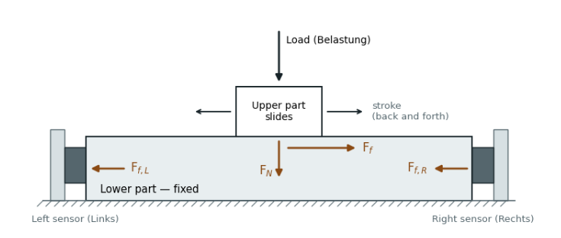

The upper part slides back and forth under the load; the lower part stays fixed. Friction drags the lower part along (F_{f}), and the left and right sensors hold it still — together they measure F_{f} = F_{f,L} + F_{f,R}. Dividing by the normal force F_{N} gives μ.
$$\text{μ}\text{i} \text{=}\frac{\text{F}\text{f,Li}\text{ + }\text{F}\text{f,Ri}}{\text{F}\text{Ni}}$$

Slide 4
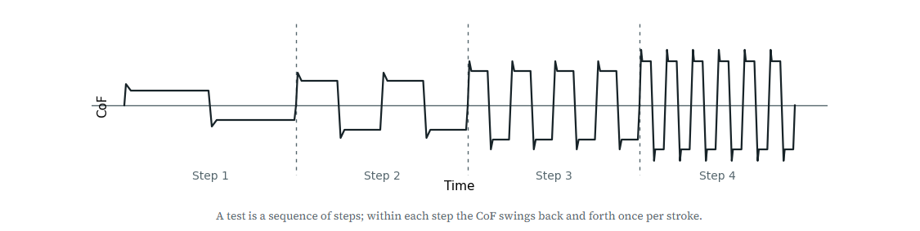
A test is a sequence of steps; within each step the CoF swings back and forth once per stroke.

Slide 5
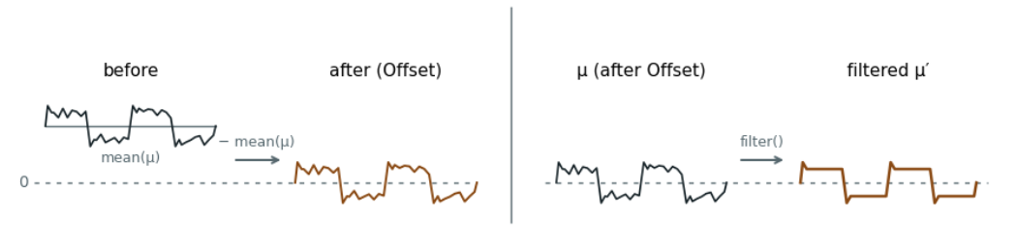
Offset & filter
Left: Offset subtracts mean(μ) so the noisy signal centres on zero — the noise stays.
Right: Filter removes the noise, turning μ into μ′, used only for finding crossings.

Slide 6
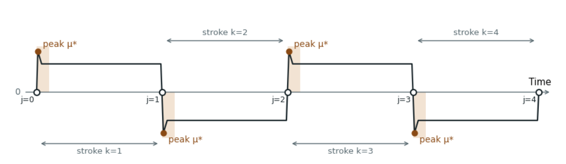
Zero crossings
Why crossings come first: the peaks can only be found once the signal is cut into strokes. Each zero crossing (j) marks where a stroke starts, and the peak μ* is searched for in a short window (shaded) right after it.

Slide 7
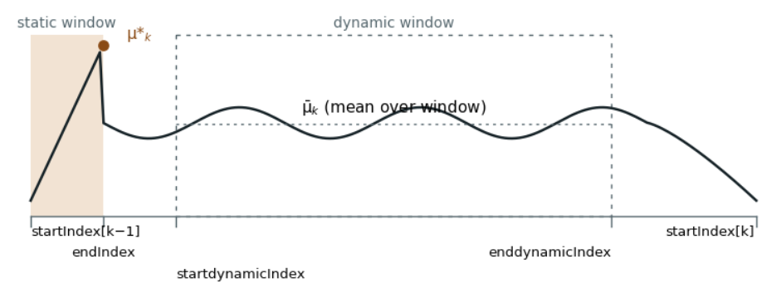
One cycle:
μ*_{k} is the peak inside the static window (shaded); μ̄_{k} is the mean over the dynamic window (dashed box).

Slide 8
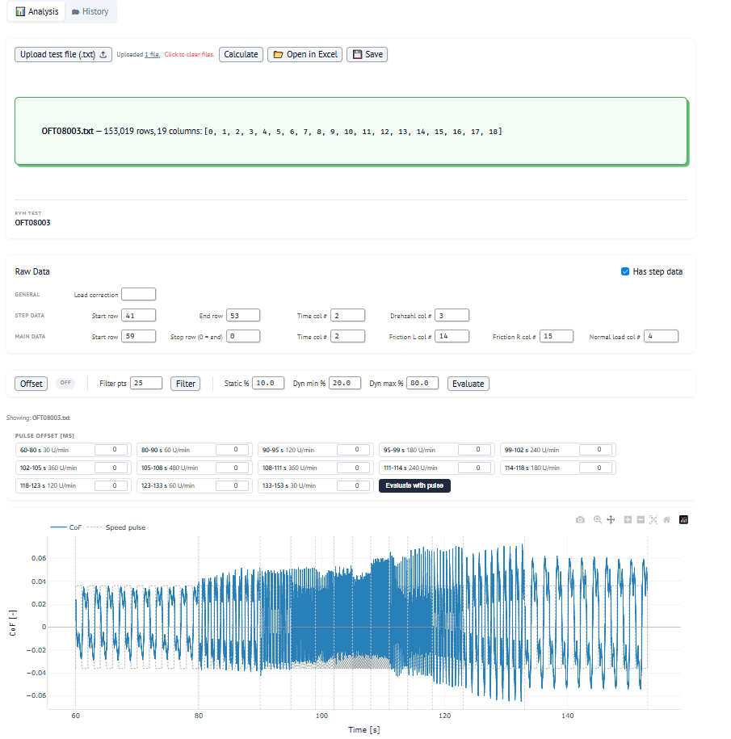
Analysis Tab

Slide 9
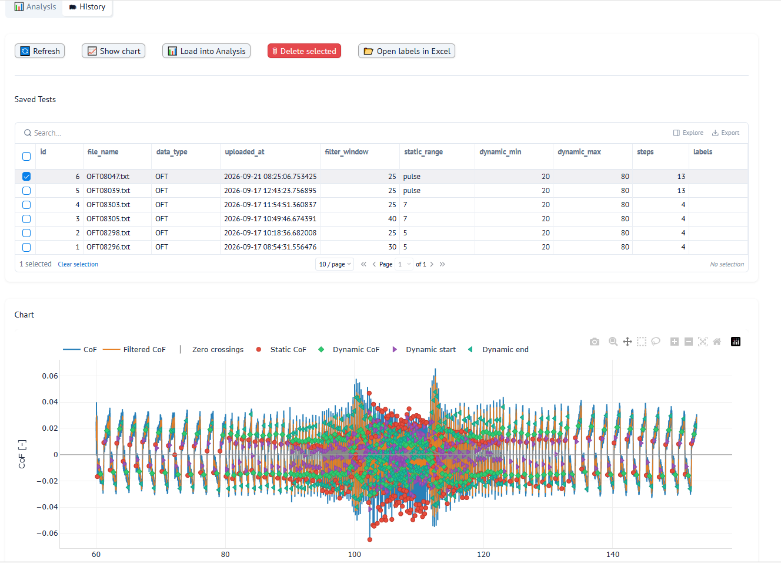
History Tab

Slide 10
Next Steps
Increasing the number of data in the History (500 ~ 1000)
Adding AI Tab than predict Friction based on the current datas ( CoF, Pressure, temp, …..)

Slide 11
What the tool already does
Analysis page
Speed-pulse evaluation
Adaptive stroke detection
One-row toolbar, raw-data card, interactive CoF chart with static and dynamic markers
Static CoF taken as the first peak after the speed pulse, with per-step offsets
Pause threshold follows each step's own speed, so slow steps are no longer cut off
History database
Help page
Label collection
Save, reload, overwrite and compare tests in SQLite, with their parameters
Formula-by-formula reference so results can be checked by hand
Mark each static point as right or wrong and store it with the test (new)
Notes:
The last card is the start of the AI feature and leads into the next slide.

Slide 12
Collecting ground truth for the static peak
1
Click a static marker to mark it correct or wrong
Status today
1,631
2
Shift+click the curve where the peak should have been
cycles in saved tests, none labelled yet
3
Save labels stores them on each cycle of the saved test
108
4
Export every labelled cycle to Excel from History
raw files ready to label
Notes:
The labelling tool is finished and works end to end. The limiting factor now is labelled data, not code.

Slide 13
Next: the tool suggests the peak
1
2
3
4
Label
Measure
Train
Integrate
Label cycles across collection, Riga and Schindler files. Aim for 1,000+ cycles over several materials and speeds.
Score the current rules against the labels: how often is the fixed-window or pulse peak right?
Model that predicts the peak position from the signal around each crossing. Start simple and beat the rule.
Show the suggestion and its confidence on the chart. The user confirms, and new labels retrain it.
Immediate action: start labelling now. Step 2 already shows whether the current rule is good enough.
Notes:
Steps 1 and 2 need no new code apart from a small script that reads the label export. Step 3: begin with a gradient-boosted model on hand-made features (time since crossing, slope, local maxima, speed) before trying a 1D neural network. Keep the rule as the fallback when the model is unsure.

