Slide 1
ICELAB Eval Tool
Automated coefficient-of-friction evaluation for SRV tribometer tests: status and next steps
October 2026
Notes:
The Eval Tool replaces the Excel/VBA workbook (Friction_Evaluation.xlsm) with a web app. 108 files = 75 in data/collection, 21 Riga, 12 Schindler.

Slide 2
From raw tribometer file to CoF in one pass
1
2
3
4
5
6
Load
CoF per sample
Offset & filter
Zero crossings
Static & dynamic
Per-step stats
Raw SRV export: Links, Rechts, Belastung, Zeit, step table
μ = (F_L + F_R) / F_N, optional load correction λ
Centre on zero; rolling median used only to find crossings
Each sign change = stroke reversal; pause gaps dropped
Peak after each crossing; mean over the stroke
Table, chart, save to History database
Matches the VBA reference workbook. Every formula and rounding step is documented on the in-app Help page (The CoF Ledger).
Notes:
The next five slides walk through these steps one by one.

Slide 3
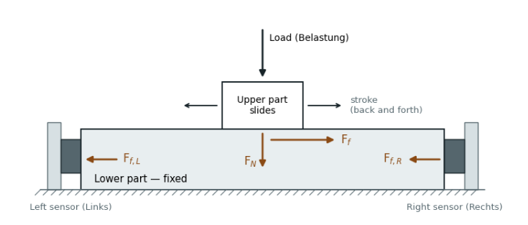

How the CoF is measured
CoF per sample
Sum of left and right friction forces divided by the normal load
The upper part slides back and forth under the load; the lower part stays fixed. Friction drags the lower part along (F_{f}), and the left and right sensors hold it still. Together they measure F_{f} = F_{f,L} + F_{f,R}. Dividing by the normal force F_{N} gives μ.

Slide 4
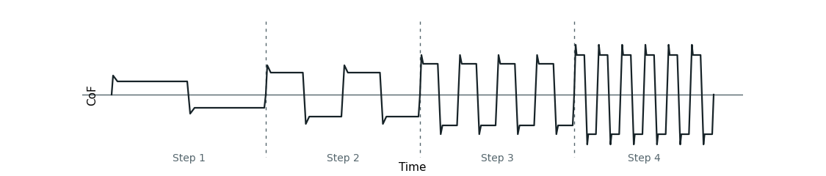
A test is a sequence of steps
Each step runs at its own speed. Within a step the CoF swings back and forth once per stroke, so faster steps give more strokes in the same time.

Slide 5
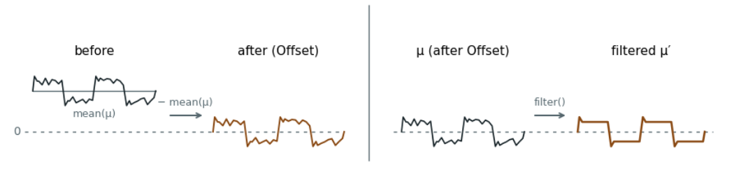
Offset & filter
Offset subtracts mean(μ) so the noisy signal centres on zero. The noise stays.
Filter removes the noise, turning μ into μ′. It is used only for finding crossings.

Slide 6
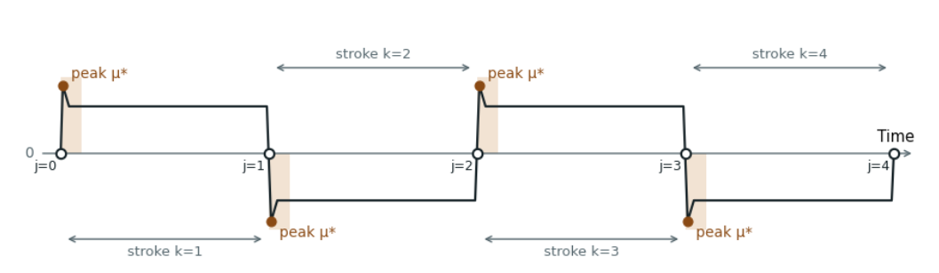
Zero crossings
Why crossings come first: the peaks can only be found once the signal is cut into strokes. Each zero crossing (j) marks where a stroke starts, and the peak μ* is searched for in a short window (shaded) right after it.

Slide 7
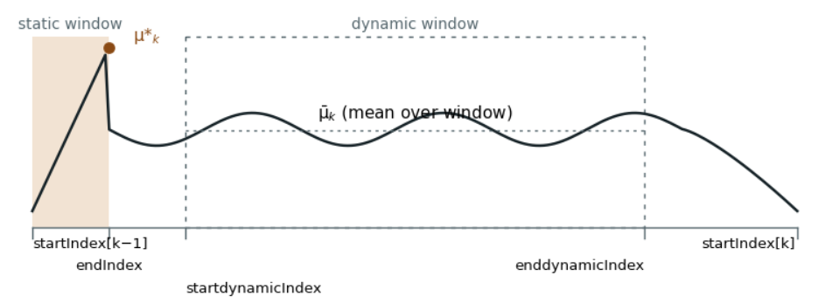
Static and dynamic CoF in one cycle
Static CoF μ*
the peak inside the static window (shaded), just after the stroke starts
Dynamic CoF μ̄
the mean over the dynamic window (dashed box) in the middle of the stroke
Window positions are set as percentages of the stroke (Static %, Dyn min %, Dyn max %), so the same settings work at every speed.

Slide 8
What the tool already does
Analysis page
Speed-pulse evaluation
Adaptive stroke detection
One-row toolbar, raw-data card, interactive CoF chart with static and dynamic markers
Static CoF taken as the first peak after the speed pulse, with per-step offsets
Pause threshold follows each step's own speed, so slow steps are no longer cut off
History database
Help page
Label collection
Save, reload, overwrite and compare tests, with their parameters
Formula-by-formula reference so results can be checked by hand
Mark each static point as right or wrong and store it with the test

Slide 9
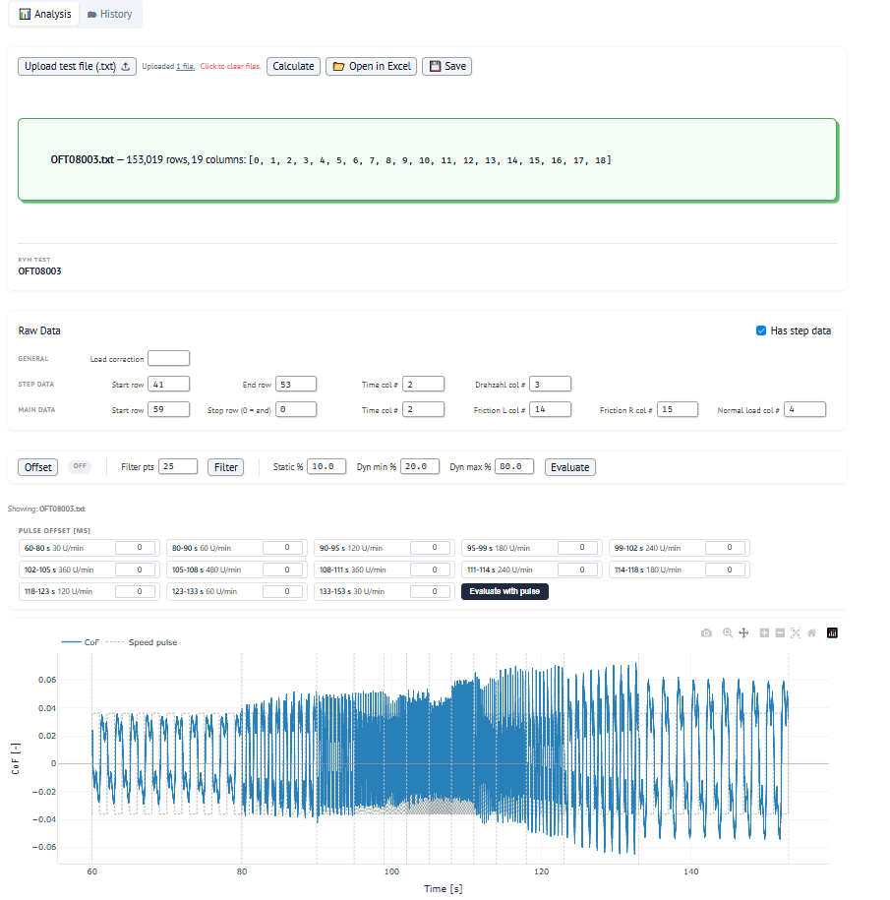
Analysis tab
1
Upload & calculate
Load a raw .txt file, run the pipeline, save or open in Excel
2
Raw data settings
Rows and columns for time, friction, load and steps
3
Offset, filter, evaluate
4
Pulse offsets
Per-step offsets for the speed-pulse method
5
Interactive chart
CoF with speed pulse; click points to label them

Slide 10
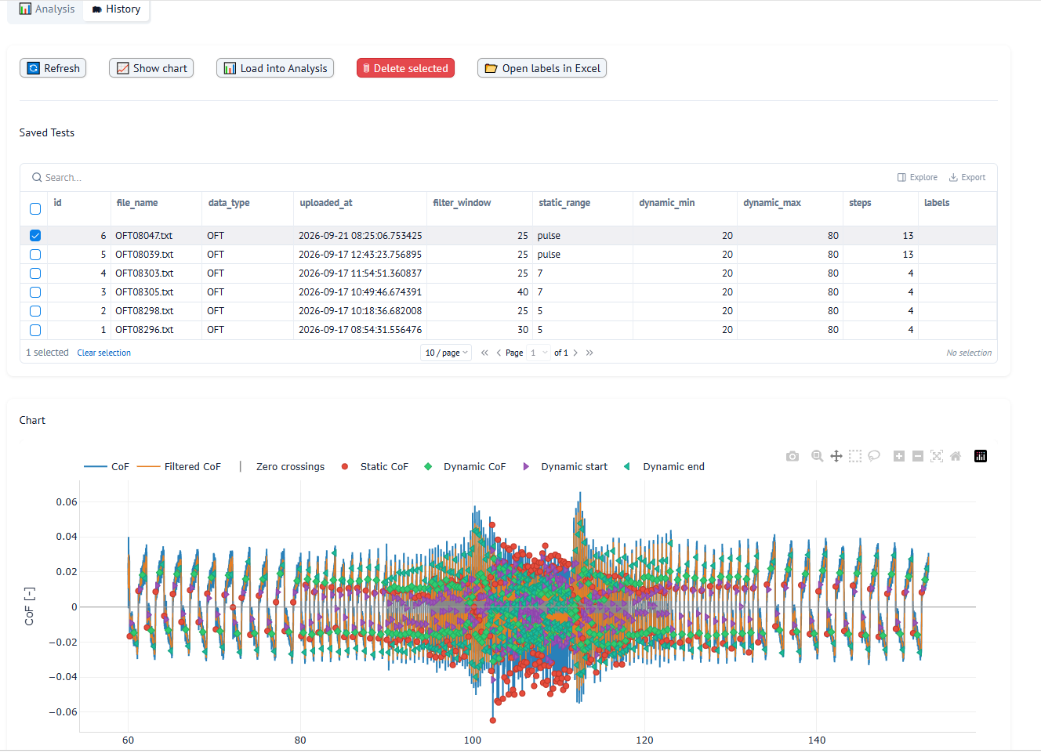
History tab
1
Saved tests
Every evaluated test with its filter, static and dynamic settings
2
Show chart
Redraw a saved test with all static and dynamic points
3
Load into Analysis
Re-open a test to adjust, re-evaluate and overwrite it
4
Open labels in Excel
Export every labelled cycle in one sheet

Slide 11
Next steps
1
2
Grow the History database
Add an AI tab
Evaluate and save 500 to 1,000 tests,
Predict friction from the test data: CoF, pressure, temperature and other conditions.
More saved tests = more data for the AI to learn from.
Trained on the saved History results.

