Slide 1
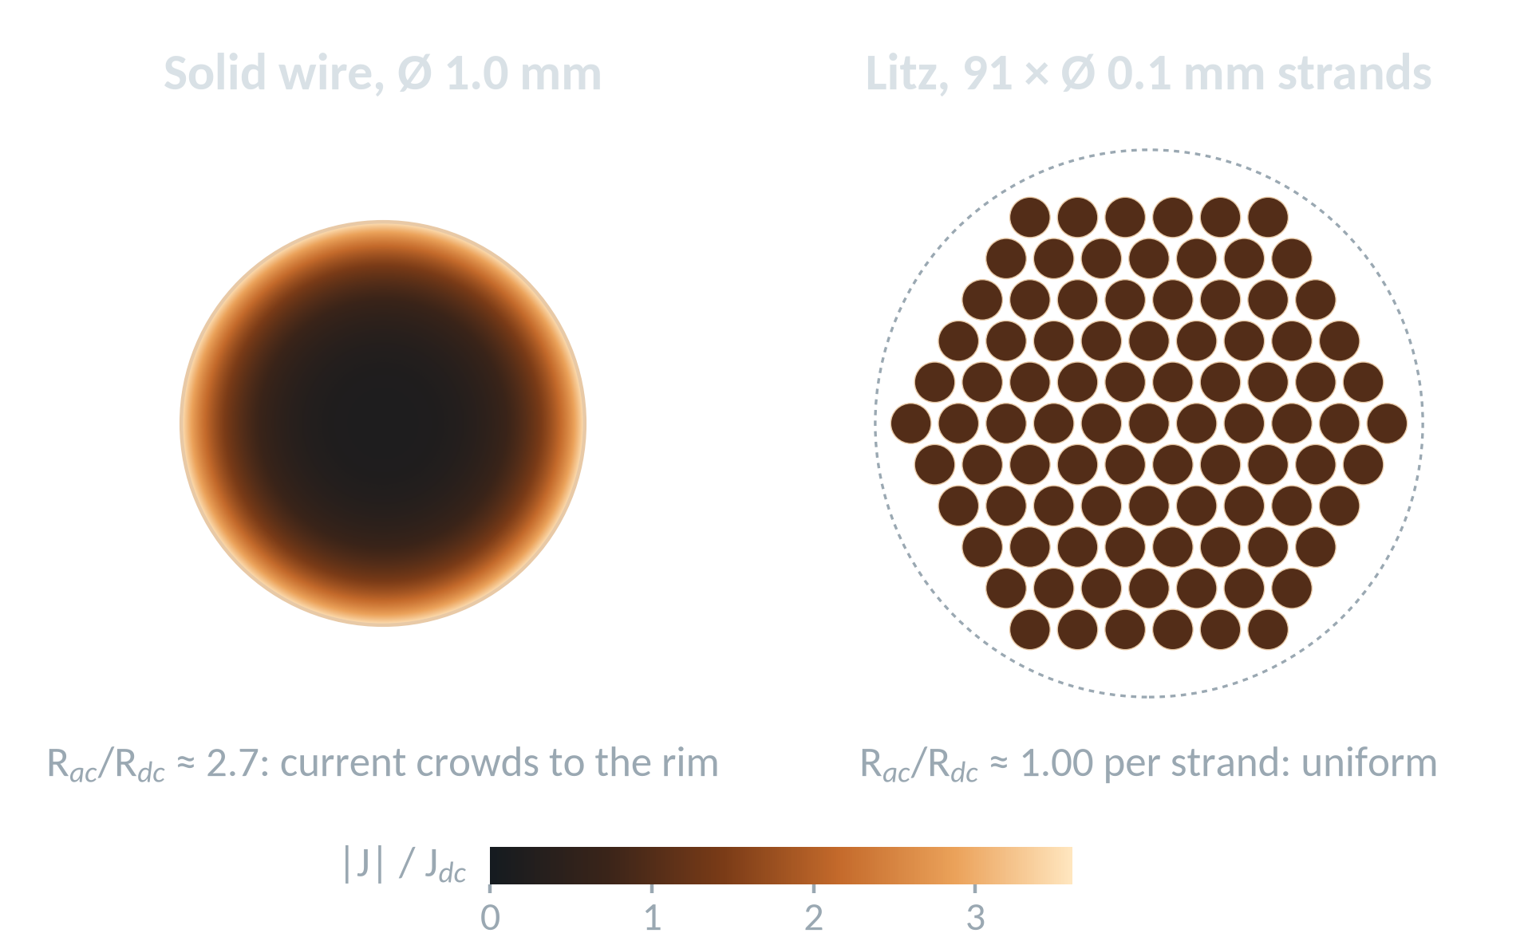




Experimental Verification of Automated Loss Simulation for Magnetic Components
POSTER DIGEST · POWER MAGNETICS
A Python-driven PLECS · SPICE · Ansys Maxwell loss workflow, checked against near-adiabatic calorimetry
Computed for this deck (skin effect only, δ ≈ 0.10 mm in copper at 400 kHz): why solid and litz windings behave so differently.
Based on the poster by P. Skoff, M. Stoiber, J. Reynvaan and W. Konrad
Silicon Austria Labs (SAL), with Infineon Technologies AG · Power Electronics for Energy Transition Symposium, Vienna, 29–30 Sep 2026
1 · Simulate
2 · Measure
3 · Compare
Python chains PLECS waveforms, Infineon SPICE switch models and 2D FEM in Ansys Maxwell to predict every loss.
A stirred, near-adiabatic Dewar calorimeter turns the inductor’s heat into watts: P = C·ΔT/Δt.
Buck converter, RM14LP, 400 kHz: litz-wire loss predicted within ≈ 1 %, solid wire ≈ 8 % too low.
Notes:
WHAT THE POSTER IS ABOUT
The poster 'Experimental verification of automated loss-simulation of magnetic components' (P. Skoff, M. Stoiber, J. Reynvaan, W. Konrad; Silicon Austria Labs with Infineon Technologies AG; Power Electronics for Energy Transition Symposium 2026) asks one question: can an automated simulation chain be trusted to predict the losses of an inductor or transformer before it is built?
Why this is hard: winding losses depend on the whole frequency content of the current (skin and proximity effect), core losses depend nonlinearly on flux density, frequency and waveform, and electrical V*I loss measurements on high-Q components are very sensitive to phase errors.
The poster therefore combines two independent pillars: (1) an automated Python workflow that simulates the converter in PLECS, the switch losses with Infineon SPICE models and the magnetic component with 2D FEM in Ansys Maxwell; (2) a calorimetric measurement that captures the component's heat directly. The comparison on a 400 kHz, ~880 W buck-converter inductor (RM14LP core) shows excellent agreement for a litz winding and an ~8 % under-prediction for a solid-wire winding.
Figure on the right (computed for this deck, not taken from the poster): exact Bessel-function solution for the current density of an isolated round copper conductor at 400 kHz. In a 1 mm solid wire the current crowds into a skin of ~0.10 mm (R_ac/R_dc ~ 2.7 from skin effect alone); 0.1 mm litz strands carry it uniformly. This is the physics behind the solid-vs-litz result on slide 5.

Slide 2
The automated simulation workflow
One Python-scripted chain from circuit waveform to switch and component losses
1
Circuit model PLECS
Why ~10 frequency components are enough
The converter is drawn in PLECS and run at its operating point (case study: buck converter, 400 kHz, ≈ 880 W).
Share of the ripple-related winding loss captured by the first N harmonics
2
Switch losses Infineon SPICE
Conduction and switching losses from Infineon device models in a SPICE solver: ≈ 6.8 W per switch.
3
Waveform → spectrum Python · FFT
The inductor current is exported and Fourier-analysed; only the 10 most dominant frequency components are kept.
N = 10 captures ≥ 98 % even in the worst (proximity-dominated) case
4
Magnetic FEM Ansys Maxwell 2D
Own illustration, not poster data: symmetric triangular ripple (I_{n} ∝ 1/n², odd n); limits R_{ac} ∝ √f (d ≫ δ) and R_{ac} ∝ f² (d ≪ δ) [9, 10].
The components drive the 2D model as parallel current sources; core, air gaps, insulation, layer stack and wire (solid / litz) are set.
CASE STUDY
Buck converter · RM14LP core · 400 kHz · ≈ 880 W
5
Loss summary Python
≈ 6.8 W
6.75 W
6.70 W
Core and winding losses are summed over all components:
P_{w} = Σ I_{n}² · R_{ac}(f_{n}) with R_{ac} from skin + proximity effect
loss per switch (SPICE)
inductor, solid wire (FEM)
inductor, litz wire (FEM)
Notes:
HOW THE AUTOMATED WORKFLOW WORKS (poster panel 'Simulation results - example: buck converter')
1) The converter is drawn in PLECS and simulated at its operating point.
2) Switch losses are simulated in a SPICE solver with Infineon device models (about 6.8 W per switch in the case study).
3) The waveforms needed for the magnetic component are extracted from PLECS and an FFT is computed. The 10 most dominant frequency components are kept; according to the poster this gives good results with acceptable simulation time.
4) In Ansys Maxwell (2D), these components are applied as parallel current sources, one per frequency. The script assigns layer stack / winding structure and wire type (litz or solid), core size and material, insulation and air gaps.
5) Losses are summed over the frequency components. For the winding this superposition is exact as long as the field problem is linear (constant permeability, no saturation): P_w = sum of I_n^2 * R_ac(f_n) [9, 10]. For the core it is an approximation because core loss is nonlinear in flux density; time-domain methods such as iGSE / i2GSE [15, 16] are the usual alternative.
WHY ABOUT TEN COMPONENTS ARE ENOUGH (own calculation, not from the poster)
For a symmetric triangular ripple current the harmonic amplitudes fall as 1/n^2 (odd n only). Higher harmonics see a larger AC resistance. In the worst case - a proximity-dominated winding with R_ac rising like f^2 - the first ten harmonics still capture about 98 % of the ripple-related winding loss; in the skin-effect regime (R_ac ~ sqrt f) it is above 99.9 %. Truncating at ten components is therefore physically well justified.
CASE STUDY: buck converter, RM14LP core, 400 kHz, about 880 W. Simulated results: ~6.8 W per switch, inductor 6.75 W with solid wire and 6.70 W with litz wire.

Slide 3
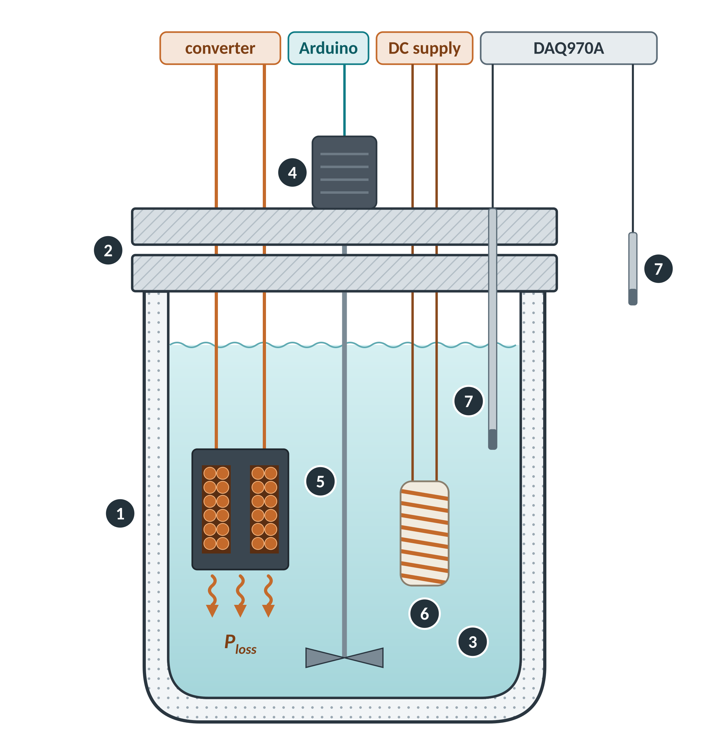



Measuring loss as heat: near-adiabatic calorimetry
Every watt dissipated in the DUT heats a stirred liquid; the loss follows from the temperature slope
P_{loss} = C_{eq} · ΔT / Δt
energy balance of a closed system
C_{eq} is the total heat capacity inside the Dewar (liquid + DUT + enclosure). The relation holds while heat exchange with the ambient is negligible — hence vacuum jacket, double lid and calibration under identical conditions.
Set-up
Why calorimetry?
1
Dewar flask with vacuum jacket
Waveform-independent
2
Custom double lid
Heat is measured, not V·I, so phase errors drop out. Electrically ΔP/P ≈ Q·Δφ: Q = 100 and 0.1° give 17 % [3, 6].
3
Dielectric liquid, stirred
Closed, near-adiabatic
4
Stepper-motor stirrer + Arduino
Only ΔT/Δt is needed: no coolant flow measurement, unlike steady-state calorimeters [4, 5].
5
DUT: inductor, fully submerged
Uniform liquid bath
6
Heater: wire-wound resistor
Insulating liquid with high heat capacity; continuous stirring prevents hot spots.
7
PT100 (liquid, ambient) → DAQ970A
Notes:
THE MEASUREMENT IDEA (poster panel 'Setup for measuring inductor losses')
All losses of the component - core and winding - end up as heat. The DUT is fully submerged in a dielectric liquid inside a Dewar flask (vacuum-insulated) closed by a custom double lid, so heat exchange with the ambient is very small: the system is near-adiabatic. The dissipated power then only raises the temperature of the contents: P_loss = C_eq * dT/dt, with C_eq the total heat capacity of liquid, DUT and enclosure.
Why this design: steady-state calorimeters, such as the double-jacketed designs in [4, 5], derive the loss from coolant mass flow and inlet/outlet temperature; the near-adiabatic transient method needs no mass-flow measurement at all. Unlike electrical V*I methods, the result is independent of waveform and frequency: for a high-Q inductor the relative loss error caused by a phase error d_phi is about Q * d_phi, e.g. 17 % for Q = 100 and 0.1 degree [3, 6]. The liquid gives electrical insulation and a high heat capacity at reasonable cost, and it is stirred continuously during calibration and measurement so that it heats uniformly.
Hardware listed on the poster: Dewar with custom double lid; stepper motor + Arduino as stirrer; PT100 sensors for liquid and ambient temperature; Keysight DAQ970A data acquisition; wire-wound resistor as heating element for calibration. The schematic is drawn for this deck (numbers 1-7 match the list).
Related work: the same SAL group evaluated a fluid-based transient calorimeter for ferrite core losses (Reynvaan et al., ICPE 2023 [2]); ETH Zurich's transient calorimetric core-loss method [3] is a closely related approach.

Slide 4
Calibration: the temperature slope measures power
Known heater powers map slope to watts; the DUT’s slope is then read off the same calibration line
① Raw records: ΔT(t) at known heater power
② Calibration line: slope vs. power
thermal lag: heat must first reach the liquid and sensor
linear region → fit slope s
13 W
● heater calibration points
‒ ‒ linear fit, s = P / C_{eq}
◆ DUT reading (example)
10 W
8 W
6 W
DUT: s = 2.11 mK/s → P = 7.4 W
4 W
2 W
Model illustration, not poster data: ΔT(t) = (P/C_{eq})·[t − τ(1 − e^(−t/τ))] with C_{eq} = 3.5 kJ/K, τ = 8 s (first-order lag between heat source and liquid).
Accuracy measures from the poster: every run starts at 35 °C · DUT stays submerged during calibration (its heat capacity counts) · continuous stirring.
1
Calibrate
2
Fit
3
Measure
4
Read off
Heat the liquid with the resistor at known DC power (2 … 13 W), DUT submerged.
Use only the linear part of each ΔT(t) record → slope s = ΔT/Δt for every power.
Operate the DUT in the converter exactly as in normal operation; record its slope.
P_{DUT} follows from the calibration line, interpolating between calibrated slopes.
Notes:
CALIBRATION (poster panel 'Calibration of setup')
Heating the liquid with a wire-wound resistor at known power for known time periods yields a series of temperature records. After an initial delay - heat must first flow from the source into the liquid and reach the PT100 - the temperature rises linearly. The linear regions are fitted and give a set of slopes dT/dt; the slope steepness is directly proportional to the power. Intermediate powers are interpolated between calibrated slopes.
Accuracy measures stated on the poster: (a) the DUT must be fully submerged in the enclosure during calibration, because it adds a non-negligible heat capacity to the system; (b) the initial liquid temperature is held at 35 degC for every run, so heat leakage and material properties are identical in calibration and measurement; (c) the liquid is stirred continuously for uniform heating.
MEASUREMENT (poster panel 'Results'): the DUT is operated as in normal operation, the dT/dt slope is recorded, and the most linear portion is compared with the calibration data.
IMPORTANT: the two charts are a model illustration made for this deck (first-order lag, C_eq = 3.5 kJ/K, tau = 8 s), not the poster's calibration data. They show the principle: slope = P / C_eq, and a DUT slope maps back to watts on the calibration line. The model also explains the initial non-linear part of every record.

Slide 5



Results: simulation vs. calorimetric measurement
Litz-wire loss is predicted within ≈ 1 %; the extra loss of solid wire is under-estimated by ≈ 8 %
Inductor loss — RM14LP, 400 kHz, ≈ 880 W
LITZ WIRE
SOLID WIRE
+0.5 %
−8.4 %
simulated vs. measured mean
per run: 0 … +1.5 %
simulated vs. measured mean
per run: −7.5 … −8.8 %
Validated for litz windings
The prediction lies within the measurement repeatability (± 0.05 W), so the workflow can drive automated design-space exploration.
Solid-wire extra loss not captured
Measured solid − litz = +0.70 W, simulated only +0.05 W: the HF eddy-current loss of solid conductors is under-represented.
Wire | Run 1 | Run 2 | Run 3 | Mean | Simulated | Sim. vs. mean
Solid | 7.3 | 7.4 | 7.4 | 7.37 | 6.75 | −8.4 %
Litz | 6.7 | 6.7 | 6.6 | 6.67 | 6.70 | +0.5 %
What to check next (our reading)
3D effects beyond the 2D model, e.g. air-gap fringing and RM end turns [13, 14]; copper resistivity at operating temperature (+0.39 %/K); core vs. winding loss split.
Calorimetric runs from the poster; all values in W. Deviation = (simulated − measured mean) / measured mean.
Notes:
RESULTS (poster panel 'Results & conclusion')
Six calorimetric runs: solid wire 7.3 / 7.4 / 7.4 W, litz wire 6.7 / 6.7 / 6.6 W. Simulated: 6.75 W (solid) and 6.70 W (litz).
- Litz: simulation within +0.5 % of the measured mean (0 to +1.5 % per run), i.e. within the repeatability of the set-up (about +/-0.05 W).
- Solid: simulation 8.4 % below the measured mean (7.5 to 8.8 % per run). Seen from the other side, the measured loss is 8 to 10 % above the simulated value.
- The key observation: the measurement shows that solid wire costs about 0.70 W more than litz, while the simulation predicts only 0.05 W difference. The extra high-frequency eddy-current loss of the solid conductor is under-represented in the simulation.
The poster's conclusion: the Python-based workflow enables accurate loss prediction of magnetic components; litz-wound designs are very close to measurement, the solid-wire effect seems under-represented and should be investigated; the simulation is nevertheless a good approximation for inductor design.
POSSIBLE CAUSES (our interpretation, not stated on the poster): (1) 2D models cannot capture 3D field effects such as air-gap fringing fields and the end turns of an RM core, which induce strong eddy currents in solid conductors but much less in fine litz strands [13, 14]; (2) copper resistivity rises by about 0.39 %/K - if the model uses 20 degC copper while the winding runs hotter, losses are under-estimated; (3) the loss split between core and winding is not measured separately, so the error cannot yet be attributed. A 3D FEM cross-check and a temperature-coupled simulation would discriminate between these causes.

Slide 6

References and related work
The poster prints no reference list — these sources document it and the methods it builds on
The poster and the authors' related work
[1] P. Skoff, M. Stoiber, J. Reynvaan, and W. Konrad, “Experimental verification of automated loss-simulation of magnetic components,” poster, Power Electronics for Energy Transition Symposium (AIT & SAL), Vienna, Austria, Sep. 29–30, 2026.
[2] J. Reynvaan, M. Pajnić, and J. Krenn, “Evaluating fluid based transient calorimetric method for measurement of the ferrite core losses,” in Proc. ICPE 2023-ECCE Asia, Jeju, Korea, 2023, pp. 3308–3313.
Calorimetric loss measurement
[3] P. Papamanolis, T. Guillod, F. Krismer, and J. W. Kolar, “Transient calorimetric measurement of ferrite core losses up to 50 MHz,” IEEE Trans. Power Electron., vol. 36, no. 3, pp. 2548–2563, 2021.
[4] D. Christen, U. Badstuebner, J. Biela, and J. W. Kolar, “Calorimetric power loss measurement for highly efficient converters,” in Proc. IPEC 2010 (ECCE Asia), Sapporo, Japan, 2010, pp. 1438–1445.
[5] S. Weier, M. A. Shafi, and R. McMahon, “Precision calorimetry for the accurate measurement of losses in power electronic devices,” IEEE Trans. Ind. Appl., vol. 46, no. 1, pp. 278–284, 2010.
[6] C. Xiao, G. Chen, and W. G. H. Odendaal, “Overview of power loss measurement techniques in power electronics systems,” IEEE Trans. Ind. Appl., vol. 43, no. 3, pp. 657–664, 2007.
[7] D. Rothmund, D. Bortis, and J. W. Kolar, “Accurate transient calorimetric measurement of soft-switching losses of 10-kV SiC MOSFETs and diodes,” IEEE Trans. Power Electron., vol. 33, no. 6, pp. 5240–5250, 2018.
[8] L. Zhu, Z. Liu, Y. Dang, S. Zhang, G. Zhang, and S. Ji, “A review of power loss measurement method for high-frequency transformer,” Renewable Energy System and Equipment, 2026.
Loss modelling of windings and cores
[9] P. L. Dowell, “Effects of eddy currents in transformer windings,” Proc. IEE, vol. 113, no. 8, pp. 1387–1394, 1966.
[10] W. G. Hurley, E. Gath, and J. G. Breslin, “Optimizing the AC resistance of multilayer transformer windings with arbitrary current waveforms,” IEEE Trans. Power Electron., vol. 15, no. 2, pp. 369–376, 2000.
[11] C. R. Sullivan, “Optimal choice for number of strands in a litz-wire transformer winding,” IEEE Trans. Power Electron., vol. 14, no. 2, pp. 283–291, 1999.
[12] R. P. Wojda and M. K. Kazimierczuk, “Winding resistance and power loss of inductors with litz and solid-round wires,” IEEE Trans. Ind. Appl., vol. 54, no. 4, pp. 3548–3557, 2018.
[13] W. A. Roshen, “Fringing field formulas and winding loss due to an air gap,” IEEE Trans. Magn., vol. 43, no. 8, pp. 3387–3394, 2007.
[14] T. Ewald and J. Biela, “Analytical winding loss and inductance models for gapped inductors with litz or solid wires,” IEEE Trans. Power Electron., vol. 37, pp. 15127–15139, 2022.
[15] K. Venkatachalam, C. R. Sullivan, T. Abdallah, and H. Tacca, “Accurate prediction of ferrite core loss with nonsinusoidal waveforms using only Steinmetz parameters,” in Proc. IEEE COMPEL, 2002, pp. 36–41.
[16] J. Mühlethäler, J. Biela, J. W. Kolar, and A. Ecklebe, “Improved core-loss calculation for magnetic components employed in power electronic systems,” IEEE Trans. Power Electron., vol. 27, no. 2, pp. 964–973, 2012.
Automated and integrated simulation / design workflows
[17] N. Förster, T. Piepenbrock, P. Rehlaender, O. Wallscheid, F. Schafmeister, and J. Böcker, “An open-source FEM magnetics toolbox for power electronic magnetic components,” in Proc. PCIM Europe, Nuremberg, Germany, 2022.
[18] N. Djekanovic, M. Luo, and D. Dujic, “Integrated simulation approach to loss calculations of power converter systems,” in Proc. PCIM Europe digital days, 2020, pp. 418–425.
[19] T. Guillod, P. Papamanolis, and J. W. Kolar, “Artificial neural network (ANN) based fast and accurate inductor modeling and design,” IEEE Open J. Power Electron., vol. 1, pp. 284–299, 2020.
[20] H. Li et al., “How MagNet: Machine learning framework for modeling power magnetic material characteristics,” IEEE Trans. Power Electron., vol. 38, no. 12, pp. 15829–15853, 2023.
How these were found: [1] is the poster’s record on SAL’s research portal, [2] the authors’ own calorimetry paper, [3]–[20] the literature on each building block. Full entries with DOIs and links: REFERENCES.md next to this deck.
Notes:
HOW THESE REFERENCES WERE FOUND
The poster itself carries no reference list. [1] is its bibliographic record (SAL research portal, poster at the Power Electronics for Energy Transition Symposium 2026, organised by AIT and SAL). [2] is the authors' own paper on the fluid-based transient calorimeter that the measurement set-up builds on. The other entries are the established literature for the three building blocks of the poster: calorimetric loss measurement [3]-[8], loss modelling of windings and cores [9]-[16], and automated or integrated simulation / design workflows with a similar aim [17]-[20]. Full entries with DOIs and links are in REFERENCES.md next to this deck.
Related activity by the same group: an SAL team including M. Stoiber, J. Reynvaan and W. Konrad received 3rd place in the Innovation Track of the MagNet Challenge 2 (data-driven magnetics modelling, see [20]).

