Slide 1
Presentation on Document Management System Competition #42057
Presented By
Md Rashidul Islam
Date: June 7, 2024

Slide 2
About myself
Bachelor in Computer Science and Engineering from RUET(ruet.ac.bd) and Masters in Computer Science from Dalhousie University(dal.ca).
Primary tech stack is Javascript, Typescript, HTML5, CSS3, .Net, Node.js, React, Angular, Sql Server, Postgresql, MySql, MongoDB, AWS Cloud services, etc.
Secondary tech stack includes Python, Java, Backbone, Extjs, Knockout, Oracle, Sybase, Informix, GIS, Hybrid Mobile Application, and so on.
Over 16 years of software development, architecting, designing(Database & system), data migration and transformation, and modernization of legacy systems, CICD, and Customer requirement study to deployment.
Work experience in IoT device manufacturing and data industry, Commercial real estate data platforms, Data & File Synchronization, Implementing application security, user facing web applications.
Experienced on leading teams as well as capable to work independently.
Love problem solving, mentoring, researching, and work together as a team.

Slide 3
Why am I good fit?
My technical experiences and qualifications are very much inline with the requirements of this role in both frontend and backend modules.
I like to communicate proactively with team members and help if needed for me or others instead of re-invent the wheel.
Have experience in hands-on coding and development of business applications.
Proficient in using design patterns and best, practices, SOLID and ACID principles, SOA and microservices, Single page app, Cloud computing.
Use to with agile methodology and its tools, multi-tasking, planning, estimation and management, quality assurance and compliance.

Slide 4
Experience in security implementation like JWT, AWS Cognito, OpenID Connect, etc.
Strong ability in feasibility study, troubleshooting, debugging, patching, in documentation.
Have two AWS Certifications and got preparation for the third.
Experience in legacy techs such as Oracle Forms/Reports and Struts.
Used to with containerization technologies such as docker and kubernetes, IaC, CICD to streamline and accelerate the SDLC.
Strong ability to quickly learn new technologies on demand and love to keep myself up to date with tech/industry trends and frequent changes.

Slide 5
Solid understanding of ORM, UI data binding, separation of concerns.
Extensive experience in bidirectional communication in web application using signalR/socket.io, horizontal scaling, pub/sub model.
I love to follow best practices and encourage team members to follow.
I’ve curiosity and enthusiasm to learn new technologies or do quick research to have solution and to make the job done.
Also, I’m eager to learn more on cyber-security and relevant security technologies and implement in projects.

Slide 6
Feature checklist and status
Develop a document management system for the web. Done
Allow to upload document and store persistently in a storage. Done
Query, download, and view documents associated with business entity. Done
Use visual studio for backend and any framework/library for frontend. Done
Secure APIs from vulnerabilities like XSS and SQL injection. Done
Implement Unit test. Done
Optionally implement Content Security Policies (CSP). Done
Make the application as production-ready as possible. Done
Create a README file to describe the steps to run the application. Done

Slide 7
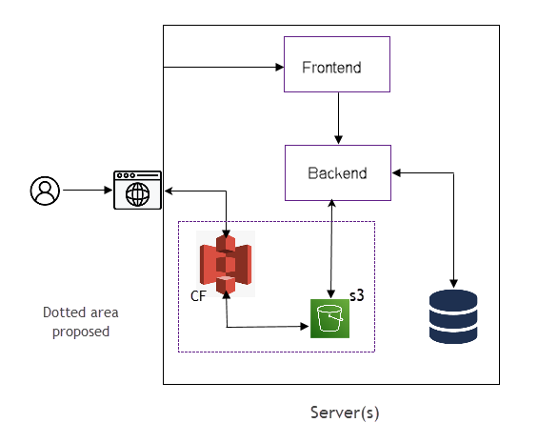
System Architecture (Microservices)

Slide 8
Tools and technologies
I have used the IDE MS Visual Studio 2022 for the development.
Backend language: C# .Net core 8, EF 8
Frontend language: Javascript/Typescript, React.js 18, Material UI, CSS3.
Unit testing framework: xunit
Database: MS Sql Server
Containerization: Docker
Code repository: github

Slide 9
System Analogy
I have considered ‘Customer’ as a business entity that usually used in different organizations such NS health, Service NS, Bank, Trans-union, Mobile operators, etc.
To open an account in those organizations, they used to ask for additional information such as driving license, utility bills, passport, PR card, etc for validation and activate the account.
Here every information is considered as a ‘Document’ and this is child entity is associated with the parent entity ‘Customer’.
At first admin needs to create a customer with the required information. Then in terms of activation, they will upload the required documents.
When all documents are uploaded, the admin staff can verify it and activate the account. (validation and activation parts are out of scope of the project).

Slide 10
Customer Model (Example)
{
id: ‘9E806726-955F-4BBE-D563-08DC8657F9F7’,
firstName: 'David',
lastName: 'Baker',
email: 'dbaker@gmail.com',
address: '25 Wall Street',
city: 'Halifax',
state: 'NS',
postalCode: 'B3A 2K9',
country: 'Canada',
phone: '9034854844',
gender: 'Male',
}

Slide 11
Document Model (Example)
{
name: ‘driving-lic.pdf',
data: ‘0x4D75D75D35D74….',
type: 'Driving License',
dateCreated: ' 2024-06-06 15:39:30.5479226 ',
customerId: ' 9E806726-955F-4BBE-D563-08DC8657F9F7 ',
}

Slide 12
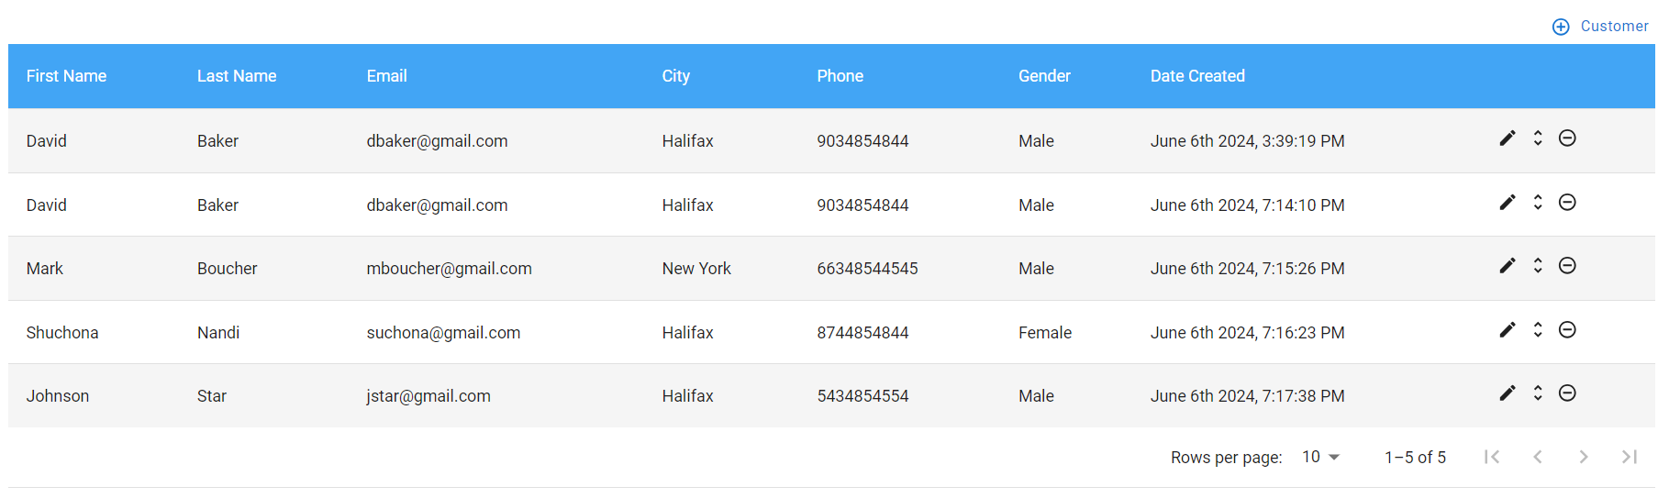
Customer Dashboard

Slide 13
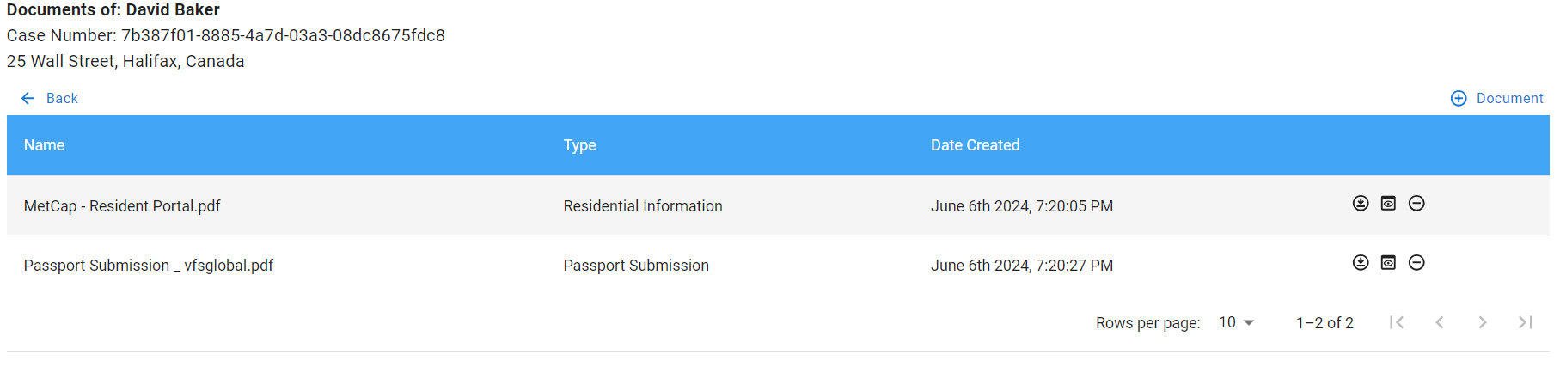
Document List

Slide 14
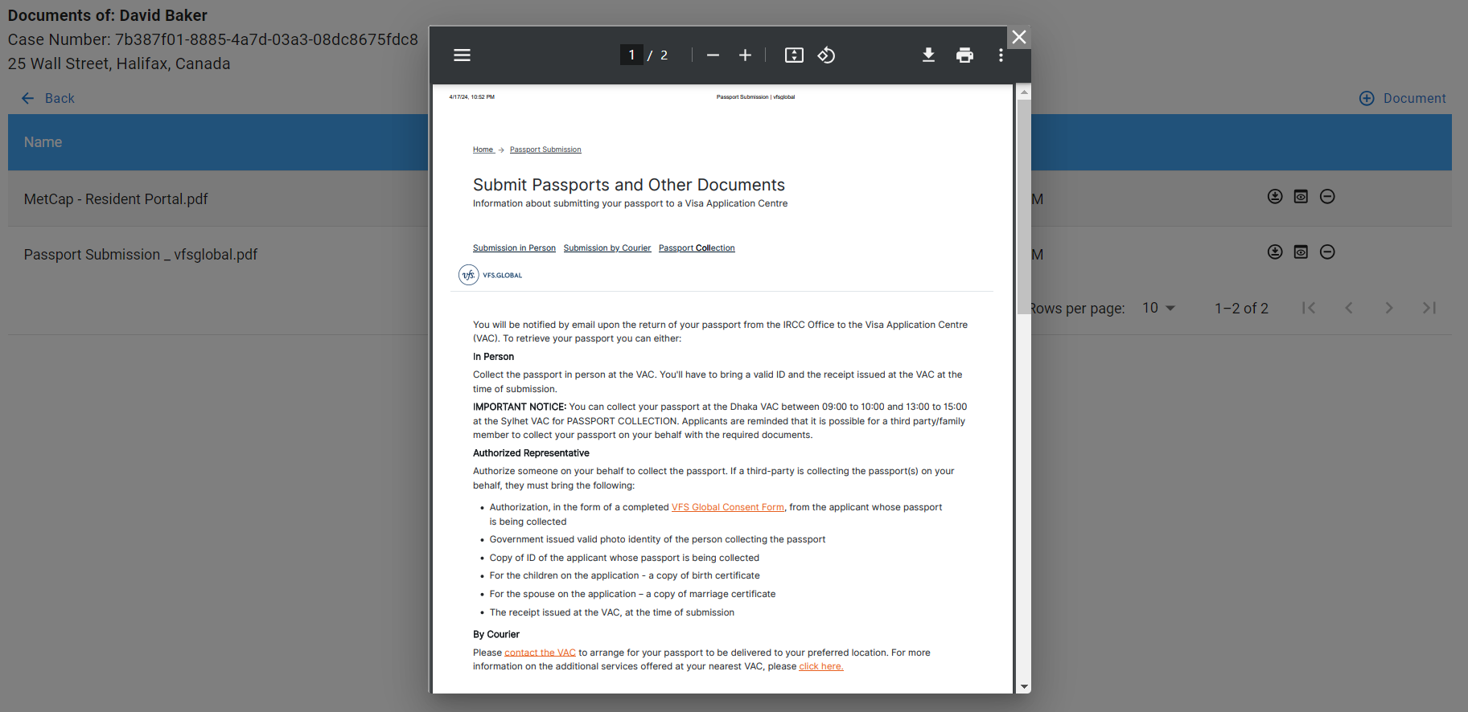
View Document

Slide 15
API Security
Sql-Injection:
Since c# is fully typed language and we are using .net core 8, everything is object but no raw query.
In LINQ all queries are parameter driven, so no string interpolation and no chances to trespass.
Framework construct blocks malicious data by type checking. For example: Guid.
XSS:
Added a middleware that sanitizes the inputs in the server.
Avoided script injection by innerHTML, instead we made parameter based tags dynamically for example in DocumentViewer.
CSP(Content Security Policy):
Implemented by adding CSP header to the response in startup.

Slide 16
Follow up questions?

Slide 17
Thank you!

