Slide 1
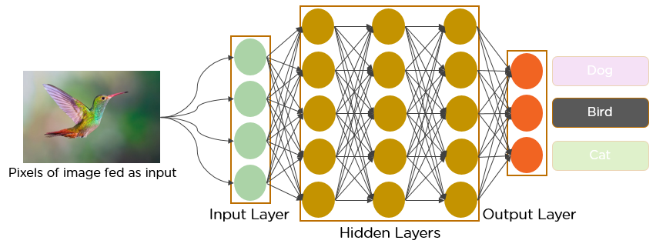
Welcome to the World of CNNs:
Unraveling Image Magic

Slide 2
Hello everyone!
Today, we're diving into the fascinating realm of Convolutional Neural Networks, or CNNs. These are superheroes in the world of image processing and analysis. Let's break down the magic behind CNNs in a nutshell.

Slide 3
What's the Big Deal with CNNs?
CNNs are specialized deep learning models designed for tasks involving images.
They mimic the way our brain processes visual information, making them ideal for tasks like image recognition, object detection, and more.

Slide 4
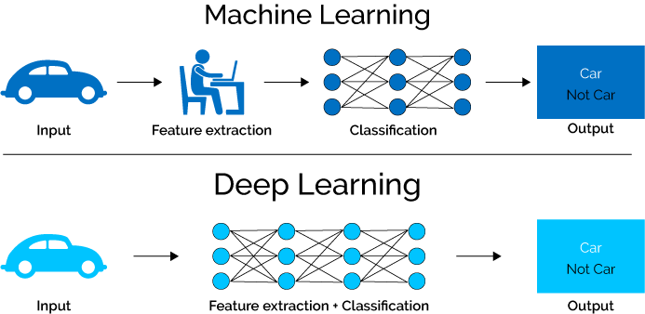
Machine Learning VS Deep Learning

Slide 5
Basic Building Blocks: Convolutional Layers
Imagine your image as a puzzle of tiny pieces.
The first key player in CNNs is the convolutional layer.
It's like a detective, scanning small portions of the image at a time.
This helps the network identify patterns, like edges or textures.

Slide 6
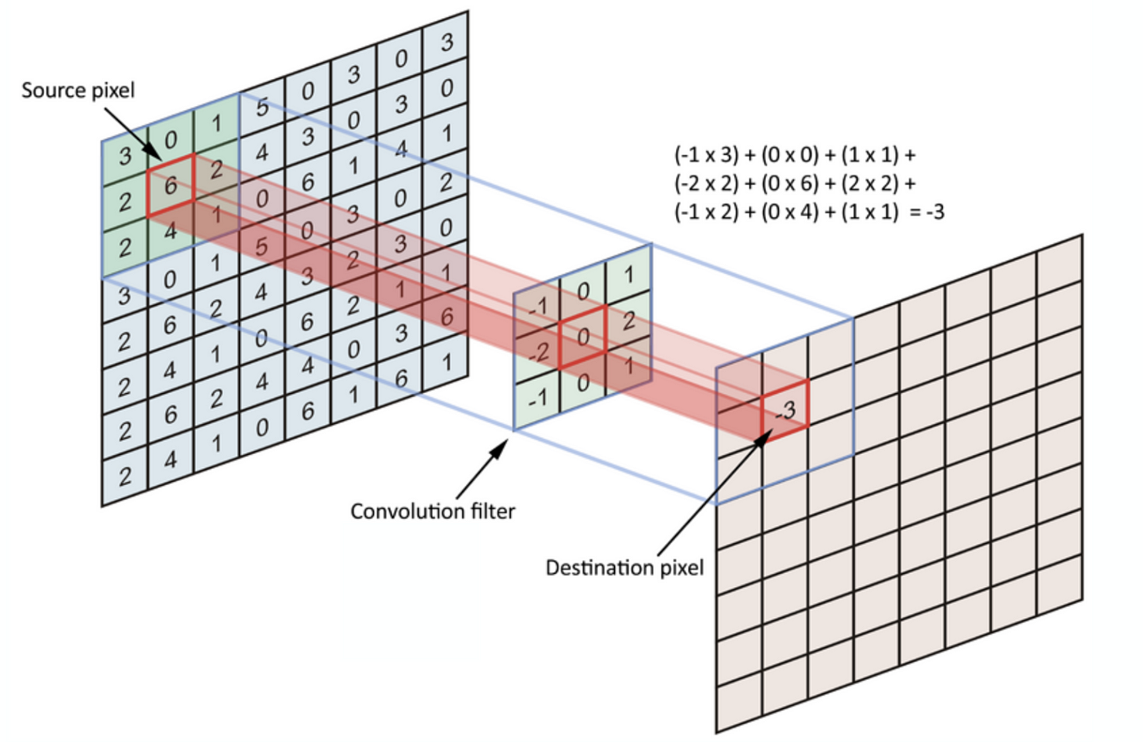
Basic Building Blocks: Convolutional Layers

Slide 7
Adding Depth: Filters and Channels
Filters are like special glasses worn by the network to see specific features.
Each filter focuses on different aspects, like detecting colors, shapes, or patterns.
Multiple filters create channels, giving the network a rich understanding of the image.

Slide 8
Pooling: Downsizing Smartly
After convolution, we don't need all the details.
Pooling layers act as a smart downsizer, keeping the essential information while reducing computational load.
It's like summarizing a story without losing its essence.

Slide 9
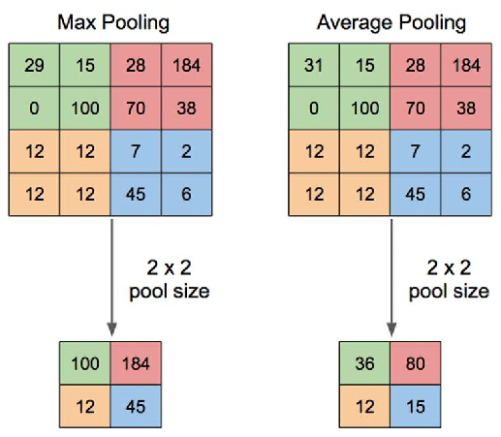
Pooling: Downsizing Smartly

Slide 10
Flattening and Fully Connected Layers
Once the network has explored the image in-depth, it flattens its understanding into a one-dimensional array.
Fully connected layers then analyze this array, making decisions based on the overall context.

Slide 11
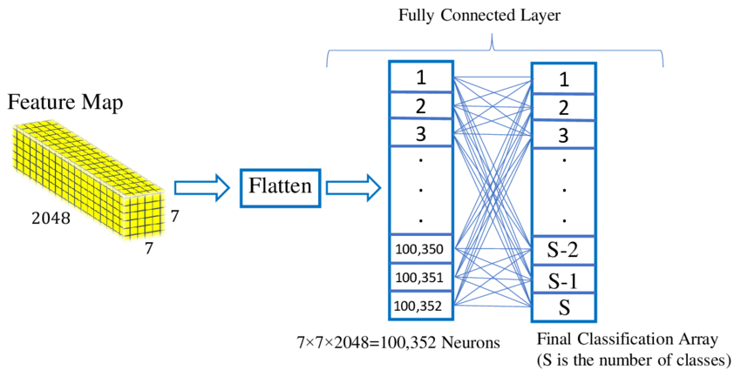
Flattening and Fully Connected Layers

Slide 12
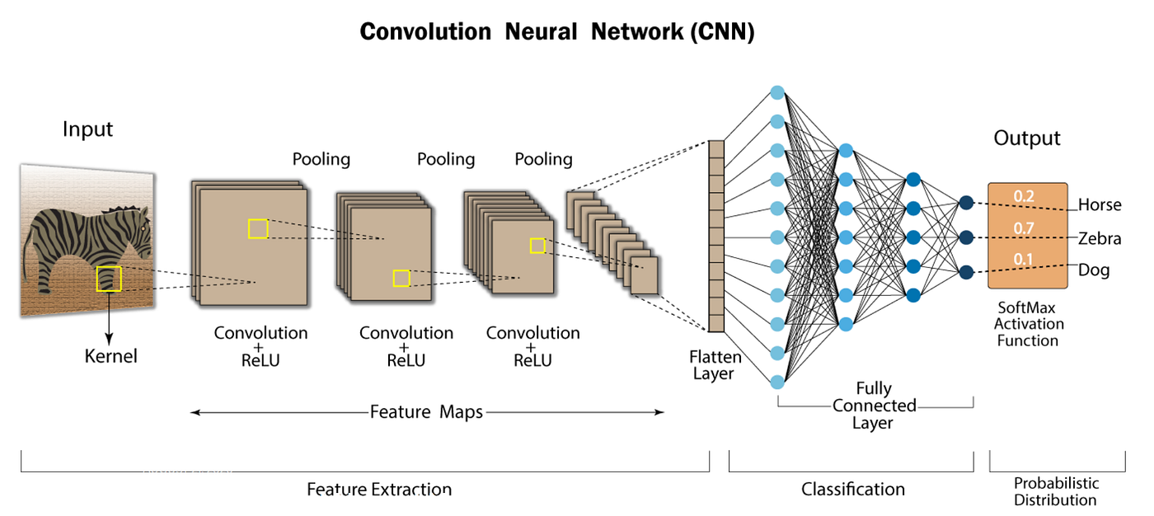
CNN Architecture

Slide 13
Training: Learning the Art
CNNs are not born geniuses; they learn from data.
During training, they adjust their parameters to get better at recognizing patterns.
It's like refining their detective skills through experience.

Slide 14
Applications: Where CNNs Shine
CNNs are everywhere!
From facial recognition in your phone to detecting objects in self-driving cars, they excel at tasks where understanding visual information is crucial.

Slide 15
Closing Thoughts: The Power of CNNs
In a nutshell, Convolutional Neural Networks are the magicians of the visual world.
They unravel the secrets hidden in pixels, making them an indispensable tool in the age of image-centric data.

