Slide 1
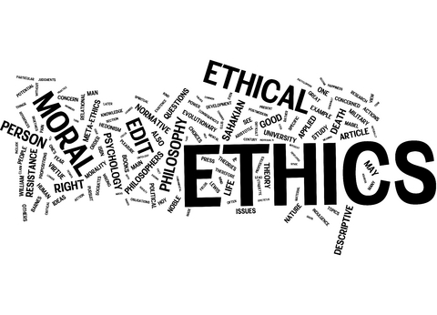

Slide 2
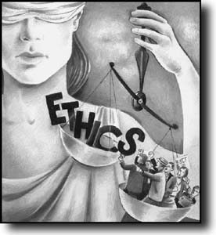
Ethics, also known as moral philosophy, is a branch of philosophy that involves systematizing, defending, and recommending concepts of right and wrong behavior.

Slide 3
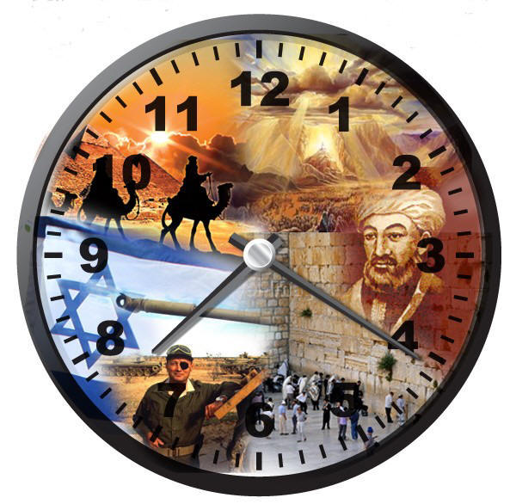
ANCIENT ETHICS
Mesopotamian Epic of Gilgamesh
Homer's Iliad
The Icelandic Eddas
The Sumerian Farmer's Almanac
The Egyptian Instruction of Amenemope

Slide 4
Ethical Theories
An introduction to three main branches of normative ethics

Slide 5
Normative vs. descriptive Ethics
Descriptive Ethics: seeks to describe how people behave and/or what sorts of moral standards they claim to follow. (Think Anthropology or sociology)
non-evaluative
Normative ethics: seeks to create or evaluate moral standards. it is an attempt to figure out what people should do or whether their current moral behavior is reasonable.

Slide 6
Three types of normative ethics
Teleological -- look at “ends” or consequences of what we do
Deontological – adheres to independent moral rules or duties; motives behind certain actions are right or wrong instead of focusing on the results (Duty-based)
The Golden rule
Religion (ex. The ten commandments)
Virtue ethics- Character-based Theories that look for the role one’s character plays in the decision making and how that decision will affect the character of others

Slide 7
Three Main Ethical
Approaches
Three main approaches to normative ethics that we will discuss:  Virtue ethics (ethics of character)  Utilitarianism (teleological)
 Deontology
The difference between these three approaches to morality tends to lie more in the way moral dilemmas are approached, rather than in the moral conclusions reached.

Slide 8
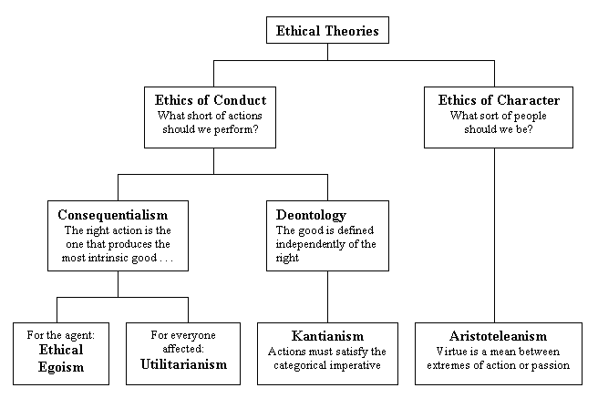

Slide 9
Virtue Theory (ethics of Character)
Virtue ethics emphasizes the role of one's character and the virtues that one’s character embodies for determining or evaluating ethical behavior.
The roots of this theory lie in the works of Plato and Aristotle.
Virtue ethics place emphasizes being rather than doing. In virtue ethics, morality stems from the identity and/or character of the individual, rather than being a reflection of the actions (or consequences) of the individual.
A virtue ethics philosopher will identify virtues, desirable characteristics, that the moral or virtuous person embodies. Possessing these virtue in virtues, ethics, is what makes one moral, and one's actions are a mere reflection of one's inner morality.

Slide 10
Deontological Ethics (Kantian Ethics or Duty Ethics)
places the emphasis on adhering to ethical principles or duties and fulfilling obligations
How these duties are defined, however, is often a point of contention and debate in deontological ethics.
Deontology also depends, at least partially, upon moral absolutes that make an action moral regardless of circumstances.
There are multiple motivations for “duty”-
Immanuel Kant--our actions should be motivated by reason, rather than by emotions -you should not only do good things when you feel like it
Divine Command Theory– It has been decreed by God to be “good.”

Slide 11
Consequentialism
 Consequentialism bases the morality of an action upon the consequences of the outcome
 Instead of saying that one has a moral duty to
abstain from murder, a consequentialist would say that we should abstain from murder because it causes undesirable effects.
 The main contention here is what outcomes should/ can be identified as objectively desirable.

Slide 12
Utilitarianism
Utilitarianism is one form of consequentialism which has as its main tenet that we should seek the greatest happiness of the greatest number.
Greatest Happiness Principle of John Stuart Mill
Seeks utility over morality
Our determinant of the desirability of an action is the net amount of happiness it brings, the number of people it brings it to, and the duration of the happiness.

Slide 13
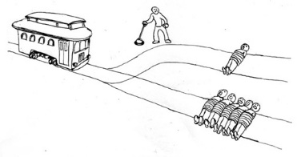
UTILITARIANISM
Seeking utility can be problematic
Example: The Trolley problem

Slide 14
Comparing the Three Ethical Approaches
A consequentialist may argue that lying is wrong because of the negative consequences produced by lying—though a consequentialist may allow that certain foreseeable consequences might make lying acceptable.
A deontologist might argue that lying is always wrong, regardless of any potential "good" that might come from lying.
A virtue ethicist would focus less on lying in any particular instance and instead consider what a decision to tell a lie or not tell a lie said about one's character and moral behavior. Therefore, the decision to lie would be made in a case-by-case basis that weigh personal benefit, group benefit, and intentions.

Slide 15

COMPONENTS/QUALITIES
Honesty
Integrity
Transparency
Accountability
Confidentiality
Objectivity
Respectfulness
Obedience to the Law

Slide 16


“Whistleblowing”

Slide 17
“Whistleblowing”
A whistleblower is a person who tells the public or someone in authority about alleged dishonest or illegal activities occurring in a government department or private company or organization.
A whistleblower is a person who raises concern about frauds, corruptions, wrongdoings and mismanagement.

Slide 18

DIMENSIONS OF ETHICS ( 3 “R’s” of Ethics)
RULES
RESPONSIBILITY
RESPECT
Notes:
Kant’s Categorical Imperative
Respect thyself!
Non-observing these sources has negative impact on organisational performance.
In modern organisation you need both Rules (Ethics) and Respect/Responsibility (Integrity: Behaviour)

Slide 19

CODES OF ETHICS
The primary aspect of codes of ethics is to provide the basic framework for ethical judgment for a professional.

Slide 20
CODES OF ETHICS
The codes of ethics are guidelines for specific group of professionals to help them perform their roles, to know how to conduct themselves, and to know how to resolve various ethical issues.
The codes of ethics help the professionals to apply moral and ethical principles to the specific situations encountered in professional practice.
These codes convey the rights, duties, and obligations of the members of the profession.

Slide 21
POSITIVE ROLES OF CODES OF ETHICS
Inspiration
Guidance
Support for responsible conduct
Deterring and disciplining unethical professional conduct
Education and promoting of mutual understanding
Contributing to a positive public image of the profession
Protecting the status quo and suppressing dissent within the profession
Promoting business interests through restraint of trade

Slide 22
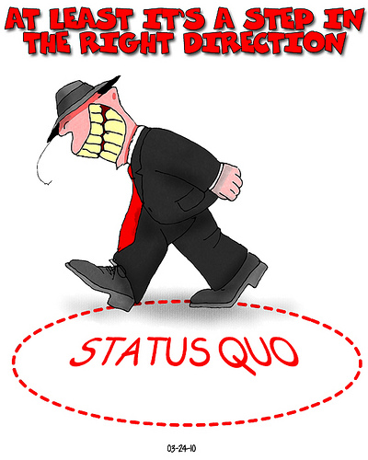
PROTECTING THE STATUS QUO
The codes institute ethical conventions. These ethical conventions can promote a minimum, acceptable level of ethical conduct.
The codes can also suppress the dispute within the profession.

Slide 23
LIMITATIONS OF CODES OF ETHICS
Codes of ethics are broad guidelines, restricted to general phrases. The codes cannot be applied directly to all situations.
Engineering codes often have internal conflicts, since several entries in codes overlap with each other, which may result in moral dilemmas.
The codes cannot serve as the final moral authority for professional conduct.

Slide 24
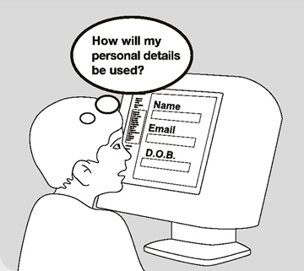

COMPUTER ETHICS
Computer ethics is the study of ethical issues that are associated primarily with computing machines and computing profession.

Slide 25
COMPUTER ETHICS
Don’t use a computer to harm other people.
Don’t interfere with other people’s computer work.
Don’t snoop around in other people’s computer files.
Don’t use a computer to steel.
Don’t copy or use propriety software for which you have not paid.
Don’t use other people’s computer resources without authorization or proper compensation.
Don’t appropriate other people’s intellectual output.

Slide 26
COMPUTER ETHICS
Think about the social consequences of the program you are waiting or the system you are designing.
Use a computer in ways that insure considerations and respect for your fellow humans.

Slide 27


