Slide 1


“E-JOB PORTAL MANAGEMENT SYSTEM”
INSTITUTE FOR ADVANCED COMPUTING
AND SOFTWARE DEVELOPMENT AKURDI, PUNE
e-DAC SEPT 2020
Centre Coordinator : Mr.Prashant Karhale
Name of Guide: Mr.Chetan Pardeshi
Group Number: 09
Group Members: Amruta Vyavahare(2013)
Rashi Gundapwar (2055)

Slide 2
Contents
Introduction
Problem Statement
Objectives of the project
Scope of the project
Flow Diagram
System Description
DFD
UML Diagrams
System Requirements (H/W & S/W)
Advantages & Disadvantages of the project
Conclusion
References

Slide 3
Introduction
The System developed for job seeker and recruiter. The System provide for intermediate place Job seeker and company.
The Company can easily get employee from Our job portal site by posting a Job. The job portal website is a common place between job seeker and company.
when job seeker can login in his account then he can search for Company by Location and apply with match profile or education detail. so job seeker can easily apply to Job.

Slide 4
Problem Statement
The job portal application is used to manage available jobs. Also an online platform for the job seeker, So end-user can search the available job applications on the respective jobs. At the same time, the recruiter or HR can view the applications and contact the candidates .So the communication between company and Job seekers are manage easily.

Slide 5
Objectives
Jobseeker can easily search for Job.
Company can Post job and select Employee.
To minimize time required for manual Recruitment process.
To maintain communication between company and Job seekers are manage easily.

Slide 6
Scope of Project
Maintain Jobseeker And Recruiter record.
Provide customized Job Posting.
Jobseeker can apply to job as per their preferred location.
Recruiters can see the job applied jobseeker data.
Communication Between Company(HR) and Jobseeker becomes easy.

Slide 7
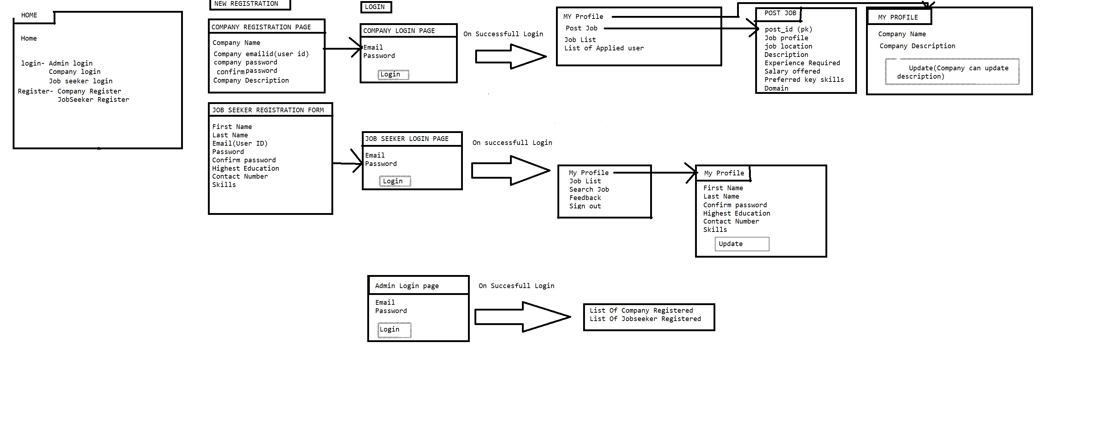
Flow Diagram

Slide 8
System Description
Modules:
1)Job Seeker Module
-Registration
-Login
-My Profile
-Update Profile
-Apply job
-search
-Feedback

Slide 9
2)Company Module-
-Registration
-Login
-My profile
-Update Profile
-Post Job
-Delete Job
-list of applied job seeker
3)Admin:
-Login
-List of Company and JobSeeker

Slide 10

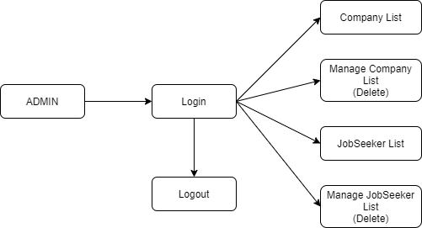
DFD For Admin
DFD Level 0
DFD Level 1
DFD Level 2

Slide 11

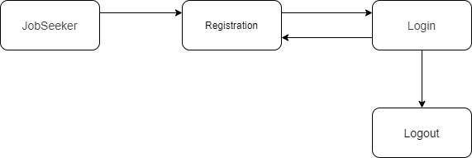
DFD For Recruiter
DFD Level 0
DFD Level 1

Slide 12
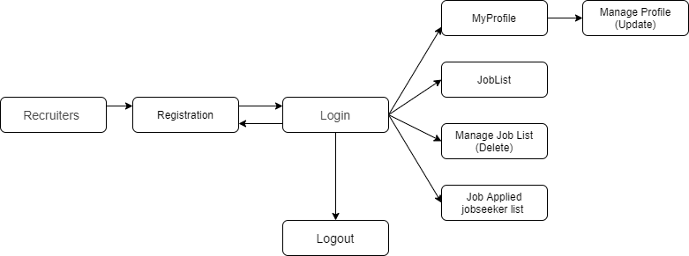
DFD Level 2

Slide 13


DFD For Job Seeker
DFD Level 0
DFD Level 1

Slide 14
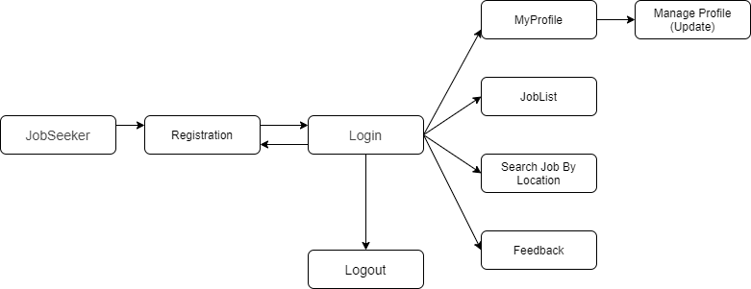
DFD Level 2

Slide 15
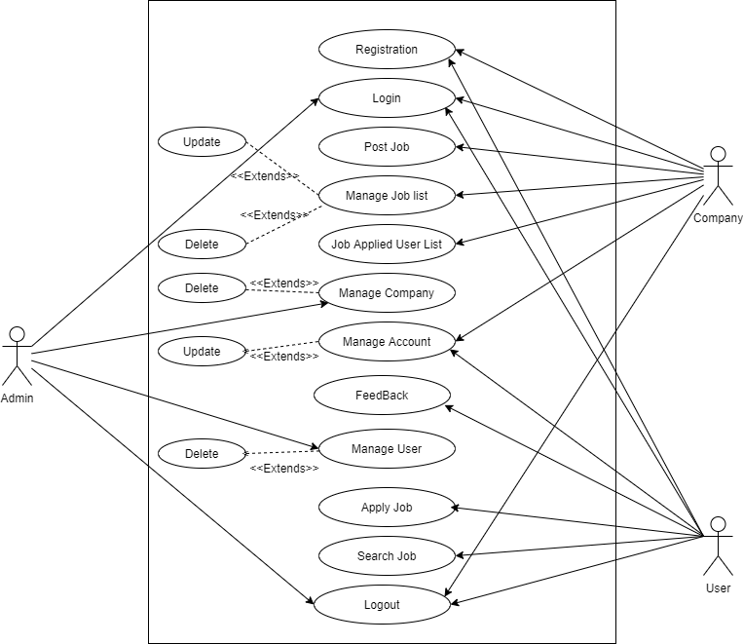
Use Case Diagram

Slide 16
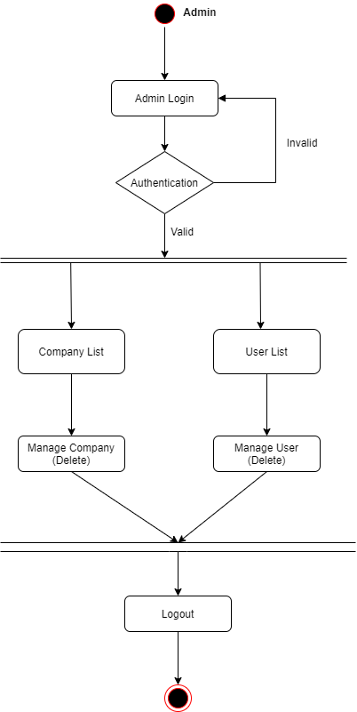
Activity Diagram For Admin

Slide 17
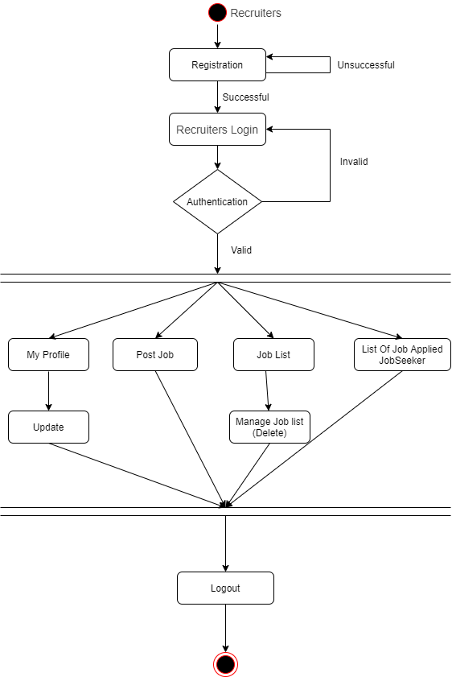
Activity Diagram For Recruiter

Slide 18
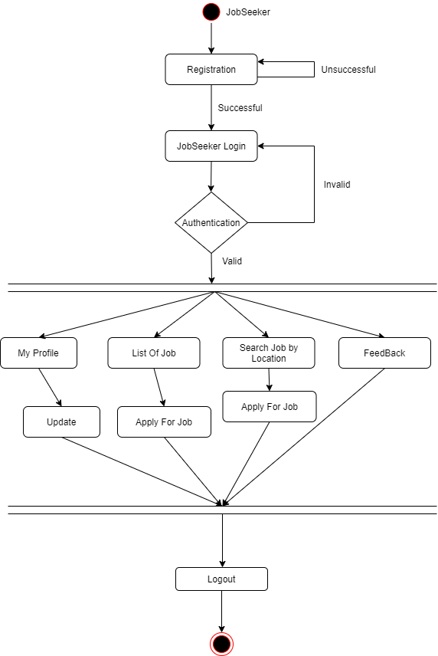
Activity Diagram For Job Seeker

Slide 19
System Requirements
Hardware Requirements:
Processor – Intel Core2Duo, Pentium –i3(min)
Speed – 2.4 GH (min)
RAM - 4 GB (min)
Hard Disk - 50 GB (min)
Software Requirements:
Operating System: Windows 8 and Above
Front End: Html,css
Back End: MySQL, Spring boot MVC and Hibernate

Slide 20
Advantages & Disadvantages
Advantages :
Job Seeker can easily search for Job as per their preferred location.
Recruiters can post job and get the list of user who applied for job
Communication Between Recruiters and Jobseeker becomes easy.
Disadvantages :
The size of the database increases day-by-day, increasing the load on the database back up and data maintenance activity Time Consuming at times.
Spring Security not used.

Slide 21
Conclusion
This Proposed System is used of the Recruiter and Job seeker for easy Communication. Job seeker can easily find job as per their choice and Recruiter can also get data of Jobseeker who are interested in that specific job.

Slide 22
References
Web Sites
http://www.bestjobs.ph
http://www.gopinoy.com
http://www.jobsdb.com.ph
http://www.jobsonline.com.ph
http://www.jobstreet.com.ph
http://www.phil-job.net

Slide 23
Thank You !

