Slide 1
WebD
Introduction to CSS
By
Manik Rastogi

Slide 2
What is CSS?
*CSS stands for Cascading Style Sheets
*CSS defines how HTML elements are to be displayed
*CSS defines Style of a web page.

Slide 3
CSS Syntax
Selector : Selects the element on which properties will be applied.
Declaration : Properties to be applied.
Property : what property you want to style.
Value : Value of the property.
selector{ property : value ; }
Div{ width : 100px; }

Slide 4
CSS Comments
Comments are used to explain your code, and may help you when you edit the source code at a later date. Comments are ignored by browsers.
A CSS comment starts with /* and ends with */.
Comments can be of multiple lines.
.
p {
color: red; /* This is a comment */ text-align: center;
}

Slide 5
CSS Selectors
CSS selectors are used to select HTML elements based on their id, class, type, attribute, and more.
Element selector selects elements based on the element name.
p { text-align: center; } : It selects all <p> elements in html.
Id selector selects elements based on the id attributes.
#id1 { text-align: center; } : It selects all elements in html where id=“id1”.

Slide 6
CSS Selectors
Class selector selects elements based on the class attributes.
.class1 { text-align: center; } : It selects all elements in html where class=“class1”.
Group selector selects more than element based on the given attributes.
P , #id1 , .class1 { text-align: center; } : It selects all elements in html where class=“class1” , id=“id1” and all <p> tags.

Slide 7
Inserting CSS
There are three ways of inserting a style sheet:
External style sheet
Internal style sheet
Inline style
External Style Sheet
<head> <link rel="stylesheet" type="text/css" href="mystyle.css"> </head>

Slide 8
Inserting CSS
Internal Style Sheet
<style> /* CSS Goes here */
</style>
Inline Style Sheet
<p style=“ /* CSS Goes here */ “>Content</p>

Slide 9
CSS Background
Background Color :
background-color: ff0000 | red;
Background Image :
background-image : url(‘image.jpg’) ;
Background Properties :
background-repeat : no-repeat | repeat-x;
background-position : right top;

Slide 10
CSS Text
Text Color :
color: ff0000 | red;
Text Alignment:
text-align : center | left | right;
Text Decoration:
text-decoration : underline | overline | line-through;
Text Transformation :
text-transform : lowercase | uppercase ;

Slide 11
CSS Font
Font :
font-family : serif | sans-serif ;
font-family : Times new Roman | Arial ;
Font Style:
font-style : italic | normal ;
Font Size:
font-size : 16px | 1.5em ;
1em = Current Browser Size i.e. if browser font size is set to 16 px then 2em = 2x16 = 32px

Slide 12
CSS Links
Link :
a:link { color : #FF0000 | red ;
background-color: #00FF00 | Blue; }
Link Visited :
a:visited { color : #FF0000 | red ; }
Link On Mouse Over :
a:hover { color : #FF0000 | red ; }

Slide 13
CSS Lists
List Item Markers :
list-style-type circle | square | upper-roman | lower-alpha;
List Item Marker image :
list-style-image: url(‘image.png’) ;
Other Properties
ul li {
color : #FF0000 | red ;
background-color : #00FF00 | Blue;
}

Slide 14
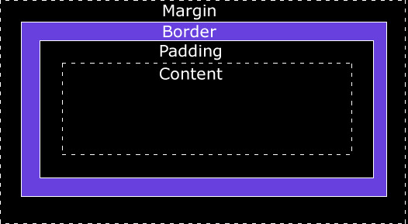
Div Box Model

Slide 15
Div Box Model
Applying CSS on Div :
div { width: 320px; padding: 10px; border: 5px solid gray; margin: 0; }
Total Width of Div : 320px (width) + 20px (left + right padding) + 10px (left + right border) + 0px (left + right margin) = 350px

Slide 16
CSS Border
Border Style :
border-style : solid | dotted | dashed | double ;
Border Width :
border-width : 5px | medium ;
Border Color :
border-color : red | #98bf21 ;
Border Individual Sides :
border-top-style : solid; | border-right-style : dotted;

Slide 17
CSS Margin
Margin :
margin : 10px | auto | 10% ;
Margin Individual Sides :
margin-top : 100px;
margin-left : 100px;
margin-bottom: 50px;
margin-right : 150px;

Slide 18
CSS Padding
Padding :
padding : 10px | 10% ;
Padding Individual Sides :
padding-top : 100px;
padding-left : 100px;
padding-bottom: 50px;
padding-right : 150px;

Slide 19
CSS Positioning
Static Positioning :
position : static;
Fixed Positioning :
{ position : fixed ;
top : 30px ;
left : 5px; }
Relative Positioning:
{ position : relative;
left : 20px; }

Slide 20
CSS Navigation Bar
Project for you guys.
Design Horizontal Navigation Bar.
Use Background color : #31E419 and Text Color : white
Use Font : Sans-serif & Bold Text.
Instruction :
Use UL List of none style.
Use Display : inline property to align list in Horizontal manner.
Style the Navigation Bar.

