Slide 1
IST 615
Project Presentation
Facilities Management System
For University Sports and Fitness Center
By
Hitesh Thadhani
Prachi Sankpal
Rashika Singh
Sai Praharsha Devalla
Tejas Dinesh Patil
Yeswanth Reddy Velapalem

Slide 2
Product Idea and Relevance
The Facilities Management System can be used for tracking and making reservations for accessing the facilities such as the tennis court, basketball court among others at the University fitness center
The system will ensure that long waiting times are prevented and proper records are maintained for the available slots
It will allow students to track available services at the sport and fitness center and book a time slot for services on the given day, provided the center is operational on that day
Notes:
Page 1
The aim of this project is to allow the students of any university to make bookings in advance at a recreational sports and fitness center using cloud services. As a place like that can have multiple play rooms for different sports like basketball, table tennis, squash, etc., it might get difficult for the administrators to maintain the records and for students to check the availability of those rooms.
We propose an application where students will be able to book a sport room in advance to avoid the long waiting times and maintain the records of the bookings made by the students. Adding to that if a student has booked a sport room for the morning slot for today, that room should become unavailable for the next student trying to book the same room for the same time slot.

Slide 3
Competitor Analysis
No direct competition but similar products include:
Kourts: It is an application which allows the user to book and play at nearby tennis clubs. The application is open source and can be accessed by anyone. On the other hand, the system we are building is more secure and allows university students and staff to access the facilities
Existing Application at University: It is only limited to esports bookings while our system includes outdoor sports as well
Notes:
Page 2
Talking about the competitor apps, we couldn't find any application that will be in a direct competition with our application, but there are few apps which are kind of similar to functionality of our application.
First is Kourts app, this app allows people to book a nearby tennis court. It is accessible to anyone from the public. On the other hand, our app will have a sign in authentication, where only the university students and staff will be able to make any bookings.
Second, there is also an existing appication at the university which is only limited to the esports gaming center, while we plan to implement a system for other sports as well.

Slide 4

Scope Definition
The main goal of system is to allow real-time booking of the available facilities on a particular day
Only university students and staff can access the system
The application can be used only at university-level for checking the availability
Real-time availability updates will be made to the system on successful booking using an unique ID and the data will be stored in the system

Slide 5
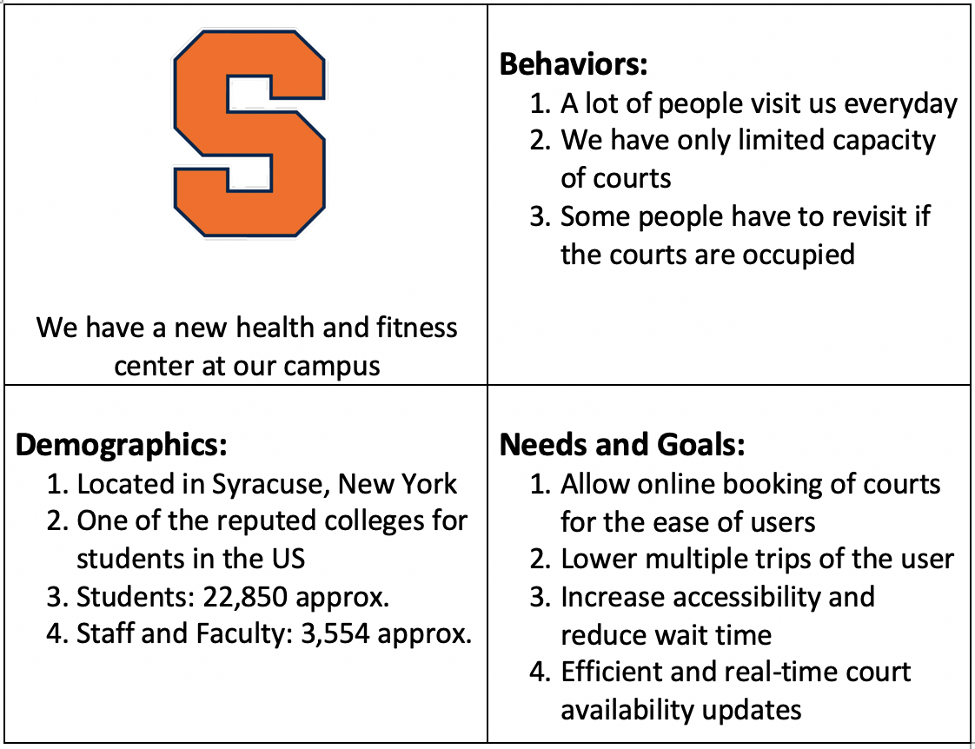
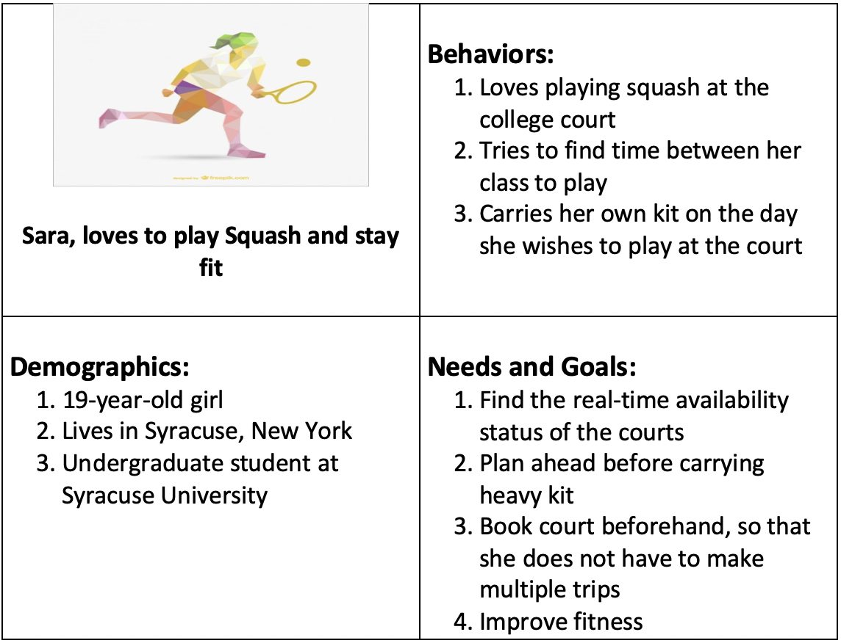
Stakeholders

Slide 6
Technology Stack
We have chosen Amazon Web Services as the cloud provider and we will be using the following services:
Cognito - AWS Cognito is used for secure sign-in for users to access the system. The User Pool feature has a free tier of 50,000 MAUs for users who sign in directly to Cognito User Pools
Elastic Beanstalk - AWS Elastic Beanstalk is easy-to-use service for deploying and scaling web applications and services. API Gateway acts as a "front door" for applications to access data, business logic, or functionality from your backend services

Slide 7
Technology Stack
API Gateway - APIs act as the "front door" for applications to access data and functionality from the backend services. Using API Gateway, you can create RESTful APIs that enable real-time two-way communication applications
Lambda - AWS Lambda is a serverless compute service that runs our code in response to events and automatically manages the underlying compute resources for us
DynamoDB - Amazon DynamoDB is a key-value and document database that delivers single-digit millisecond performance at any scale. DynamoDB can handle more than 10 trillion requests per day and can support peaks of more than 20 million requests per second

Slide 8
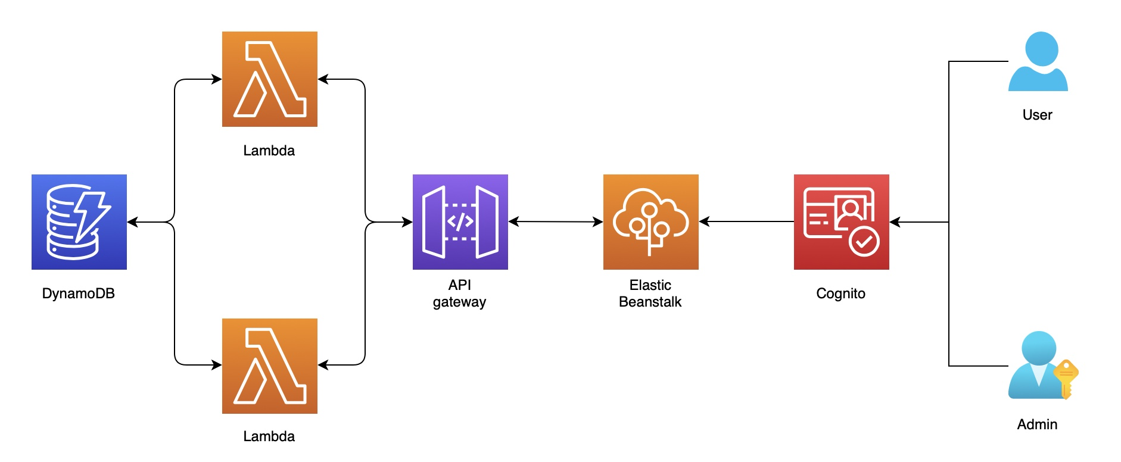
Architecture

Slide 9
Cost Model
Since, this is a university based application, we are expecting a sudden rise in the users after few initial days
The forecasted student enrollment for Syracuse University for the year 2021 is 30,000 students
For the initial month, the number of monthly users expected is around 1500, but given the strong contact between students, it is expected to reach almost the 6000 mark next month
Once the application has reached to all the students, we are expecting a daily traffic of 6000 users, approximately, 20% of the total count of the students

Slide 10
AWS Cognito
Cognito in free tier doesn't charge for 50,000 MAUs (Monthly Active Users)
This free tier is not restricted for the first 12 months only
For implementing additional security features, $0.0050 is charged for each MAU
For additional users (after 50,000), $0.0055 would be charged for each new user
Based on the student statistics and considering all students to be active users;
We will have 30,000 MAUs
Expected Annual Cost: 0.00 USD

Slide 11
Elastic Beanstalk
Elastic Beanstalk has no additional charge besides EC2 instance or S3 bucket charges on which the application is stored and run. We are using EC2
The primary cost for the website deployed on Beanstalk is based on number of EC2 instances and Elastic load balancing running between the instances
We have set load balancer with min and max number of instances as 1. Hence, the pricing will be same as that for EC2 instance
Specification of EC2 incurred by lambda:
OS: Linux, vCPU: 1, Type: t2.micro, Storage: 8 GB, Memory: 8GB
Reservation term: 1 Year, No Up-front Costs
Expected Annual Cost: 23.21 (USD) * 12 (Months) = 278.52 (USD)

Slide 12
API Gateway
API Gateway in free tier provides one million (per month) API calls received for REST APIs for the first 12 months
API Gateway also provides 7,50,000 (per month) connection minnutes in the free tier
After that we are considering 1,80,000 requests per month (considering 6000 daily requests) for 1 API;
Expected API annual cost: 0.63 (USD) * 12 (months) = 7.56 (USD)

Slide 13
Lambda
Lambda in free tire provides 1M free requests per month and 400,000 GB-seconds of compute time per month
We will calculate the costs for Lambda without free tier: The charge is based on the number of requests for your functions and the duration of time it takes for the code to execute. The price for Duration depends on the amount of memory allocated to the function between 128 MB and 308 MB in the increments of 64MB
One API has two methods; so, monthly requests for lambda = 6000 *2 * 30 = 3,60,000
Duration of each request: 100 ms
Amount of memory allocated: 128 MB
Expected Annual Lambda Costs: 0.15 (USD) * 12 (months) = 1.8 (USD)

Slide 14
DynamoDB
DynamoDB has 2 pricing options - “On-Demand” and “Provisioned Capacity”
We will use “Provisioned Capacity” because we can closely forecast the amount of traffic accessing to DynamoDB
Read and Write requests:
0.00013 (USD per readings) * 24 hrs * 250 (Daily requests) = 0.78 (USD Daily)
0.00065 (USD per readings) * 24 hrs * 104 (Daily requests) = 1.62 (USD Daily)
Pricing is based on Core features like Write Capacity Units(WCU), Read Capacity Units(RCU), Data Storage and optional features like backup, DynamoDB Streams
Data Storage:Free tier provides free storage of first 25GB every month, which is sufficient for storing our data
Expected Annual cost for DynamoDB: 2.4 * 30 (monthly) * 12 = 864 (USD)

Slide 15
Cost Model
AWS Services | Monthly Cost | Yearly Cost
AWS Cognito | $0.00 | $0.00
Elastic Beanstalk | $23.21 | $278.52
API Gateway | $0.63 | $7.56
Lambda | $0.15 | $1.80
DynamoDB | $72.00 | $864.00
Total Cost for AWS Services | $95.99 | $1151.88

Slide 16
Revenue Model
Services | Per Unit Cost | Required Quantity | Total Cost ($)
AWS Services | $1152 | 4 | 4,608
Developer Cost | $30*80 (hours) | 6 | 14,400
Fixed Cost |  |  | 19,008
Yearly Maintenance | $600 | 4 | 2400
Yearly Renewal Cost | 20% of Fixed Cost | 1 | 3,801
Variable Cost |  |  | 6,201

Slide 17
Demo Features
The system allows any student user to login to the system using his/her credentials
The user will be able to book any slot for any activity that they wish to book for the particular day
The details of the booking are stored into the system and the user can see available slots for the particular day

Slide 18
Future Goals and Expectations
In the future, we would like to extend the system to have additional features such as RFID functionalities
Getting the ‘https’ port enabled on Elastic Beanstalk so that the we can integrate AWS Cognito for users to sign in
The system would be extended to include bookings for next 7 days by integrating calendar services for date and time
Adding functionalities for cancellation of a booking to the system can be included. If a user does not show up, booking will be reserved for 15 minutes, after that the room will become ‘available’.

Slide 19
Thank You!

