Slide 1
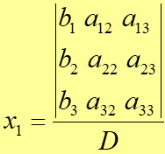

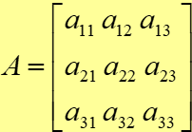




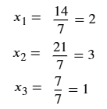
Cramer’s Rule
Example:
D =
= 7
= 14
In the first tutorial, the last 2 questions were to obtain nodal and mesh equation in the form Ax = b, [G]v =i or [R]i = v just by inspection.
You can use Cramer’s rule to obtain the node voltages and mesh currents.
= 21
= 7

Slide 2
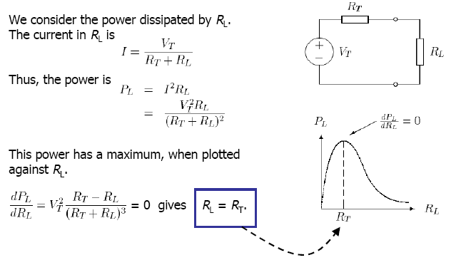
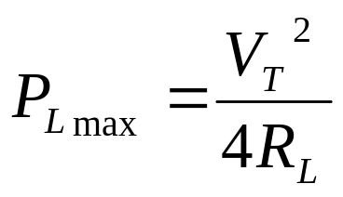
Maximum Power Transfer Theorem
Max. Power

Slide 3







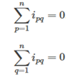
Tellegan’s Theorem
In a lumped network, at any instant in time, the sum of the instantaneous power delivered to all branches in a network is zero.
Valid for any lumped network (linear or nonlinear, passive or active, time varying or time invariant)
Ipq current flowing through branch K between the nodes p and q

Slide 4
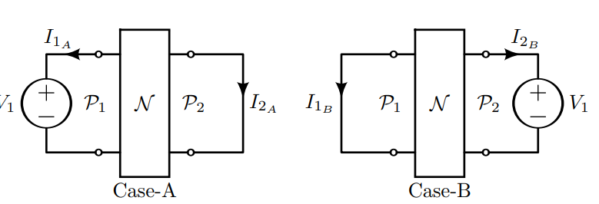
Reciprocity Theorem
In a linear, bilateral two-port network with a single source, the ratio of excitation to response is constant even though the source is interchanged from input terminals to the output terminals.
The passive (resistive) network N has two ports P₁ and P₂. An excitation voltage V₁ is applied at P₁, and the short circuit current is measured at P₂ as I₂. Then, if we apply the same excitation V₁ at P₂, the short circuit current measured at P₁ will be I₂.

Slide 5
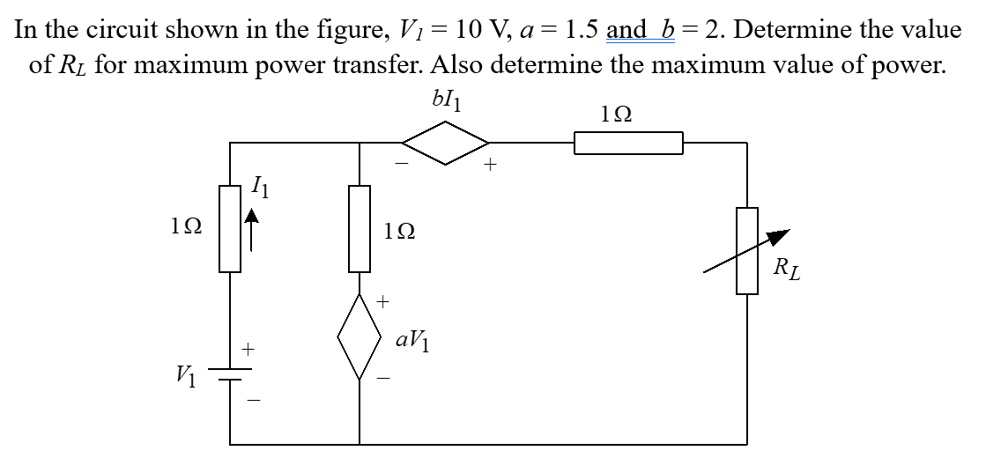
Problems

Slide 6
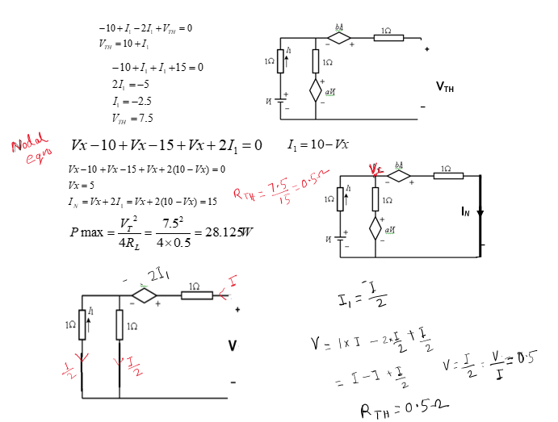
Another method for R_{TH}

Slide 7
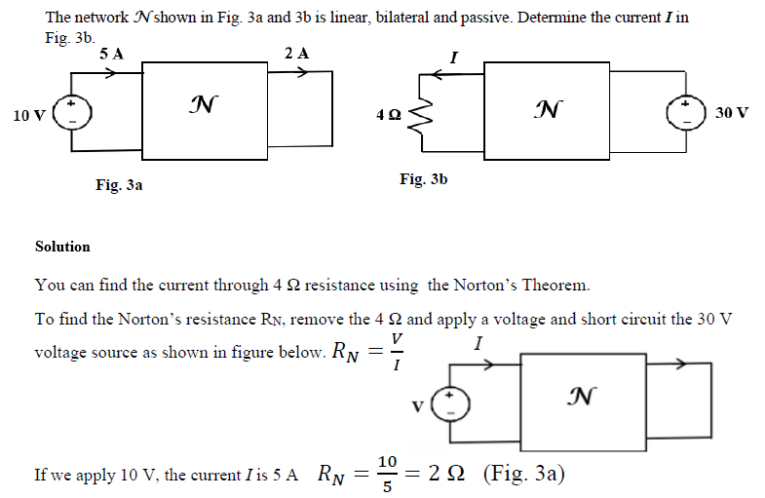

Slide 8
