Slide 1
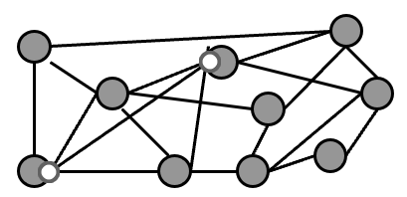
Network Topology (Graph Theory)
What are Graphs?
General meaning in everyday math:
A plot or chart of numerical data using a coordinate system.
Technical meaning in discrete mathematics:
A particular class of discrete structures that is useful for representing relations and has a convenient graphical representation.
Apps in networking, scheduling, flow optimization, circuit design, and path planning

Slide 2
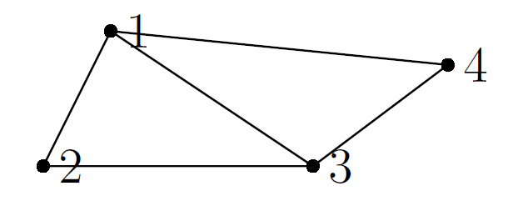
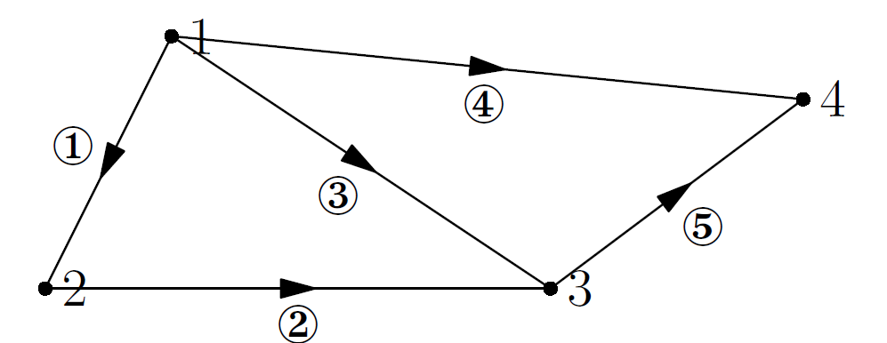
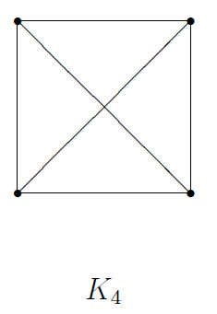
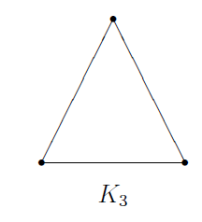
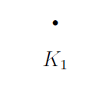

Network Topology (Graph Theory)
A simple graph G = (V,E) consists of V , a nonempty set of vertices, and E, a set of unordered pairs of distinct elements of V called edges.
A graph is a collection of nodes joined by edges (branches).
An undirected graph
A directed graph
The complete graph of n vertices, denoted by Kn, is the simple graph that contains
exactly one edge between each pair of distinct vertices.
The graph Kn for n = 1, 2, 3, 4, 5, 6 are displayed as follows

Slide 3
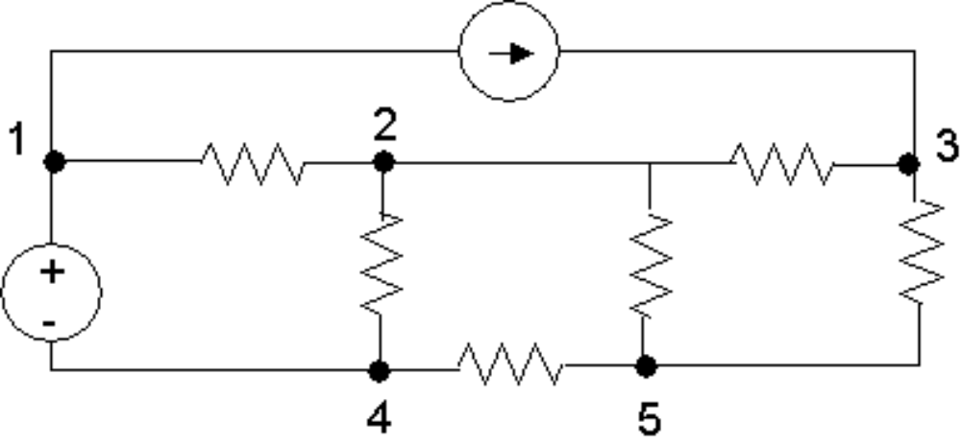
Graph Theory in Circuit Analysis
Whether the circuit is input via a GUI or as a text file, at some level the circuit will be represented as a graph, with elements as edges and nodes as nodes.
For example, when entering a circuit into PSpice via a text file, we number each node, and specify each element (edge) in the circuit with its value and endpoints.

Slide 4
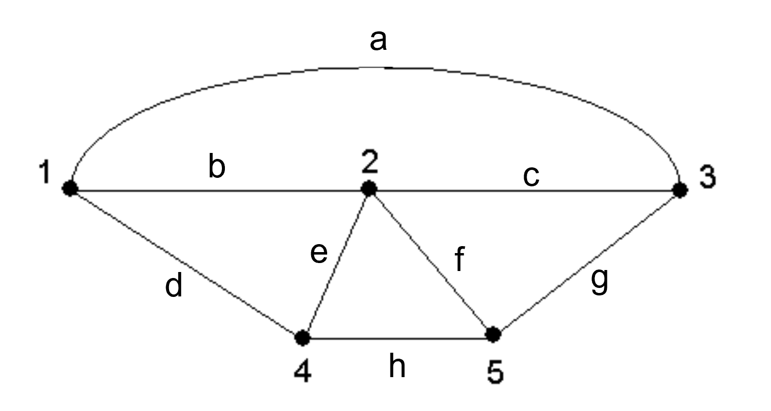
Graph of a Circuit
Here is a graph of the circuit. It is simply the circuit without elements.
We refer to the lines above as edges (and the nodes are nodes).
The graph provides connectivity information. To actually solve the circuit using this graph, the types of elements forming the edges would need to be provided.

Slide 5
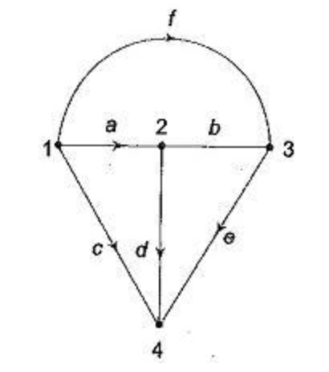
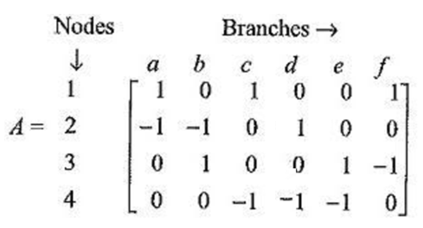
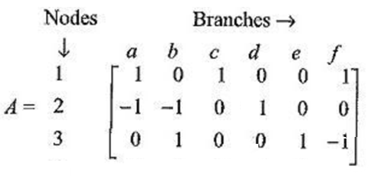
Incidence Matrix
The incidence matrix of this directed graph has one column for each node of the graph and one row for each edge of the graph:

Slide 6
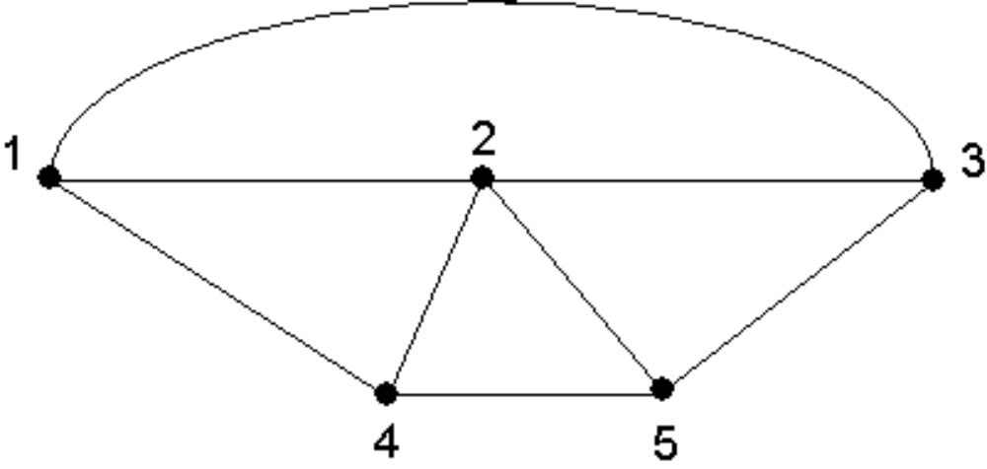
Trees and Co-Trees
a
b
c
e
f
d
g
h
A tree is defined as any set of edges in a graph that touches every node without forming any closed paths.
Each tree has a co-tree, which is the set of edges not in the tree.

Slide 7
Cut Set
a
b
c
e
f
d
g
h
A cut set is a minimal set of edges that, when broken, breaks the graph into two completely separate parts (two groups of nodes.
Minimal means that a cut set cannot contain another smaller cut set that would break the graph into the same two parts.

Slide 8
Fundamental Cut Set
a
b
c
e
f
d
g
h
A fundamental cut set w.r.t. that tree is a cut set that only contains one branch of the tree.
There may be many fundamental cut sets w.r.t. a given tree.

Slide 9
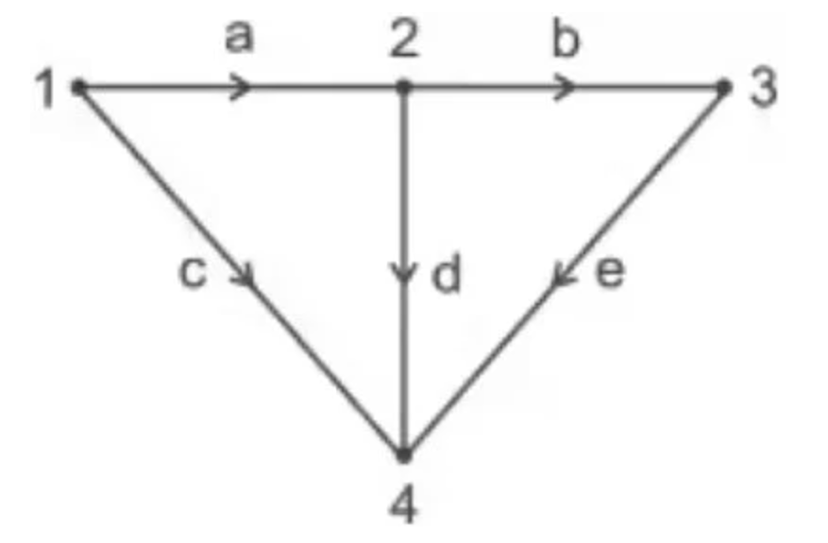
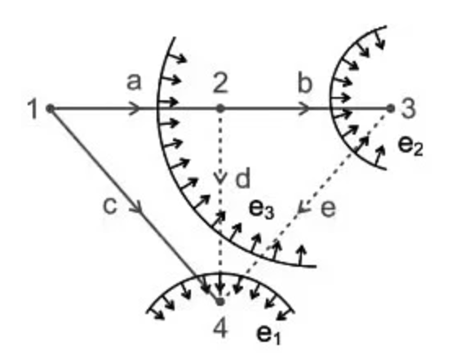
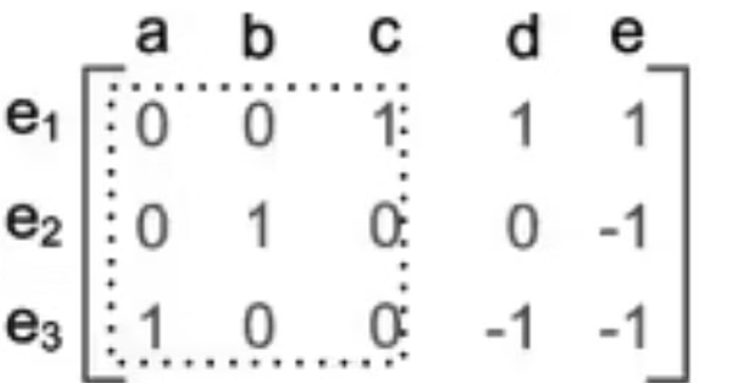
Example: Fundamental Cut Set Matrix

Slide 10
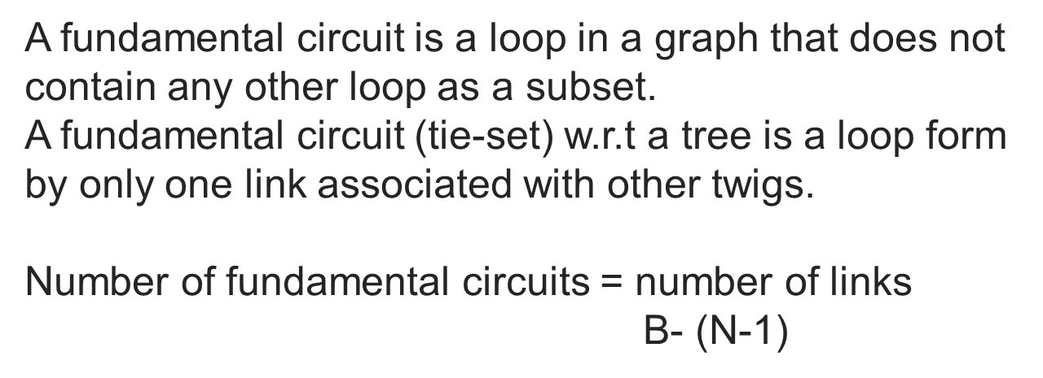
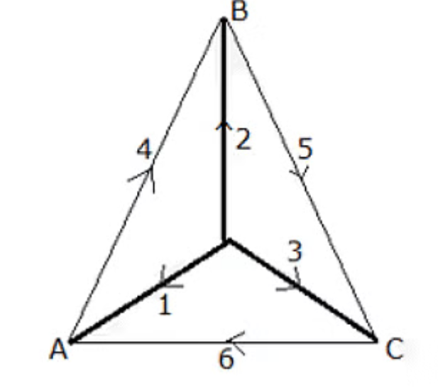
Fundamental Circuits

Slide 11
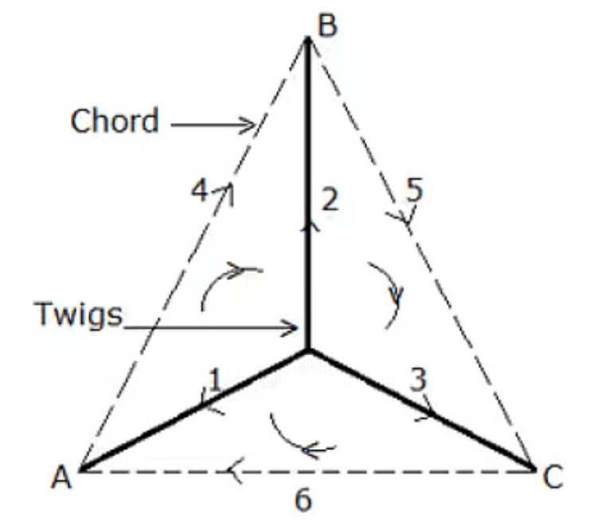
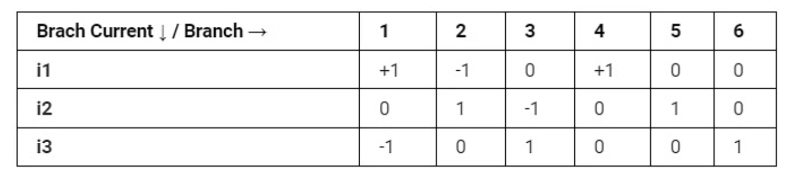
Example: Fundamental Circuit (Tie-set) Matrix

