Slide 1
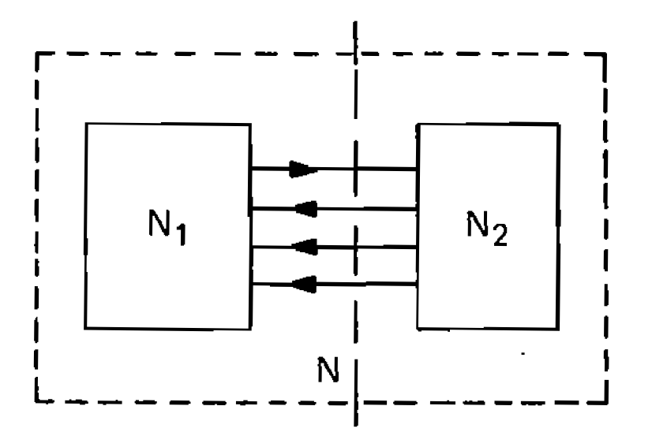
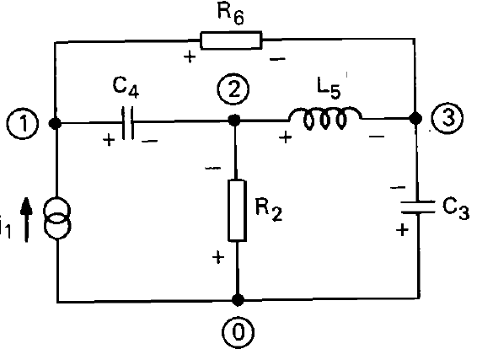
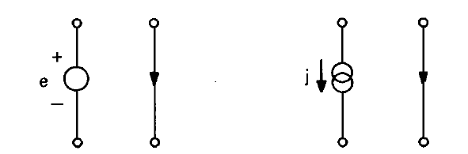

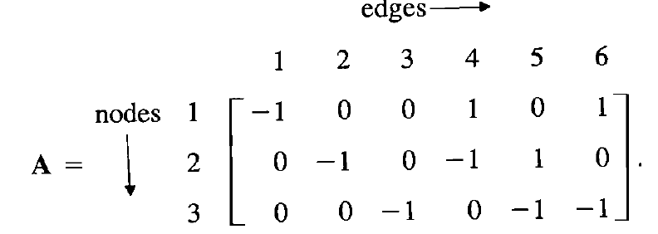
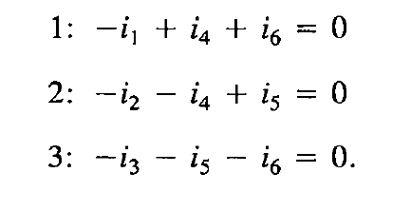
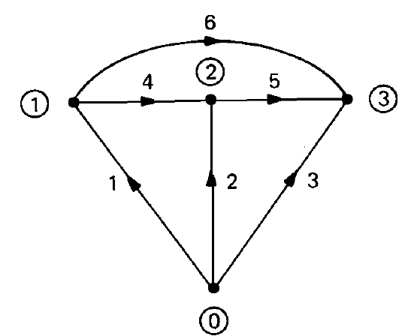
Graph-Theoretic Formulation of Network Equations
Generalization of KCL
N is internally portioned into N₁ and N₂ joined by a number of interconnections.
Ai =0 where A is the incidence matrix

Slide 2
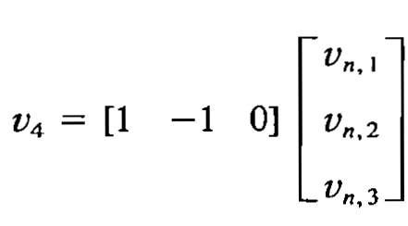
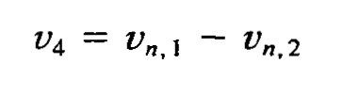
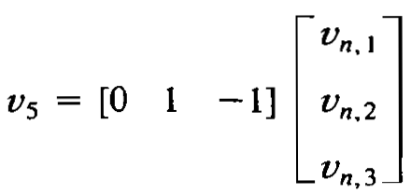
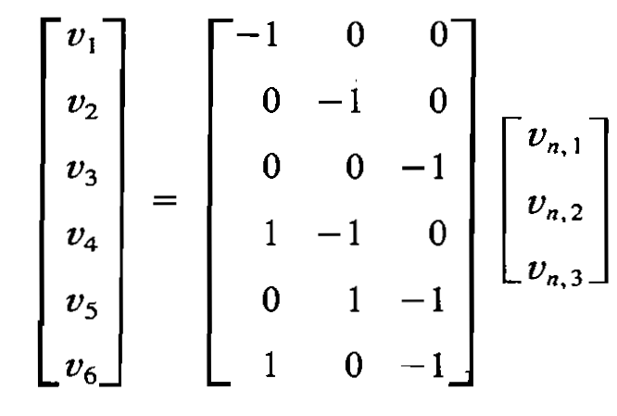



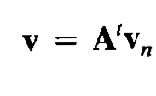
KVL and Incidence matrix
The voltage of the i^{th} node w.r.t the reference node is v_{n,i.}
_{The voltage of branch 4 is}
_{The voltage of branch 4 is}
where A^{t} is the transpose incidence matrix A

Slide 3
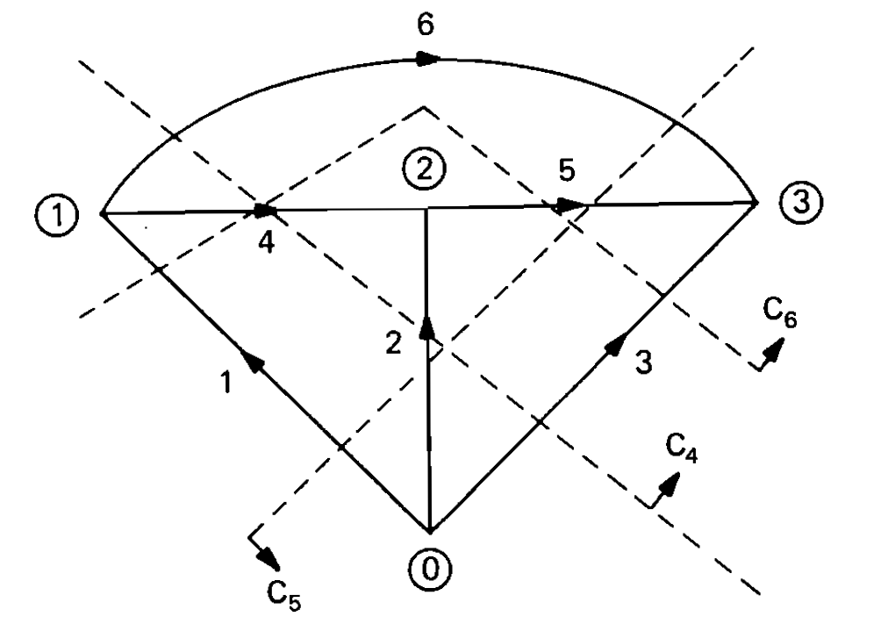
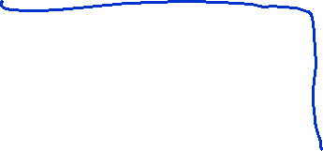
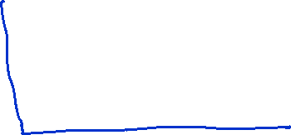
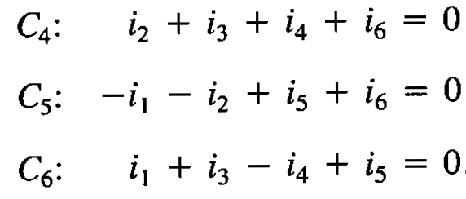
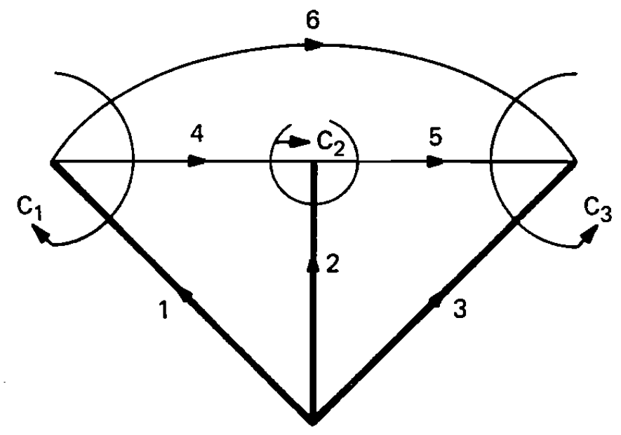
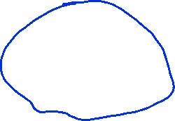
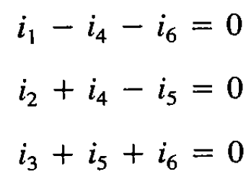
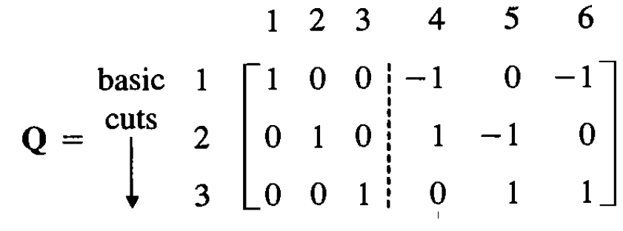
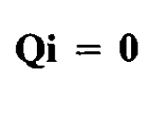
Cutset and KCL
Directed graph with additional cuts
Directed graph with a tree
Number the twigs (tree branches 1,2,3 and then number chords (co-tree branches) 4,5, 6

Slide 4
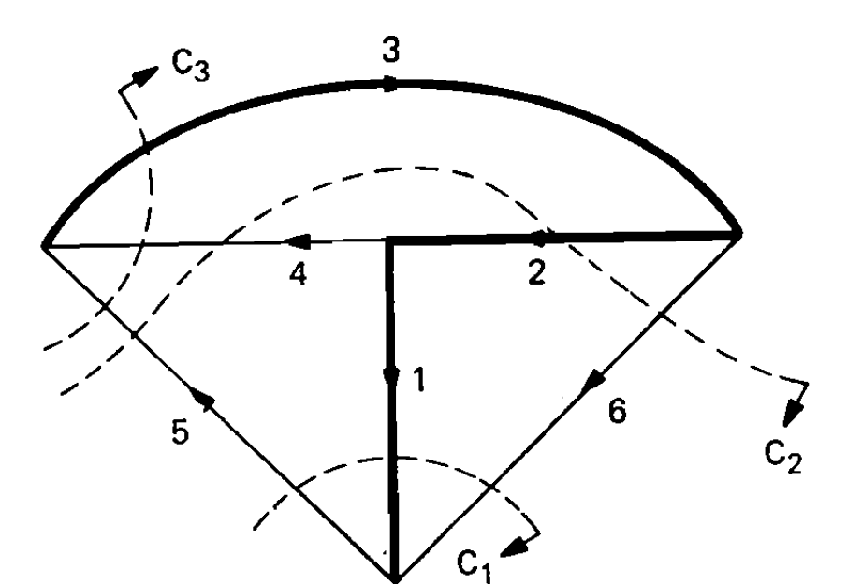
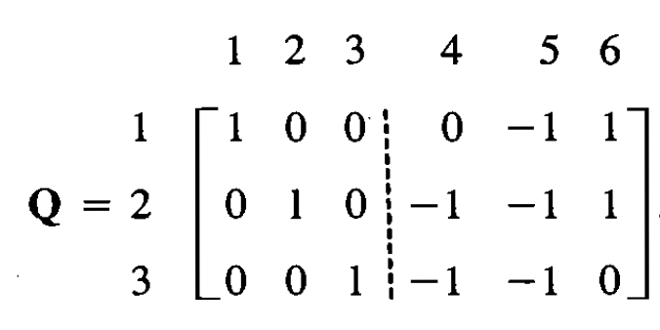


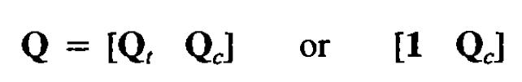
KCL with another tree
t stands for tree and c for co-tree. 1 stands for unity matrix

Slide 5
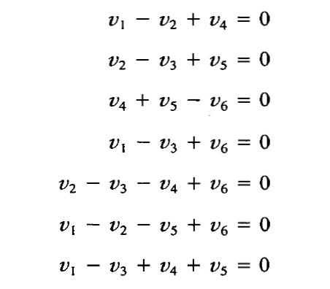
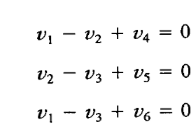

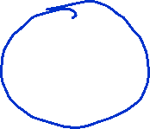

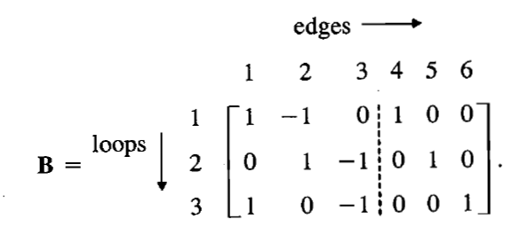

Tieset and KVL
4,5 and 6 the links

Slide 6
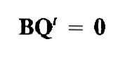

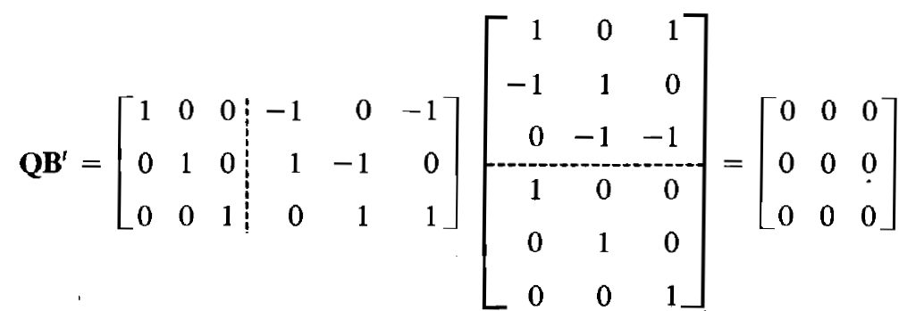
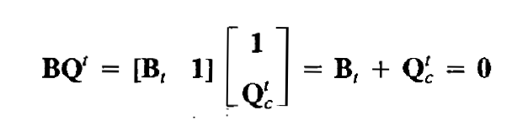



Orthogonality relations for Q and B
Arrange the columns of Q and B in the same sequence of edges

Slide 7
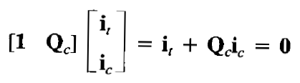

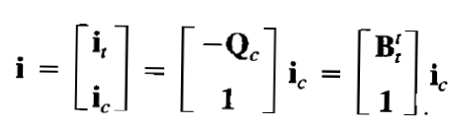

Independent Current and Voltage equations
Branch currents and voltages in terms of a smaller number of independent equations
Qi = 0 where i is the vector of all branch currents
All the branch currents are obtained in terms of link (chord) currents.

Slide 8
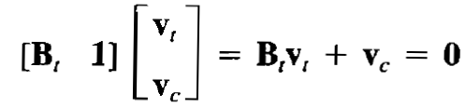

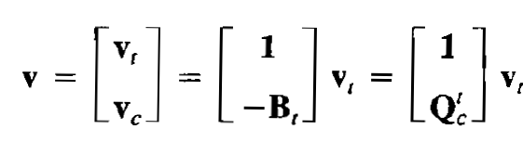

Bv=0 where v is the vector of all branch voltages
All the branch voltages are obtained in terms of tree branch (twig) voltages.

Slide 9
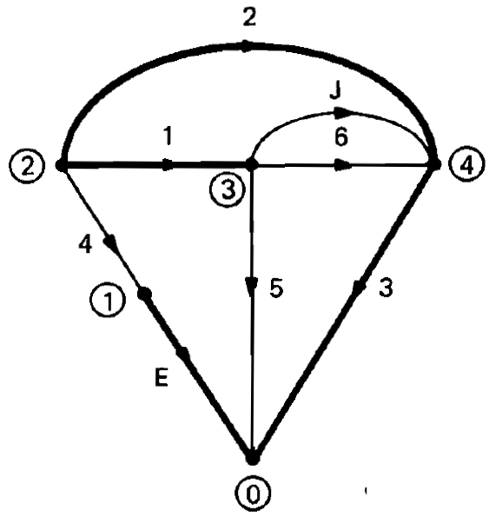
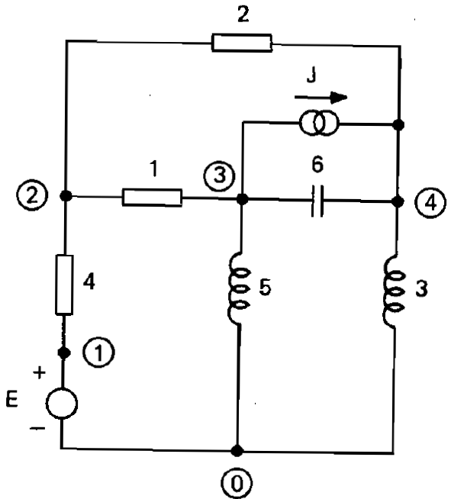
Voltage and current sources in graphs
All the current sources are placed in the cotree.
All the voltage sources are placed in the tree.
Represent all the voltage sources in the tree branches (nos. 1,2..
Complete the tree by taking branches of passive elements (no. Cont)
Continue numbering the remaining passive branches
Then number the current sources

Slide 10
