Slide 1
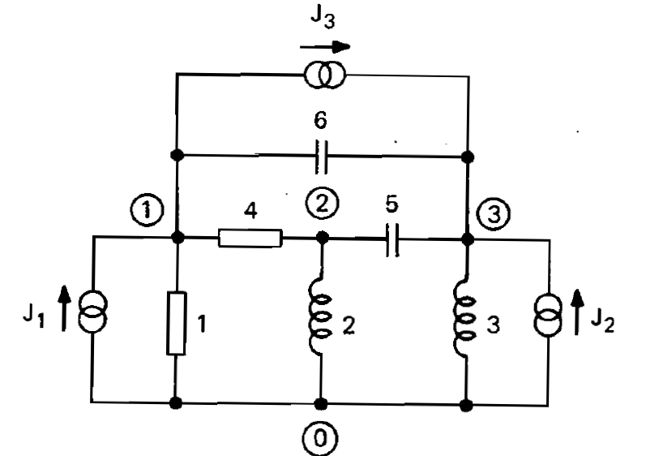
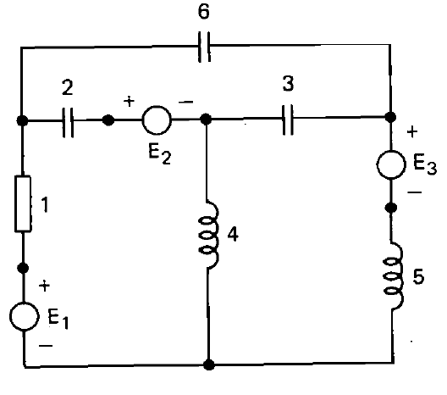












NODAL AND MESH (LOOP) EQUATIONS

Slide 2

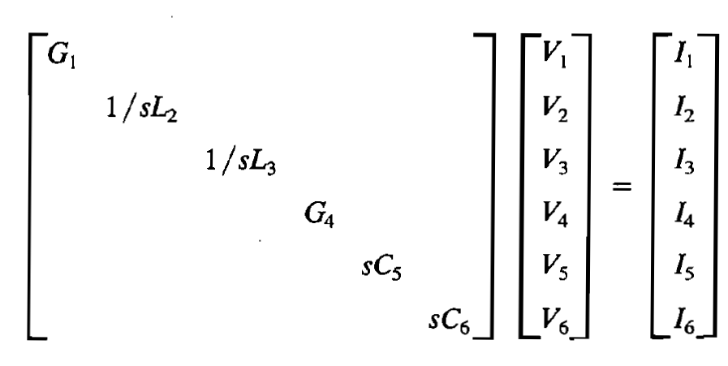
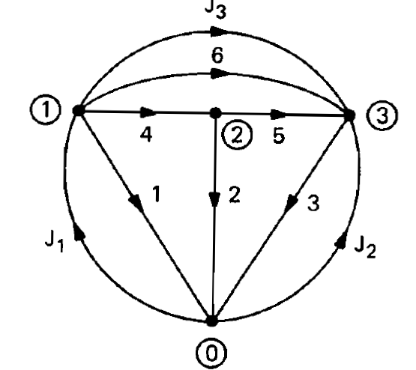
Formulation of Nodal Equations
Branch admittance Yb branch current Ib and branch voltage Vb
All matrices.
All voltage sources are converted into current sources.
KCL AI =0 A is the incidence. matrix
Let Aa is the augmented matrix (Augmented with the current sources).

Slide 3


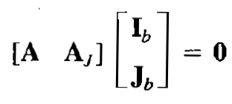





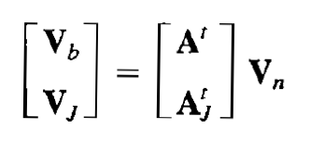
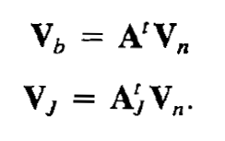

Slide 4

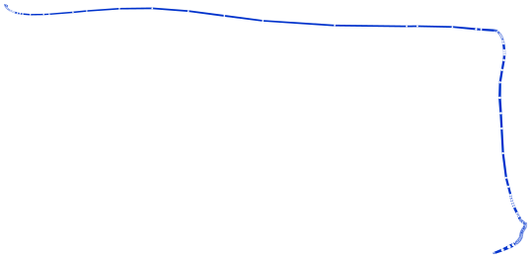
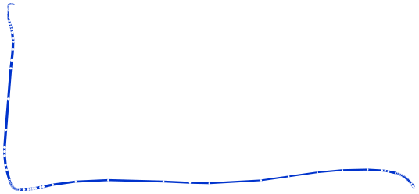


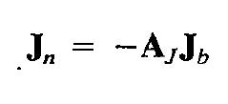



Slide 5

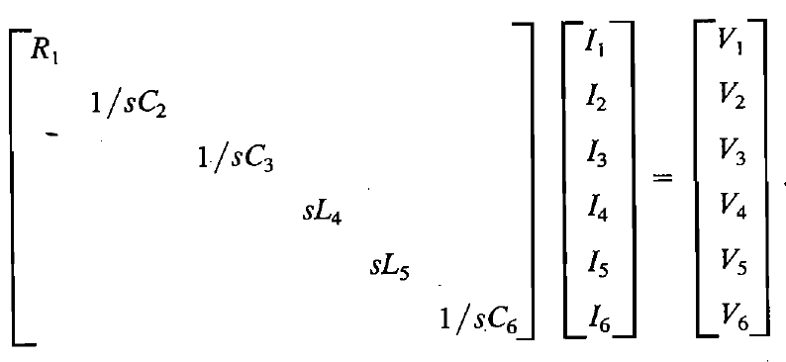
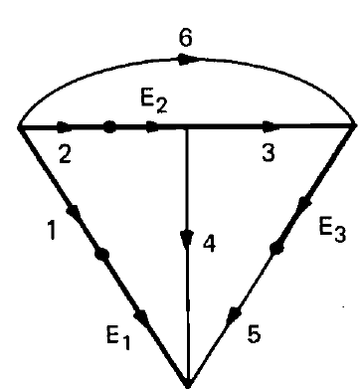
Formulation of Loop Equations
Branch impedanceZb branch current Ib and branch voltage Vb
All matrices.
All current sources are converted into voltage sources.
KVL Bv =0 B is the f-tieset matrix
Let Ba is the augmented matrix (Augmented with the current sources).

Slide 6


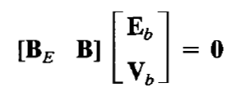




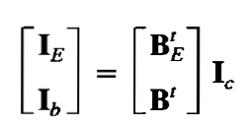

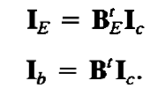

Slide 7

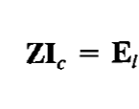
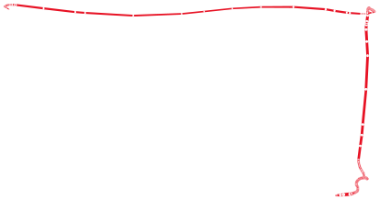













Slide 8

