Slide 1
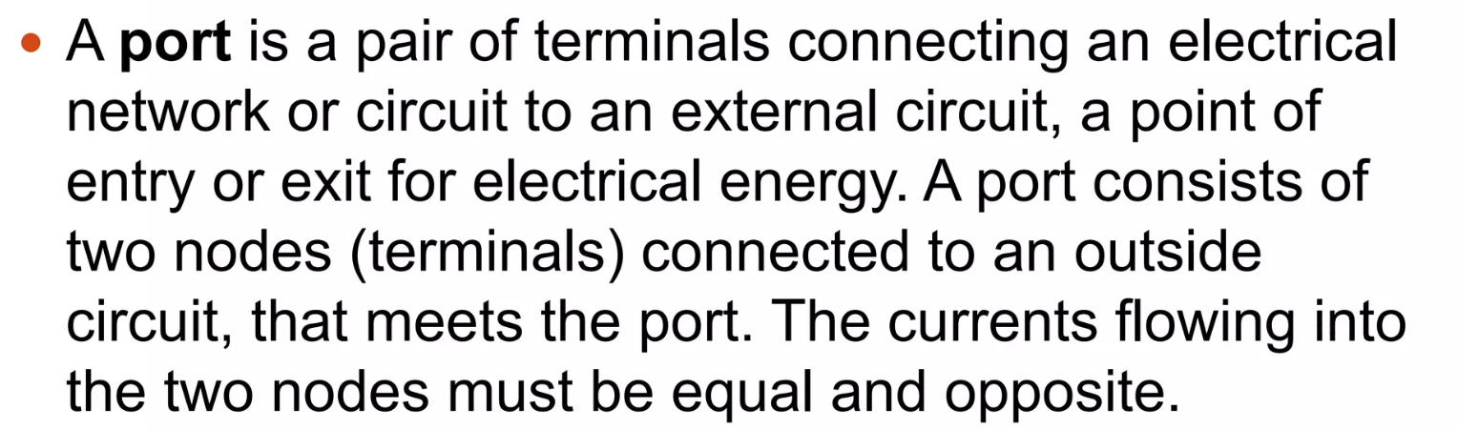
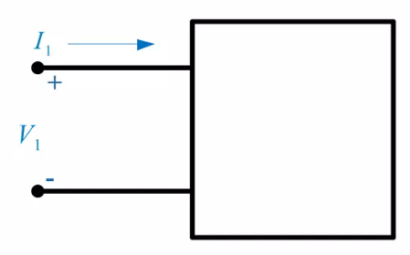
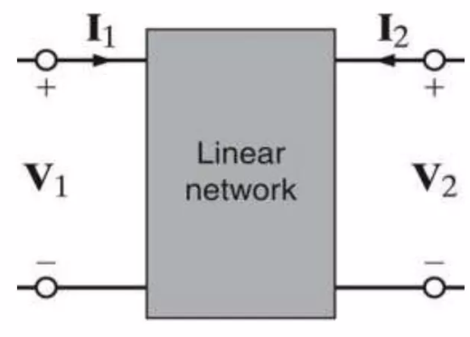
Network Functions
One-port and two-port networks
1-port network
2-port network
In 2-port network, port 1 is considered as input port. Port 2 is output port
Inside the network, there is no independent sources

Slide 2

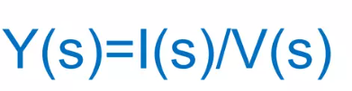
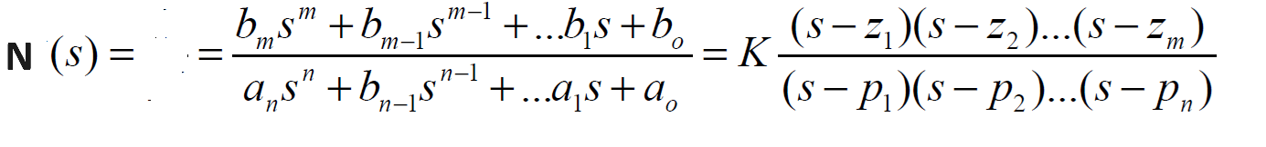
Network function is defined as the Laplace transform of the output divided by the Laplace transform of the input when initial conditions are zero.
Network functions of one-port networks are driving point impedance and admittance functions.
Network functions of two-port network networks are driving point and transfer functions.
Z₁₁(s),Y₁₁(s),Z₂₂(s),Y₂₂(s) Driving point functions
G₁₂(s),α₁₂(s),Z₁₂(s),Y₁₂(s) Transfer functions
G₁₂(s) = V₂(s)/V₁(s) Voltage Transfer Function
K=bm/an
z1, z2,….. zeros of N(s) p1, p2, … are poles of N(s)

Slide 3
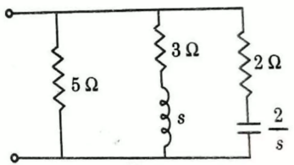
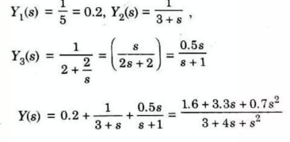
Find the driving point admittance function Y(s) of the following network.

Slide 4
Network function models
Transfer function of the typical elements of linear networks
A linear system can be regarded as the composing of several typical elements, which are:
1 Proportioning element
Relationship between the input and output variables:
i(t) =k v(t)
Transfer function:
Block diagram representation and unit step response:
Examples:
amplifier, gear train,
tachometer…

Slide 5
2 Integrating element
Relationship between the input and output variables:
Transfer function:
Block diagram representation and unit step response:
Examples:
Integrating circuit, integrating motor, integrating wheel…

Slide 6
3 Differentiating element
Relationship between the input and output variables:
Transfer function:
Block diagram representation and unit step response:
Examples:
differentiating amplifier, differential valve, differential condenser…

Slide 7
4 First Order Systems
Relationship between the input and output variables:
Transfer function:
Block diagram representation and unit step response:
Examples:
RC circuits

Slide 8
5 Second Order System
Relationship between the input and output variables:
Transfer function:
Block diagram representation and unit step response:
Examples:
oscillator, oscillating table,
oscillating circuit…

Slide 9
6 Delay element (Transportation Lag)
Relationship between the input and output variables:
Transfer function:
Block diagram representation and unit step response:
Examples:
gap effect of gear mechanism, threshold voltage of transistors…

Slide 10
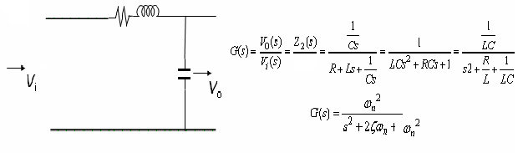
An Example-Second Order System
z₁(s)+z₂(s)
R=1;
L=.4;
C=1e-3;
n=1;
d=[L*C R*C 1];
s=tf(n,d)
1
------------------------
0.0004 s^2 + 0.001 s + 1
ω_{n}=sqrt(1/(L*C))= 50
ζ=(R/2)*sqrt(C/L)=0.0250

Slide 11
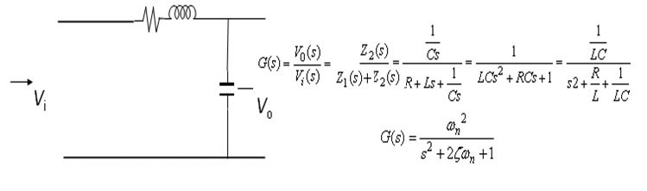
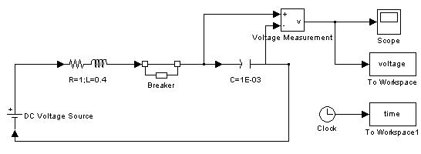
An Example
R=1;
L=.4;
C=1e-3;
n=1;
d=[L*C R*C 1];
s=tf(n,d)
1
------------------------
0.0004 s^2 + 0.001 s + 1
ω_{n}=sqrt(1/(L*C))= 50
ζ=(R/2)*sqrt(C/L)=0.0250

Slide 13
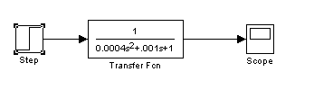
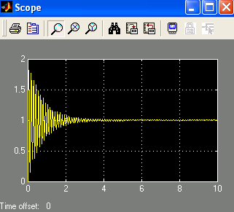
Step response

