Slide 1


State Variable Analysis of Networks
System variable: Any variable that responds to an input or initial conditions in a system.
State variables: The smallest set of linearly independent system
variables such that the values of the members of the set at time
along with known forcing function completely determine the value of all system variables for all .
Sate vector: A vector whose elements are the state variables.
State space: The n-dimensional space whose axes are the state variables.
State equations: A set of n simultaneous, first-order differential equations with n variables, where the n variables to be solved are the state variables.
Output equation: The algebraic equation that expresses the output variables of a system as linear combinations of the state variables and the inputs.

Slide 2
State: The state of a dynamic system is the smallest set of variables (called state variables) such that the knowledge of these variables at t= t₀, together with the knowledge of the input for t >= t0, completely determines the behavior of the system for any time t >= t₀.
The state of a system may be considered to be the minimal amount of information necessary at any time to completely characterise any possible future behaviour of the system.
The concept of a state is applicable to mechanical systems and other systems such as biological, economical, social systems.

Slide 3
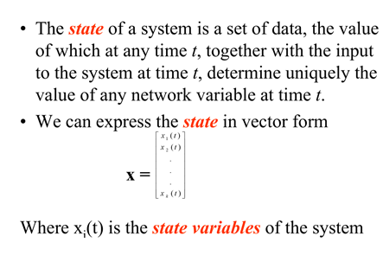

Slide 4
Applying the state space representation
Minimum number of state variables that describe the state of the system completely
Components of the state vector should be linearly independent.
How do we estimate?
The order of the differential equation
The number of independent energy storage elements of a system

Slide 5
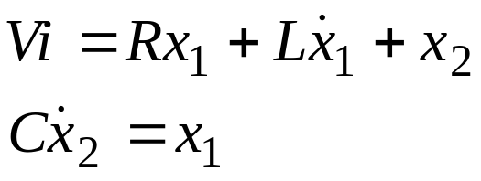
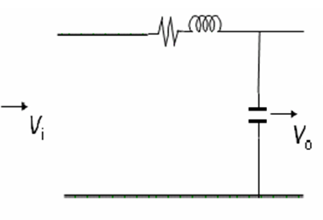
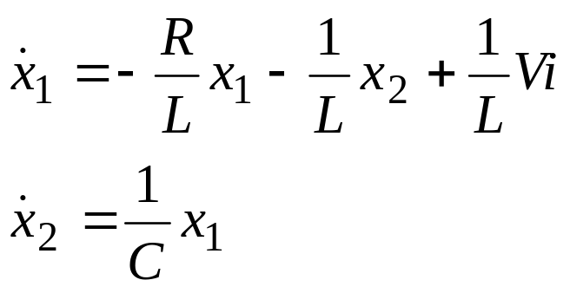









State equations of an RLC circuit
Capacitor voltage x2 and inductor current x1 are the state variables
A=[-R/L -1/L;1/C 0];

Slide 6
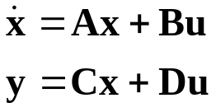



A system is represented in state space by the follwing
equations:
for and initial conditions, ,where
state vector
derivative of the state vector with respect to
time
output vector
input or control vector
system matrix
input matrix
output matrix
feedforward matrix

Slide 7
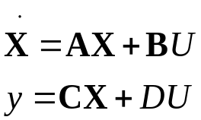
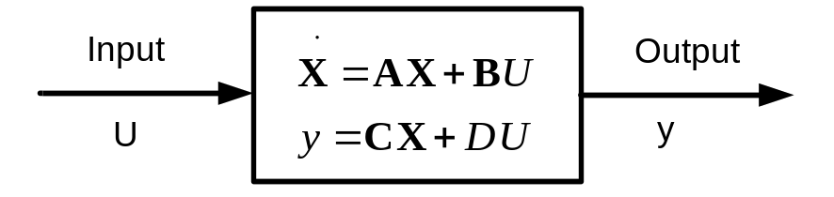
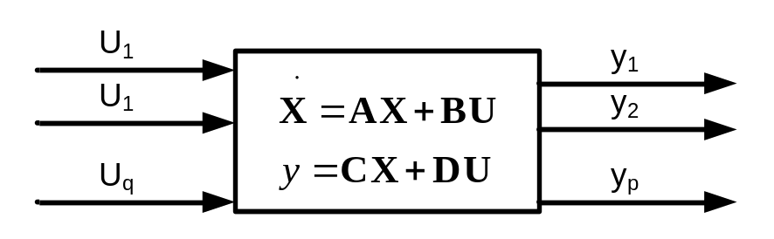
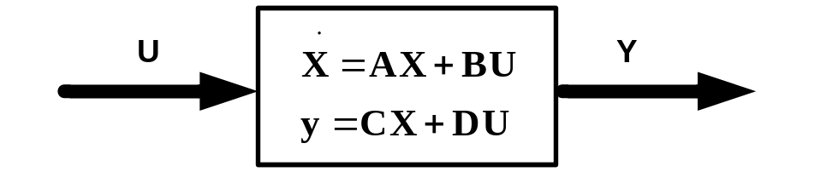
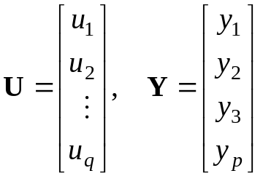
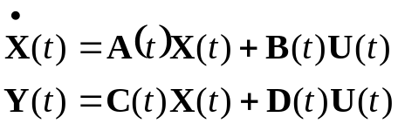
State Space

Slide 8
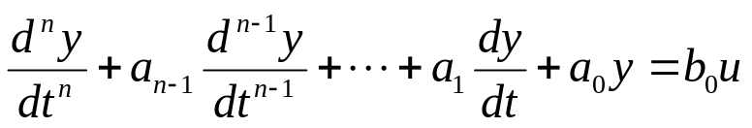
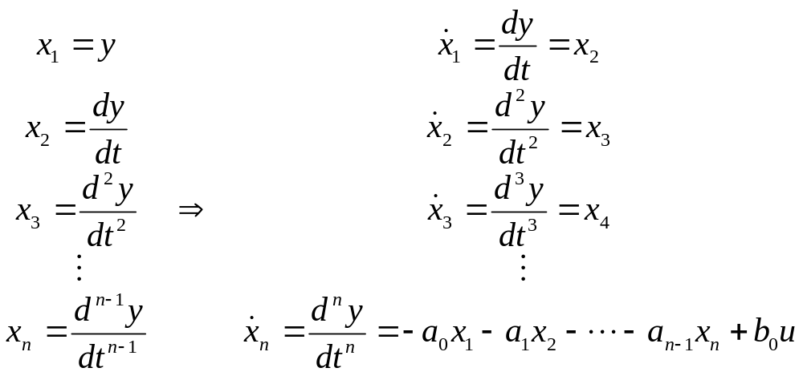
Converting a diff.equation to State variable form
A set of state variables is called phase variables, where each subsequent state variable is defined to be the derivative of the previous state variable.
Consider the differential equation
Choosing the state variables

Slide 9
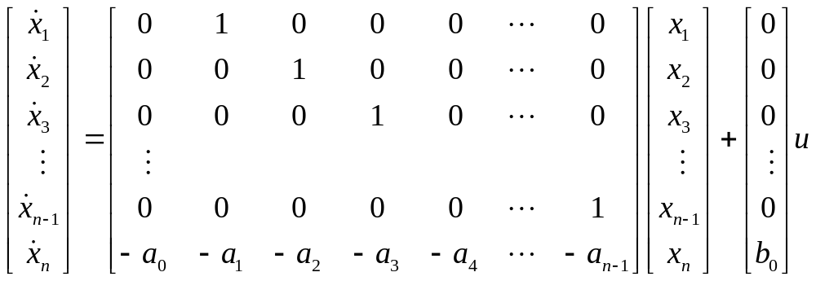
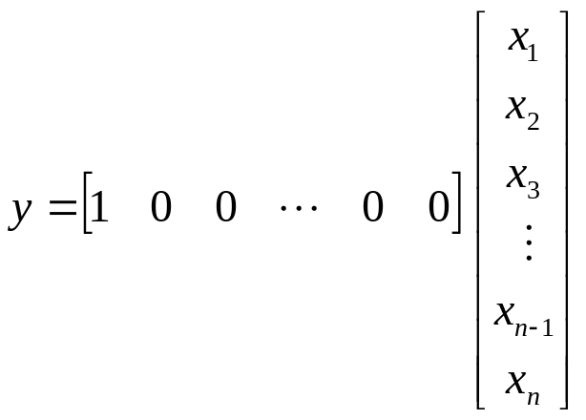

Slide 10

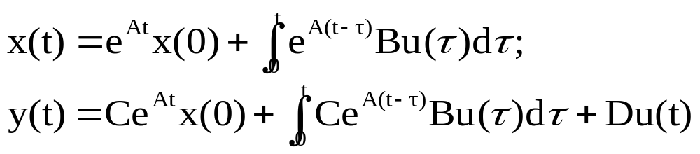
State-Space Solutions
The system:
Given x(0) and u(t) for t ≥ 0. The solution for x and y is
Another approach is by using Laplace transform:

Slide 11
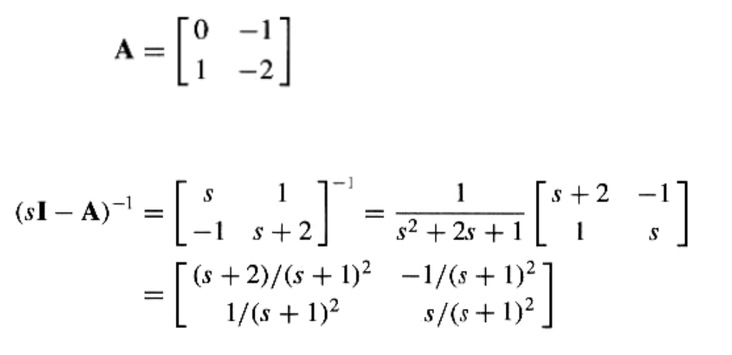

Slide 12
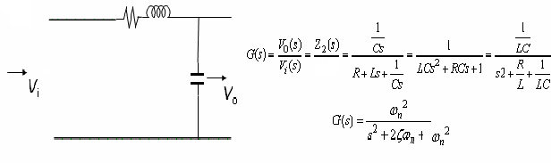
This example is from the previous slides. Here we can find the state space representation
z₁(s)+z₂(s)
R=1;
L=.25;
C=4;
n=1;
d=[L*C R*C 1];
s=tf(n,d)
1
-------------
s^2 + 4 s + 1
ω_{n}=sqrt(1/(L*C))= 50
ζ=(R/2)*sqrt(C/L)
t=0:20;
y=1+.0774*exp(-3.732*t)-1.0774*exp(-.2679*t);

Slide 13
A=[-R/L -1/L;1/C 0];
eig(A)
ans =
Eigenvalues of A matrix and poles of transfer function are same
-3.7321
-0.2679

Slide 14
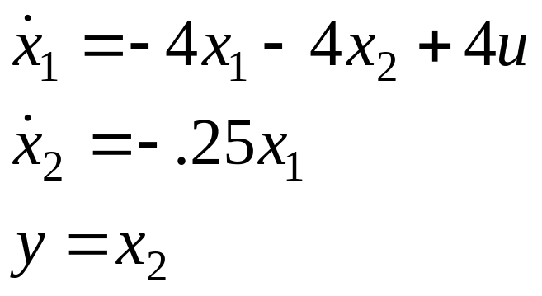
State Equations
u=1
dif.m
function c= dif(t,x);
A=[-4 -4; 0.25 0];
B=[4;0];
c=A*x+B;
This in an m file named dif
x0=([0;.0]);
ts=[0 20];
[t,x]=ode23('dif',ts,x0);
Copy this in command window

Slide 15
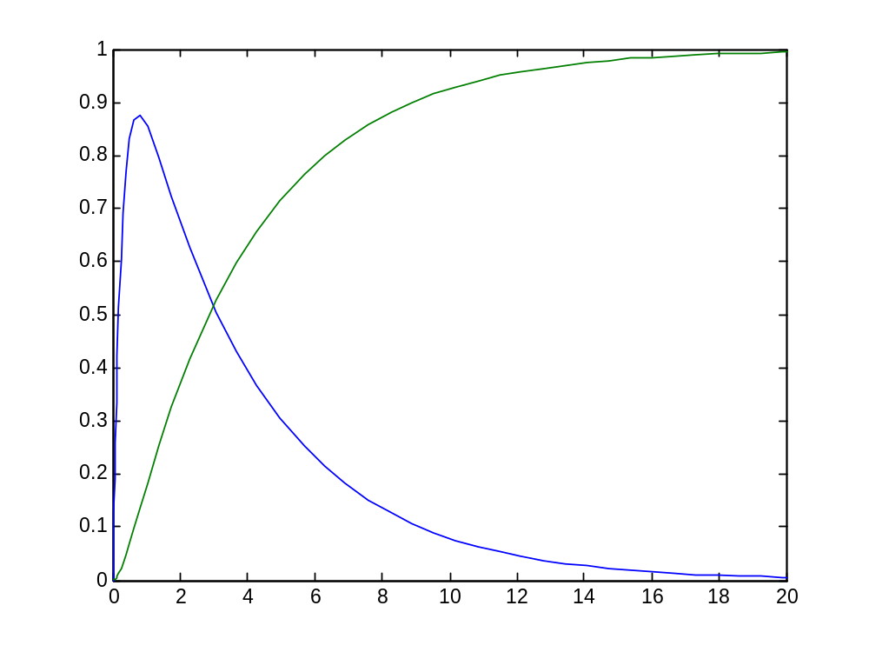
Plot(t,x)

Slide 16
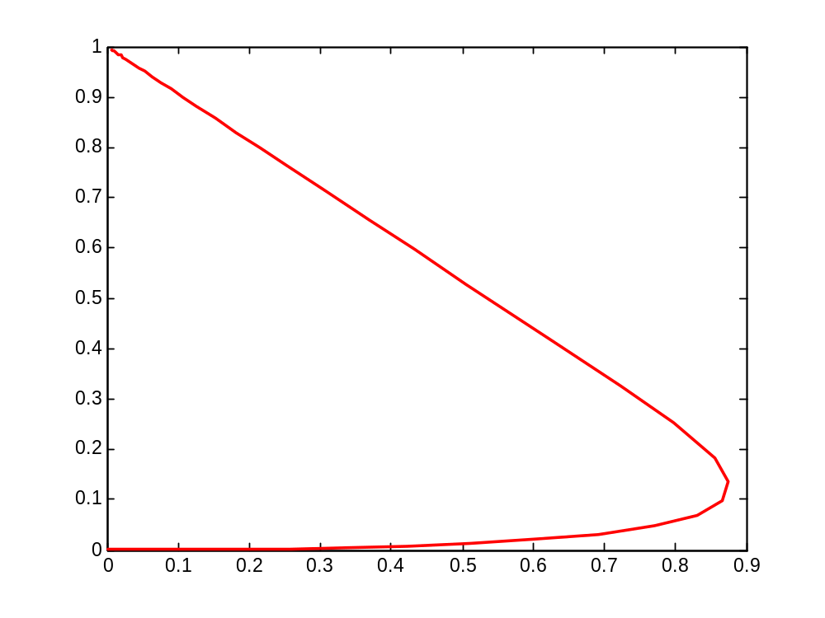
plot(x(:,1),x(:,2))

Slide 17
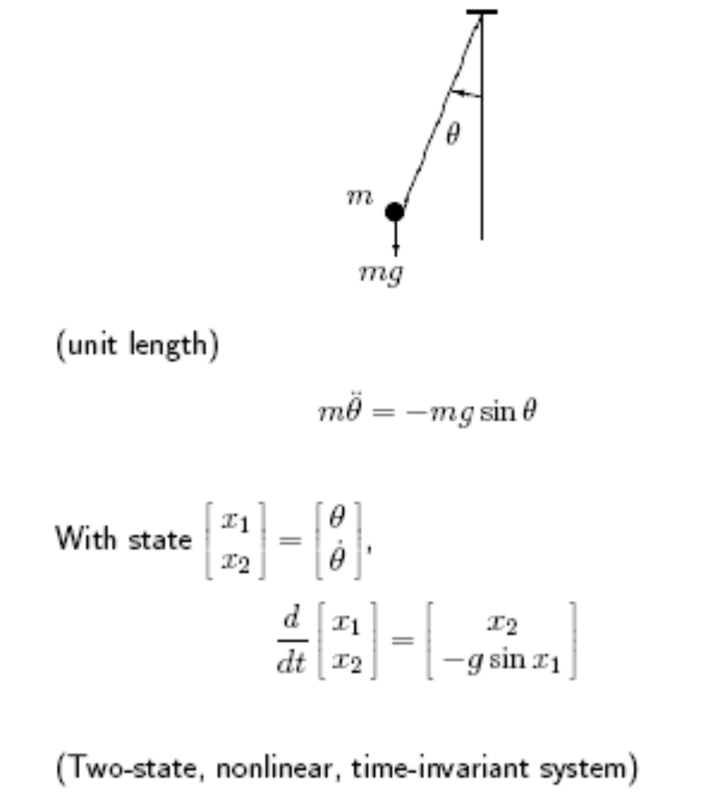
Simple Pendulum

Slide 18
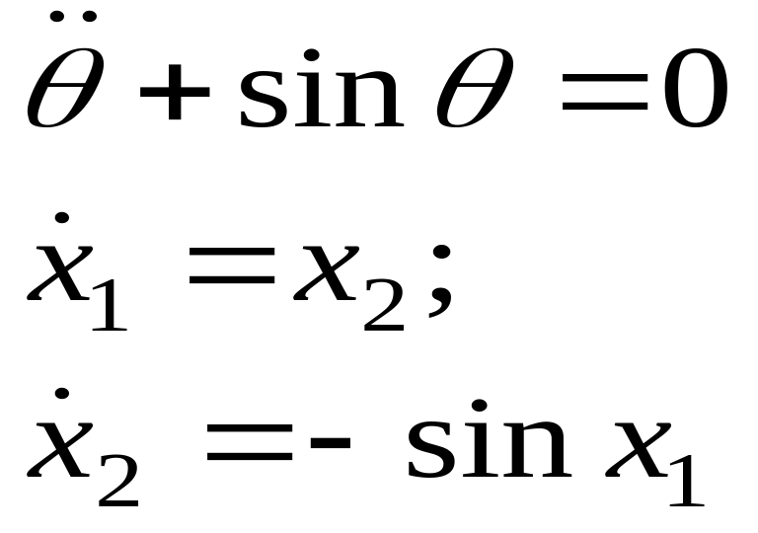
Simple Pendulum
Assume m=g=1
function c= pend(t,x);
c=[x(2);-sin(x(1))];
ts=[0 20];
x0=[.5;-.5];
[t,x]=ode23('pend', ts,x0);
plot(x)
plot(x(:,1),x(:,2))

Slide 19
A system is represented in state space by the follwing
equations:
for and initial conditions, ,where
state vector
derivative of the state vector with respect to
time
output vector
input or control vector
system matrix
input matrix
output matrix
feedforward matrix

Slide 20


Solving linear state equations
is called the state transition matrix
When u = 0 X(t) can be determined as

Slide 21
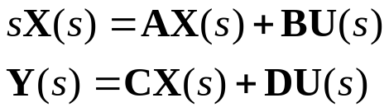





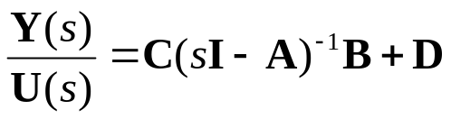
Converting from state space to a transfer function
Given the state and output equations
Take the Laplace transform assuming zero initial conditions:
(1)
(2)
Solving for in Eq. (1),
or
(3)
Substitutin Eq. (3) into Eq. (2) yields
The transfer function is

