Slide 1
EEC 201- Network Theory

Slide 2
Network theory and Field Theory
All electrical and magnetic phenomena can be explained in terms fields resulting from charge and current (Maxwell’s equation). Then why another theory?
For practical matter, we need only current and voltage. Simple concept,
Circuit theory is based on approximations and assumptions.
Field theory is more general, no assumptions.

Slide 3
Please revise the following which you studied in the earlier course:
Charge, current, voltage, power, energy, circuit elements(R,L,C), independent sources, dependent sources, source transformation, KVL, KCL, mesh analysis, nodal analysis.
Course Syllabus Outline:
Network Theorems, Network Topology, Transients, Network functions, Single and two-port networks, Three-phase circuits, AC circuits with non-sinusoidal inputs, magnetic circuits.

Slide 4
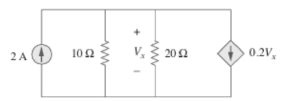

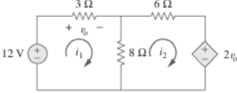
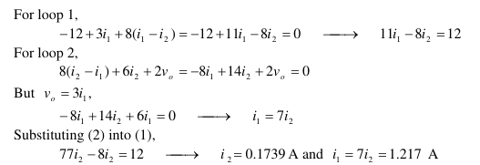
Examples-Nodal and Mesh Analysis

Slide 5


Linearity
Basically, a mathematical equation is said to be linear
if the following properties hold:
homogeneity
additivity
Homogenity requires that if the input (excitation) of a system (equation) is multiplied by a constant, then the output should be obtained by multiplying by the same constant to obtain the correct solution.
The additivity property is equivalent to the statement that the response of a system to a sum of inputs is the same as the responses of the system when each input is applied separately and the individual responses
summed (added together).
Superposition
The homogeneity property and the additivity property are combined to form the superposition property. Thus a system is linear if it satisfies the superposition property shown below:
Homogeneity
Superposition
Additivity

Slide 6
Definitions
variable: attributes of the equation or system that change
independent variable: a variable is active in changing the behavior of the equation or system; typically not affected by changes in other variables
(our independent variable will always be time in this class)
dependent variable: a variable that changes due to changes in other variables
parameter: constants that determine the behavior and character of the equation or system; impact how variables change
Resistance, inductance and capacitance are parameters

Slide 7
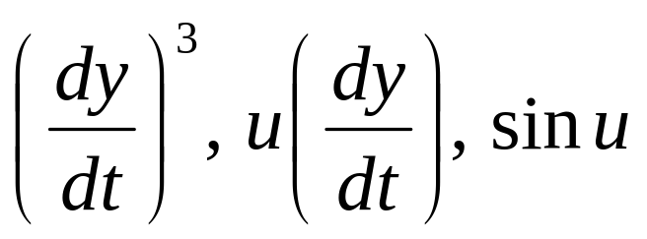


A linear term is one which is first degree in the dependent variables and their derivatives.
A linear equation is an equation consisting of a sum of linear terms. All others are nonlinear equations.
If any term of a differential equation contains contains higher powers, products or transcendental functions of the dependent variables, it is nonlinear
Simple Pendulum
Van der Pol equation
Duffing’s equation

Slide 8
Unilateral and Bilateral Circuits
The circuit whose properties or characteristics are same in either directions is called bilateral circuit
e.g.: A resistor, a transmission line
The impedance (or resistance) offered by the bilateral elements is same for either direction of the current flow.
The circuit whose properties or characteristics are not same in either directions is called unilateral circuit
e.g.: a diode

Slide 9
What is a lumped element?
• A discrete object that can exchange energy with other objects
• An object whose internal physics can be combined into terminal relations
• Whose size is smaller than wavelength of the appropriate signal
. Signals do not take time to propagate
Lumped and Distributed Circuits
Because the wavelength is so massive compared to the circuit, a wave reaches all parts of a component at virtually the same instant. The phase of the voltage and current remains constant throughout
Distributed element’s parameters are physically distributed in space. All electrical effects do not take place at the same instant of time.
Because the wavelength is now comparable to the physical length of the trace or wire, the signal at the input of a wire will have a different phase than the signal at the output

Slide 10
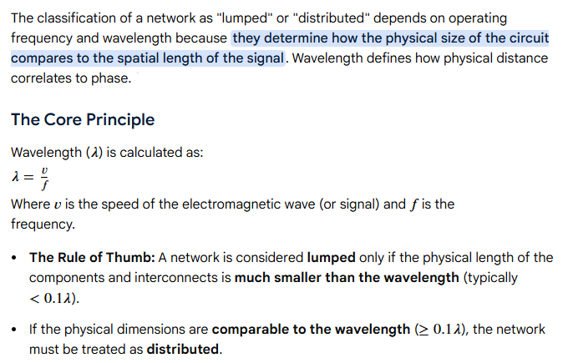

Slide 11

Passivity
Let E(t) be the energy delivered to this element from an external source upto time t. The power delivered will be p(t) = v(t) i(t).
The element is passive if
An element which does not satisfy this condition, ie, for some time t, E(t) < 0, is called active.
A passive element can never return more electrical energy than previously stored to an external network.
Active circuits uses other forms of energy in order to supply electrical energy.
Only in the presence of activity are the amplification and oscillation possible.

Slide 12
Deterministic and stochastic networks
In a deterministic network, an identical input will always produce the exact same output, with zero randomness. In a stochastic network, the output involves probabilities, meaning the same input can yield varying results due to built-in randomness.

Slide 13
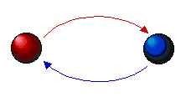
System
Definition: A system is a collection of components that act and interact toward the accomplishment of some logical end.
The key emphasis here is "mutual interaction," in that something is occurring between the parts, over time, which maintains the system. A system is different than a heap or a collection, mostly.
This definition of a system implies something beyond cause and effect. Rather than simply A affects B, there is an implication that B also affects.
Systems generally tend to be dynamic – their status changes over time. To describe this status, we use the concept of the state of a system.
All electrical circuits are systems. All systems are not circuits.

Slide 14
MODELS
A model is defined as a representation of a system for the purpose of studying the system.
A simplification of reality intended to promote understanding.
Sometimes, the actual system is available for investigation (at reasonable cost and effort)
Sometimes, only a model of a system can be used – and usually has to be constructed explicitly:
A model of a system is also a system
Built to capture some relevant properties of the original system
Simplified with respect to original system, reduced complexity
Models appear in many different kinds, with many different characteristics

Slide 15
SIMULATION
A simulation is the execution of a model, represented by a computer program that gives information about the system being investigated.
The simulation approach of analyzing a model is opposed to the analytical approach, where the method of analyzing the system is purely theoretical.
Instead of building extensive mathematical models by experts, the readily available simulation software has made it possible to model and analyze the operation of a real system by non-experts, who are managers but not programmers.

Slide 16
Grading Policy
Homework, quiz (surprise and announced), submissions -20%
Attendance - 10 %
MTE - 20%
ETE - 50%
Academic dishonesty will not be tolerated.

