Slide 1
Introduction to MATLAB/SIMULINK
&
Writing functions in MATLAB
        Official MathWorks tutorial:
  http://www.mathworks.com/academia/student_center/tutorials/launchpad.html
(Matrix Laboratory)

Slide 2
Desktop Tools
Command Window
  type commands
Workspace
  view program variables
  clear to clear
  double click on a variable to see it in the Array Editor
Command History
  view past commands
  save a whole session using diary
Launch Pad
  access tools, demos and documentation

Slide 3
Matrices
a vector x = [1 2 5 1]
x =
1 2 5 1
a matrix x = [1 2 3; 5 1 4; 3 2 -1]
x =
1 2 3
5 1 4
3 2 -1
transpose y = x’

Slide 4
x(i,j) subscription
whole row
whole column
y=x(2,3)
y =
4
y=x(3,:)
y =
3 2 -1
y=x(:,2)
y =
2
1
2

Slide 5
Operators (arithmetic)
+ addition
- subtraction
* multiplication
/ division
^ power
‘ complex conjugate transpose
.* element-by-element mult
./ element-by-element div
.^ element-by-element power
.‘ transpose

Slide 6

Operators (relational, logical)
== equal
~= not equal
< less than
<= less than or equal
> greater than
>= greater than or equal
& AND
| OR
~ NOT
pi 3.14159265…
j imaginary unit,
i same as j

Slide 7
Generating Vectors from functions
x = zeros(1,3)
x =
0 0 0
x = ones(1,3)
x =
1 1 1
x = rand(1,3)
x =
0.9501 0.2311 0.6068
zeros(M,N) MxN matrix of zeros
ones(M,N) MxN matrix of ones
rand(M,N) MxN matrix of uniformly distributed random numbers on (0,1)

Slide 8
Operators
x = [ zeros(1,3) ones(1,2) ]
x =
0 0 0 1 1
x = [ 1 3 5 7 9]
x =
1 3 5 7 9
y = x(2)
y =
3
y = x(2:4)
y =
3 5 7
[ ] concatenation
( ) subscription

Slide 9
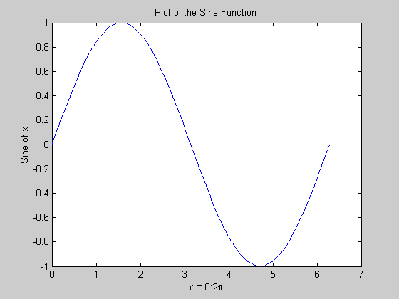
Matlab Graphics
x = 0:pi/100:2*pi;
y = sin(x);
plot(x,y)
xlabel('x = 0:2\pi')
ylabel('Sine of x')
title('Plot of the Sine Function')

Slide 10
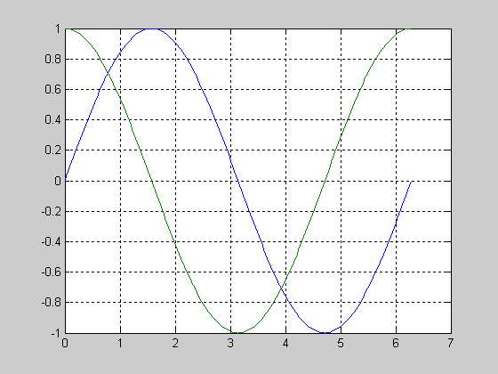
Multiple Graphs
t = 0:pi/100:2*pi;
y1=sin(t);
y2=sin(t+pi/2);
plot(t,y1,t,y2)
grid on

Slide 11
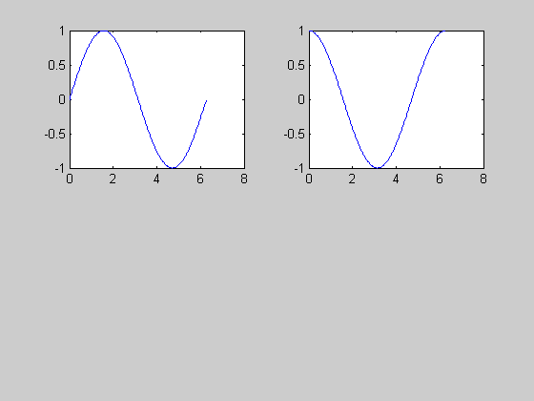
Multiple Plots
t = 0:pi/100:2*pi;
y1=sin(t);
y2=sin(t+pi/2);
subplot(2,2,1)
plot(t,y1)
subplot(2,2,2)
plot(t,y2)

Slide 12
Graph Functions (summary)
plot linear plot
stem discrete plot
grid add grid lines
xlabel add X-axis label
ylabel add Y-axis label
title add graph title
subplot divide figure window
figure create new figure window
pause wait for user response

Slide 13
Flow Control
if A > B
'greater'
elseif A < B
'less'
else
'equal'
end
for x = 1:10
r(x) = x;
end
if statement
switch statement
for loops
while loops
continue statement
break statement

Slide 14
Math Functions
Elementary functions (sin, cos, sqrt, abs, exp, log10, round)
  type help elfun
Advanced functions (bessel, beta, gamma, erf)
  type help specfun
  type help elmat

Slide 15
MATLAB Script Files
A MATLAB script file (Called an M-file) is a text (plain ASCII) file that contains one or more MATLAB commands and, optionally, comments.
The file is saved with the extension ".m".
When the filename (without the extension) is issued as a command in MATLAB, the file is opened, read, and the commands are executed as if input from the keyboard. The result is similar to running a program in C. The following slide is the contents of an M-file. Note that there are no prompts (>>).
Notes:
Instructor notes:
There are two types of M-files…script files and function files. We start out with script files. Script files are called M-files because the extension on the file is “.m”. Script files are a collection of Matlab commands that when executed are the same as if the commands had been entered from the keyboard. Variables that are used in script files are equivalent to global variables. A variable that originates in a script file is immediately known in the command window. Variables that originated in the command window are known in the script file. This is one are in which script and function files differ. Function files, like C/C++ functions use local variables which must be passed in and out of the function.

Slide 16
MATLAB Script Files
% This is a MATLAB script file.
load iris.dat; %Load data file
x= iris( : , 4); %Extract volts vector
t = .005*[1:length(x)]; %Create time vector
plot (t,x) %Plot x vs time
xlabel ('Time in Seconds') % Label x axis
ylabel (‘x') % Label y axis
title (‘time versus x')
grid %Put a grid on graph
Notes:
Instructor notes:
This example demonstrates several key things about Matlab script files. We’ve got the script file d13.m. In order to invoke it, Matlab’s current working directory must be the same directory as where d13.m is stored, or the entire pathname to the script file must be entered at the command prompt. The load d13.dat command will open the file, d13.dat. Because the entire pathname to d13.dat is not specified, the current working directory must contain d13.dat. The load will open the file and read the entire file into Matlab creating an array called d13 without the “.dat” extension. Note the semicolon at the end of the line. This will prevent the contents of the array from being echoed to the command window.
The second line creates a vector called voltage by reading in all of the rows in column 4 from the d13 matrix. Again, note the semicolon at the end of the line.
The third line creates a time vector by multiplying 0.005 times a vector that has elements 1 to the length of the voltage vector.
The fourth line plots the time on the x-axis and the voltage on the y-axis opening a new window that contains the plot. Lines 5 and 6 add labels to the x-axis and y-axis respectively.
Line seven places a title on the plot and line eight puts a grid on the plot.

Slide 17
MATLAB Function Files
A MATLAB function file (called an M-file) is a text (plain ASCII) file that contains a MATLAB function and, optionally, comments.
The file is saved with the function name and the usual MATLAB script file extension, ".m".
A MATLAB function may be called from the command line or from any other M-file.
Notes:
Instructor notes:
Now that we’ve seen a script file, we’re going to move to function files. Function files in Matlab are very much like functions in C/C++. The key difference between function files and script files is that variables in function files are local. Any variables that are used within a function file need to be specified within the function or passed in as arguments in the argument list.
You may want to point out the similarities between C/C++ functions and Matlab function files. One difference between the two is that while a C/C++ function can only “return” one value, Matlab functions can return as many as desired.
The function file should have the same name as the function itself with the “.m” extension added to it.
Unlike C/C++ functions which can only be called from within a program, Matlab function files can be called directly from the command window, from a script file, or from another function file.

Slide 18
MATLAB Function Files
When the function is called in MATLAB, the file is accessed, the function is executed, and control is returned to the MATLAB workspace.
Since the function is not part of the MATLAB workspace, its variables and their values are not known after control is returned.
Any values to be returned must be specified in the function syntax.
Notes:
Instructor notes:
This first bullet points out the reason that variables inside of function files are local and not known to the command window is that executing a function file causes control to switch out of the Matlab workspace into the function file’s workspace.
As the second and third bullet points indicate, the function file is not part of the Matlab workspace and therefore those variables that exist within the function file and their corresponding values are not known to the command window when control is returned from the function file. In order to transfer the values of desired variables back to the Matlab workspace, they must be passed back according to the function call syntax.
What this boils down to is that variables that are being passed into the function need to appear in parentheses to the right of the function name during the function call and variables that are being passed back from the function to the Matlab workspace must appear in square brackets to the left of the equals sign in the function call and function definition.

Slide 19
MATLAB Function Files
The syntax for a MATLAB function definition is:
function [val1, … , valn] = myfunc (arg1, … , argk)
where val1 through valn are the specified returned values from the function and arg1 through argk are the values sent to the function.
Since variables are local in MATLAB (as they are in C), the function has its own memory locations for all of the variables and only the values (not their addresses) are passed between the MATLAB workspace and the function.
Notes:
Instructor notes:
Most of the information on this slide has been previewed on the previous slide. Arguments that are going into the function appear within parentheses to the right of the function name when the function is called. This is how you would get variables from the Matlab workspace or another function file into the called function. Values that are being determined within the function and returned by the function appear in square brackets prior to the equal sign on the line on which the function is called. These values will be returned by the function back to the Matlab workspace of the workspace of another function if this function were called within another function.
Just as in C/C++, it’s the value of the variables that’s being passed. Addresses are NOT passed between workspaces.

Slide 20
Example of a MATLAB Function File
function [ a , b ] = swap ( a , b )
% The function swap receives two values, swaps them,
% and returns the result. The syntax for the call is
% [a, b] = swap (a, b) where the a and b in the ( ) are the
% values sent to the function and the a and b in the [ ] are
% returned values which are assigned to corresponding
% variables in your program.
temp=a;
a=b;
b=temp;
Notes:
Instructor notes:
Here we have an example of a swap function that has the same variables in its argument list as it does in its returned values list. In this example a and b are passed into the function. Within the function, temp is assigned a’s value, a is assigned b’s value and temp, which is a’s original value, is assigned to b. So, by the end of swap, the values of a and b have been swapped. Then, the swapped a and b are returned. To actually have the swap of a and b have an effect in the workspace that called swap requires that in the call to the function, the same variables were used in the calling “return” list and the calling “argument” list.
A side note here…the comments that occur immediately after the first line of the function definition will be displayed in the command window if the user types help function_name at the command prompt. So, in this example, if the user were, at the command prompt, to type help swap, then the six comment lines that appear in the function definition above, would be displayed in the command window.

Slide 21
Example of a MATLAB Function File
To use the function a MATLAB program could assign values to two variables (the names do not have to be a and b) and then call the function to swap them. For instance the MATLAB commands:
>> x = 5 ; y = 6 ; [ x , y ] = swap ( x , y )
result in:
x =
6
y =
5
Notes:
Instructor notes:
Here we see the result of calling the swap function. Note that the variables in the function call do not have to be a and b, since a and b are local to the function definition. What is necessary is that the variables in square brackets and in parentheses have the same name. When called with initial values of x=5 and y=6, swap switches the values of x and y in the calling workspace.
Hopefully some carryover from C/C++ explanation of functions will help out here, but this is somewhat of an abstract point to get a grasp of and quite possibly should be gone over slowly on the board or with an example that demonstrates visually what is taking place. It is slightly different than what happens in the C/C++ examples of swap.

Slide 22
MATLAB Function Files
Referring to the function, the comments immediately following the function definition statement are the "help" for the function. The MATLAB command:
>>help swap %displays:
The function swap receives two values, swaps them,
and returns the result. The syntax for the call is
[a, b] = swap (a, b) where the a and b in the ( ) are the
values sent to the function and the a and b in the [ ] are
returned values which are assigned to corresponding
variables in your program.
Notes:
Instructor notes:
As quickly mentioned on an earlier slide, when entering help function_name at the cojmmand prompt, the comment information that appears immediately beneath the first line of the function will be displayed as help information in the command window.

Slide 23
Function to convert rectangular to polar
function [m,phi]=rect2pol(x,y)
% This command will convert x+jy into m<phi (polar) form
m=sqrt(x^2+y^2);
phi=atan(y/x)*180/pi;
Then write in the command window
[a,b]=rec2pol(3,4)
Then write in the command window
help rec2pol

Slide 24
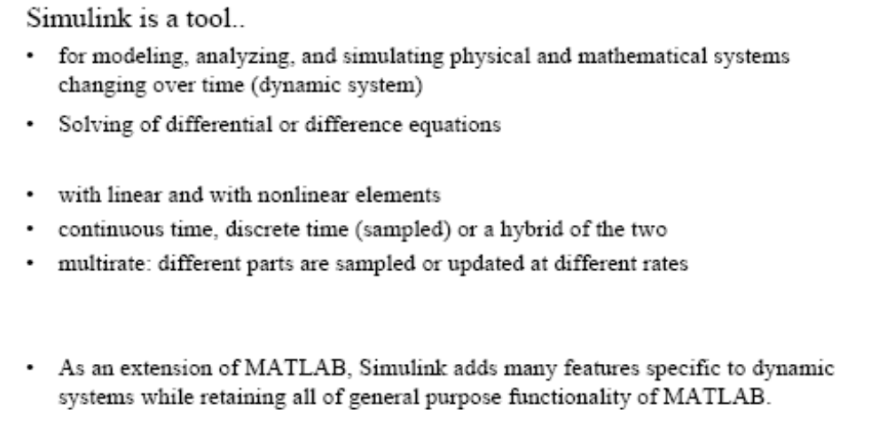
Introduction to SIMULINK

Slide 25
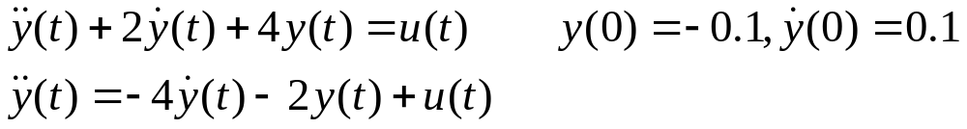
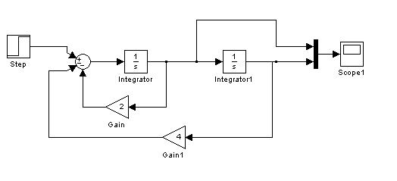
Simulation of Differential Equation
Not to use scope for taking printouts, use ‘to workspace’ block

