Slide 1
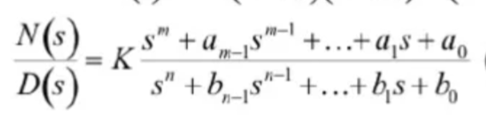
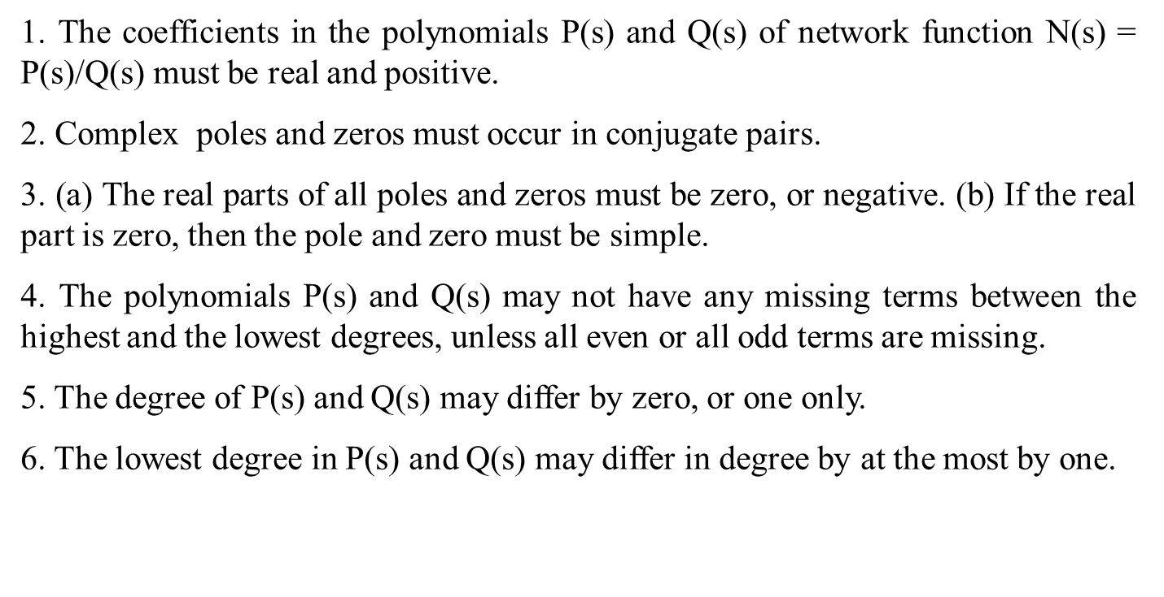

Slide 2
1. (a) The coefficients in the polynomials P(s) and Q(s) of N(s)=P(s)/Q(s) must be real. (b) The coefficients in Q(s) must be positive, but some of the coefficients in P(s) may be negative.
2. Complex or imaginary poles and zeros must occur in conjugate pairs.
3. The real part of poles must be negative, or zero. If the real part is zero, then the pole must be simple.
4. The polynomial Q(s) may not have any missing terms between the highest and the lowest degree, unless all even or all odd terms are missing.
5. The polynomial P(s) may have missing terms between the lowest and the highest degree.
6. The degree of P(s) may be as small as zero, independent of the degree of Q(s).

Slide 3
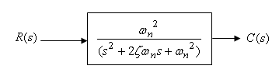

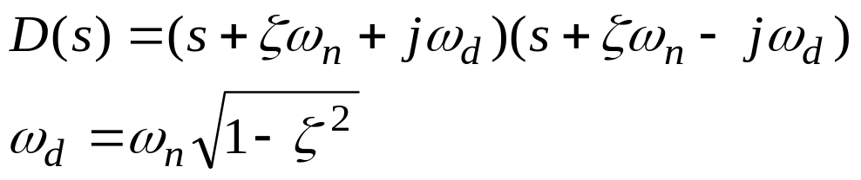
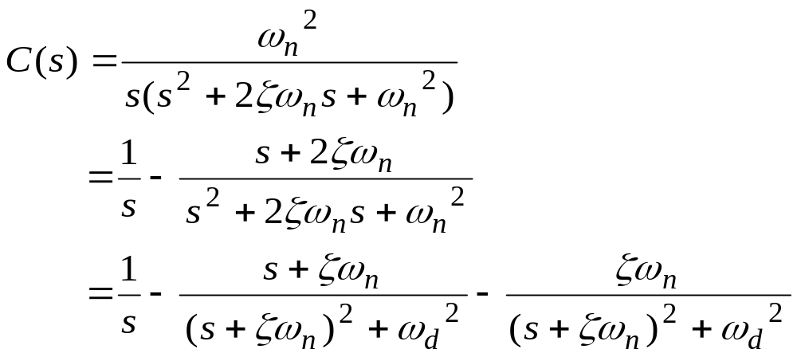
Unit step response of second-order systems
Damped frequency
Natural frequency (ωn) represents the frequency at which the system would oscillate if there were no damping, while damping ratio (ζ) determines the rate at which oscillations decay.

Slide 4
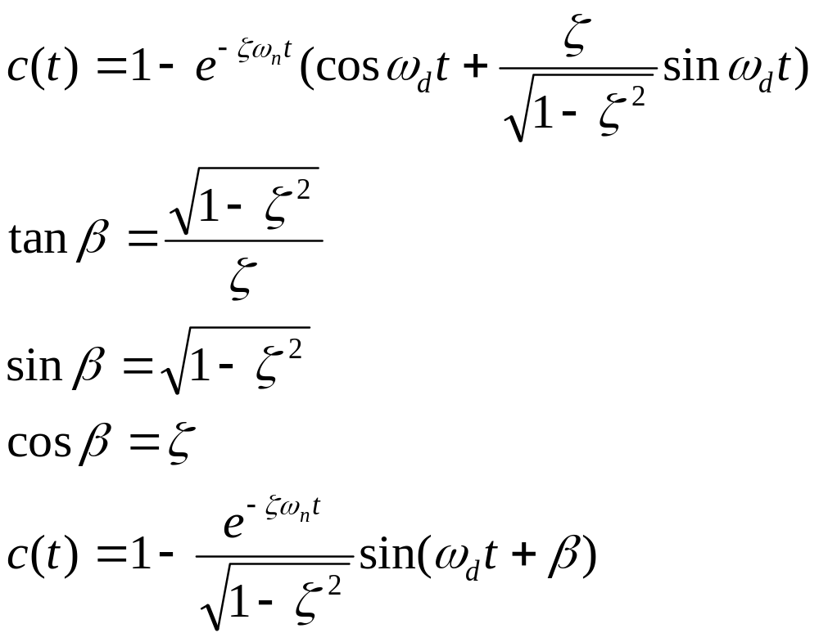
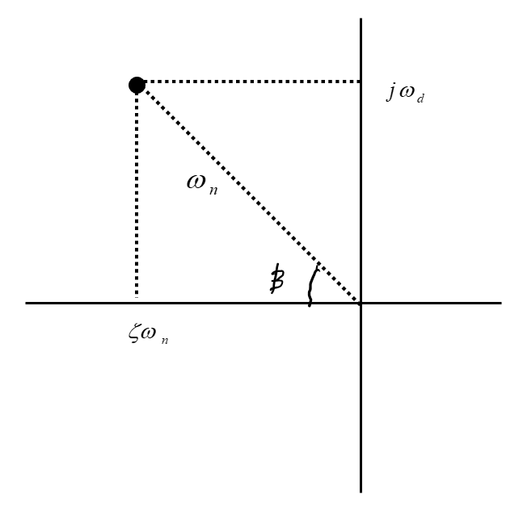
Time domain response refers to how a system's output changes over time in response to an input.
The unit impulse response is the derivative of the unit step response, and the unit step response is the derivative of the unit ramp response.
ζ =0 undamped. Poles on the imaginary axis. 0<ζ <1 underdamped. Complex poles in LHS.
ζ =1 critically damped. Same poles on –ve real axis. ζ >1 overdamped. Poles on –ve real axis

Slide 5
