Slide 1
Gain in dB =20logM
Upto ω =ω_{n} the magnitude plot is zero and then a line with slope -40dB/D. Phase varies from 0 to -180 degrees

Slide 2
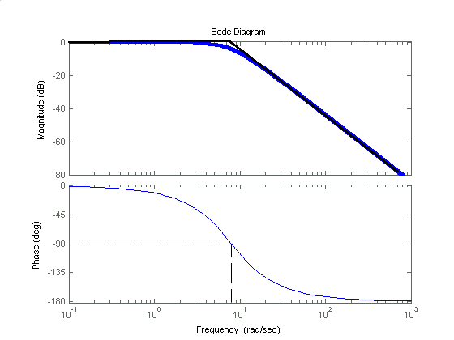
5

Slide 3
Bode plot of
s=zpk([],[0,-1,-2],1) bode(s)
-15.6
-126.6

Slide 4
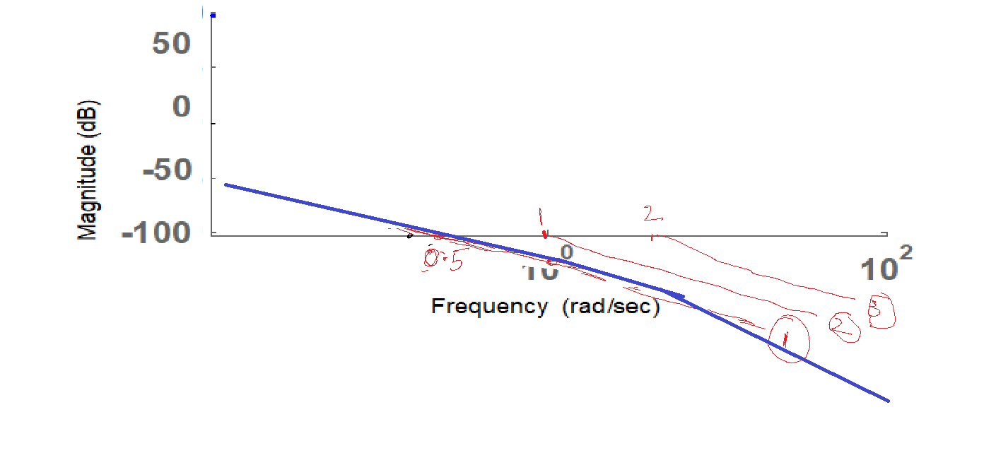








Approximate magnitude plot
Add the 3 individual logarithmic plots of each from the system’s network function.

