Slide 1
NETWORK THEOREMS

Slide 2
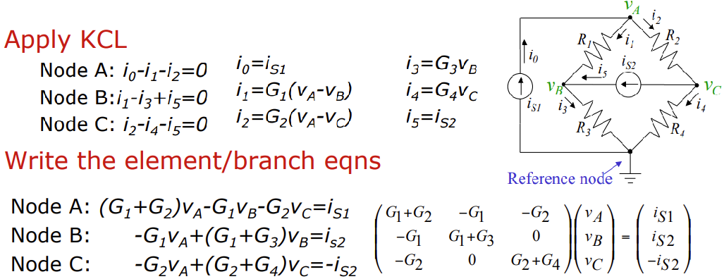
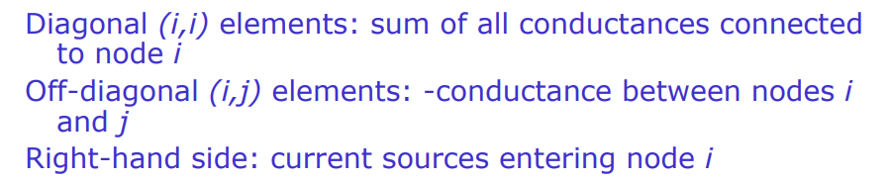
Nodal Equations by Inspection

Slide 3
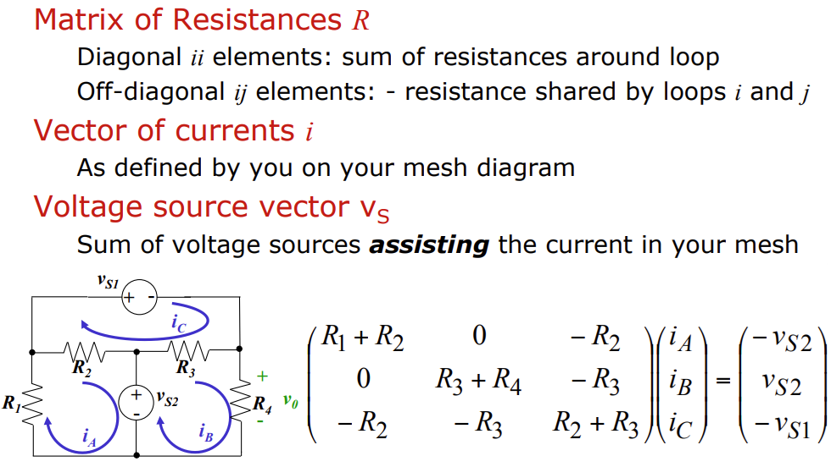
Mesh Equations by Inspection

Slide 4
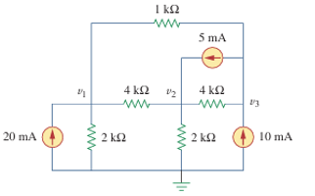
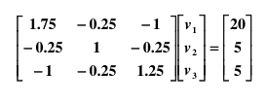
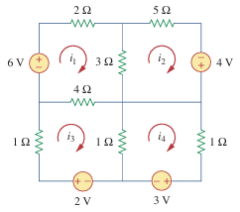
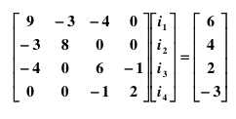

Slide 5
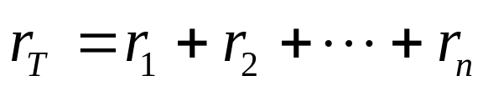
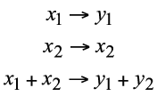
SUPERPOSITION PRINCIPLE
The superposition principle states that the total response is the sum of the responses to each of the independent sources acting individually. In equation form, this is
Setting independent voltage source equal to zero means short it. Setting independent current source equal to zero means open it.
When a circuit is subjected to an excitation x1, it provides a response y1., When the system is subjected to an excitation x2, it provides a corresponding response y2. For a linear cuit, it is necessary that the excitation x1 + x2 result in a response y1 + y2. This is usually called the principle of superposition. It is expressed as

Slide 6
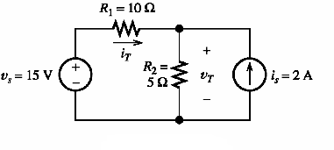
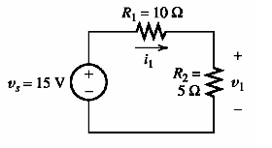
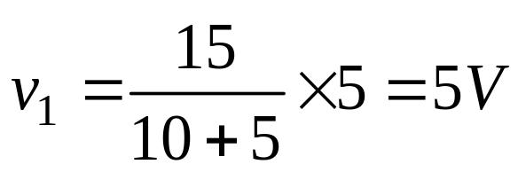
Find the voltage across R₂ Using Superposition
First consider voltage source alone, current source=0

Slide 7
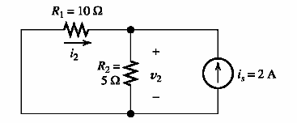
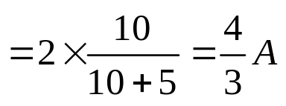
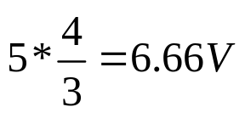

Then consider current source alone, voltage souce =0
Total current 2 A is divided into two branches. Current through 5 ohm is
Voltage V₂=
Total voltage =
Answer

Slide 8
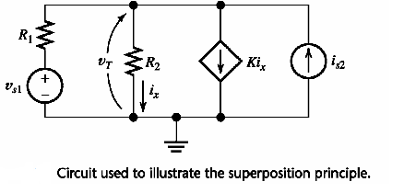
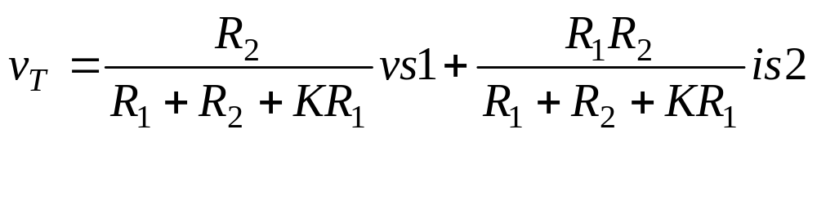
Solve the ckt. using node equation to get v_{T}

Slide 9
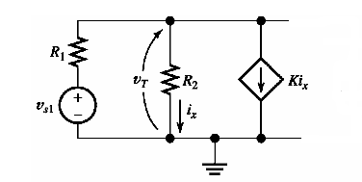
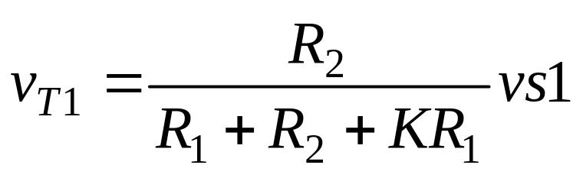
Set current source =0, and find v_{T1}

Slide 10
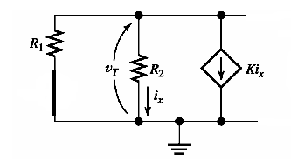
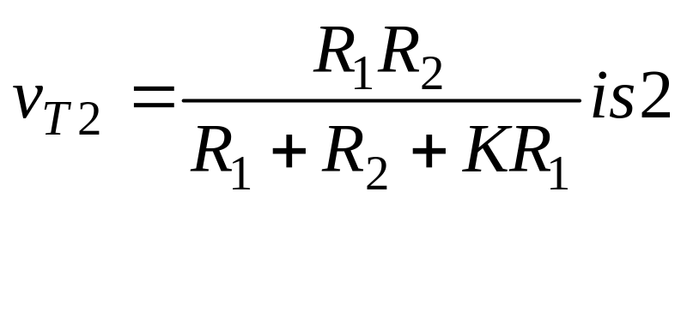
Set voltage source =0, and find v_{T2}
V_{T}=V_{T1}+V_{T2}

Slide 11
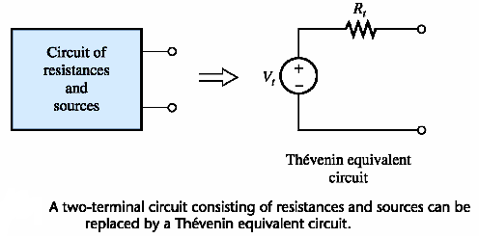
Thevenin’s Theorem

Slide 12
Thevenin’s Theorem
Thevenin’s theorem : A linear two terminal circuit can be replaced by an equivalent circuit consisting of a voltage V_{Th} in series with an impedance Z_{Th} , where V_{Th} is the open circuit voltage at the terminals and Z_{Th} is the input or equivalent impedance at the terminals when the independent source are turned off.

Slide 13
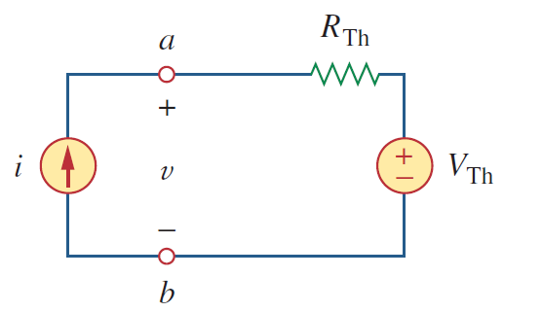
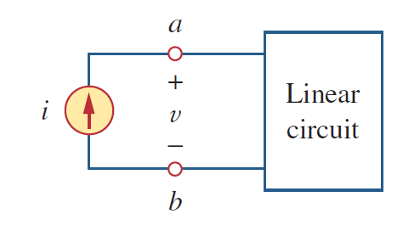




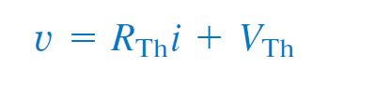
Proof
Assume that the linear circuit contains two independent current sources i_{s1} and i_{s2} and two independent voltage sources v_{s1} and v_{s2}
When terminals a and b are open-circuited i = 0, v = B0
When all the internal sources are turned off B₀ = 0

Slide 14
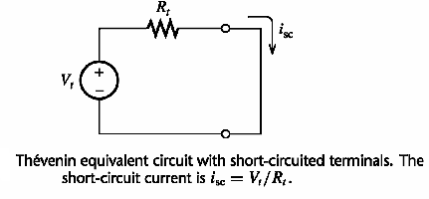
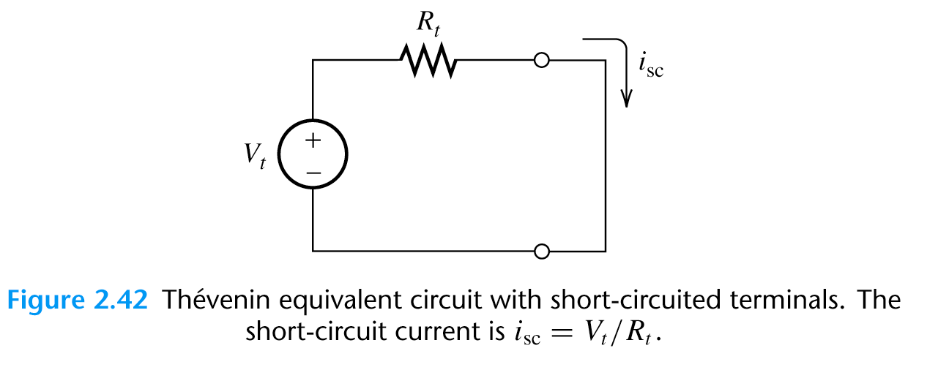
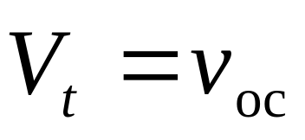
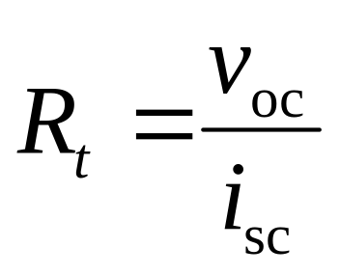

Slide 15
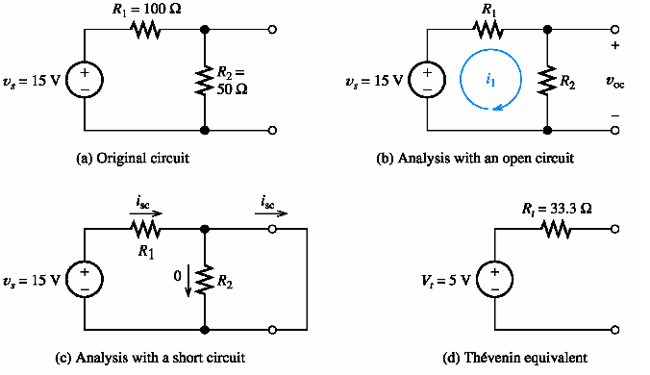

Slide 16
Finding the Thévenin Resistance Directly
When zeroing a voltage source, it becomes an open circuit. When zeroing a current source, it becomes a short circuit.
We can find the Thévenin resistance by zeroing the sources in the original network and then computing the resistance between the terminals.

Slide 17
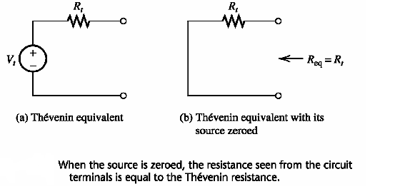

Slide 18
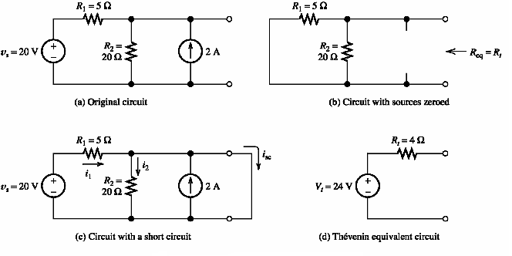

Slide 19
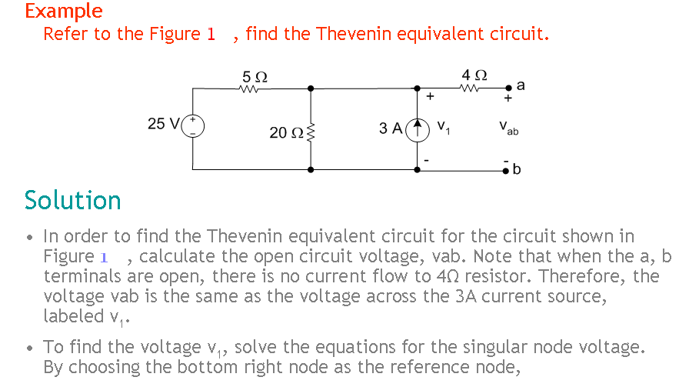

Slide 20
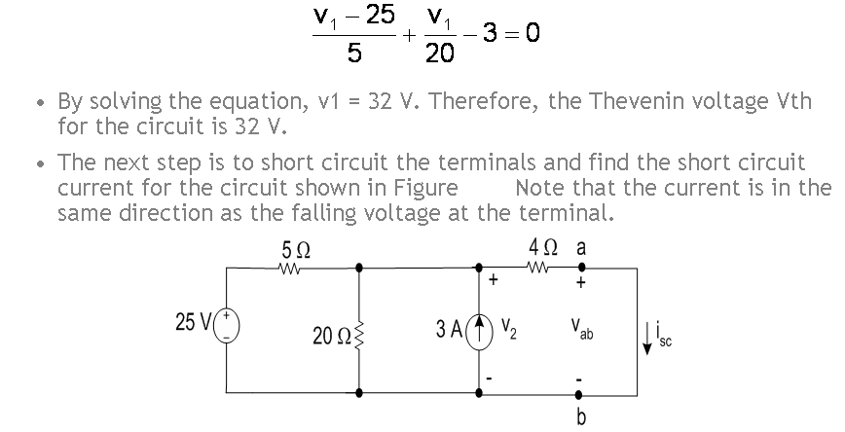
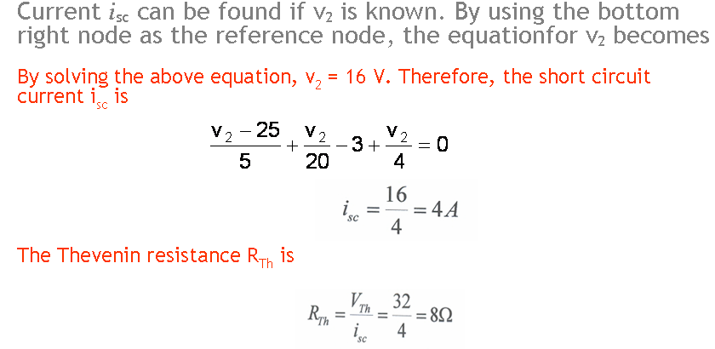
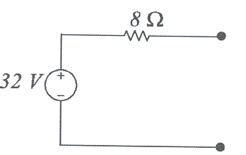

Slide 21
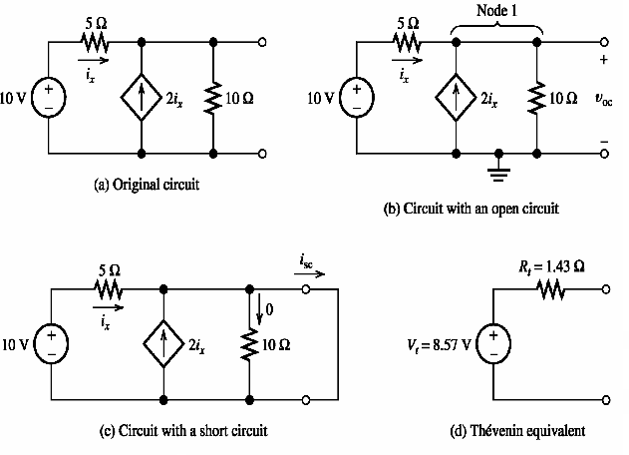

Slide 22
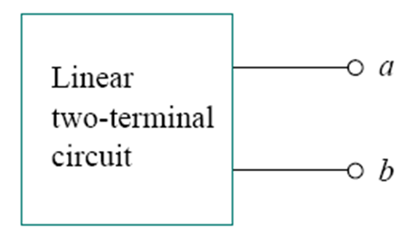
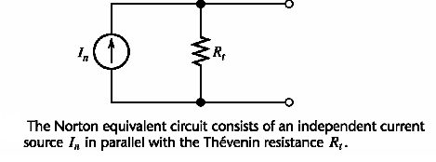
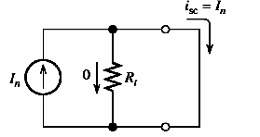
Norton’s Theorem
Norton’s Theorem : a linear two-terminal circuit can be replaced by an equivalent circuit consisting of a current source I_{N} in parallel with an impendence Z_{N}, where I_{N} is the short circuit current through the terminals and Z_{N} is the input or equivalent impedance at the terminals when the independent source are turned off.

Slide 23
Step-by-step Thévenin/Norton-Equivalent-Circuit Analysis
1. Perform two of these:
a. Determine the open-circuit voltage V_{t} = v_{oc}.
b. Determine the short-circuit current I_{n} = i_{sc}.
c. Zero the sources and find the Thévenin resistance R_{t} looking back into the terminals.

Slide 24
2. Use the equation V_{t} = R_{t} I_{n} to compute the remaining value.
3. The Thévenin equivalent consists of a voltage source V_{t} in series with R_{t} .
4. The Norton equivalent consists of a current source I_{n} in parallel with R_{t} .

Slide 25
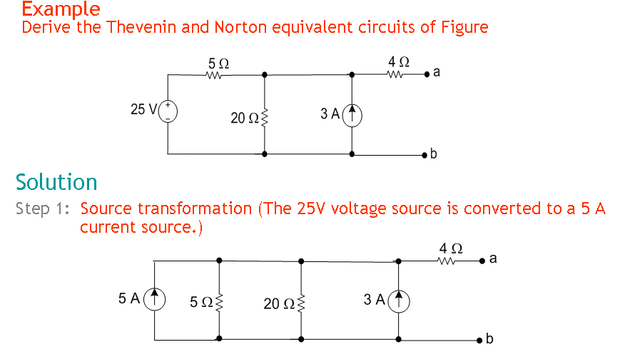
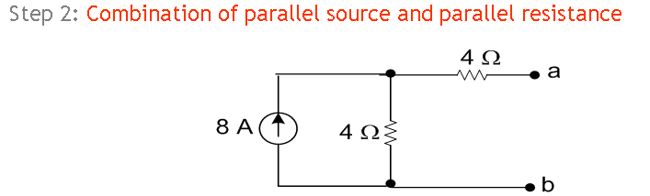

Slide 26
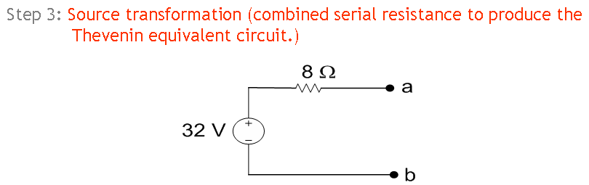
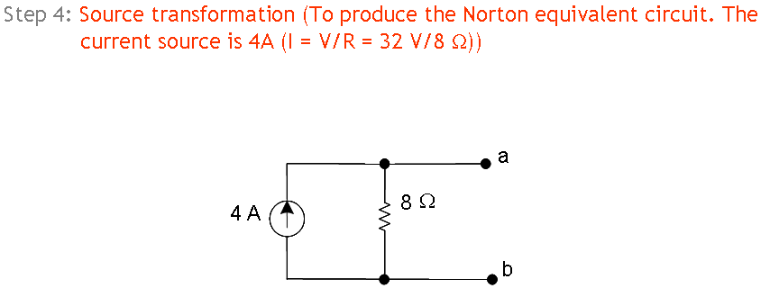

Slide 27
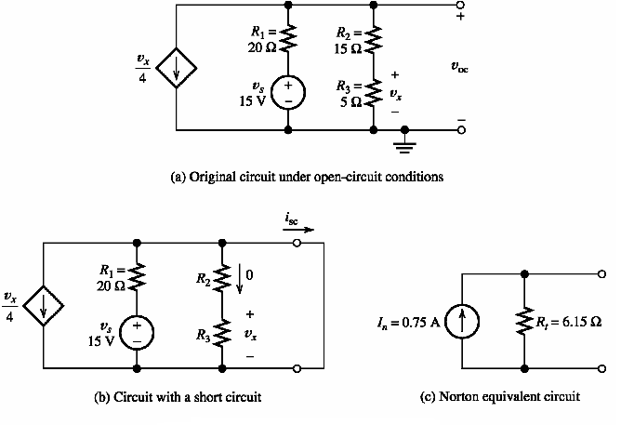

Slide 28
When there are dependent sources, not to use the direct method for finding Thevenin’s resistance.
Then find R_{t} by dividing V_{t} by In
Or apply a unit voltage across the terminals and obtain the resulting current. Then R_{t}=1/ resulting current

