Slide 1
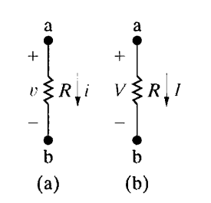
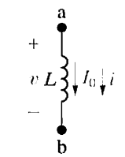
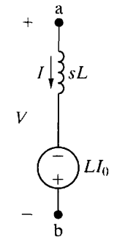
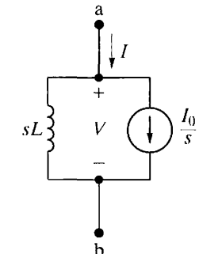
Circuit Analysis in the s Domain
Circuit Elements in the s Domain
Resistance
(a)Time domain v(t)= Ri(t) v = Ri
(b) s- domain V(s)= RI(s) V = RI
Inductor
(a)Time domain v= Ldi/dt
(b) s- domain V= LsI - Li₀

Slide 2
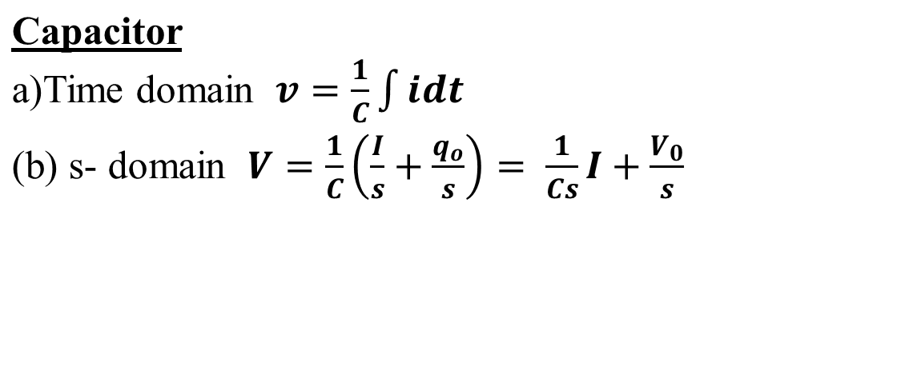
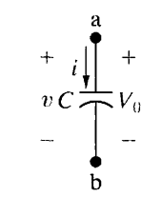
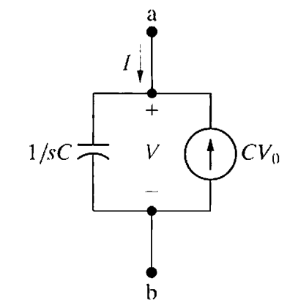
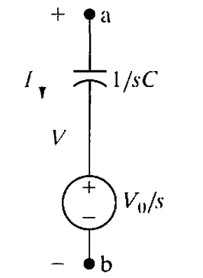

Slide 3
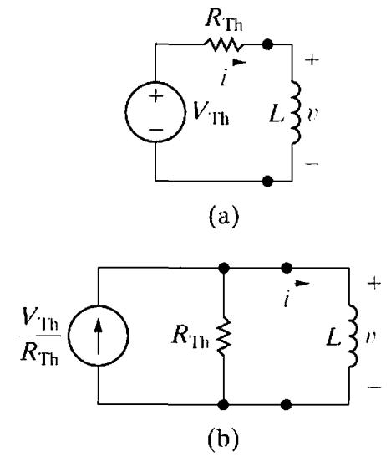
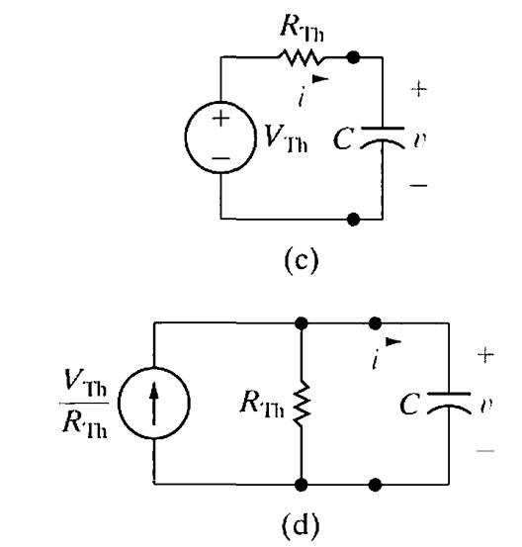
A General Solution for Step Responses of First Order Circuits
(a) An inductor connected to a Thevenin equivalent. (b) An inductor connected to a Norton equivalent. (c) A capacitor connected to a Thevenin equivalent. (d) A capacitor connected to a Norton equivalent.

Slide 4
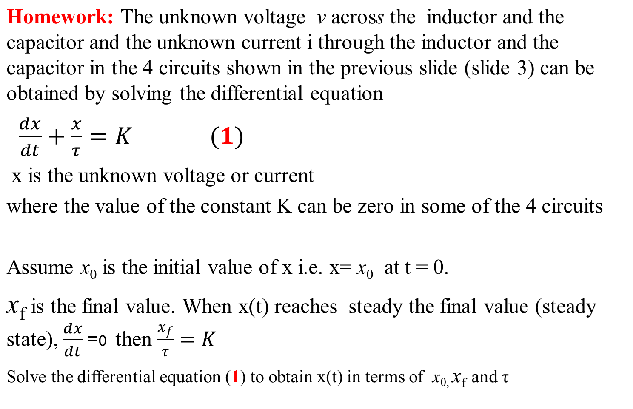

Slide 5

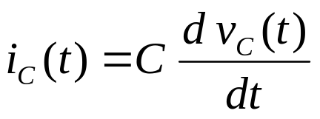
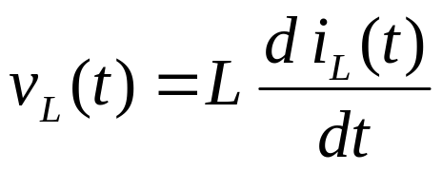
RLC Characteristics
Element | V/I Relation | DC Steady-State
Resistor |  | V = I R
Capacitor |  | I = 0; open
Inductor |  | V = 0; short

Slide 6
what’s the complete response (CR)?
  Complete response = transient response + steady state response
  OR….
  Complete response = natural response + forced response

Slide 7

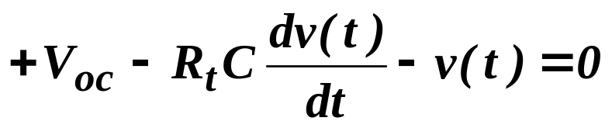
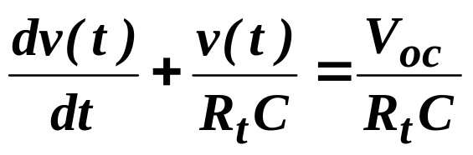
A First-Order RC Circuit
i(t)
+ -
R_{t}
+
v(t)
-
V_{oc}
+
–
C
The capacitor has an initial voltage v(0)
KVL

Slide 8
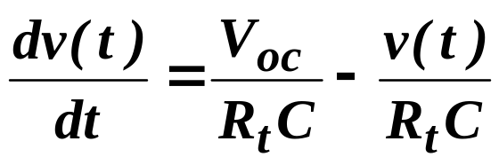
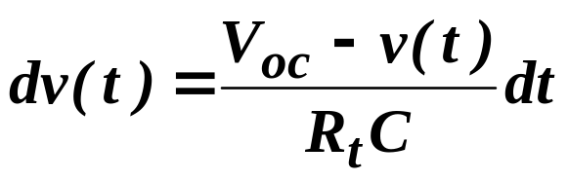
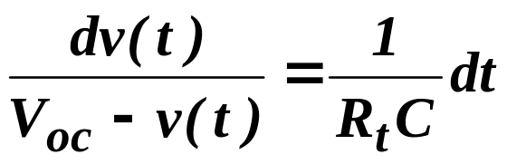
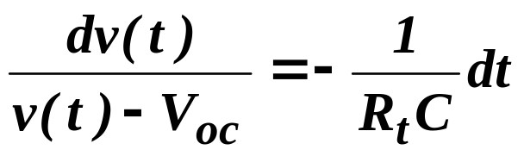
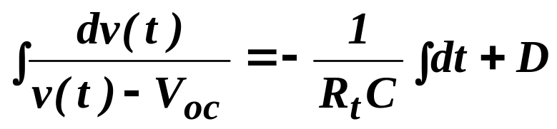
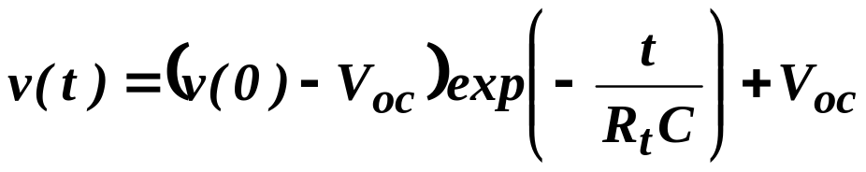
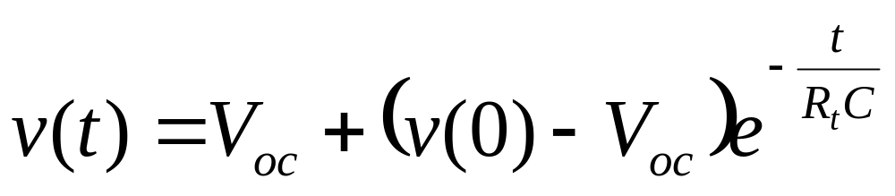
SOLUTION OF 1st ORDER EQUATION

Slide 9
SOLUTION OF 1st ORDER EQUATION

Slide 10
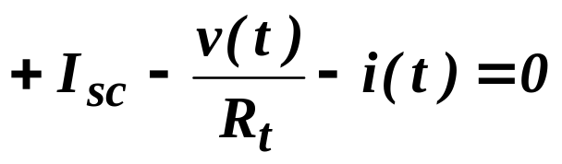
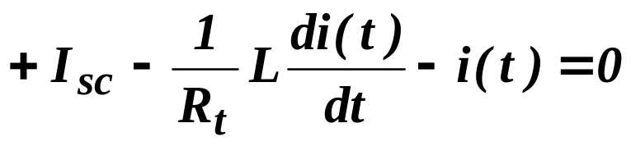
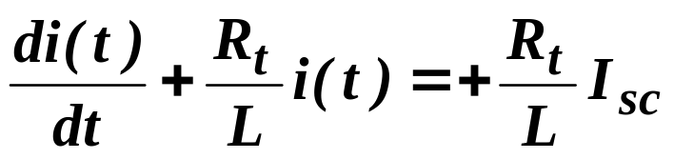
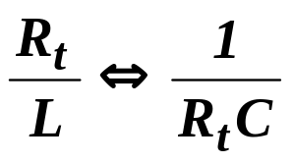
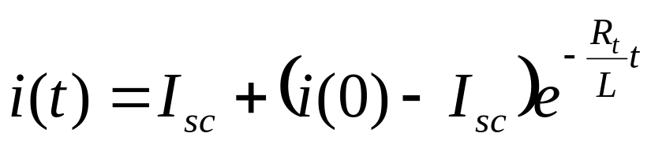
A First-Order RL Circuit
+
v(t)
-
I_{sc}
R_{t}
L
i(t)
The inductor has an initial current i(0)
KCL

Slide 11
Finding the Complete Response of First Order Circuit
Find the forced response before the disturbance. Evaluate at t = t(0⁻) to determine initial conditions [v(0) or i(0)]
Find forced response (steady state) after the disturbance t= t() [V_{oc} or I_{sc} ]
Add the natural response (Ke^{-t/}) to the new forced response. Use initial conditions to calculate K

Slide 12
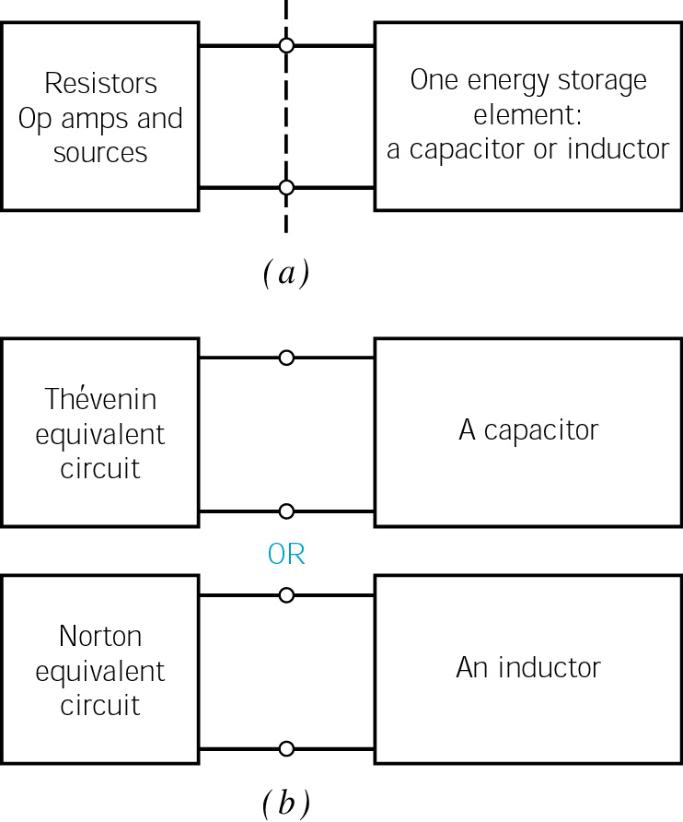
A plan for analyzing first-order circuits. (a) First, separate the energy storage element from the rest of the circuit. (b) Next, replace the circuit connected to a capacitor by its Thévenin equivalent circuit, or replace the circuit connected to an inductor by its Norton equivalent circuit.

Slide 13
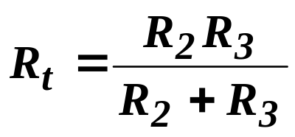
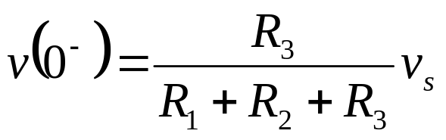
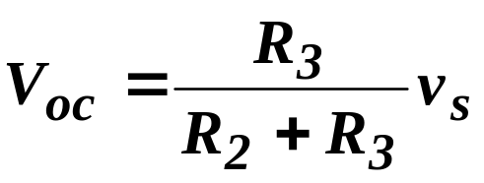
Example-1
If vs = 4V, R1 = 20kohms,
R2 = 20 kohms
R3 = 40 kohms
t = 0
R₁
R₂
+
v(t)
-
v_{s}
+
–
R₃
C

Slide 14
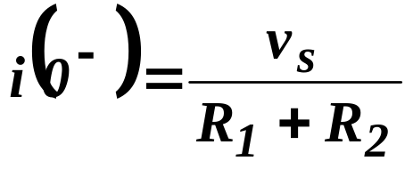
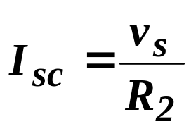
Example-2
t = 0
R₁
R₂
v_{s}
+
–
R₃
L
i(t)

Slide 15
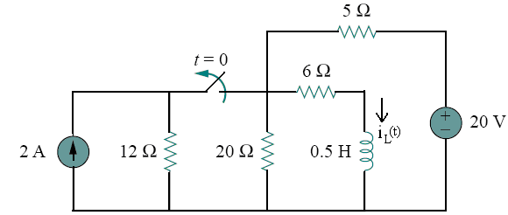
Example-3
The switch in the circuit of figure 1 has been closed for a long time
and it is opened at t = 0. Calculate:
The initial value of i_{L} and, the final value of . i_{L}
The time constant for t ≥ 0.
An expression for i_{L}(t) for t ≥ 0.

Slide 16

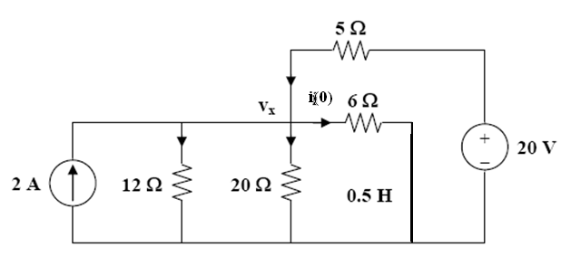
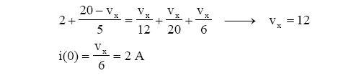
Initial Value i(0)

Slide 17
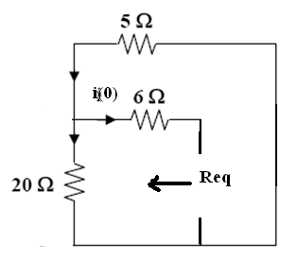

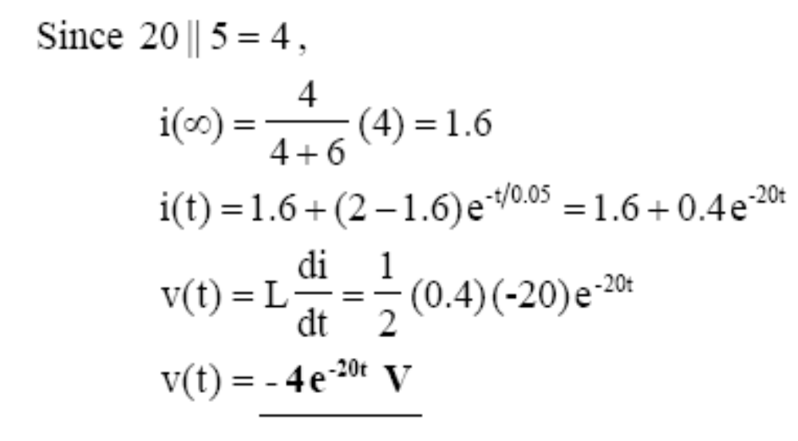
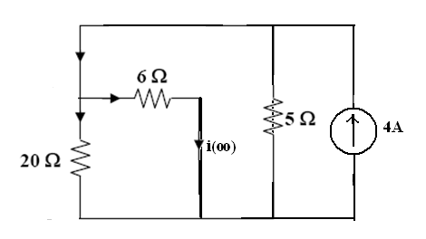
Time constant
Final Value

