Slide 1
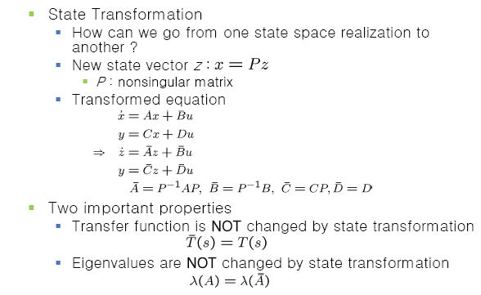
State Transformations

Slide 2
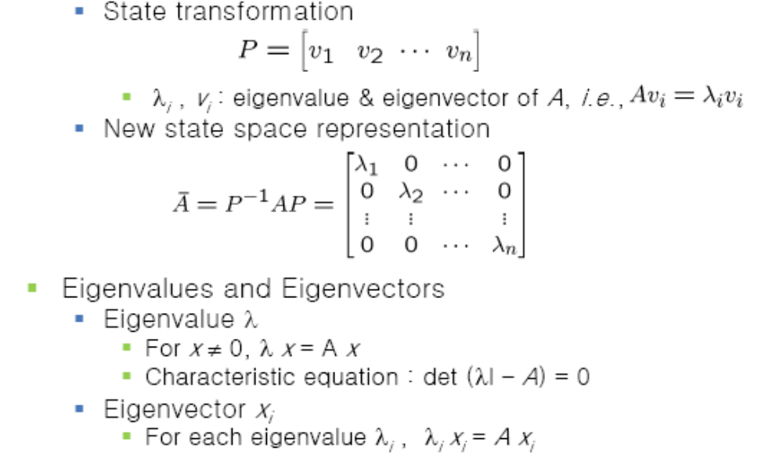
Modal Canonical Form

Slide 3
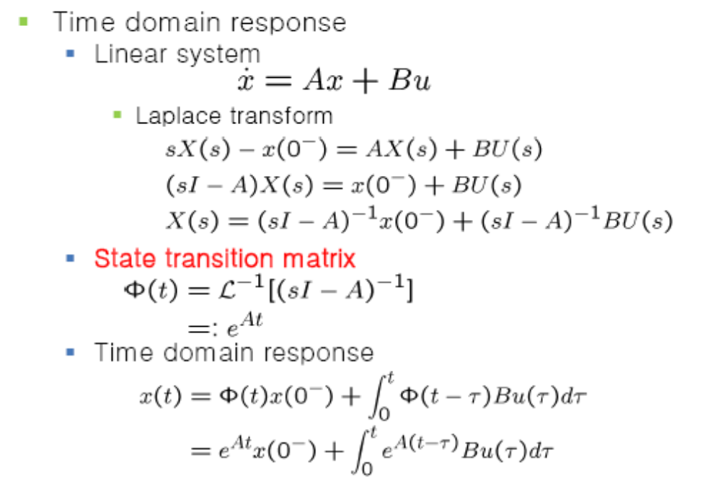
State Transition Matrix

Slide 4
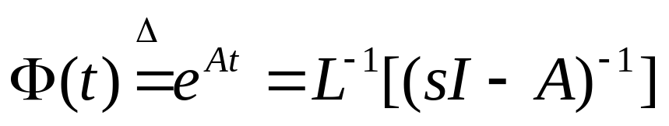
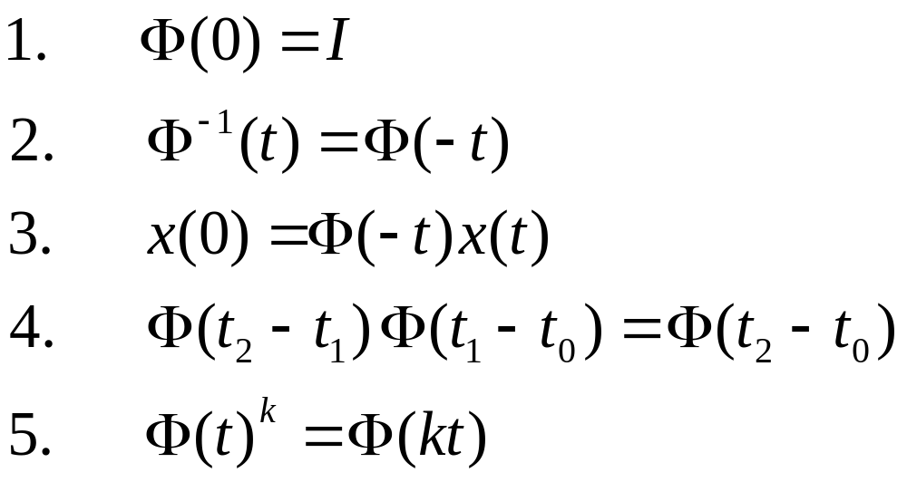
Properties of State Transition Matrix

Slide 5
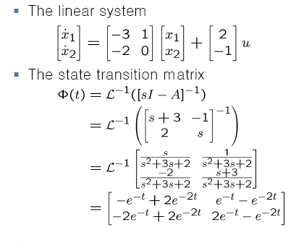
State Transition Matrix

Slide 6
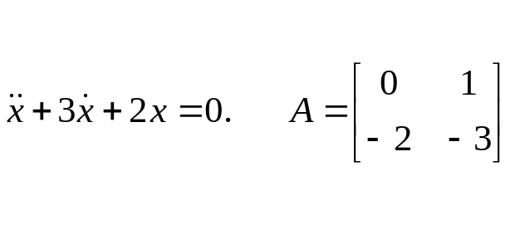
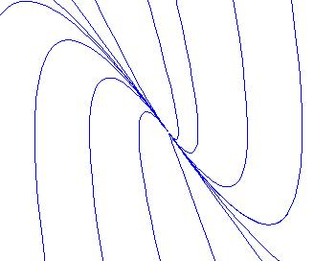
Types of Eqbm. points
Node
eig(A)
-1
-2
e =
0.7071 -0.4472
-0.7071 0.8944

Slide 7
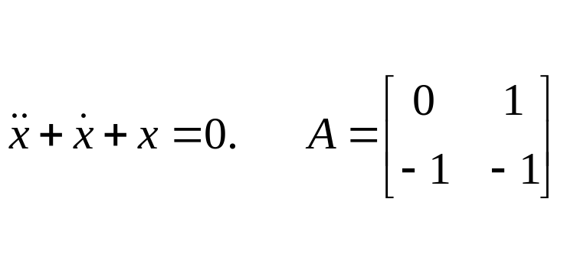
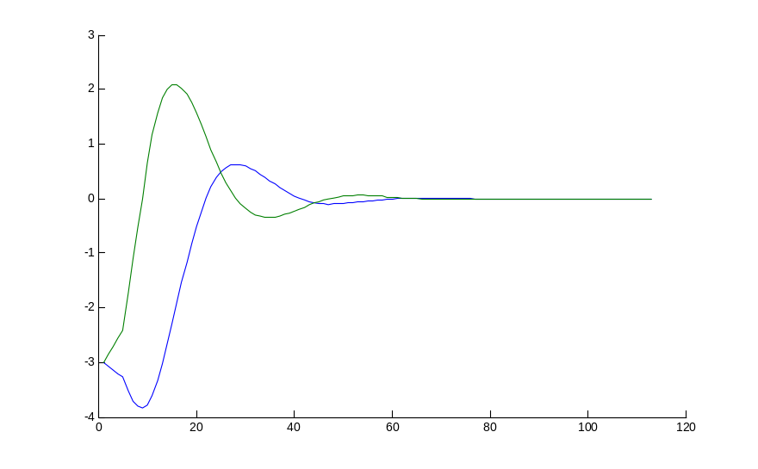
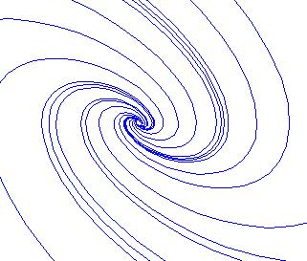
eig(A)
-0.5000 + 0.8660i
-0.5000 - 0.8660i

Slide 8
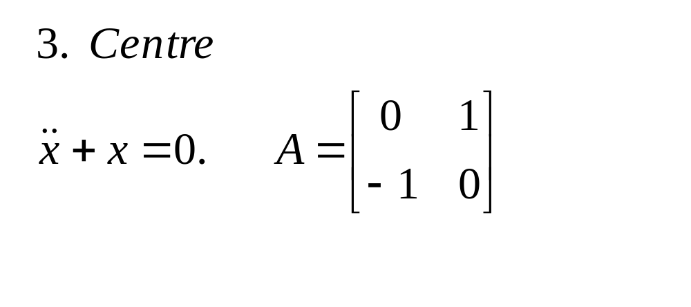
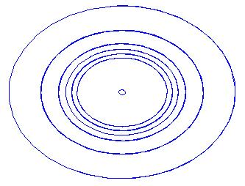
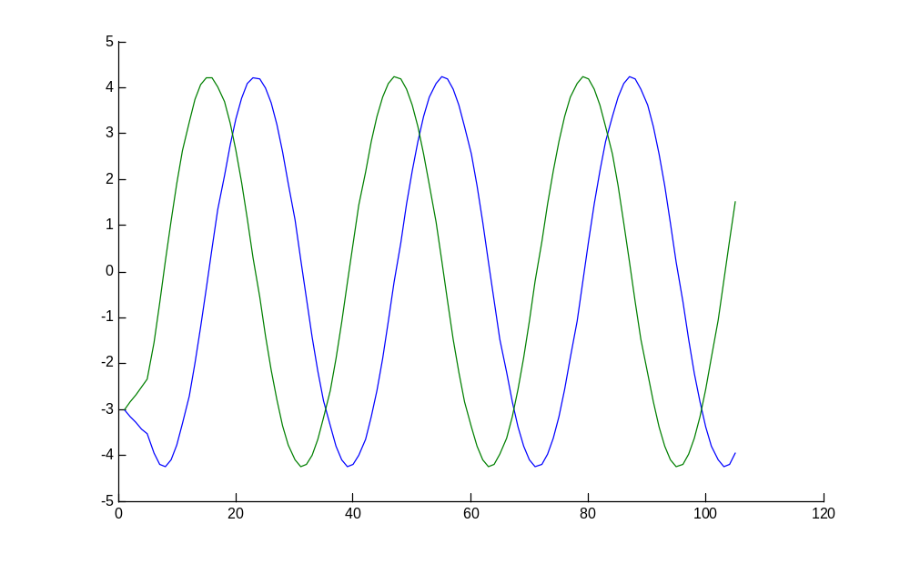
eig(A)
0 + 1.0000i
0 - 1.0000i

Slide 9
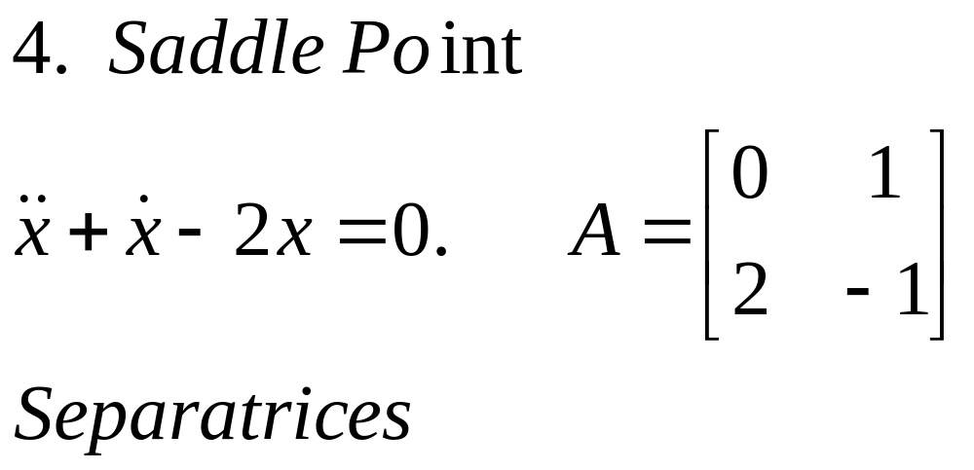



Slide 10
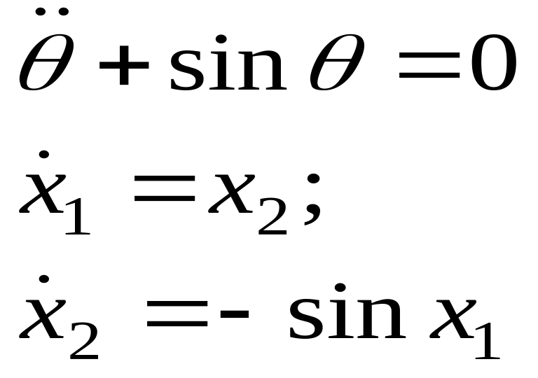
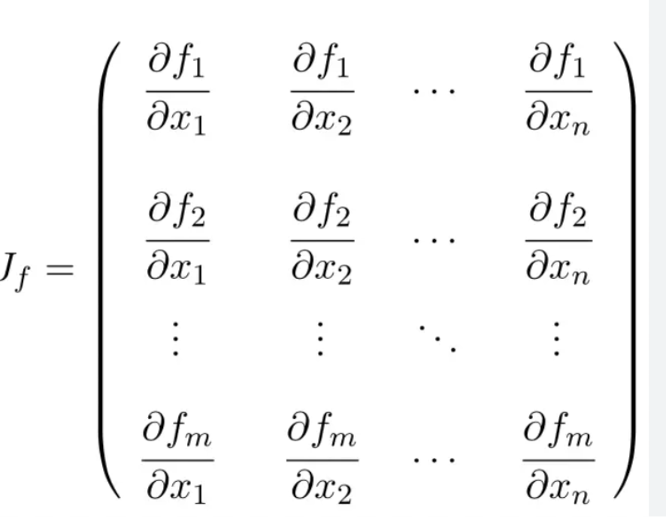
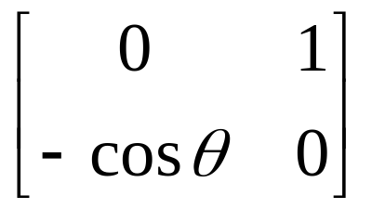
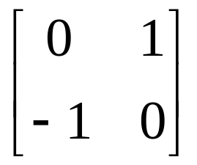

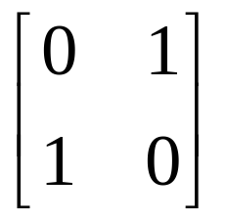

Equilibrium points are (0,0) and (± π,0) and Jacobian matrix Jf is
f1 = x2
f2= -sinx1
At (0,0), Jacobian is
Eigenvalues are 0 ± j1
Center
Eigenvalues are 1 and -1
Saddle
At (0,0), Jacobian is

Slide 11
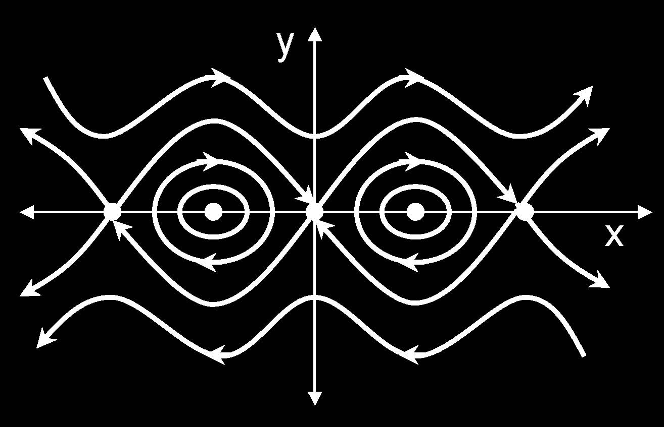
Phase plane portrait of Simple pendulum

Slide 12
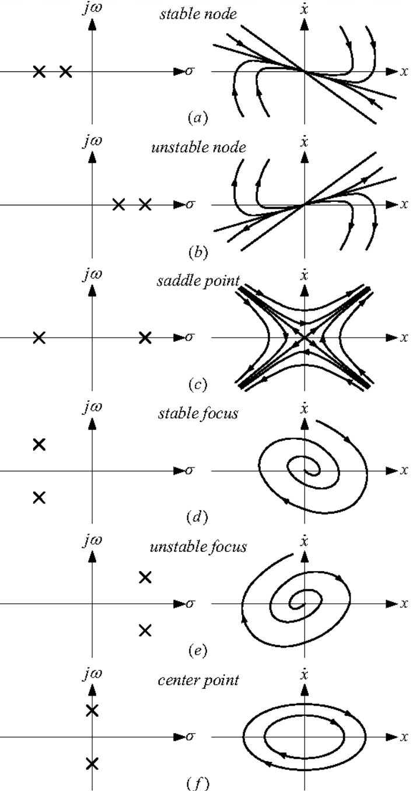
Types of Equilibrium points of linear circuits

