Slide 1
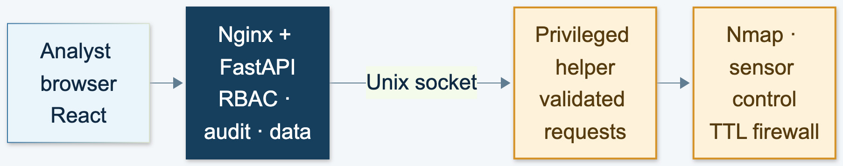
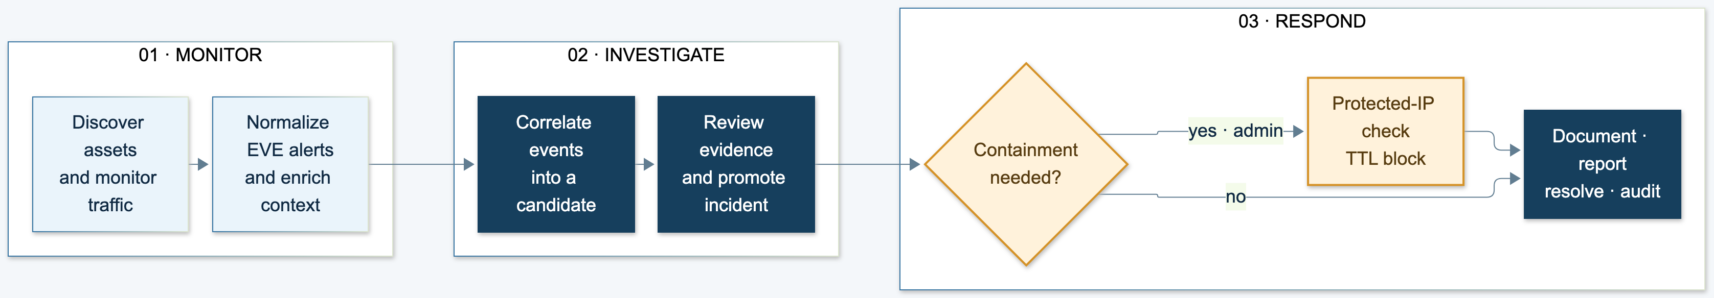
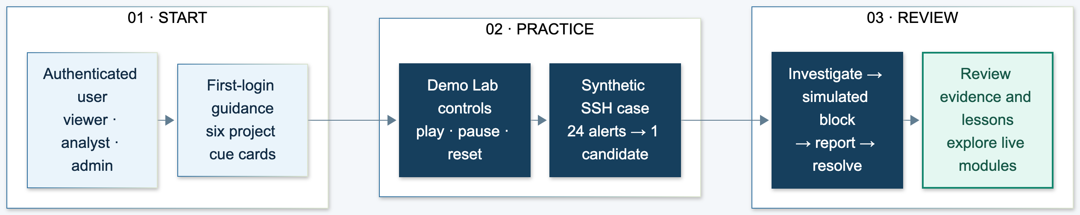
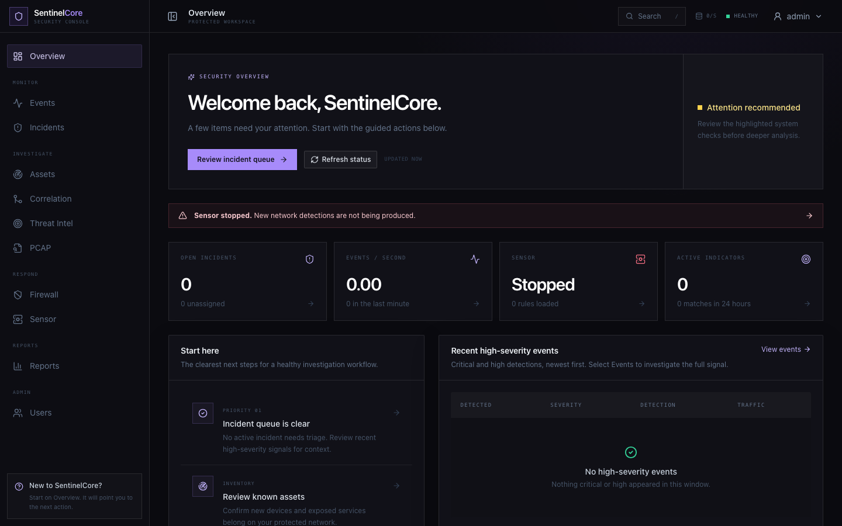

PROJECT-I (CEUP 301)
SENTINELCORE
PROJECT-I · CEUP301
An Explainable Network Detection & Incident Response Platform
TEAM CS26084
SELF-HOSTED · RULE-DRIVEN · AUDITABLE · REVERSIBLE RESPONSE
CSPIT · CSE
OM RASHIYA · 24CS084 | YASH PATEL · 24CS082
FACULTY GUIDE · PROF. AKSHITA KADAM
Department of Computer Science & Engineering
CSE Department · CSPIT, CHARUSAT
ABSTRACT & OBJECTIVE
IMPLEMENTED SCOPE
SentinelCore is a self-hosted network detection and incident response prototype. It transforms Suricata telemetry into searchable evidence and explainable, rule-correlated incidents, giving analysts a connected path from asset context to investigation, reversible response and reporting.
12 functional modules · 7 Compose services
3 access roles · 4 correlation evaluators
Rule-based detection · 60 s–24 h block TTL
ARCHITECTURE · DATA AND CONTROL BOUNDARIES
DATA PLANE
CONTROL PLANE
Fig. 1. The API has no NET_ADMIN / NET_RAW capability; uploaded PCAPs are parsed separately as an unprivileged process.
DETECTION TO RESPONSE FLOW
Fig. 2. Explainable evidence remains linked to analyst decisions.
FIRST-LOGIN GUIDANCE & DEMO
Fig. 3. Browser-only simulated data; no sensor or firewall changes.
TECHNOLOGY STACK
SECURITY BY DESIGN
EVALUATION & LIMITS
• React / Vite + Nginx user interface
• FastAPI, SQLAlchemy and PostgreSQL
• Redis streams and background workers
• Suricata, Nmap, tshark and Docker Compose
• Unprivileged API; validated helper socket
• Gateway, DNS and host IPs protected
• Expiring firewall rules with reconciliation
• Append-only audit log + SHA-256 chain
Unit, API and browser suites cover the platform workflow. A corrected PCAP assertion requires the documented aggregate test total to be rerun. Attack detection accuracy and fixed-resource throughput studies are prepared but not yet executed; no benchmark claim is asserted.
APPLICATION EVIDENCE
CONCLUSION & NEXT STUDY
REFERENCES & SOURCE
SentinelCore connects detection, evidence, analyst decisions and safe response in one local workflow. The next study will run the frozen A1–A8 lab matrix and controlled load campaign, then report detection rates, false positives, alert latency, packet loss and resource use.
[1] NIST SP 800-61 Rev. 3, 2025.
[2] OISF, Suricata 8 EVE JSON Output.
[3] SentinelCore project repository.
Operational overview · incident and sensor status
TARGET: SMEs · EDUCATION · SECURITY LABS
Monitor or test only authorized networks.
SCAN FOR PROJECT REPOSITORY

