Slide 1
CLOUD STRATEGY

Slide 2
Agenda
Introduction
What is Cloud Computing?
Creating your vision for cloud computing
Creating a Cloud Roadmap
Expected Benefits and Risks

Slide 3
Cloud Strategy
Optimize existing IT environment.
Gradual transition to cloud.
Estimation of cost-efficiency.
Design of the IT architecture.
Deployment of the cloud infrastructure.
Continuous technological audit of the project.

Slide 4
What is Cloud Computing?
Cloud computing is a model for enabling convenient, on-demand network access to a shared pool of configurable computing resources (e.g., networks, servers, storage, applications and services) that can be rapidly provisioned and released with minimal management effort.
Characteristics of Cloud Computing:
On-demand self-service
Broader network access
Resource Pooling

Slide 5
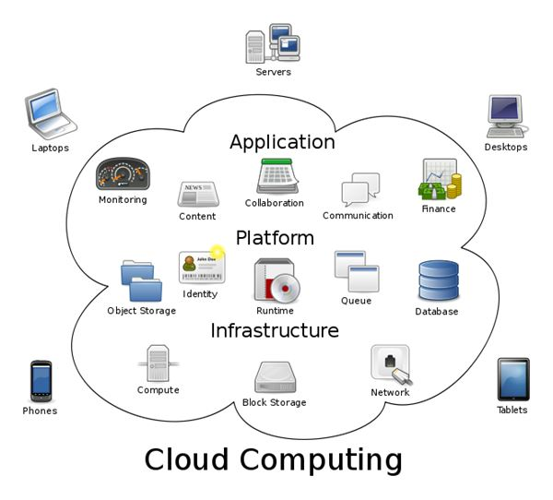
Cloud is simply an evolution of outsourcing the IT Stack

Slide 6
Creating your vision for Cloud Computing
Scalable: Cloud computing solution should scale up to support the business processing requirements without a significant increase in hardware and software expenses.
Manageable: We need to be able to manage our cloud computing solution, including adding, deleting, and managing compute resources across a number of different types of systems without having to move through a great deal of complexity.
Securable: We should be able to leverage state-of-the-art security best practices, including encryption and identity management.
Portable: Application and data should be easily portable to other platforms, cloud and non-cloud, to meet the needs of the business.
Durable: Cloud computing solution should be resilient to internal and external system issues, and provide uptime that meets or surpasses the uptime requirements of the business.

Slide 7
Creating a cloud roadmap
Step1: Define the new strategies.
We need to address these key capabilities in our strategy:
Multi-tenancy
Governance
Globalization
Integration
Virtual Image Repository

Slide 8
Creating a cloud roadmap
Step2 : Define new softwares and models.
New software requirements should be understood when creating the roadmap.
Includes addition of cloud infrastructure management and understanding the differences between Paas , Saas , Iaas.
Cloud infrastructure management :
Should manage a shared pool of physical computing resources that is controlled and managed by the IT organization, and provides a single point of access/management.
Automatic workload distribution within the cloud according to policy, including server service provisioning and de-provisioning by cloud users, so that the exact needs are met and resources are shared efficiently.
Should leverage open standards and provide interoperability with features such as automatic conversion between hypervisor types.

Slide 9
Creating a cloud roadmap
Difference between SaaS , PaaS , IaaS :-
Cloud Software as a Service(SaaS) :
The capability provided to the consumer is to use the provider’s applications running on a cloud infrastructure.
Cloud Platform as a Service(PaaS) :
The capability provided to the consumer is to deploy onto the cloud infrastructure consumer-created or acquired applications created using programming languages and tools supported by the provider.
Cloud Infrastructure as a Service(IaaS) :
The capability provided to the consumer is to provision processing, storage, networks, and other fundamental computing resources where the consumer is able to deploy and run arbitrary software, which can include operating systems and applications.

Slide 10
Creating a cloud roadmap
Step 3 : Define Business-driven policies
We define the business policies we need to consider and create, including the who, what, why, and where around the use of the virtualized resources.
Examples of these policies include which groups can access which virtual machines, and what they can accomplish when they access those resources.
Step4 : Create a Deployment Enterprise Strategy
Access the business , culture and value.
Understand the enterprise data , services , processes.
Understand the cloud resources.
Identify candidate data , services , processes.
Create a governance strategy , security strategy , cloud management strategy.
Implement cloud management , security , governance , operations.

Slide 11
Expected Benefits and Risks
Benefits :
Agility
Adaptability
Flexibility
Cost Savings
Risks :
Security
Privacy
Enterprise Support
Service Maturity
Return on Investment Concerns

Slide 12
THANK YOU!

