Slide 1

Willson Financial
Red Team

Slide 2

Team members
Ronald Stewart
Rashmi Sathiyanarayanan
Oyun Tsolmon

Slide 3
Willson Financial Case Study
Willson Financial was founded by Jake and Ned Willson. Both partners have degrees in finance, with Ned having his MBA. Jake and Ned also both have their CFA license and have registered their company with the SEC. They have one office employee; Phoenix Two Star, who is responsible for client appointments, office supplies, and other office duties. They also hired a part-time compliance manager, June Santos, to ensure that the company would stringently follow all SEC regulations. Jake and Ned have been very busy with their clientele increasing exponentially over the past year. As a result, they decided it was time to step back, and reevaluate their business structure.
Some of the questions to be answered are:
How many clients have been added for each of the past six months?
What is the average amount of assets (in currency) for the entire client list?
How many clients have a high number (more than 10 a month) of transactions?

Slide 4
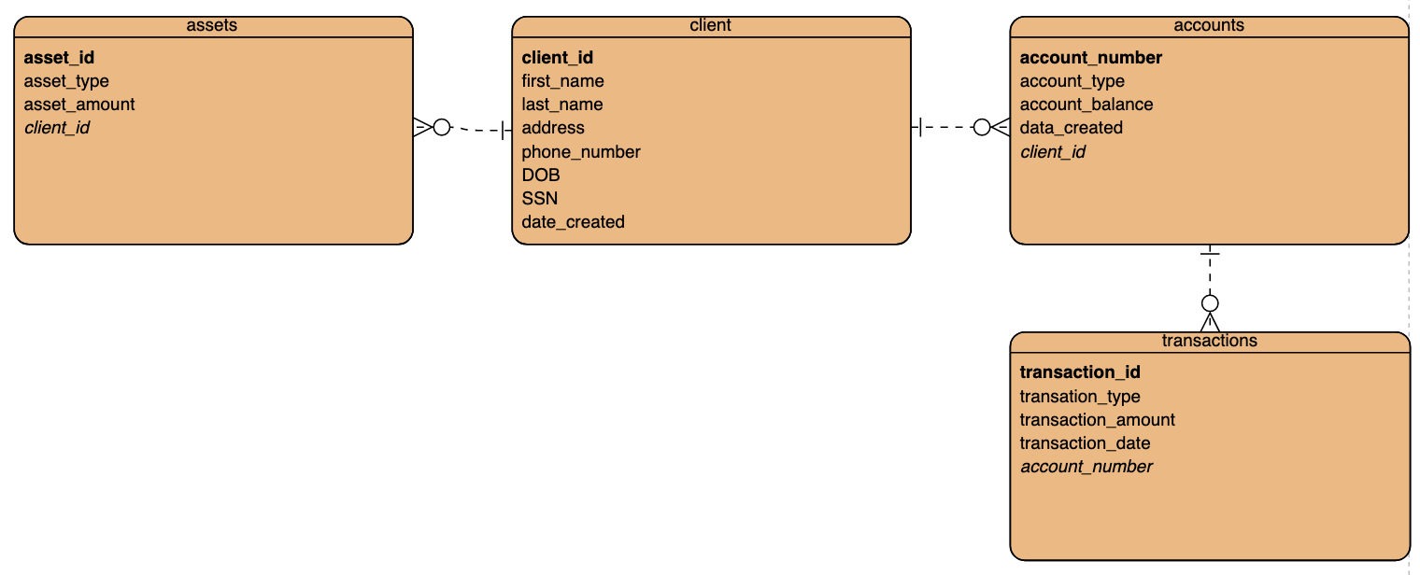
ERD Business Rules
A client can have many accounts, but an account can only belong to one client
A client can have many assets, but each asset can only belong to one client
An account can have many transactions, but each transaction can only belong to one account

Slide 5
Client Report How many clients have been added for each of the past six months?
To get this information, we are retrieving the date the client was created in the format of YY-MM-DD. We also need to retrieve the number of clients created in a specific month for the last six months to display all clients added each month for the last six months.
We can retrieve the first name, last name and the date created from the date created is less than current date minus six months. This retrieves the clients added for the last six months.

Slide 6
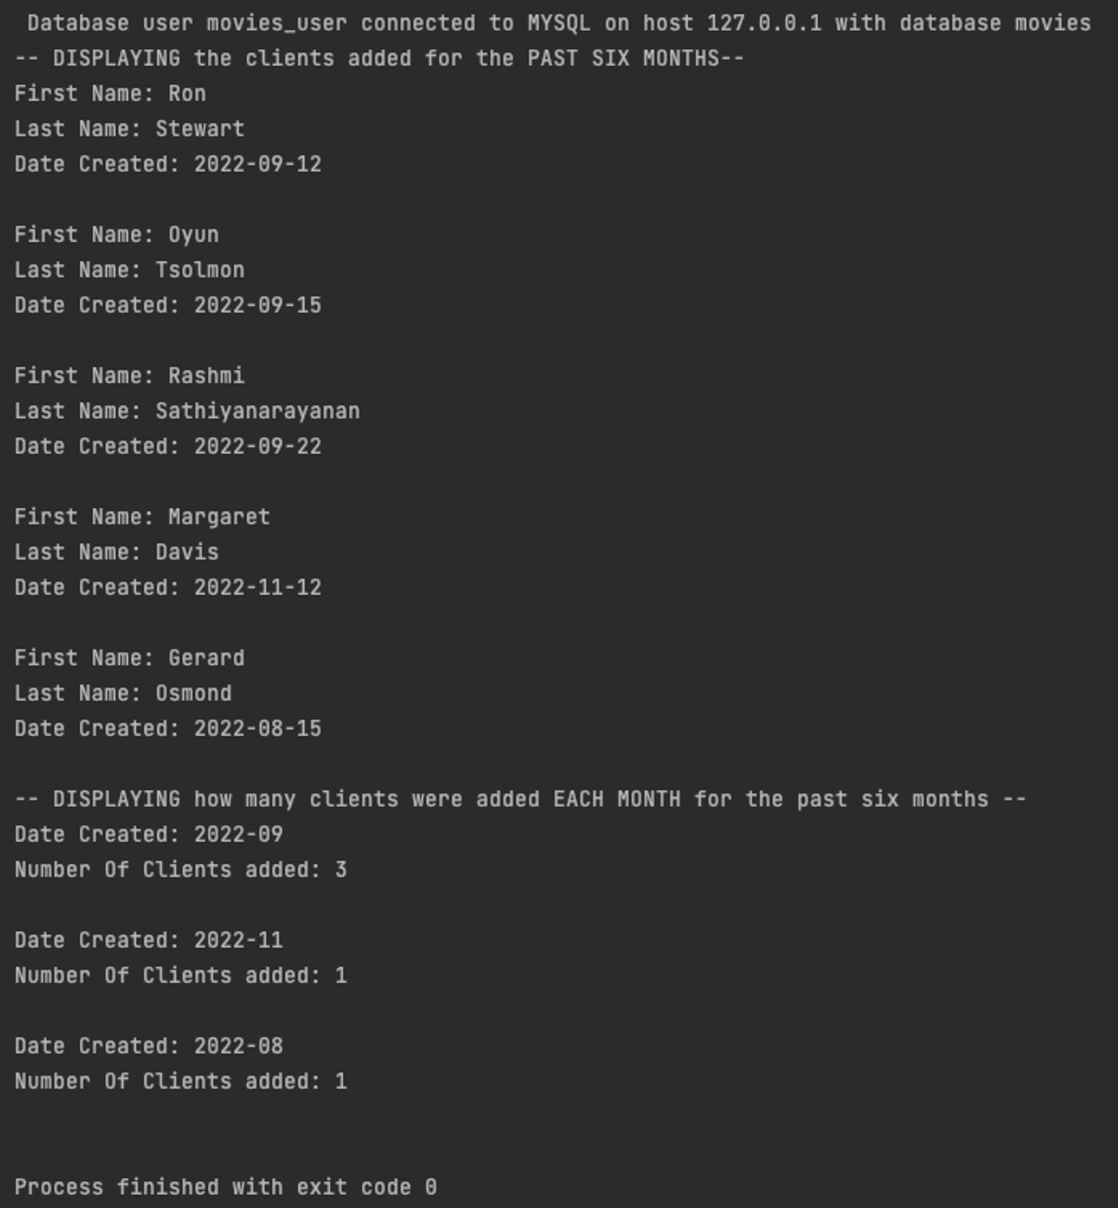
Client Report How many clients have been added for each of the past six months?

Slide 7
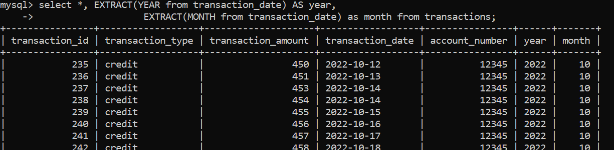
Transactions Report How many clients have a high number (more than ten a month) of transactions?
To get this information, we must first extract the month and year from the transaction date

Slide 8
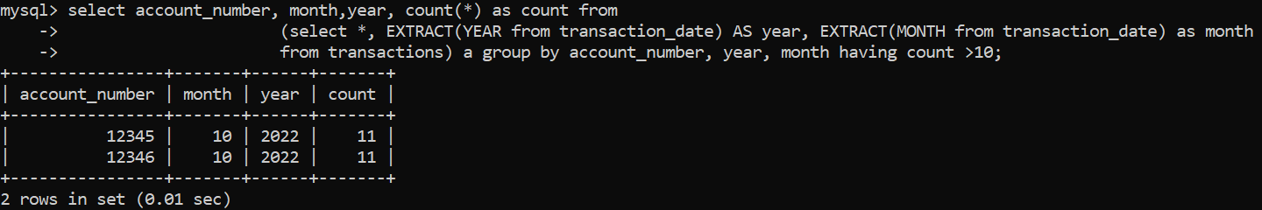
Transactions Report How many clients have a high number (more than ten a month) of transactions?
Next, we will group the transactions by account number, year, and month.

Slide 9
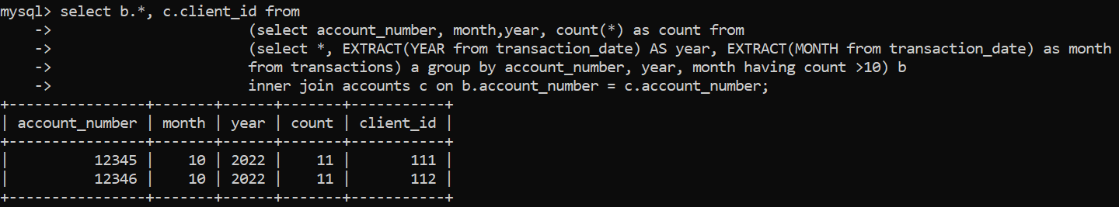
Transactions Report How many clients have a high number (more than ten a month) of transactions?
Then, we get the count of transactions for each group (account number, year, month).
After that, we join the above output with the accounts table based on account number to get the client ID.

Slide 10
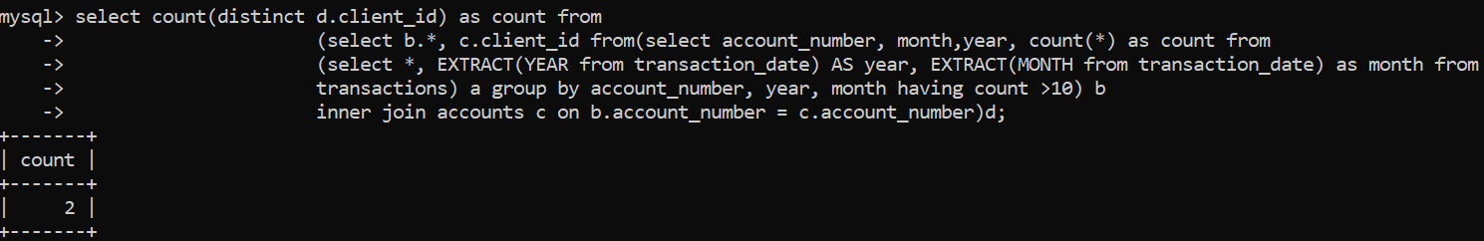
Transactions Report How many clients have a high number (more than ten a month) of transactions?
Finally, we’ll get the count of clients by getting the count of the distinct client ID from the previous output

Slide 11
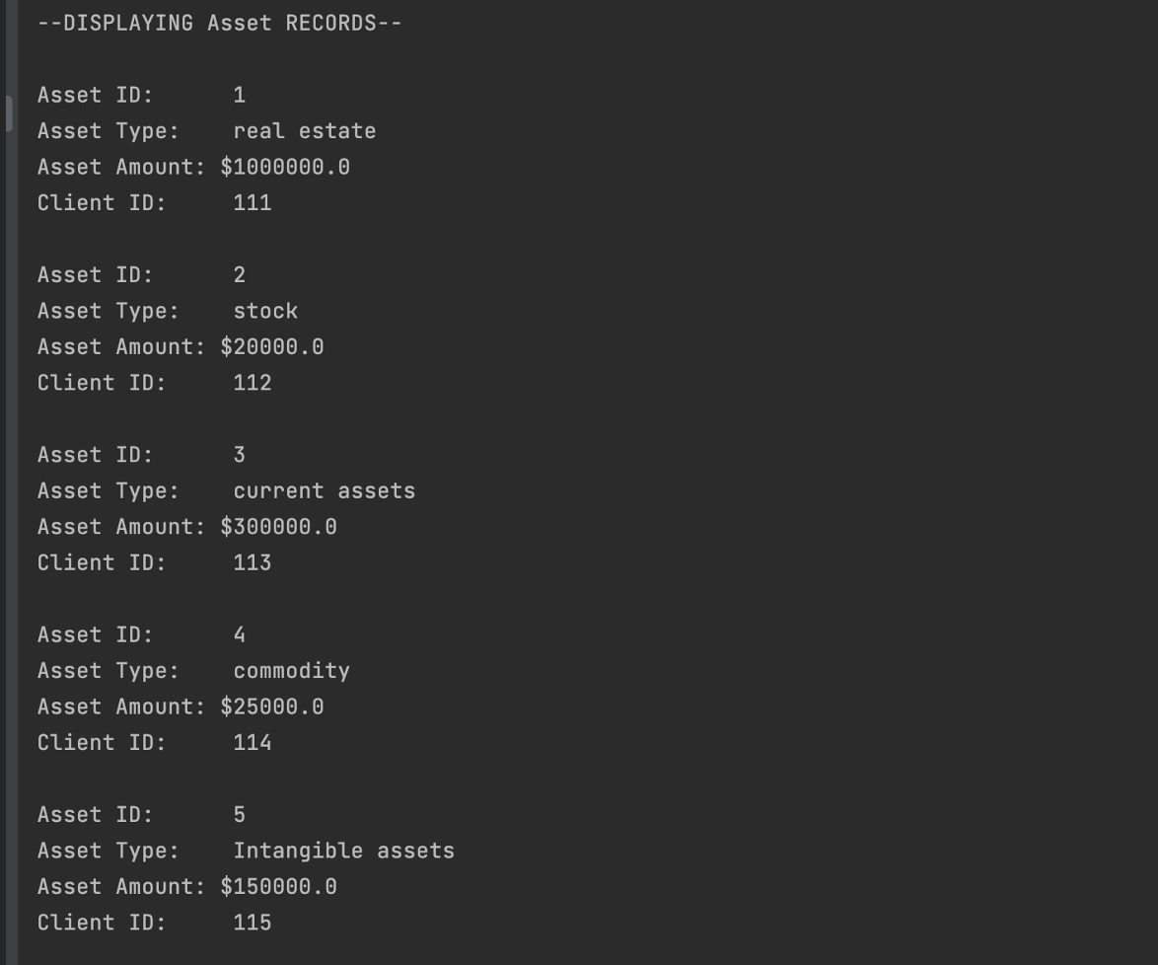
Assets Report What is the average amount of assets (in currency) for the entire client list?
First, we select all columns from the assets table
The output is organized by order of asset ID (PK) and prints the corresponding asset type, as well as the total amount
We also print the corresponding client ID (FK)

Slide 12
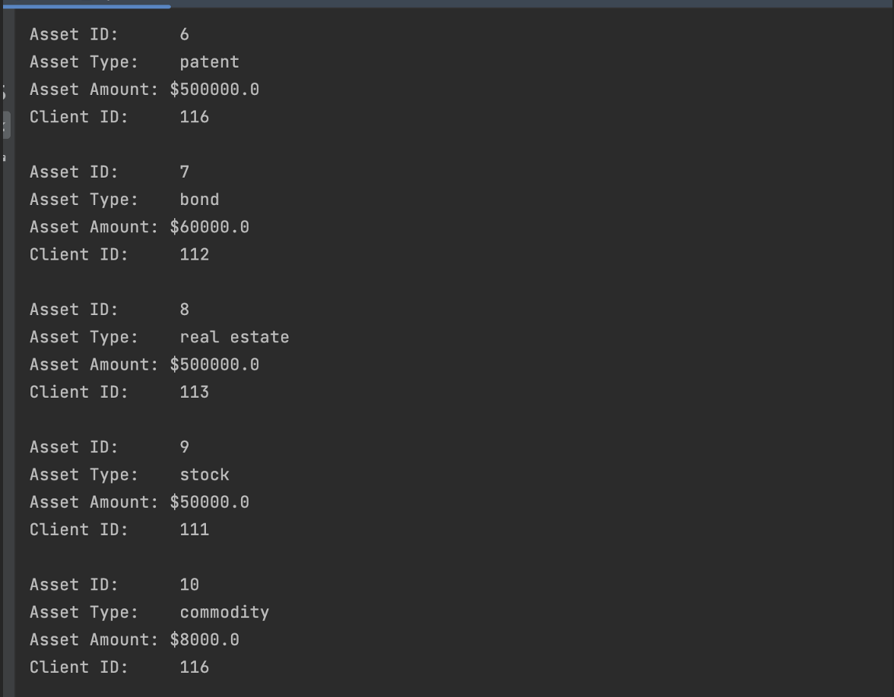
Assets Report What is the average amount of assets (in currency) for the entire client list?

Slide 13
Assets Report What is the average amount of assets (in currency) for the entire client list?
Lastly, we take the average of all client assets and print the result as a dollar amount

