Slide 1
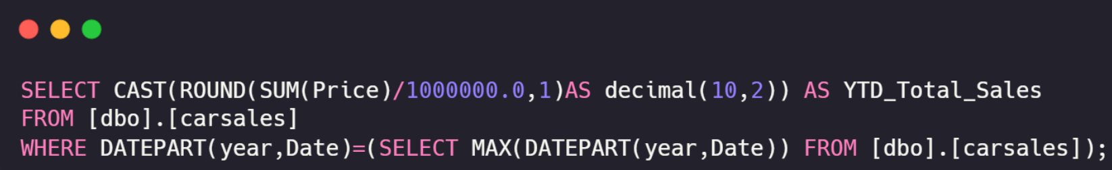
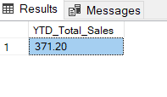
Car Sales – Query Document
YTD Total Sales :
Output :

Slide 2
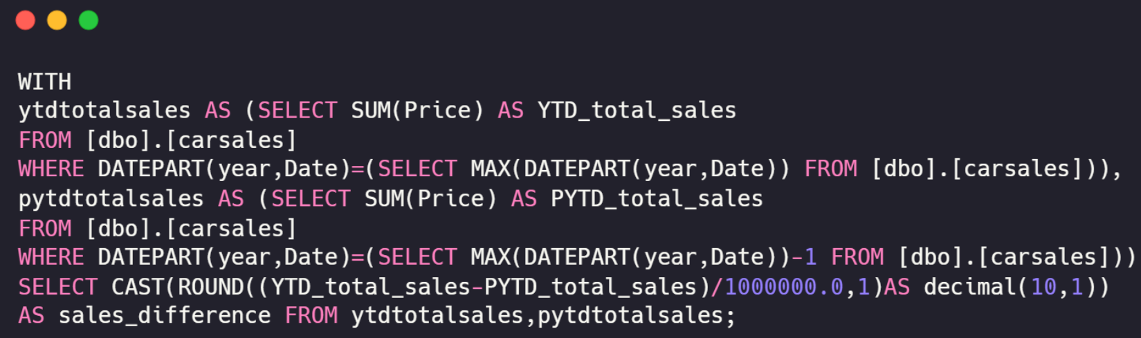

Car Sales – Query Document
Sales Difference :
Output :

Slide 3
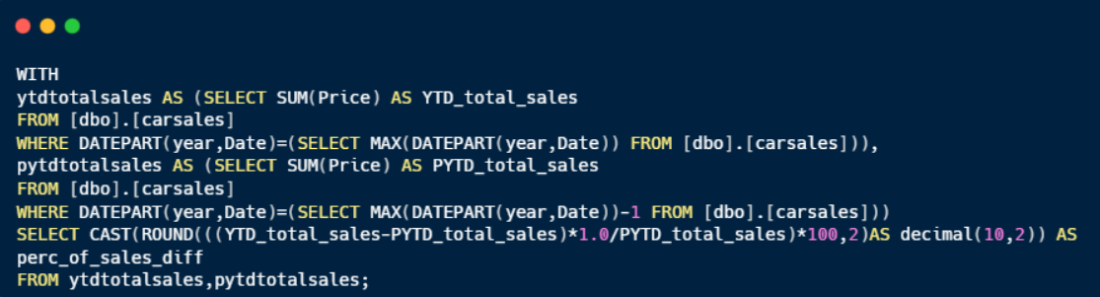

Car Sales – Query Document
Sales Difference in % :
Output :

Slide 4
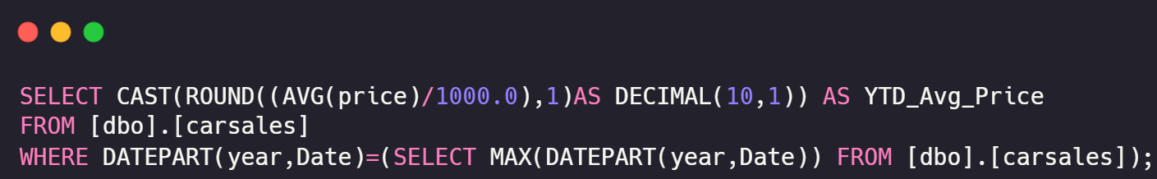

Car Sales – Query Document
YTD Average Price :
Output :

Slide 5
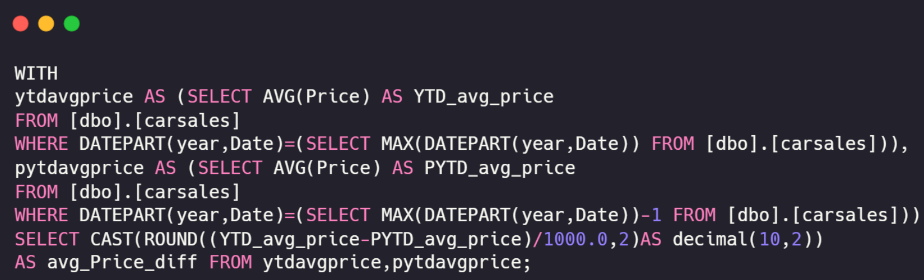

Car Sales – Query Document
Average Price Difference :
Output :

Slide 6
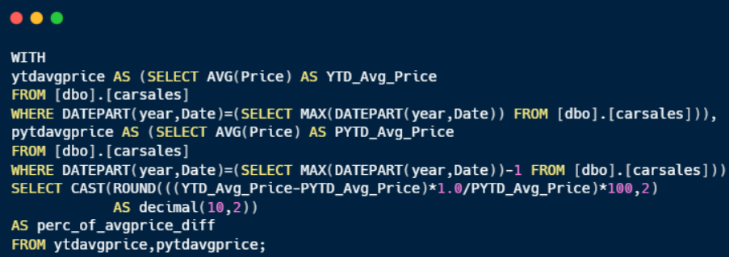

Car Sales – Query Document
Avg Price Difference in % :
Output :

Slide 7
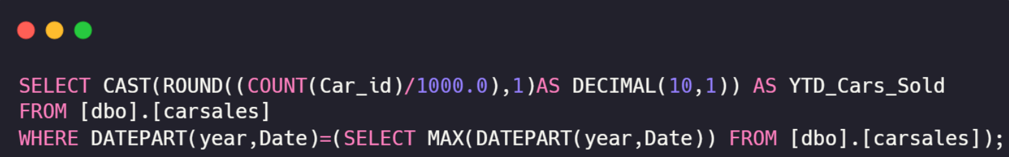

Car Sales – Query Document
YTD Cars Sold :
Output :

Slide 8
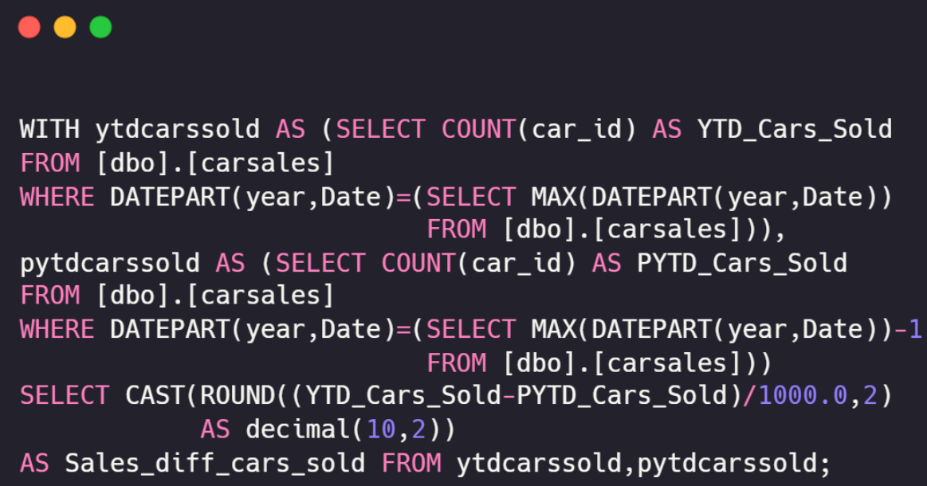

Car Sales – Query Document
Cars Sold Difference :
Output :

Slide 9
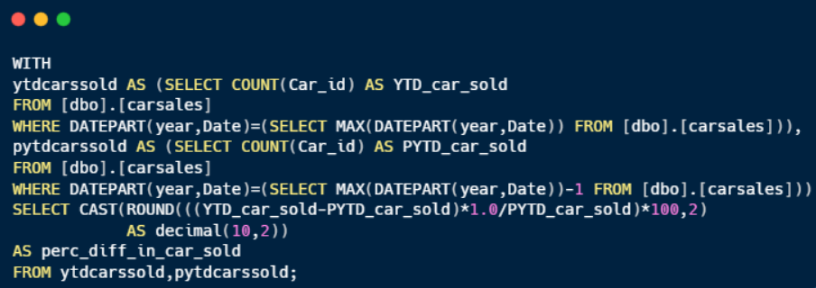

Car Sales – Query Document
Cars Sold Difference in % :
Output :

Slide 10
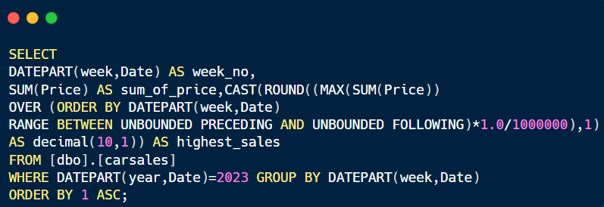
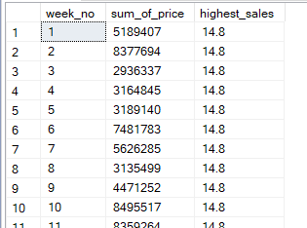
Car Sales – Query Document
YTD Sales Weekly Trend:
Output :

Slide 11
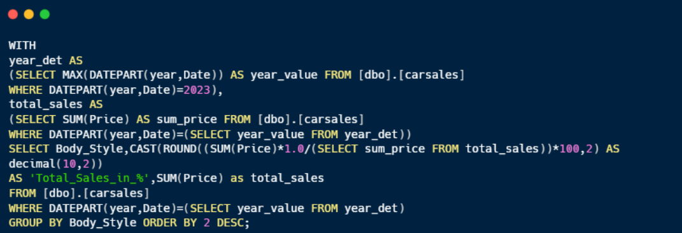
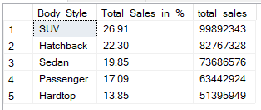
Car Sales – Query Document
YTD Total Sales by Body Style :
Output :

Slide 12
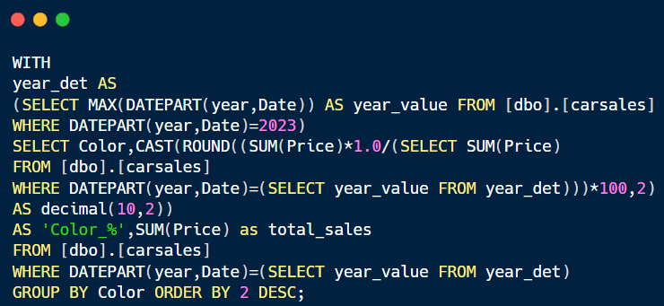
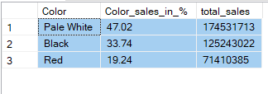
Car Sales – Query Document
YTD Total Sales by Color :
Output :

Slide 13
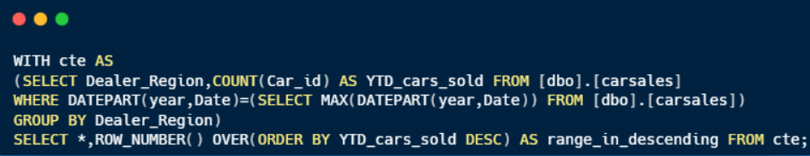
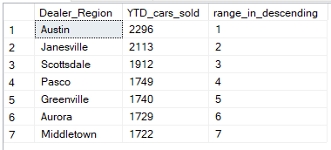
Car Sales – Query Document
YTD Cars Sold by Dealer Region :
Output :

Slide 14
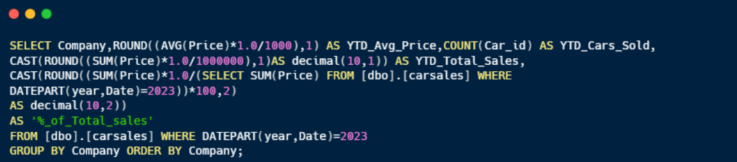
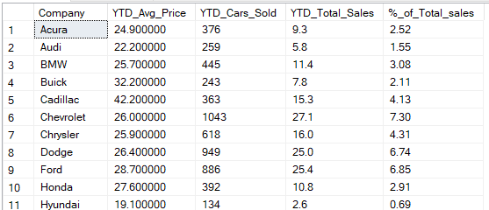
Car Sales – Query Document
YTD Company Wise Sales Trend:
Output :

Slide 15
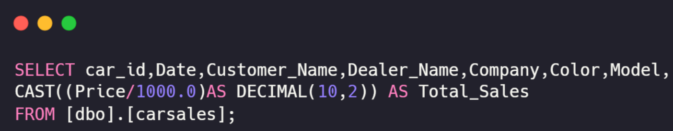
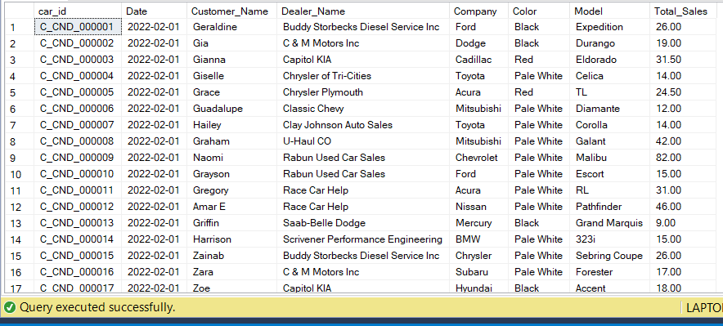
Car Sales – Query Document
Car Sales Detail Table :
Output :

