Slide 1
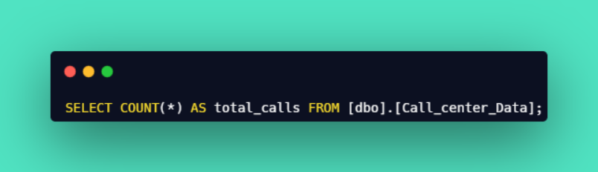

Call Center Analysis - Query Document
1
Total Calls :
Output :

Slide 2
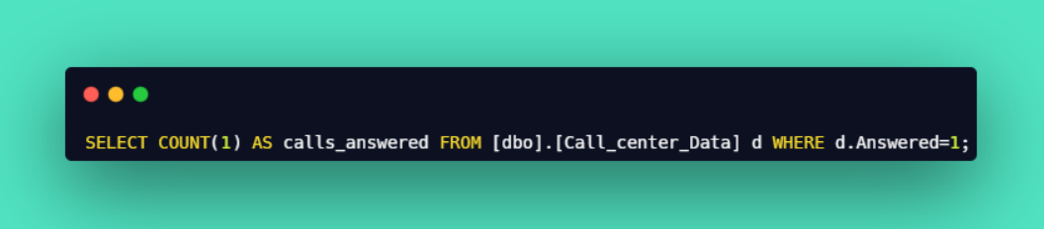

Call Center Analysis - Query Document
2
Calls Answered :
Output :

Slide 3
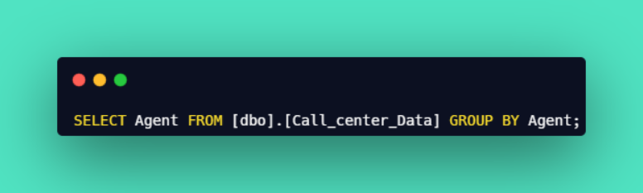
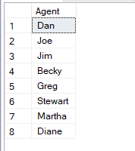
Call Center Analysis - Query Document
3
Total Agent :
Output :

Slide 4
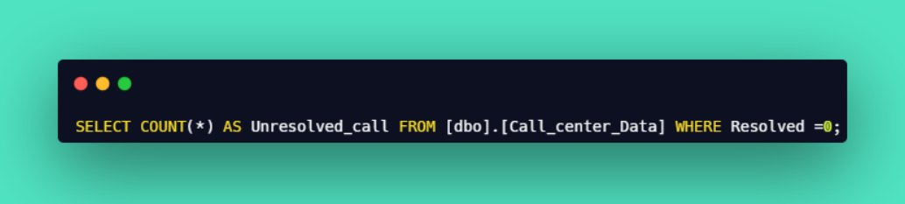

Call Center Analysis - Query Document
4
Unresolved :
Output :

Slide 5
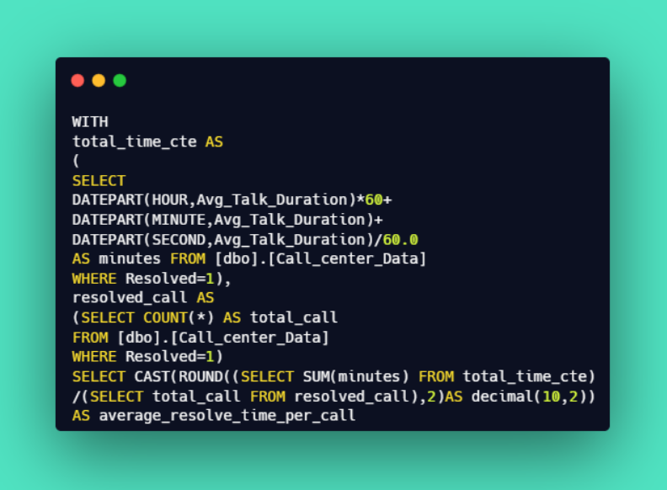

Call Center Analysis - Query Document
5
Avg. Resolved Time :
Output :

Slide 6
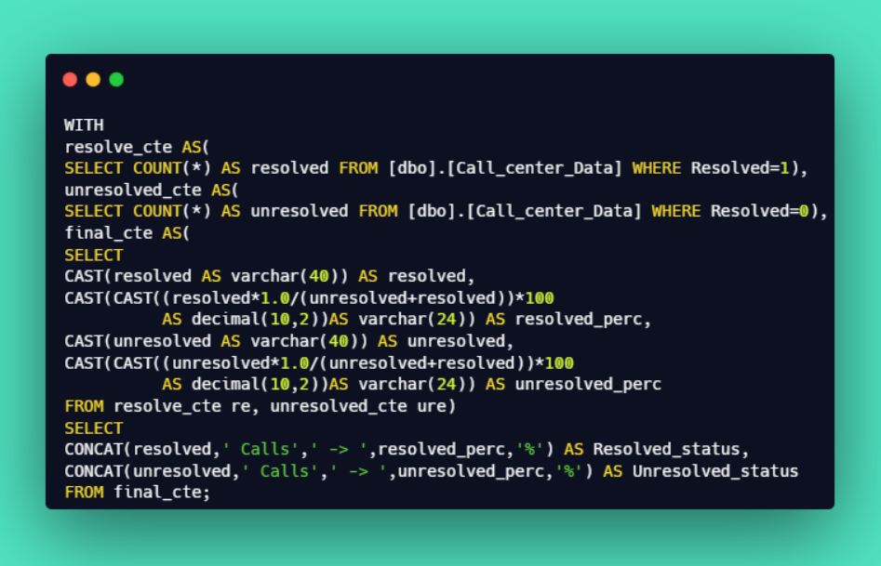

Call Center Analysis - Query Document
6
Call Status:
Output :

Slide 7
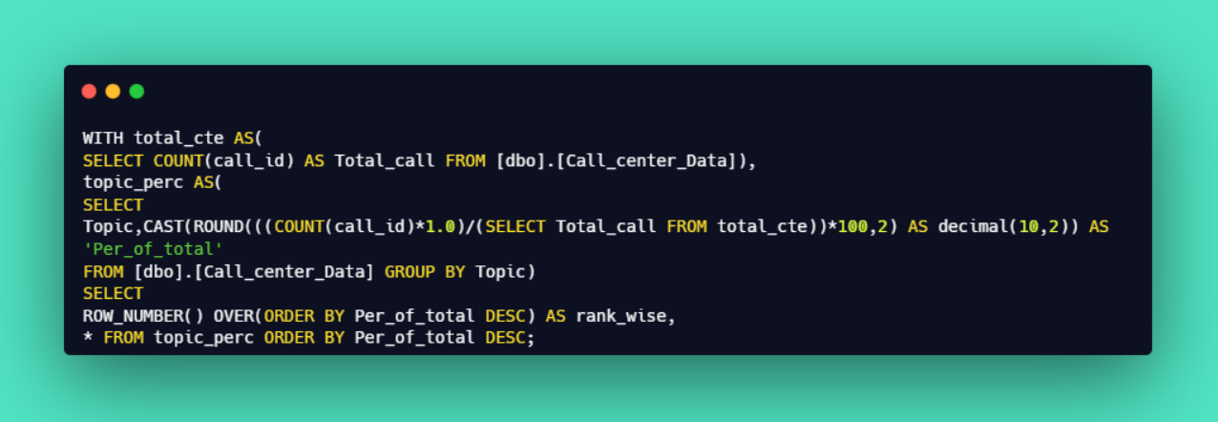
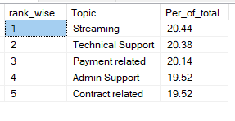
Call Center Analysis - Query Document
7
Calls by Topic :
Output :

Slide 8
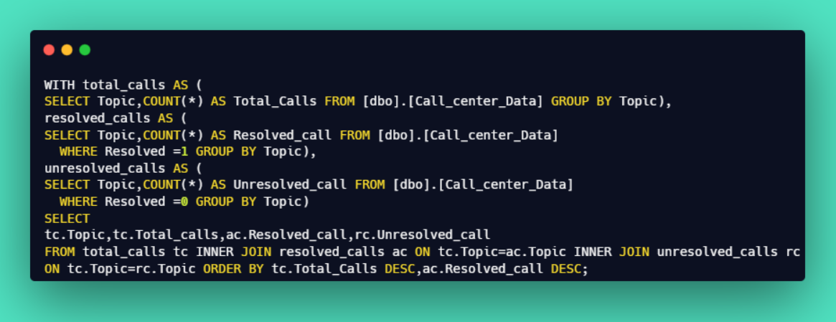
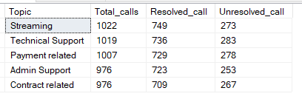
Call Center Analysis - Query Document
8
Total Calls, Resolved and Unresolved call by Topic :
Output :

Slide 9
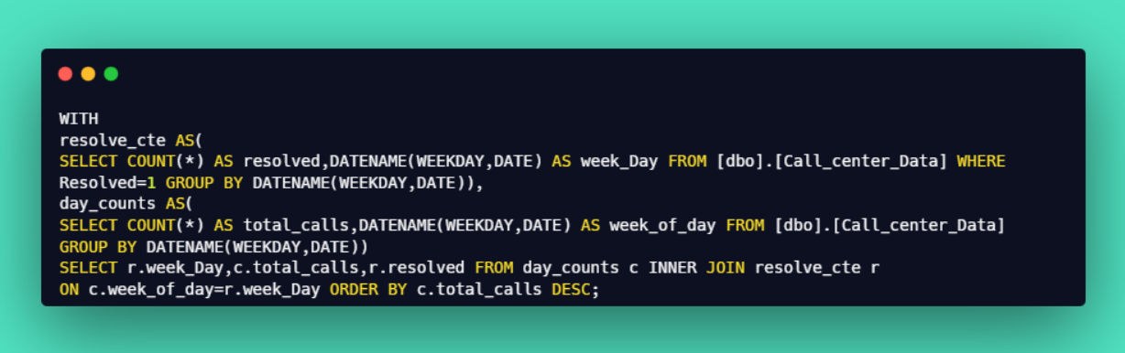
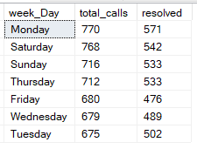
Call Center Analysis - Query Document
9
Total Calls by Week :
Output :

Slide 10
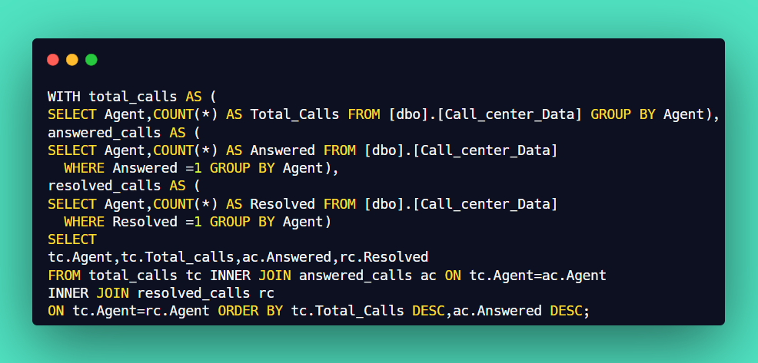
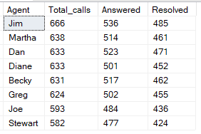
Call Center Analysis - Query Document
10
Total Calls, Answered and Resolved call by Agent :
Output :

Slide 11
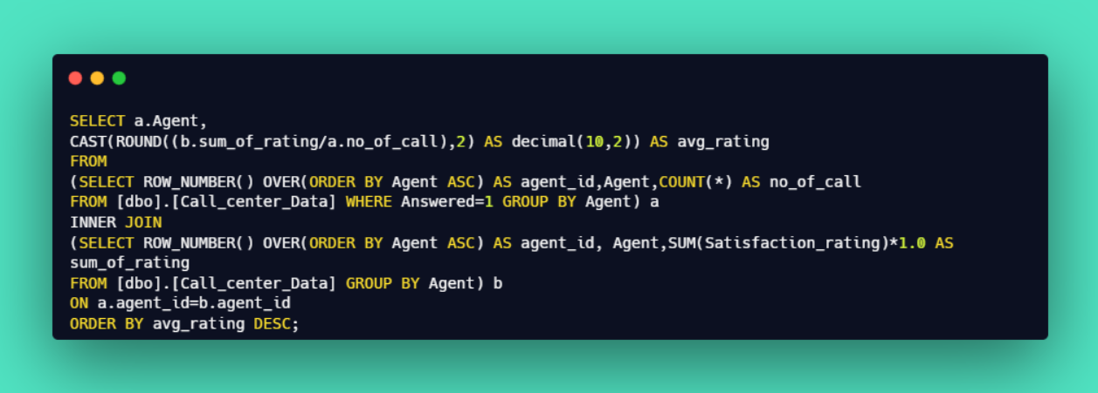
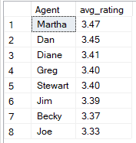
Call Center Analysis - Query Document
11
Agents Avg. Satisfaction Rating :
Output :

Slide 12
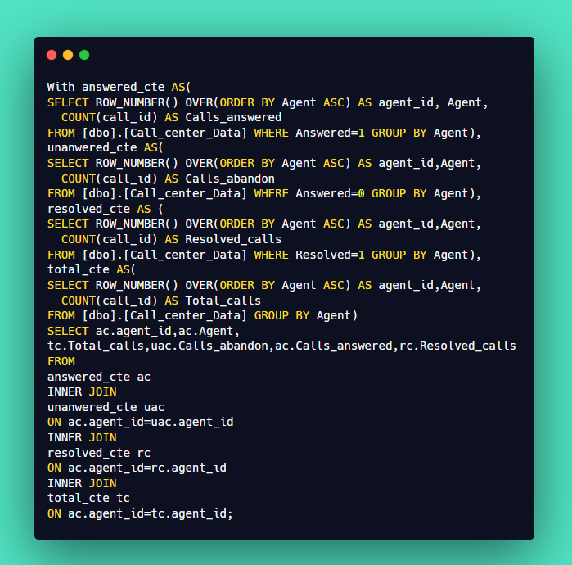
Call Center Analysis - Query Document
12
Agent Wise Report :

Slide 13
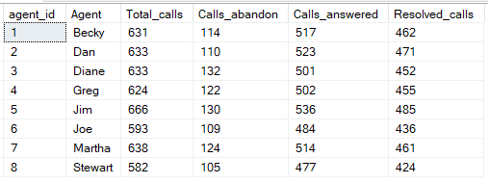
Call Center Analysis - Query Document
13
Output :

