Slide 1
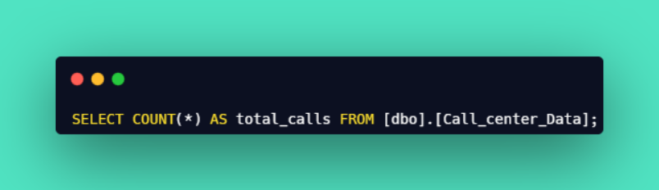

Call Center Analysis - Query Document
1

Slide 2
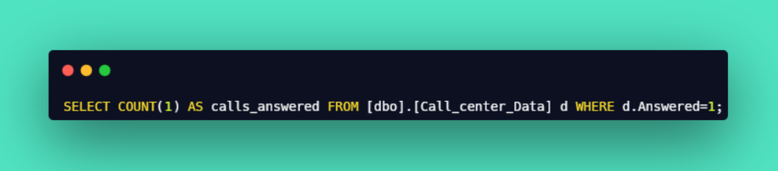

Call Center Analysis - Query Document
2

Slide 3
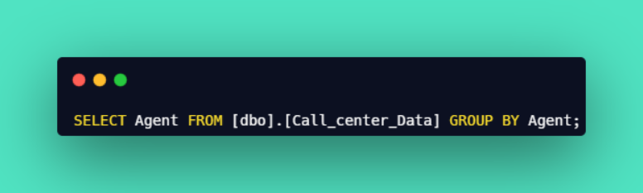
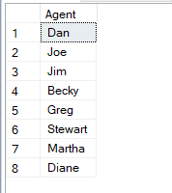
Call Center Analysis - Query Document
3

Slide 4
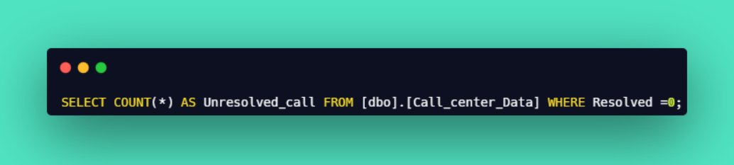

Call Center Analysis - Query Document
4

Slide 5
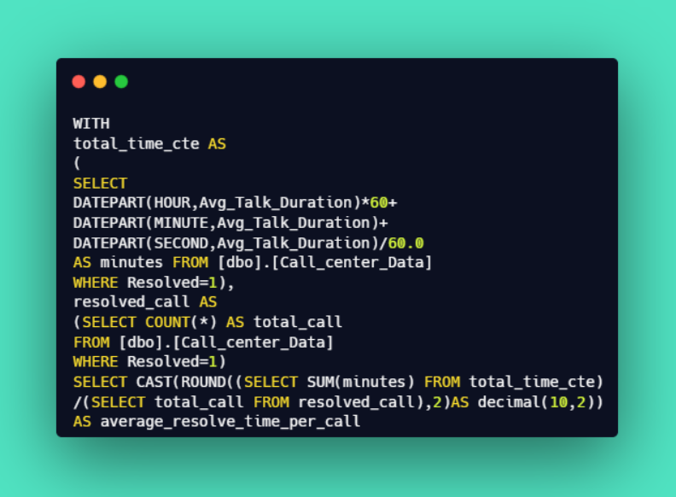

Call Center Analysis - Query Document
5

Slide 6
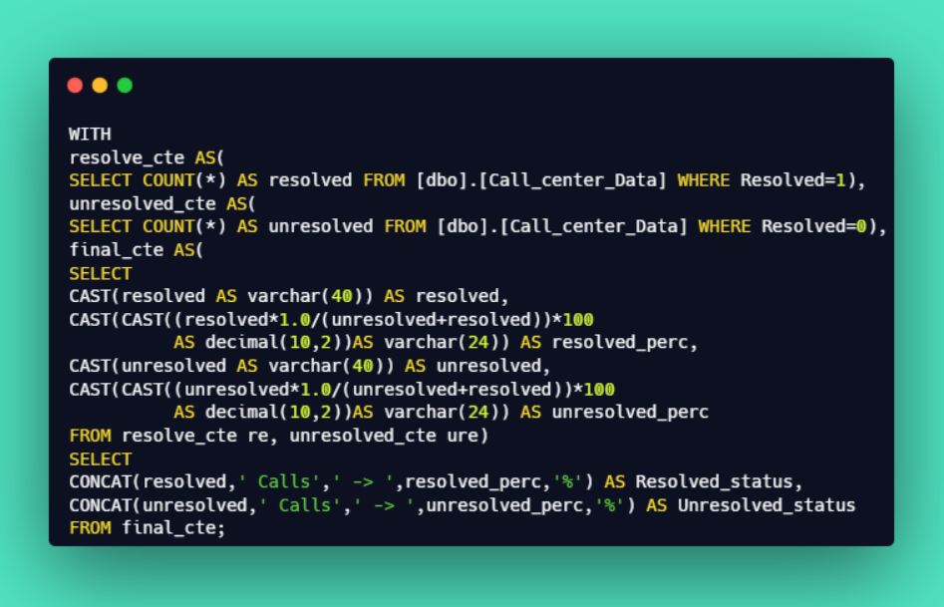

Call Center Analysis - Query Document
6

Slide 7
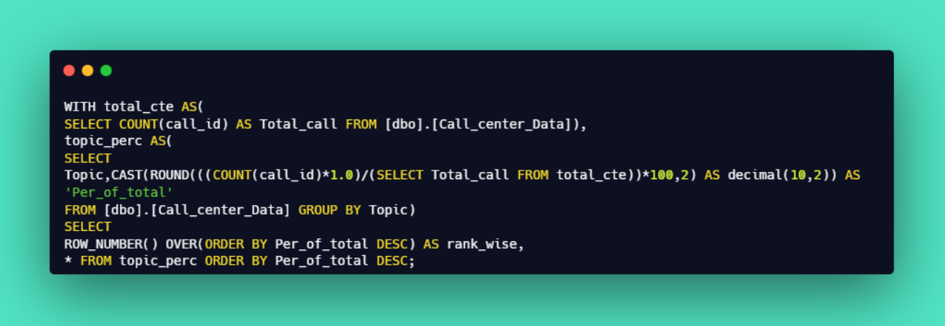
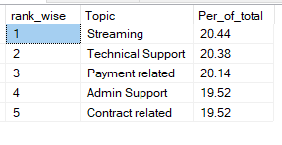
Call Center Analysis - Query Document
7

Slide 8
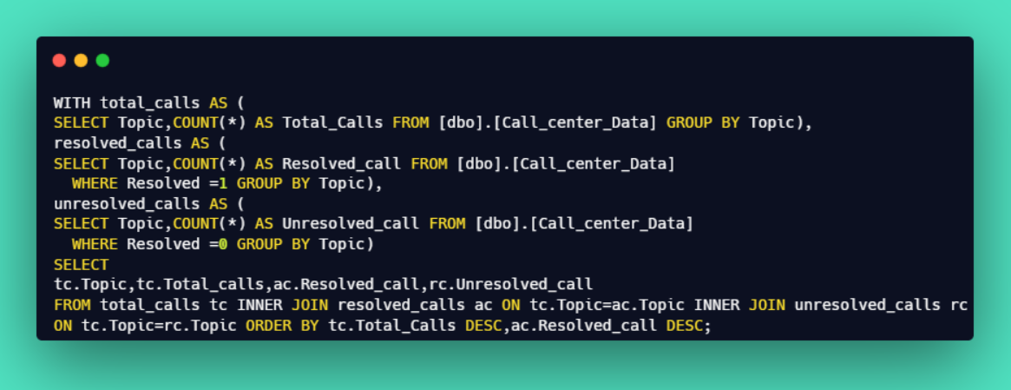
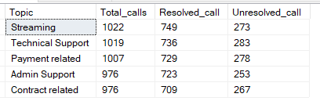
Call Center Analysis - Query Document
8

Slide 9
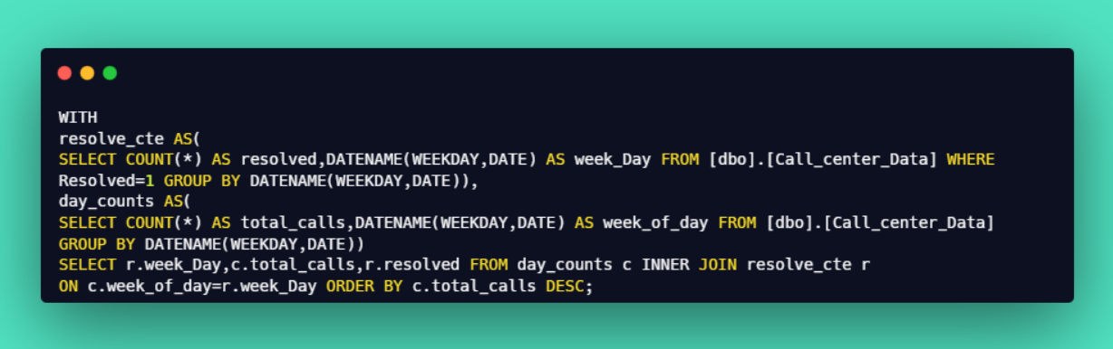
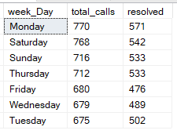
Call Center Analysis - Query Document
9

Slide 10
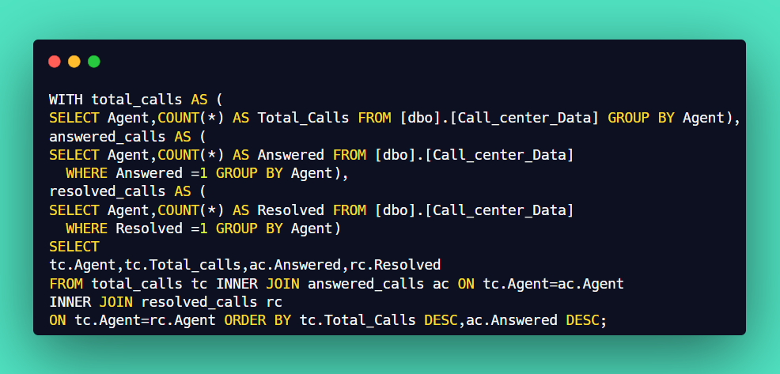
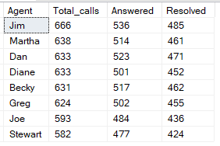
Call Center Analysis - Query Document
10

Slide 11
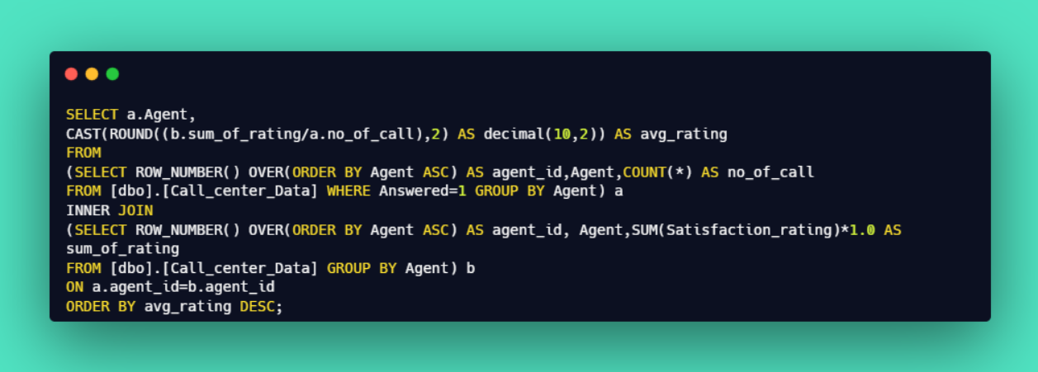
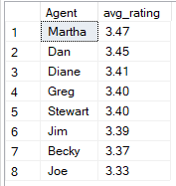
Call Center Analysis - Query Document
11

Slide 12
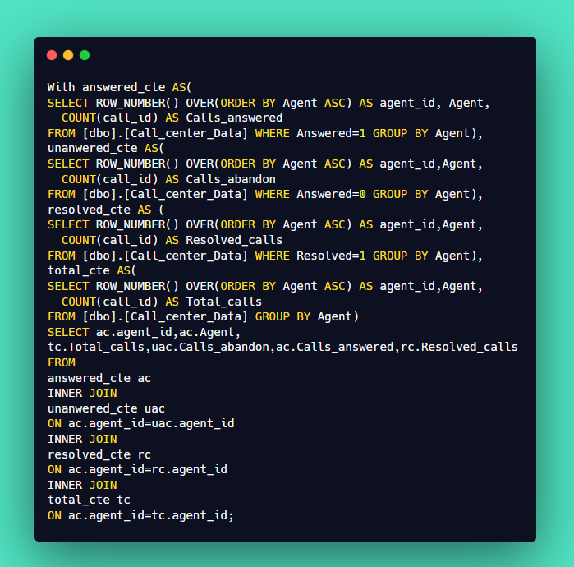
Call Center Analysis - Query Document
12

Slide 13
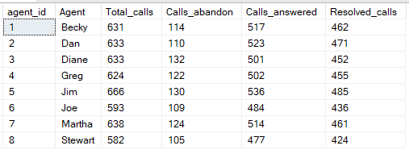
Call Center Analysis - Query Document
13

