Slide 1
MUSIC RECOMMENDATION BASED ON CURRENT MOOD
Spring 2020 - Introduction to Machine Learning
Binghamton University
Computer Science
Sharvari Joshi | Krupa Sawant | Vinit Bhosale | Rashmi Badadale
sjoshi14@binghamton.edu | ksawant1@gmail.com | vbhosal1@binghamton.edu | rbadada1@binghamton.edu
B00814899 | B00814013 | B00800199 | B00815835

Slide 2
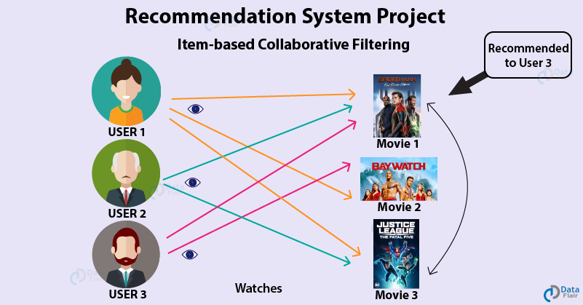
What is Recommendation system?
A Recommendation System is an
extensive class of web applications
that involves predicting the user
responses to the options.
Recommendation engines discovers
data patterns in the data set by
learning consumers choices and
produces the outcomes that relates
to their needs and interests.
Companies like Amazon, Netflix, Linkedin, and Pandora leverage recommender systems to help users discover new and relevant items (products, videos, jobs, music), creating a meaningful user experience while driving incremental revenue.

Slide 3
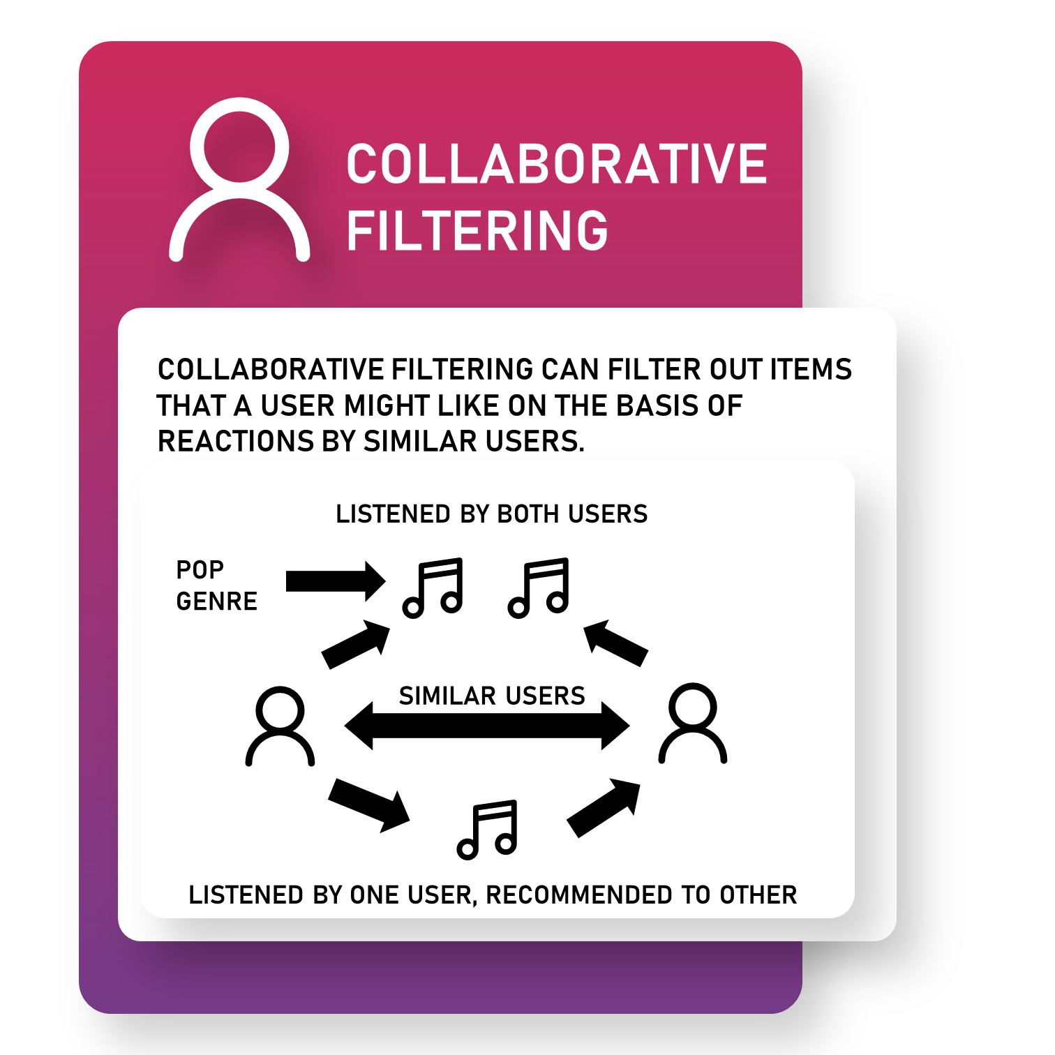
Types of Recommender System
1. Collaborative Filtering
The collaborative filtering approach to recommendation algorithms involves collecting a large amount of information on users’ behaviors, activities or preferences and predicting what users will like based on their similarity to other users.
Assumption that previous information in a user’s history about how they agree with other users .(for instance User A liked Movie A and User B liked Movie A, so they will have similar interests).
Issue- the system need a large amount of data to make accurate recommendations.

Slide 4
2. Content Based Filtering
The content-based filtering approach differs from the the collaborative filtering approach as it filters based on an analysis of both the item being recommended and the user.
Content-based filtering closely examines the actual item to determine which features are most important in making recommendations and how those features interact with the user’s preferences.
Example Pandora uses the properties of a song or artist to seed a “station” that plays music with similar properties. This is an example of a content-based approach.

Slide 5
Music Recommendation Models
A content-based approach is often the technique relied upon the most in music recommender systems. The model will consider music data about a particular song when making a recommendation .
Music Data
Two main categories of data are used in a content-based filtering model, metadata and actual audio content.
Metadata refers to the tags people have placed on pieces of music. For instance, metadata could be the genre of music that users have ascribed to a song, or keywords,lyrics used in reviews of music on popular websites.
Audio content refers to the actual acoustic and music features of a song. This can be anything from the rhythm and beats per minute of a song to what keys and chords are played in the song.

Slide 6
Dataset

Slide 7
Steps Involved in the Algorithm
Step 1. Clustering
A fundamental step for any unsupervised algorithm is to determine the optimal number of clusters into which the data may be clustered.
The Elbow Method is one of the most popular methods to determine this optimal value of k.
How k-means works:
The process begins with k centroids initialised at random.These centroids are used to assign points to its nearest cluster.
The mean of all points within the cluster is then used to update the position of the centroids.
The above steps are repeated until the values of the centroids stabilise.

Slide 8
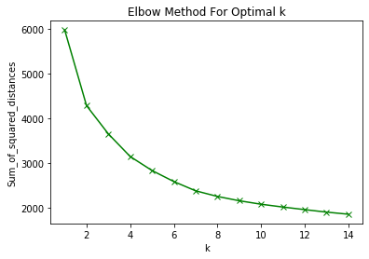
To give equal importance to all features,
we need to scale the continuous features.
We will be using scikit-learn’s MinMaxScaler
as the feature matrix is a mix of binary and
continuous features .
For each k value, we will initialise k-means
and use the inertia attribute to identify the
sum of squared distances of samples to the nearest cluster centre.
We have a plot of sum of squared distances for k in the range
specified above. If the plot looks like an arm, then the elbow on the arm is optimal k.
the elbow is at k=5 indicating the optimal k for this dataset is 3

Slide 9
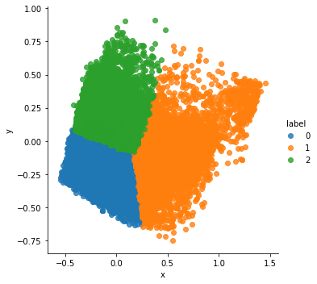
Step 2: Data Reduction using Principle Component Analysis (PCA)
Applications: Data Visualization and to Speed-up Machine Learning Algorithms
In this section, the code projects the original data into 2 dimensions.
Note that after dimensionality reduction, there usually isn’t a particular meaning assigned to each principal component. The new components are just the two main dimensions of variation.
This section is just plotting 2 dimensional data. Notice on the graph below that the classes seem well separated from each other.

Slide 10
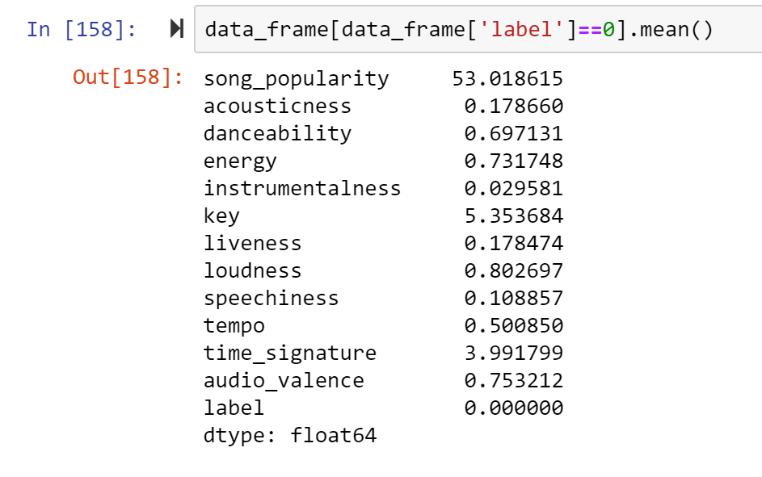
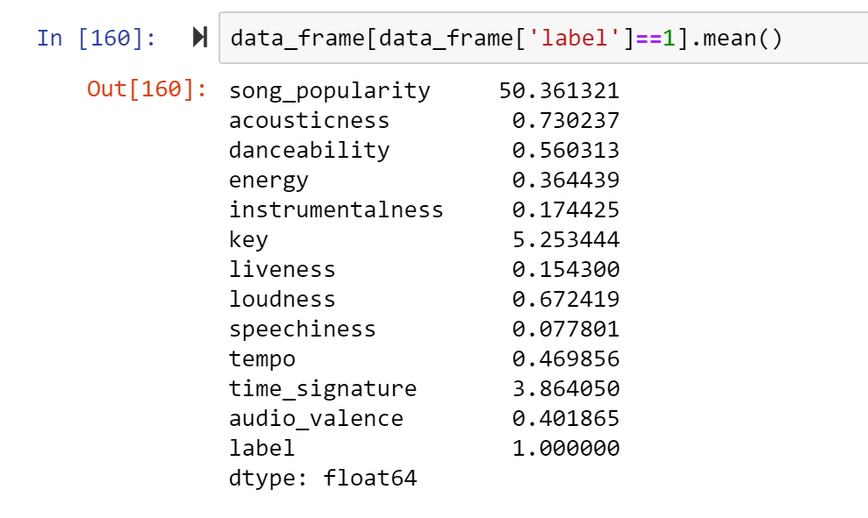
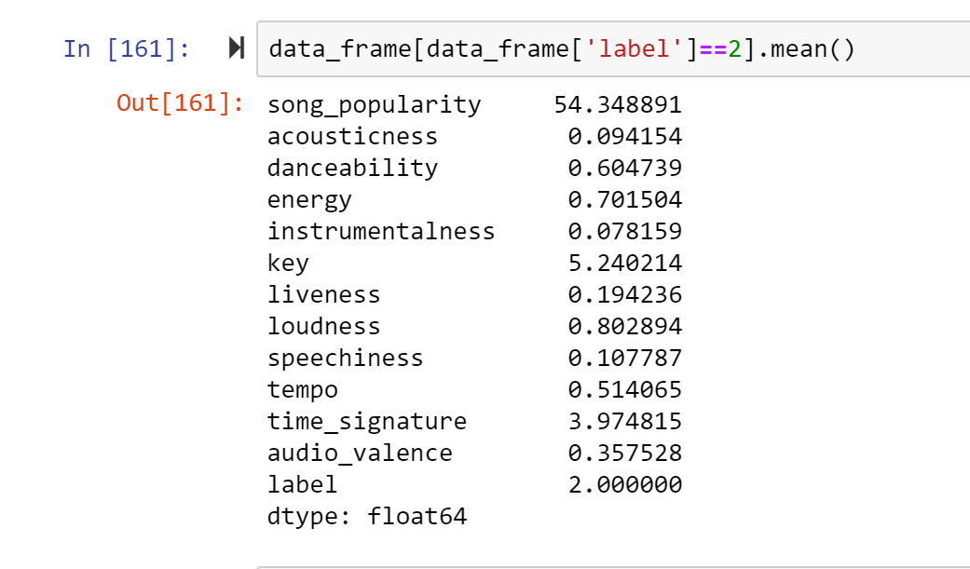
Let’s see each of the 4 clusters and what rows they contain

Slide 11
Step 3- Mood Prediction
We then assign a mood to each cluster by looking at the songs within them and identifying the key emotions that we can associate with the majority of songs in a particular cluster.
There is typical set of audio features representing everything from physical characteristics of the audio signal (amplitude, spectral flux, etc) to perceptual features (loudness, brightness) to musically relevant features (chroma, beat locations, tempo, etc). We put these into a classifier and measure performance .
For example, songs having elements of hip hop can put you in joyous and elated mood, loudness, or intensity of a song can be connected with anger, while softer songs would suggest tenderness, sadness, or fear.

Slide 12
Split the data
After labelling songs with their respective moods, we could train a supervised learning model to accurately predict a users’s mood given a song.
We split the dataset into a training and test set and trained 4 a classifier models using Random Forest Classifier on the training set.
The mood label given to each song was used as the target data, that we’re aiming to correctly predict.
We use a confusion matrix which is a table that is often used to describe the performance of a classification model on a set of test data for which the true values are known. It allows the visualization of the performance of an algorithm.

Slide 13
Step 4: Mood Identification

Slide 14
Step 5: Song Recommendation

Slide 15
Results

