Slide 1

QUIZLET
DONE BY :
RASHMI N
RACHANA B
RISHIKA MALLI
SHRUTHI S R

Slide 2
“One of the most important areas we can develop as professionals is competence in accessing and sharing knowledge.” - Connie Malamed

Slide 3
INTRODUCTION
Quizlet is built more as a study tool.
Trends in education are ever changing and one among them is an e-learning technique.
An app which contains the presentation of all the units of the respective subjects and an assessment at the end.

Slide 4
TEACHERS VIEW
Innovative uses of mobile technologies in education.
A platform where they can upload the ppt’s and an assessment quiz on to the cloud .

Slide 5
STUDENTS VIEW
An app where student can access the ppt’s uploaded by the teachers and take up the quiz at the end of each unit.
Students prevail the scores after each quiz.

Slide 6
TOOLS
A database connectivity.
A cloud connectivity
Works on android platform.
Developed using android studio in windows environment.

Slide 7
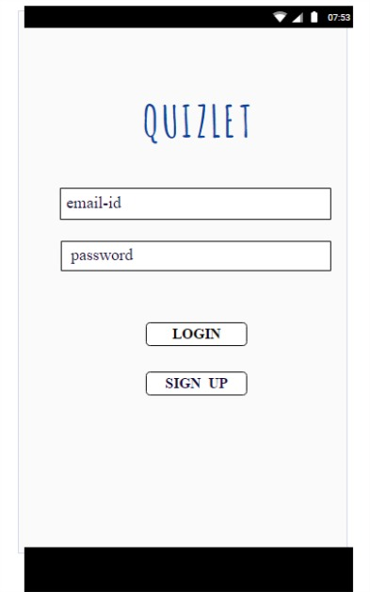
FRONTEND
Has login for current users.
Has sign up for new users.

Slide 8
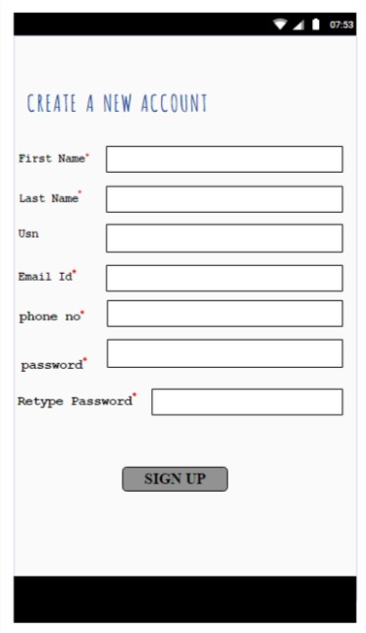
ON CLICK SIGN UP
The new user has to register:
Name
Usn
E-mail id
Phone no

Slide 9
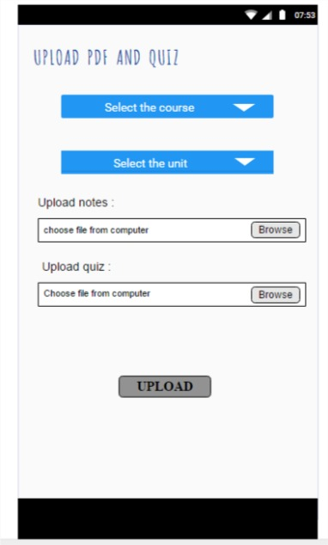
USER AS A TEACHER
The mentor on login will see
this page where he has to do
the following steps to upload
his pdf and quiz.

Slide 10
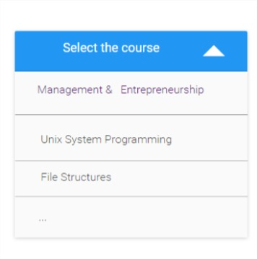
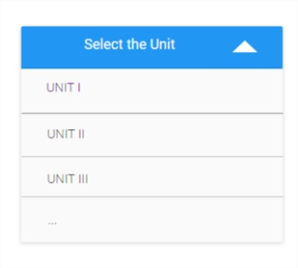
Choose the course and unit from dropbox.
Choose the file to upload.
Upload the file.

Slide 11
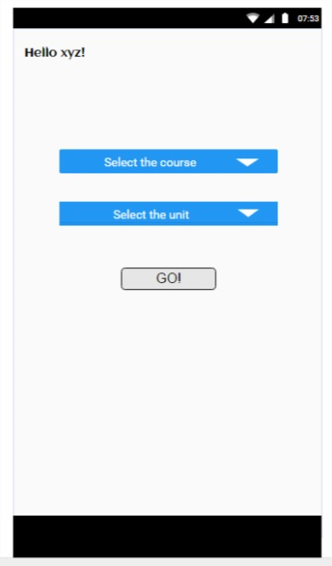
USER AS A STUDENT
Student on login will see this page.
They should select the course and unit required.
Then click on go.

Slide 12
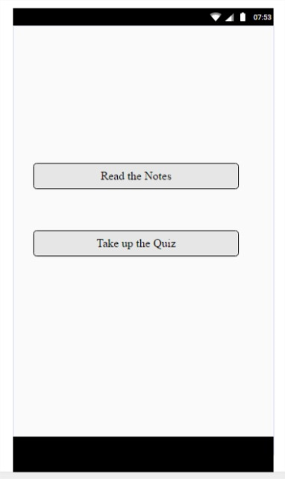
On click go they will see this page.
There are two options:
Read the notes – This contains the
notes of selected course and unit.
2 . Take up the quiz – This contains the
assessment of selected course and
unit.

Slide 13
MOTIVE
To emerge as a trending, up-to-date study application on google playstore .
To create a new era and promote e-learning.
To know ones potential and understanding capacity.

Slide 14
CONCLUSION
Quizlet will be a great application that will provide best benefits- all notes at one place.
We here by request you to guide us in making this project as a successful, emergent one which is apt for this electronic world.

