Slide 1

Learning PROJECT ii PRESENTATION ON nest e- commerce website
SCHOOL OF ENGINEERING AND TECHNOLOGY
DEPARTMENT OF COMPUTER SCIENCE AND ENGINEERING
Presented By
Name : Rashmi Ranjan Sahoo
(23UG010660)
Under the Guidance of :
Mr. Bani Prasad Nayak
Assistant Professor
Dept. Of CSE,
GIET University , Gunupur

Slide 2
OUTLINES
S.NO. | CONTENTS | PAGE NO.
1 | PROBLEM STATEMENT | 3
2 | INTRODUCTION | 4
3 | TECHNOLOGIES USED | 5
4 | NECESSARY DIAGRAMS | 6
5 | FEATURES | 7
6 | CHALLENGES | 8
7 | LIMITATIONS | 9
8 | SCREENSHOTS | 10-19
9 | CONCLUSION | 20
10 | FUTURE ENHANCEMENT | 21
11 | REFERENCES | 22

Slide 3
PROBLEM STATEMENT :
Innovative Shopping Experience with Cutting-Edge Technology :
Augmented Reality Shopping: Experience products like never before with our augmented reality feature, allowing you to visualize items in your own space before making a purchase.
Virtual Try-On: Our innovative virtual try-on technology enables you to see how clothing, accessories, or beauty products will look on you, ensuring a perfect fit and style.
Smart Search Functionality: Our advanced search capabilities utilize natural language processing to understand your queries better, making it easier to find exactly what you’re looking for.
Real-Time Inventory Updates: Stay informed with real-time inventory updates, ensuring that you can shop with confidence knowing that the products you want are available.

Slide 4
INTRODUCTION:
NEST E-Commerce is an innovative online shopping platform designed to provide a seamless, secure, and efficient shopping experience. Built using modern technologies, it offers a wide range of products across multiple categories, ensuring convenience for buyers and sellers alike. With a user-friendly interface, powerful search features, and reliable payment options, Nest E-Commerce aims to revolutionize digital shopping.
The platform incorporates advanced functionalities like AI-driven recommendations, real-time order tracking, and personalized shopping experiences. It is designed to support businesses of all sizes, enabling them to showcase their products, manage transactions, and engage customers effectively. Nest E-Commerce prioritizes customer satisfaction, ensuring smooth navigation and responsive customer support.
Whether you're a consumer looking for quality products or a business seeking a robust marketplace, Nest E-Commerce delivers a dynamic and trustworthy solution tailored for modern commerce.

Slide 5




TECHNOLOGIES USED :
This website is made with the help of :

Slide 6
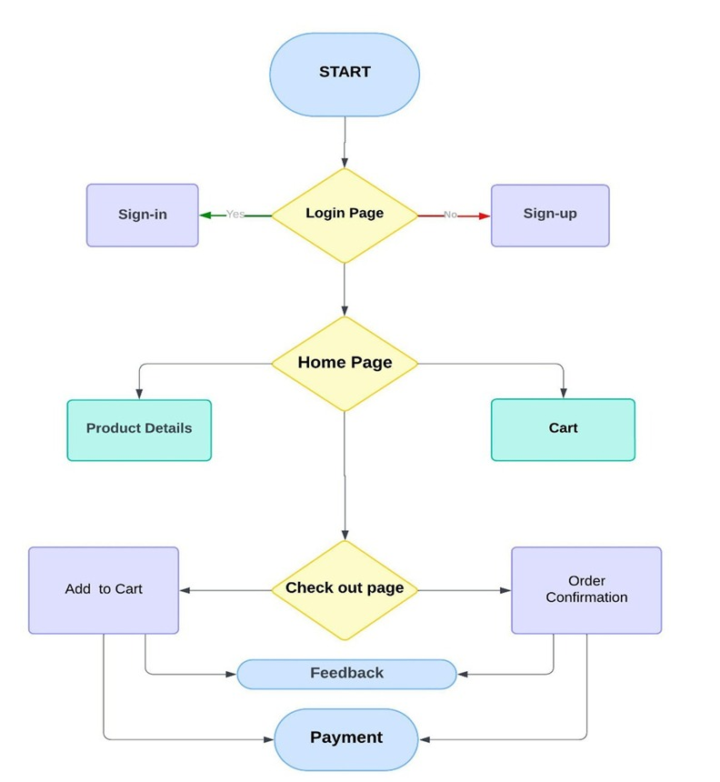
NECESSARY DIAGRAMS :

Slide 7
FEATURES :
SECURE PAYMENT OPTION
PRODUCTS FROM TRUSTED SOURCES WITH AUTHENTICATION
SECURED PACKAGING (HASSLE FREE DELIVERY)
24 X 7 COSTUMER CARE SERVICE
WIDE RANGE OF PRODUCTS FROM LOCAL VENDORS
COSTUMISATION AVAILABLE ON CLOTHINGS

Slide 8
CHALLENGES:
Lack of Personal Interaction
High Competition
Complex Taxation Issues
Technology Dependence

Slide 9
LIMITATIONS:
Limited Brand Recognition – New platforms struggle to gain trust and visibility among customers.
Low Website Traffic – Without strong marketing, attracting visitors can be difficult.
Security Concerns – Ensuring secure transactions and protecting user data is crucial but complex.
Competitive Market – Established e-commerce giants make it tough for new businesses to stand out.
Technical Issues – Bugs, slow loading speeds, or payment failures can drive users away.
Initial Financial Constraints – Funding marketing, development, and fulfillment may be expensive.

Slide 10
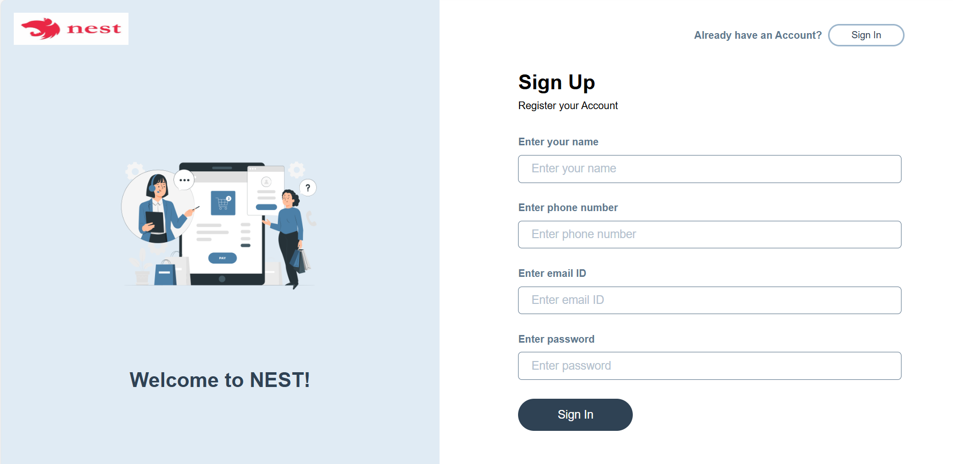
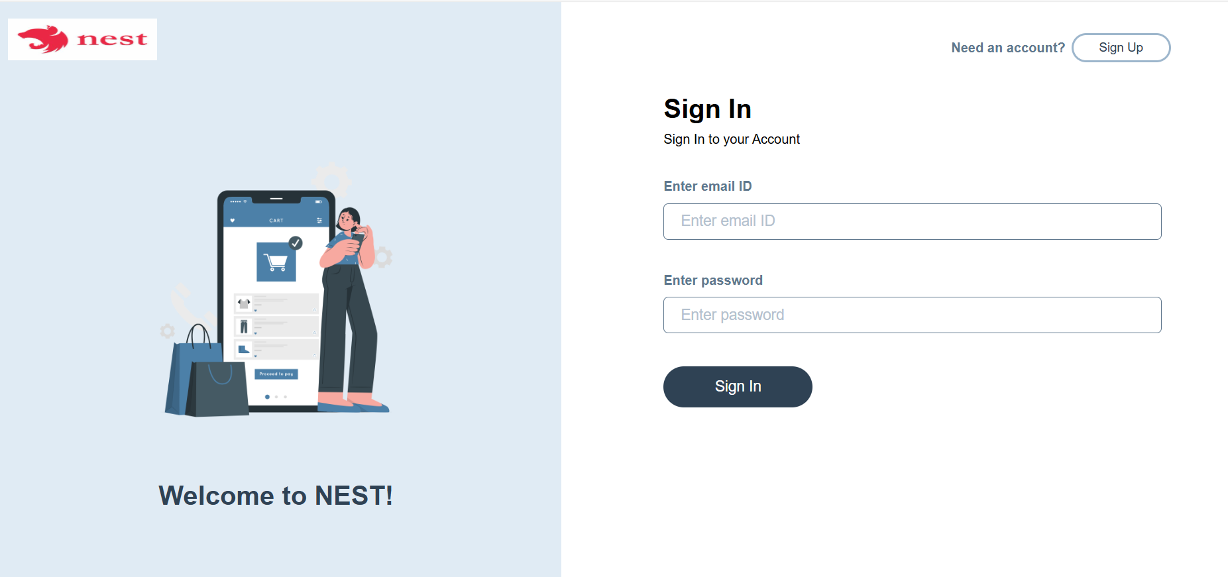
SCREENSHOTS:

Slide 11
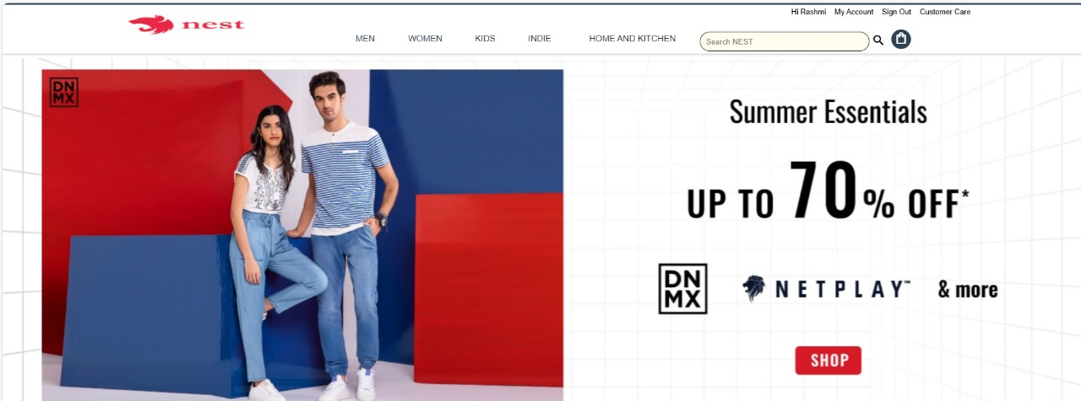
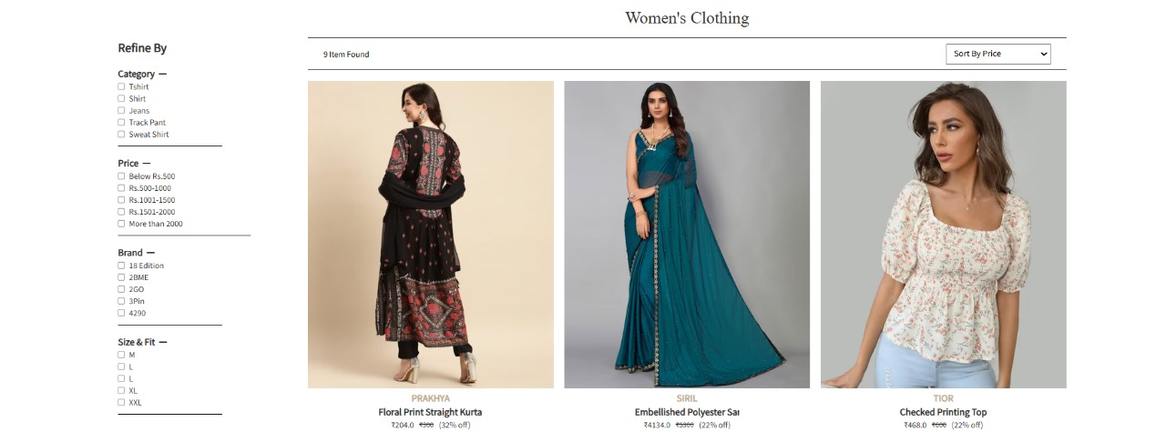

Slide 12
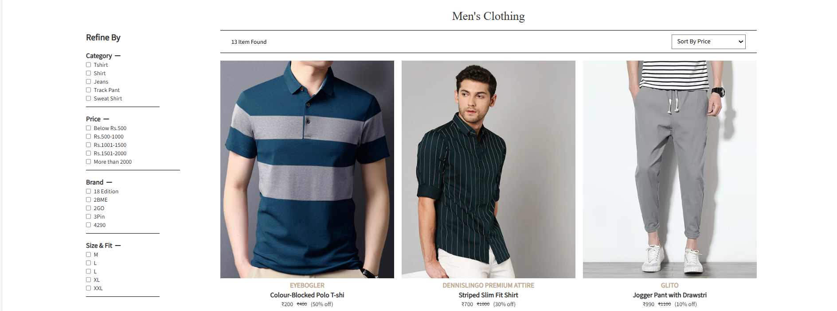


Slide 13
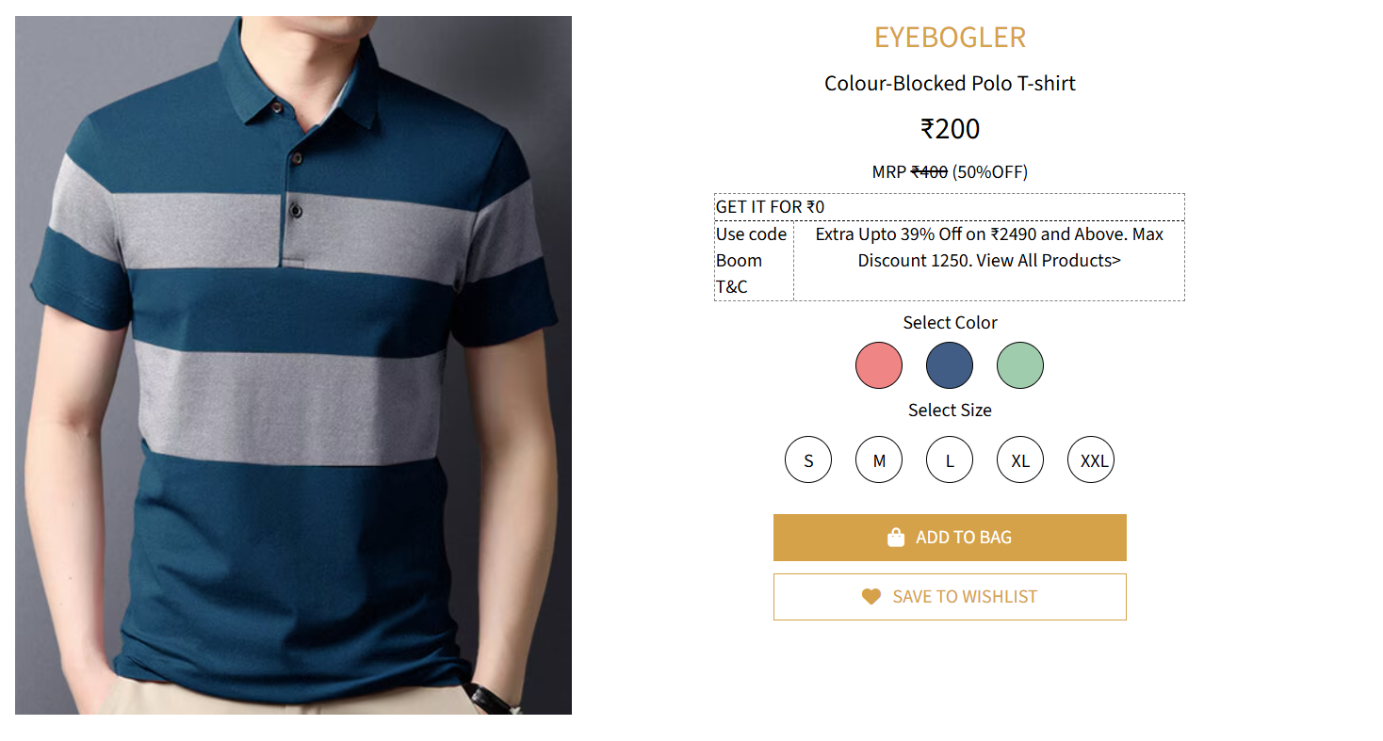
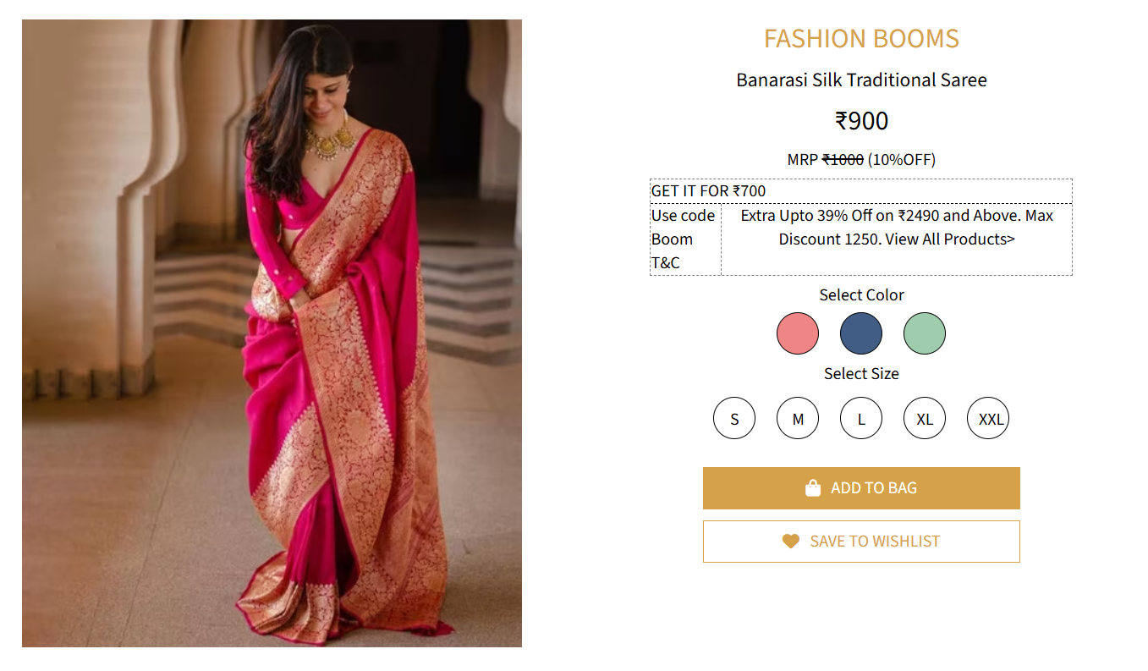

Slide 14
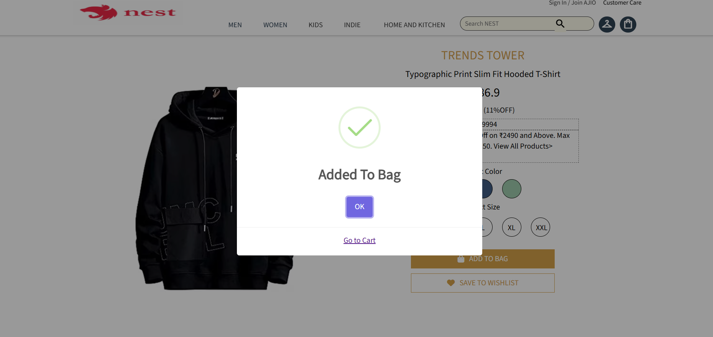
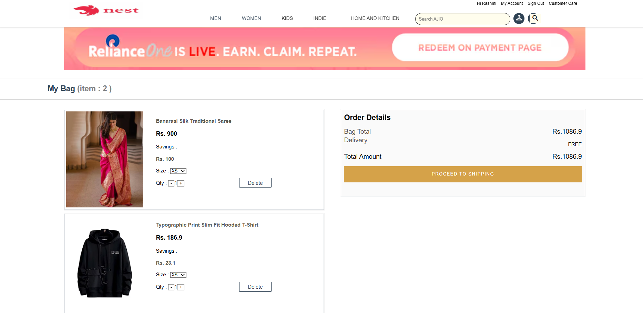

Slide 15
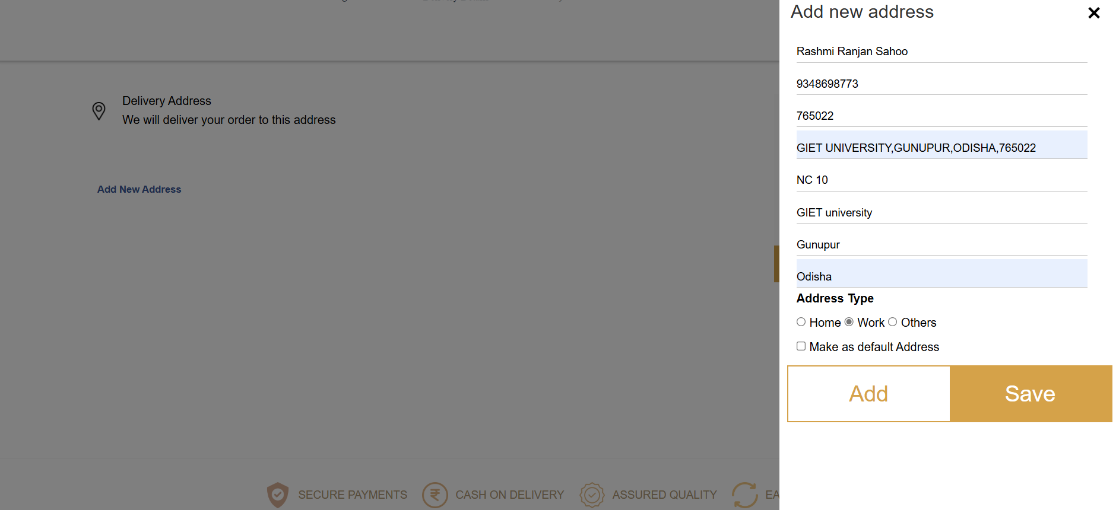
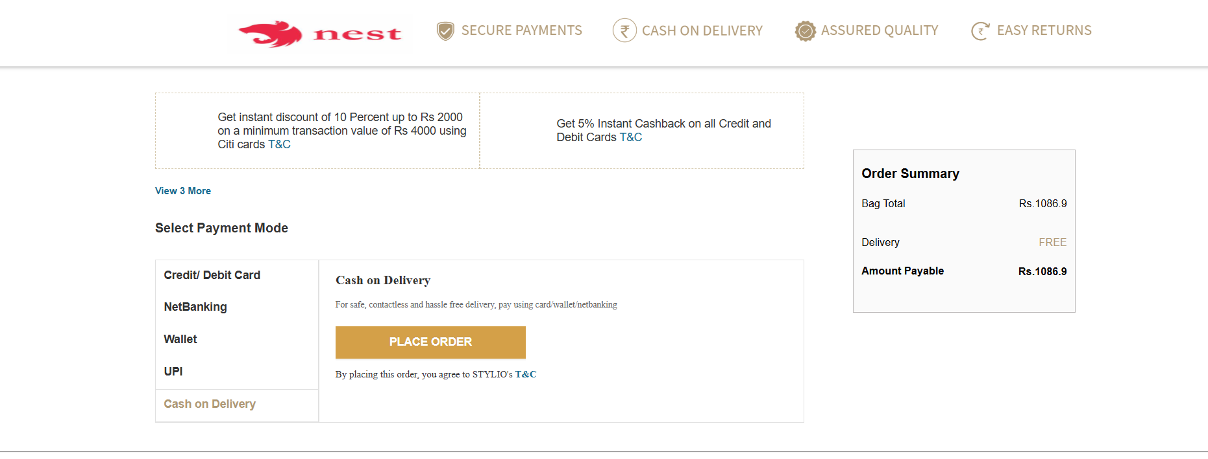

Slide 16
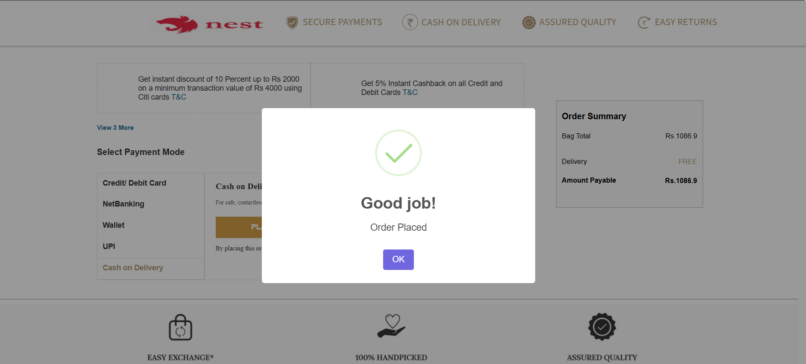
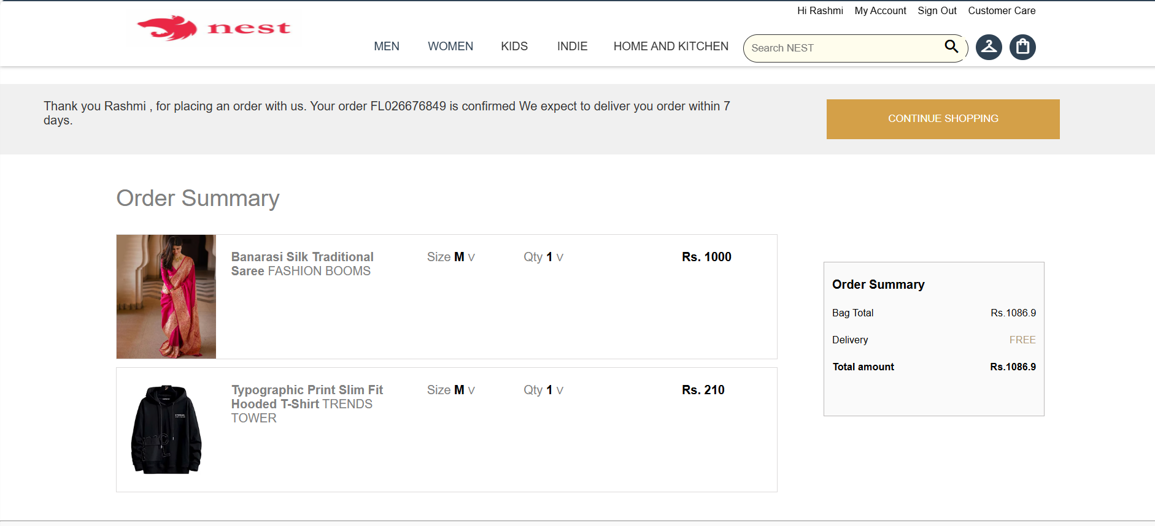

Slide 17
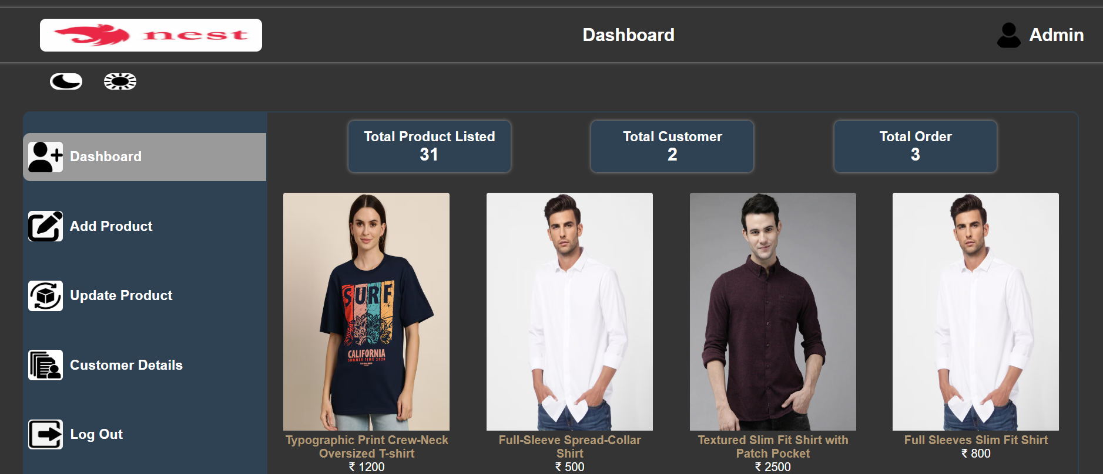
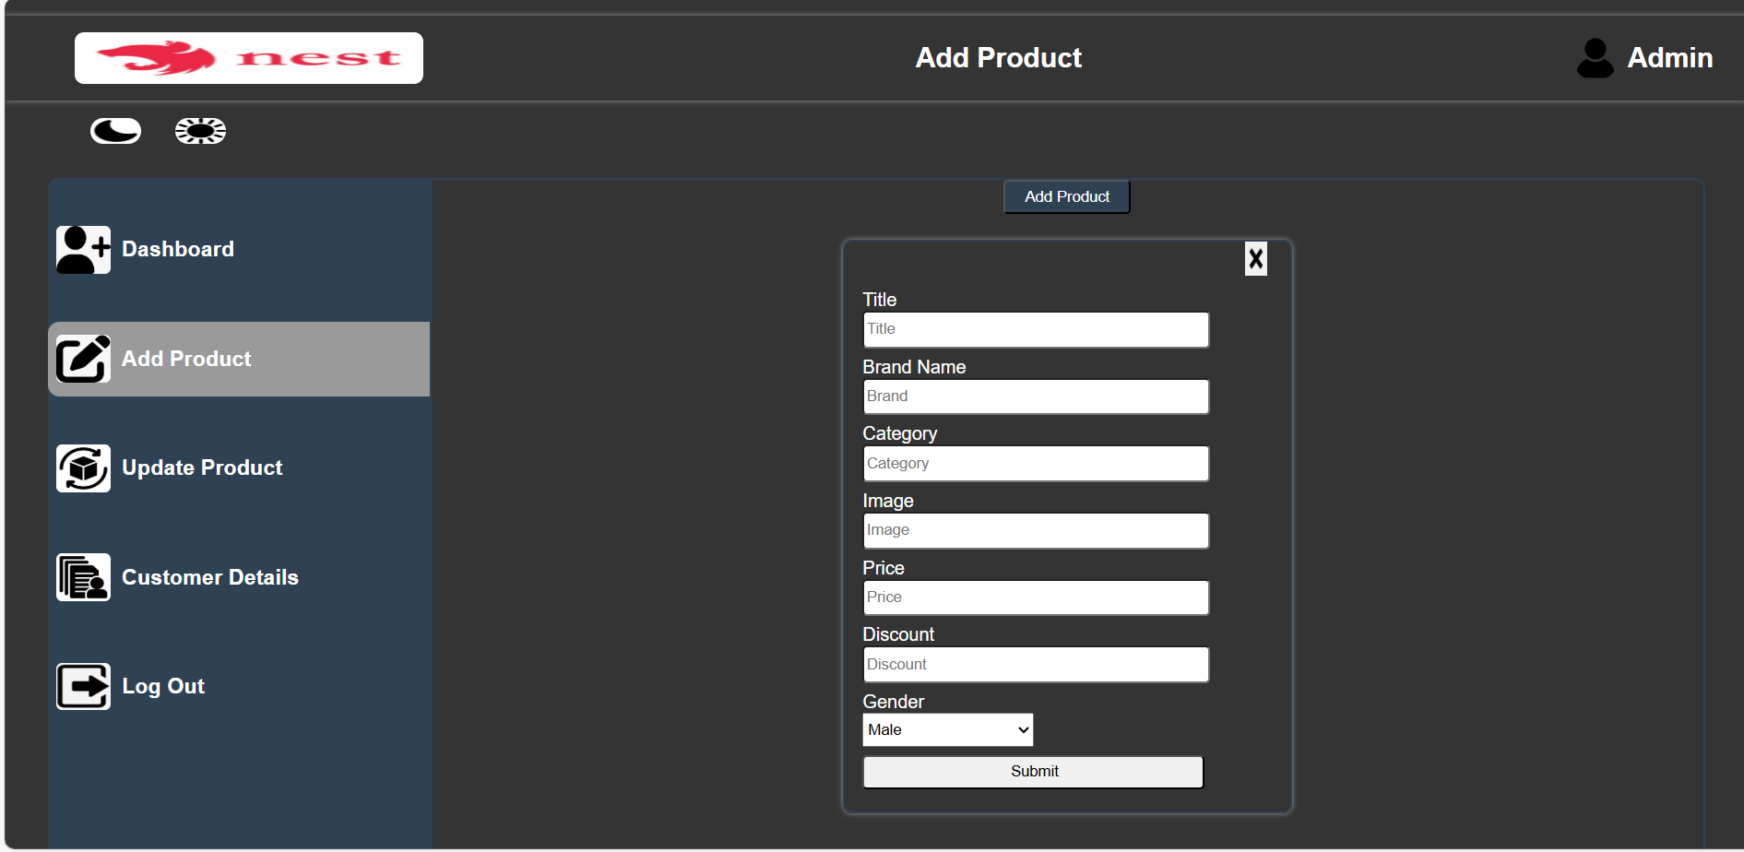

Slide 18
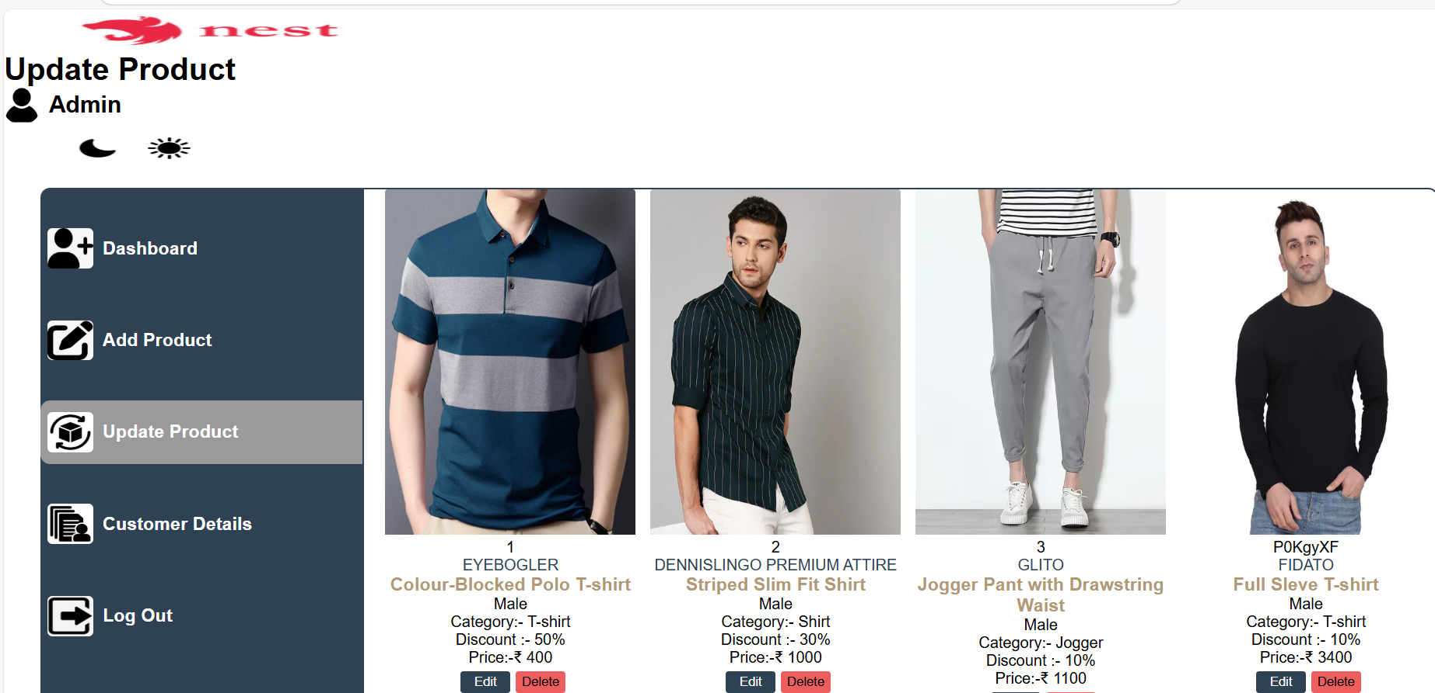
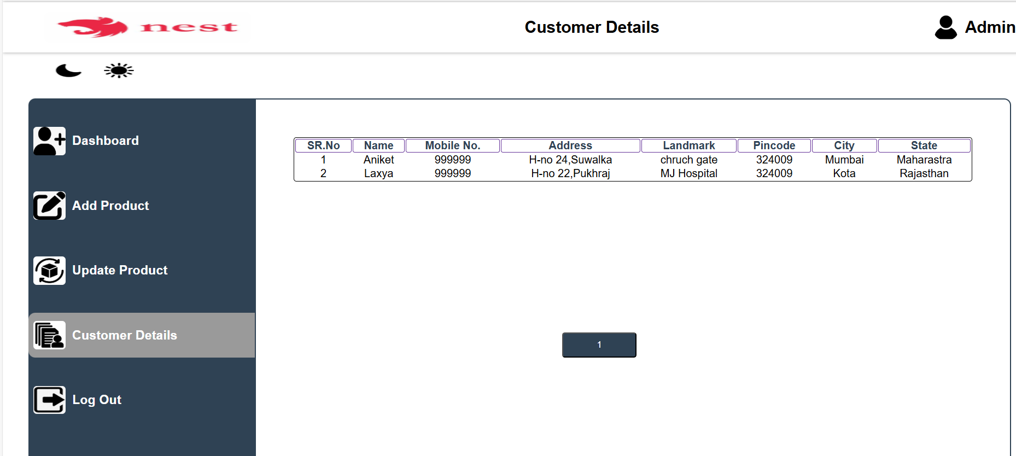

Slide 19
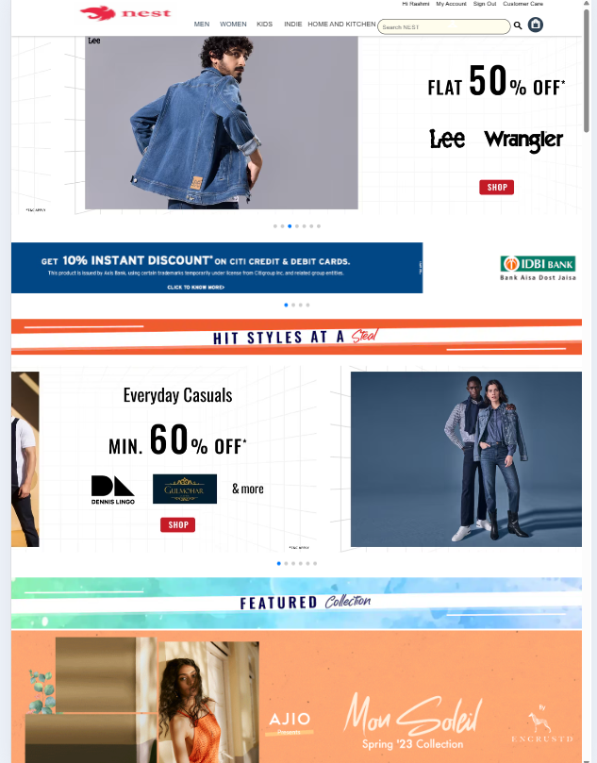
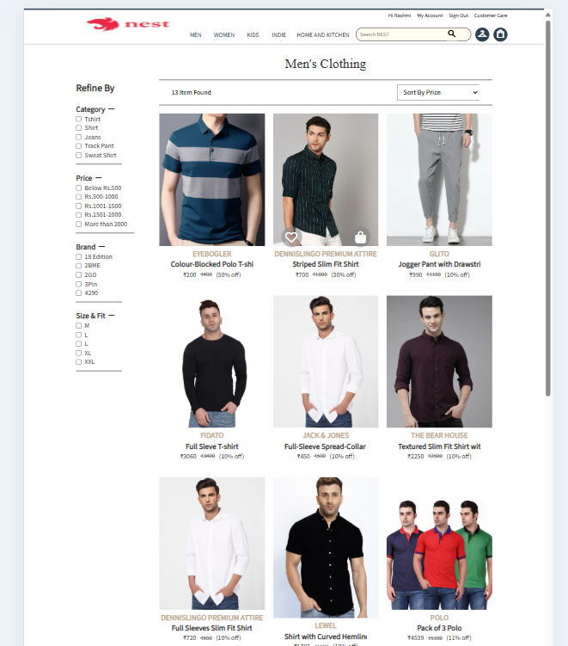

Slide 20
CONCLUSION :
In conclusion, [NEST E-commerce Website] stands as a premier destination for all your shopping needs, offering a diverse range of high-quality products at competitive prices. Our commitment to customer satisfaction is reflected in our user-friendly interface, secure payment options, and reliable shipping services. We understand that shopping online should be a seamless experience, which is why we prioritize convenience and accessibility. With our dedicated customer support team, we are here to assist you with any inquiries or concerns, ensuring that your experience is as enjoyable as possible. Join our community of satisfied customers and explore our extensive catalog today. Whether you’re looking for the latest trends, essential items, or unique gifts, [Your E-commerce Website Name] is here to meet your needs. Thank you for choosing us as your trusted shopping partner!

Slide 21
FUTURE ENHANCMENT :
All Products see our website by 3D Animation
Costumizable AI Model
Stronger Security
Privacy Measures
Eco-Friendly E-commerce

Slide 22
REFERENCES :
Class Teacher (Mr. Bani Prasad Nayak)
Seniors
YouTube
W3School
MDN
Google

Slide 23
Q&A
Thank you all for your attention! Any questions?

