Slide 1


Heart Disease Analysis
Business Issues considered
About Dataset
Data Exploration
Inferential Analysis
Interpretation and Recommendations
By Rashmi Chauhan
Phase 2 Project- Flatiron School

Slide 2

Business Problem
Efficient Diagnosis and Risk Stratification of Heart Disease in Cardiac patients
Stakeholder: Cardiology Department at a Healthcare Facility

Slide 3
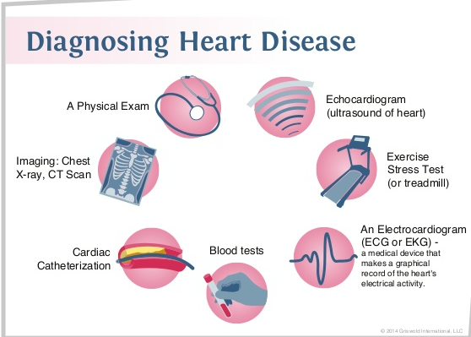
Dataset
UCI Heart Disease Dataset (from UCI repository)
It has Patient data from Cleveland hospital
It is composed of 14 attributes:
age, sex, chest pain type,
resting blood pressure, serum cholesterol, fasting blood sugar,
resting electrocardiographic results,
maximum heart rate achieved, exercise-induced angina, oldpeak (ST depression induced by exercise relative to rest),
slope (the slope of the peak exercise), number of major vessels and Thalassemia.

Slide 4
Findings
The minimum age with a heart disease is 29 yrs and the maximum is 77 yrs per the data set.
Most people get heart disease between 52 - 53 yrs age.
Age - The older age increases the heart diseases.risk of narrowing arteries.
High Blood pressure and Cholesterol are risk factors for heart disease.
Gender: Men are at higher risk.
Individuals with atypical angina are at risk for heart attacks if their condition goes unrecognized or untreated.

Slide 5
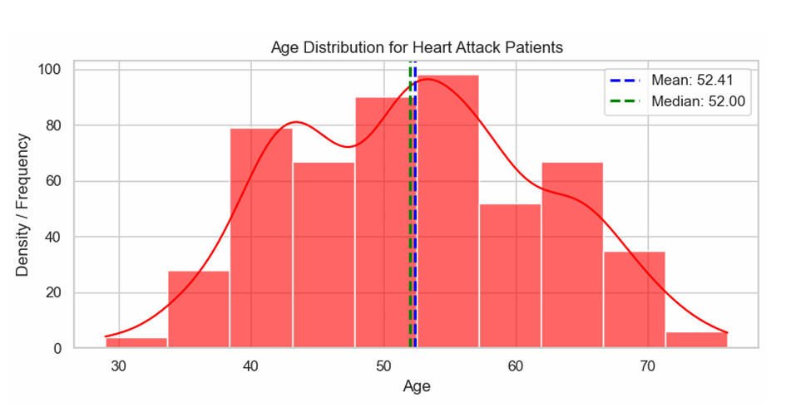
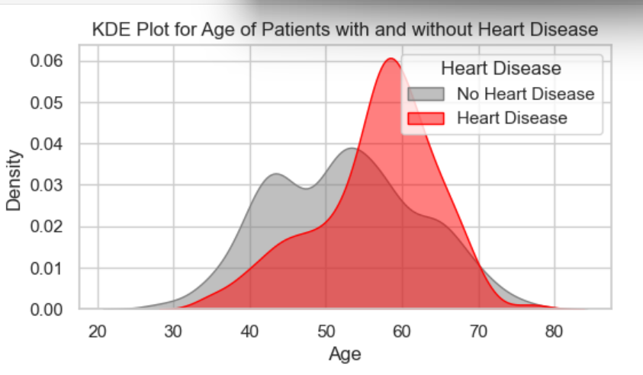

Slide 6
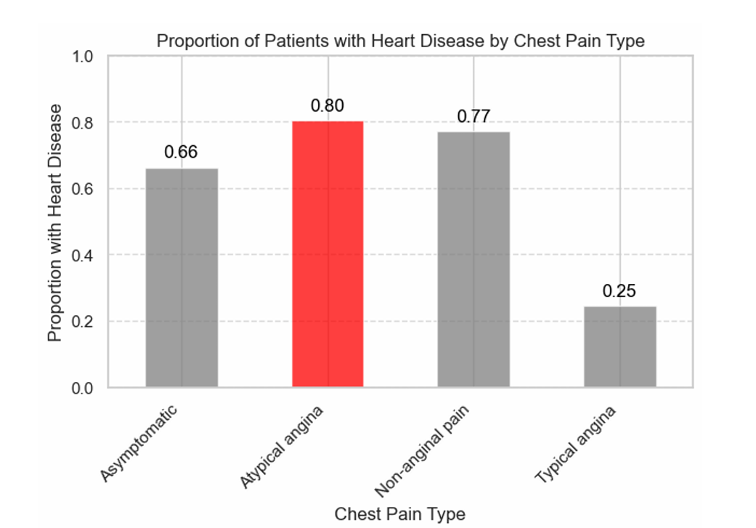
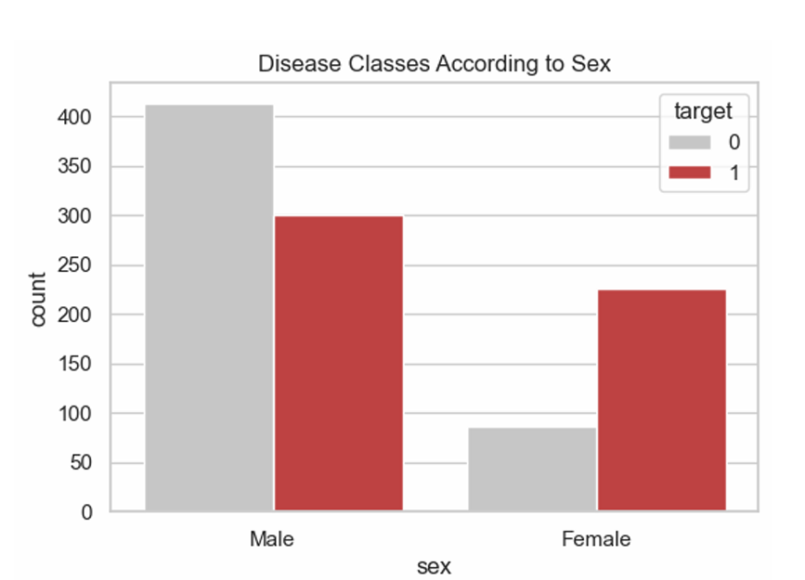

Slide 7
Inferential Analysis Results
There is a statistically significant association between gender and the incidence of heart disease.
(Chi square hypothesis test is performed)
There is a significant difference in age distributions between patients with and without heart disease.
(Mann-Whitney test is performed)
There is a statistically significant association between different types of chest pain and the heart disease occurrence among patients with
(Chis square test is performed)

Slide 8
Insights & Recommendations:
Preventing Severe Cardiac Events by Early identification and intervention: Can reduce the incidence of severe cardiac events, leading to better patient outcomes and reduced healthcare costs.
Personalizing Treatment Plans: Understanding the risk level can guide physicians in tailoring treatment plans based on individual patient profiles.
Identifying High-Risk Patients: We can prioritize patients who may require immediate attention and further diagnostic testing.
Data-driven approach to enhance the accuracy of diagnosis and improve patient outcomes.

