Slide 1


SMART INDIA HACKATHON 2026
AEGISNET AI
Many vendor syntaxes. One security model. One auditable verdict.
Problem Statement ID – SIH26155
Problem Statement Title – AI-Driven Multi-Vendor Network Security Compliance Auditor
Theme – Blockchain and Cybersecurity
PS Category – Software
Team ID – 168312
Team Name – Ansarash
VENDOR COVERAGE
Cisco IOS ✓ Implemented
Juniper Junos ✓ Implemented
Fortinet FortiOS ✓ Implemented
Palo Alto PAN-OS ◇ Planned
Notes:
Open with the pain: one auditor, many vendor syntaxes, days of manual checking. AegisNet converts every vendor into one Common Security Model and audits it once. Cisco and Juniper work today; Fortinet and Palo Alto are the next adapters.

Slide 2
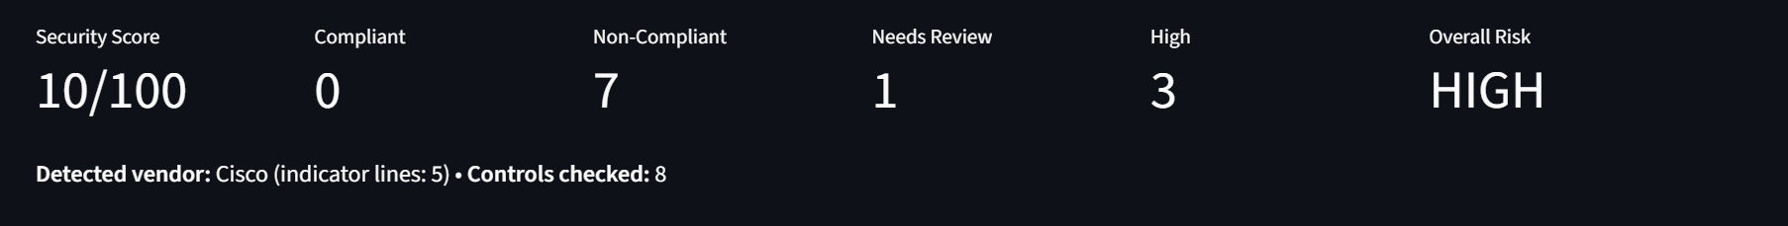
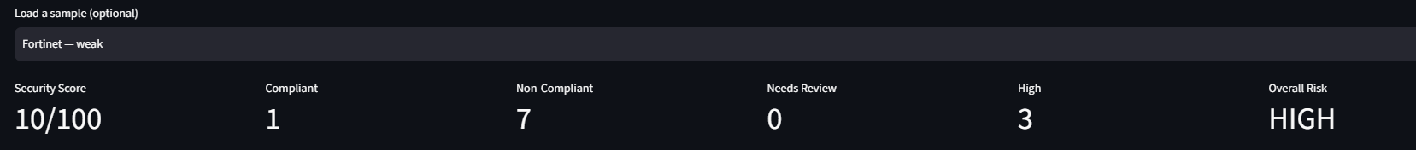
AEGISNET AI
Ansarash
❖ Proposed Solution Unified multi-vendor security compliance auditor
1
INPUT
2
PARSE AND NORMALISE
3
UNIFIED COMPLIANCE ENGINE
4
ACTIONABLE OUTPUT
Cisco IOS, Juniper Junos or Fortinet FortiOS configuration, uploaded or pasted
Vendor detection → vendor adapter → Common Security Model with line-level evidence
8 deterministic controls, severity-weighted score, NIST SP 800-53 and CERT-In mapping
Prioritised findings, vendor-specific fix with rollback, JSON report
What makes AegisNet different
Cisco IOS weak sample (live app)
✓ Write a control once and audit it on every vendor
✓ Every finding points to the exact line in the original config
✓ Findings mapped to NIST SP 800-53 and the CERT-In Directions (2022)
✓ Fix and rollback commands generated per vendor
✓ Live re-audit: edit the config and watch the score change
✓ Secrets masked before anything is shown or exported
✓ A “Needs Review” state when a config can't prove a setting
Same engine, third vendor: Fortinet FortiOS weak sample (live app)
◇ Planned AI-assisted normalisation for unfamiliar syntax (with confidence score and human review), AI explanations of findings, a Palo Alto PAN-OS adapter.
AI interprets. Deterministic rules decide.
✓ Implemented (live today) ◇ Planned (roadmap)
Notes:
Demo: open the live app, choose Paste / edit config, load Cisco - weak. Point at the score (10/100), the Common Security Model table with line numbers, then one opened finding.

Slide 3
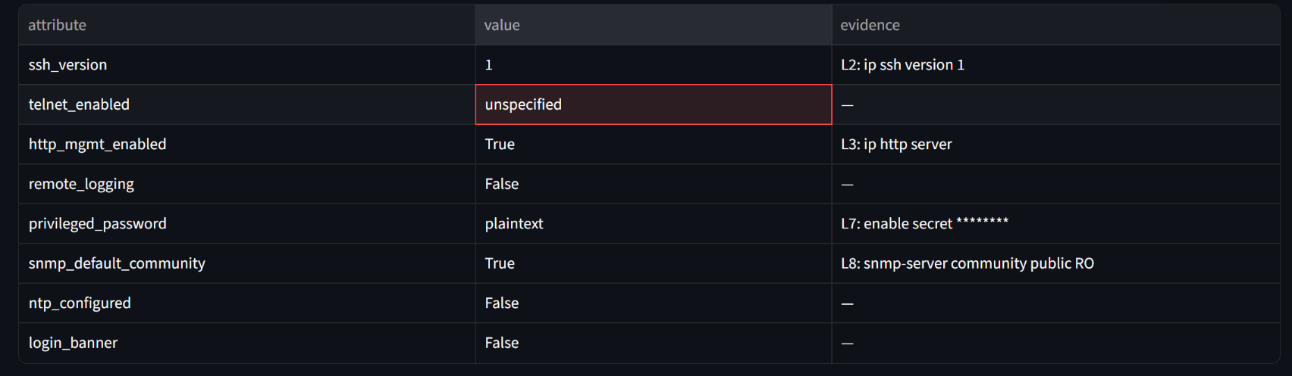
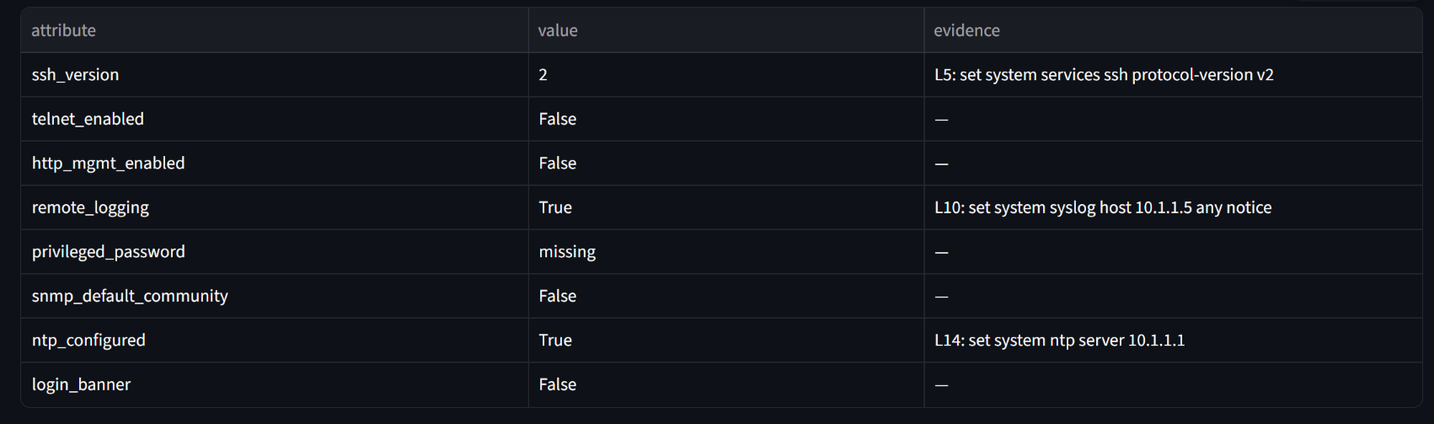
TECHNICAL APPROACH
Ansarash
Config
›
Vendor detection
›
Adapters (3 vendors)
›
Common Security Model
›
Rule engine
›
Findings + Remediation
Stack Python • Streamlit • line-based adapters (comments ignored) • rule table • JSON export ◇ LLM layer (Gemini, or a local model for air-gapped use)
✓ Add a vendor with one parser function ✓ Junos set + curly-brace, FortiOS config tree ✓ Unrecognised vendor halts the audit, no guessing
One control, every vendor
Cisco IOS Common Security Model (live app)
Common attribute | Cisco IOS | Juniper Junos | Fortinet FortiOS
remote_logging = false | no “logging host” line | no “set system syslog host” line | no syslogd server line
Finding AG-04 (Medium) Remote logging absent. Maps to NIST AU-2 and CERT-In Directions item (iv): logs retained for a rolling 180 days.
Vendor | Fix | Rollback
Cisco | logging host <SYSLOG_IP> | no logging host <SYSLOG_IP>
Juniper | set system syslog host <SYSLOG_IP> any notice | delete system syslog host <SYSLOG_IP>
Fortinet | syslogd: set status enable; set server <SYSLOG_IP> | set status disable
Juniper Junos (curly-brace) Common Security Model (live app)
✓ Implemented (live today) ◇ Planned (roadmap)
Notes:
Core idea in one table: the same attribute, remote_logging = false, comes out of two different vendor syntaxes, and one rule produces one finding with a vendor-specific fix and rollback. AI is planned as an interpreter only; the rule engine always decides.

Slide 4
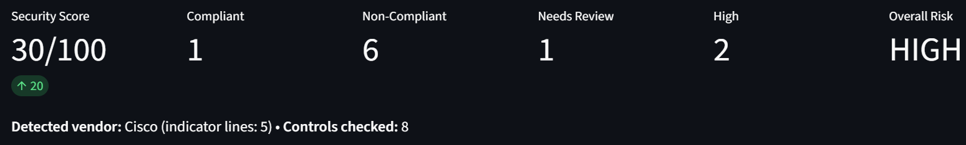
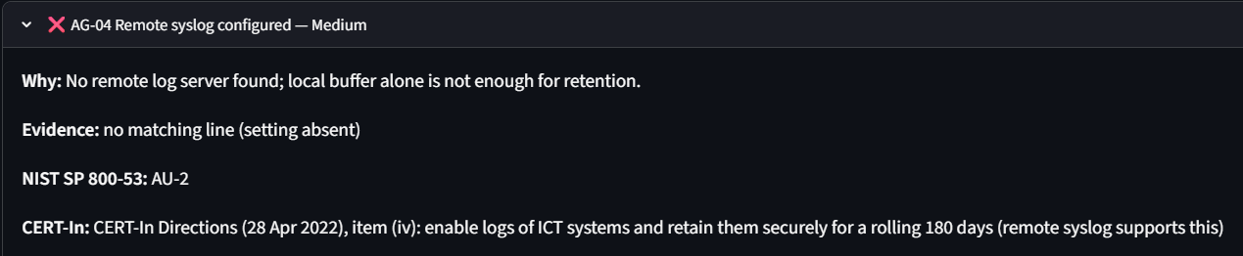
FEASIBILITY AND VIABILITY
Ansarash
01 Technically feasible: prototype status
02 Challenges and mitigation
03 Scalability roadmap
Item | Status
Vendors | 3: Cisco IOS, Juniper Junos (set + curly-brace), Fortinet FortiOS
Controls | 8
Test configs | 7 (6 valid, 1 invalid)
Weak Cisco | 10/100
After fixing SSH | 30/100 (+20)
Hardened Cisco | 100/100
Deployment | Live on Streamlit Cloud
Different syntax per vendor: a separate adapter per vendor, one shared model
Version variations: modular adapters; regression tests per version are planned
Incorrect AI mapping (planned): confidence score, human review flag, AI never decides the verdict
Config can't prove a setting: shown as “Needs Review”, not scored
Remediation risk: every fix ships with a rollback; administrators review before applying
◇ Planned
Palo Alto PAN-OS adapter
Firewall rule-base analysis (any-any, shadowed, redundant rules)
CIS Benchmark mapping, plus NCIIPC and RBI
Config drift tracking with a fleet-wide score
PDF and SARIF reports
Live app: score after changing SSH to v2
◇ AI guardrails (planned)
1 Secrets redacted before any AI step
2 AI maps unknown lines, with a confidence score
3 Low confidence flagged for human review
Finding AG-04: evidence, NIST and CERT-In reference
4 Rule engine makes the verdict
✓ Implemented (live today) ◇ Planned (roadmap)
Notes:
All numbers on this slide were measured on the live app: weak Cisco 10, after fixing SSH 30, hardened Cisco 100. 5 test configs = 4 valid vendor configs and 1 invalid file used to prove the audit halts.

Slide 5






IMPACT AND BENEFITS
Ansarash
TARGET USERS
Network administrators
Cybersecurity teams
MSPs
Government and institutional networks
Critical infrastructure operators
Security
Efficiency
Consistency
Finds misconfigurations such as plaintext secrets, default SNMP communities, Telnet and HTTP management
One interface and one audit for multiple vendors; results appear instantly on the test configs
The same control and the same score logic for every vendor
Explainability
Privacy
India relevance
Every finding shows its evidence line, framework reference, fix and rollback
Configs are processed without any device access, and secrets are masked in output
Checks aligned to the CERT-In Directions (2022) on log retention and NTP sync, relevant to government bodies, PSUs and MSPs. ◇ Planned: NCIIPC and RBI mappings.
KEY BENEFIT One unified, explainable security assessment across multi-vendor networks
✓ Implemented (live today) ◇ Planned (roadmap)
Notes:
Only quote a time saving if you have measured it yourself (for example manual check of one config vs AegisNet). No number is claimed on this slide.

Slide 6
RESEARCH AND REFERENCES
Ansarash
Security frameworks
Vendor documentation
NIST SP 800-53 Rev. 5
AC-8, AC-17, AU-2, AU-8, CM-7, IA-5
✓ Used in prototype
✓ Cisco IOS security configuration guides
✓ Juniper Junos security documentation
✓ Fortinet FortiOS administration and CLI documentation
◇ Palo Alto PAN-OS documentation
CERT-In Directions, 28 April 2022
Under Section 70B(6) of the IT Act, 2000: items (i) and (iv)
✓ Used in prototype
CIS Benchmarks
Cisco IOS and Juniper Junos secure configuration
◇ Planned
Technical research
Multi-vendor configuration parsing
Configuration normalisation
Rule-based policy evaluation
Explainable security analysis
Vendor-specific remediation generation
DISA STIG
Security configuration guidance (reference)
Reference
NCIIPC guidelines and RBI Cyber Security Framework
India-specific mappings
◇ Planned
Framework mappings show indicative alignment and are not a formal certification.
✓ Implemented (live today) ◇ Planned (roadmap)
Notes:
Confirm CERT-In items (i) and (iv) against the official PDF before presenting. CIS Benchmark section numbers are not shown because they are not verified yet.

