Slide 1


FRAUD DETECTION & TRANSACTION MONITORING LAYER FOR ON-CHAIN FINANCE
Mini Project Presentation – Fundamentals of Blockchain
Team: Rashmi DT (USN0362) | Bhoomika P (USN0090) | Anita (USN0055)
Guide: Cynthia J, School of Computer Science and Engineering

Slide 2

Problem Statement
PROBLEM STATEMENT
Ethereum is public and permissionless: anyone can create a new wallet and split or move funds in seconds, and there is no central compliance checkpoint. Exchanges and compliance analysts must find laundering patterns in raw transaction data by hand or with opaque tools, and nothing guarantees that a flagged alert or its review decision was not edited later.
Who is affected?
Current pain points
Gap to address
• Compliance officers at exchanges and wallet providers (VASPs)
• DeFi protocols and their users exposed to illicit flows
• Auditors and regulators who need evidence of what was flagged and who decided
• Manual review of public chain data is slow
• Rule-only or black-box scores are hard to justify to a regulator
• Alert logs live in editable databases
• Exchanges and bots trigger false alarms
• Missing today: explainable, real-time scoring with a tamper-evident review trail in one workflow
• This project: live mainnet monitoring, a 0–100 score with named reasons, an analyst case workflow, and alerts anchored in a smart contract

Slide 3
Problem Linkage
FinTech Link
Anti-money-laundering (AML) transaction monitoring for crypto payments and DeFi. The stakeholder is the compliance analyst at an exchange or custodian, who must detect, justify and document suspicious activity (FATF risk-based approach for virtual assets).
Blockchain Link
Immutability and transparency of the audit trail. The RiskRegistry contract stores only a transaction hash, the flagged wallet, a 0–100 score, a reason bitmask and a review status. Role-based access (owner / analyst), duplicate protection, final review states, and events make alerts and decisions impossible to silently alter or delete.
External Data Link
(Live / Off-chain)
Source: Ethereum mainnet blocks via Alchemy JSON-RPC (read-only, https). Live data, polled about every 12 s. Detection runs off-chain in Python. Alerts reach the contract through an analyst-approved queue (outbox.json) signed only by the anchor script on Sepolia testnet; no mainnet keys or funds are involved.

Slide 4
System Architecture
Data source
Ingestion
Detection
Analyst dashboard
Smart contract
Ethereum mainnet (Alchemy RPC)
Python + SQLite
Rules + Isolation Forest
Cases + review
RiskRegistry (Sepolia)
Component Description
Mainnet blocks
(JSON-RPC, read-only)
Ingest to SQLite
(transfers)
Features, rules,
Isolation Forest
Score 0–100 +
reason codes
• Ingestion reads real mainnet blocks over read-only RPC and stores transfers.
• Detection applies 8 rules and an Isolation Forest; a noisy-OR formula turns signals into one explained score.
• Dashboard groups alerts into one case per wallet and mirrors the contract's review rules.
• RiskRegistry stores hash, wallet, score, reason bitmask and status; emits events for every change.
Analyst reviews case
(dashboard)
outbox.json
(approved queue)
anchor.js signs
(key in .env only)
RiskRegistry.sol
(Sepolia)
The web server holds no private key: only anchor.js signs transactions.
The proof (alert ID, tx hash, gas) flows back via anchored.json to the dashboard.

Slide 5
Smart Contract Design
Component | Type | Purpose
owner / isAnalyst | State variable | Roles: owner manages analysts and watchlist; analysts write alerts
_alerts, _alertIdPlusOne | State variable | Stores each alert; maps tx hash to id so a transaction is reported once
raiseAlert() | Function | Validates hash, wallet, score 1–100, non-zero reasons; rejects duplicates; stores alert
updateStatus() | Function | Open→Reviewed/Escalated/Dismissed; Escalated and Dismissed are final
AlertRaised / AlertStatusChanged | Event | Emitted on every alert and every review decision (audit trail)
onlyAnalyst / onlyOwner | Modifier | Only approved analysts write; only the owner edits roles and watchlist
Key Solidity Snippet
function raiseAlert(bytes32 txHash,
address subject, uint8 riskScore,
uint16 reasonMask)
external onlyAnalyst returns (uint256 id)
{
if (riskScore == 0 || riskScore > 100)
revert InvalidRiskScore(riskScore);
if (reasonMask == 0) revert NoReasonGiven();
uint256 e = _alertIdPlusOne[txHash];
if (e != 0) revert AlreadyReported(txHash, e-1);
id = _alerts.length;
_alerts.push(Alert(txHash, subject, ...));
_alertIdPlusOne[txHash] = id + 1;
emit AlertRaised(id, txHash, subject,
riskScore, reasonMask);
}

Slide 6
Testing & Results
TC ID | Test scenario | Input | Expected result | Actual result | Status
TC-02 | Analyst anchors an alert | raiseAlert(hash, wallet, 82, mask) | AlertRaised event emitted | Event emitted, alert stored | Pass
TC-07 | Review workflow | Open → Reviewed → Escalated | Two AlertStatusChanged events | Both events emitted | Pass
TC-04 | Negative: non-analyst raises alert | Call from an unapproved account | Revert | Reverted (not analyst) | Pass
TC-05 | Negative: same tx reported twice | raiseAlert with an existing hash | Revert AlreadyReported | Reverted | Pass
15 / 15
683,007 gas
0x1D5a…924b
Hardhat tests passed (8 negative)
+ 8 anchor tests, 54 Python tests
Per raiseAlert on Sepolia
(deployment: 6,426,712 gas)
Deployed contract address
(Sepolia, block 12053731)
Detector on simulated fraud (seed 7, 3,546 transfers): 42/42 injected scenarios detected. Precision 0.996 with an exchange allowlist (1 false alert), 0.606 without it (161 false alerts).
These figures come from simulated data and are not a claim of real-world accuracy.

Slide 7
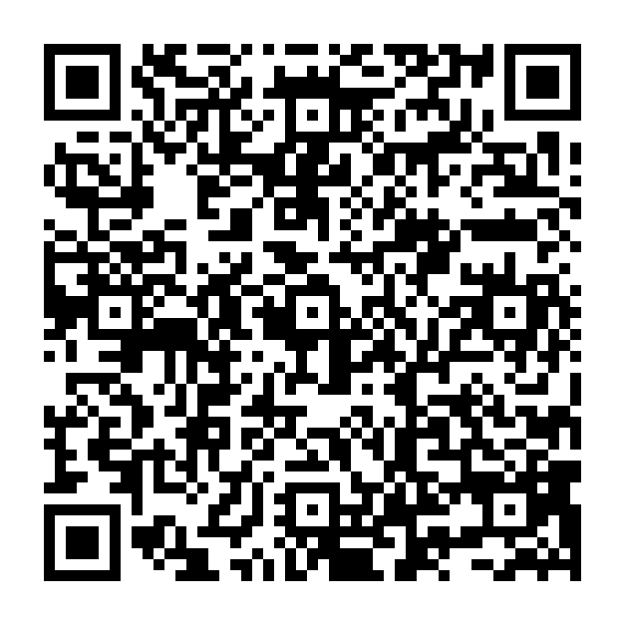
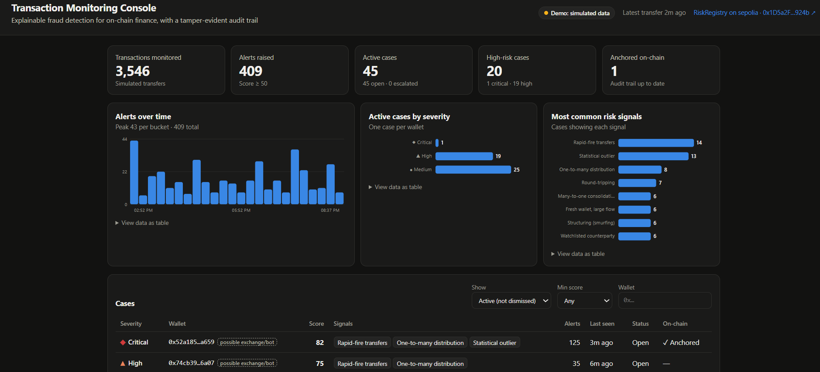
Video Walkthrough
[Insert QR code
after uploading the video]
Scan to watch
Watch the demo video
Video link: [https://drive.google.com/file/d/1XM5nRSkE7Bwcg5PfBr3fC0w2XQcKWQ9K/view?usp=sharin ]

Slide 8
Objectives & Scope
1
Ingest live Ethereum mainnet transfers through JSON-RPC into a local database (one live run added 2,365 transfers).
In Scope
• Live ingestion of ETH transfers
• Rules + Isolation Forest, explainable score
• Case dashboard and review workflow
• On-chain anchoring on Sepolia
2
Detect seven AML patterns plus ML outliers and explain every alert (42 of 42 injected scenarios found on simulated data).
3
Deploy and test a role-based RiskRegistry contract on Sepolia (15 test cases, 8 of them negative).
Out of Scope
• Mainnet deployment or real funds
• Blocking or freezing transactions
• ERC-20 and internal transfers (future extension)
• KYC / identity data
4
Give analysts a dashboard to review cases and anchor alerts on-chain (alert #0 anchored on Sepolia).

Slide 9
Literature Review
Sl. | Author(s) & Year | Paper title / Source | Approach / Technique | Limitation / Gap
1 | Weber et al., 2019 | Anti-Money Laundering in Bitcoin: Experimenting with Graph Convolutional Networks for Financial Forensics – KDD Anomaly Detection in Finance Workshop | Graph convolutional network on a labelled Bitcoin transaction graph (Elliptic dataset) | Offline experiment on one labelled dataset; no live alerting, analyst workflow or audit trail
2 | Chen et al., 2020 | Phishing Scam Detection on Ethereum: Towards Financial Security for Blockchain Ecosystem – IJCAI 2020 | Graph-based cascade features with a LightGBM dual-sampling ensemble | Supervised and needs labelled phishing accounts; classifies accounts but does not give explained, anchored alerts
3 | Hassan et al., 2022 | Anomaly Detection in Blockchain Networks: A Comprehensive Survey – arXiv:2112.06089 | Survey of anomaly-detection models, metrics and requirements by blockchain layer | A survey: maps the field and open challenges but provides no working monitoring layer
4 | Luo et al., 2023 | AI-powered Fraud Detection in Decentralized Finance: A Project Life Cycle Perspective – arXiv:2308.15992 | Taxonomy of DeFi fraud with statistical, ML and graph detection methods | Notes that early-stage detection is immature (little data, scarce ground truth); a review, not a tool
5 | Liu, Ting & Zhou, 2008 | Isolation Forest – IEEE ICDM 2008 | Unsupervised anomaly detection by random isolation trees | General method; needs domain features and rules to be useful for AML and to be explained
Summary: existing work detects well offline, but none combines real-time monitoring, explainable scores and a tamper-evident review trail.

Slide 10
Conclusion & Future Scope
Conclusion
Future Scope
• Built a working monitoring layer: live mainnet ingestion, eight rules plus Isolation Forest, and an explained 0–100 risk score per wallet.
• Deployed RiskRegistry on Sepolia and anchored a real alert (score 82, reasons: high velocity, fan-out, ML outlier) with its tx hash and gas shown on the dashboard.
• All 15 contract tests, 8 anchor tests and 54 Python tests pass; every objective on slide 4 was demonstrated.
• Live mode shows exchanges can raise false alarms, which is why allowlisting and human review are part of the design.
• Monitor ERC-20 tokens and internal transfers
• Add graph features and labelled data for supervised learning
• Batch anchoring and cheaper storage to cut gas
• Multi-signature analyst approval and role audit
• Deploy to an L2 and add alert webhooks for compliance tools
Key outcome: suspicious on-chain activity is detected in real time, explained in plain terms, and recorded in a tamper-evident audit trail.

Slide 11
References
[1] M. Weber et al., “Anti-money laundering in Bitcoin: Experimenting with graph convolutional networks for financial forensics,” KDD Workshop on Anomaly Detection in Finance, 2019, arXiv:1908.02591.
[2] W. Chen, X. Guo, Z. Chen, Z. Zheng, and Y. Lu, “Phishing scam detection on Ethereum: Towards financial security for blockchain ecosystem,” in Proc. IJCAI, 2020, pp. 4506–4512.
[3] M. U. Hassan, M. H. Rehmani, and J. Chen, “Anomaly detection in blockchain networks: A comprehensive survey,” arXiv:2112.06089, 2022.
[4] B. Luo, Z. Zhang, Q. Wang, A. Ke, S. Lu, and B. He, “AI-powered fraud detection in decentralized finance: A project life cycle perspective,” arXiv:2308.15992, 2023.
[5] F. T. Liu, K. M. Ting, and Z.-H. Zhou, “Isolation forest,” in Proc. IEEE ICDM, 2008, pp. 413–422.
[6] FATF, “Updated guidance for a risk-based approach to virtual assets and virtual asset service providers,” Oct. 2021. [Online]. Available: https://www.fatf-gafi.org
[7] Ethereum Foundation, “Solidity documentation.” [Online]. Available: https://docs.soliditylang.org

