Slide 1
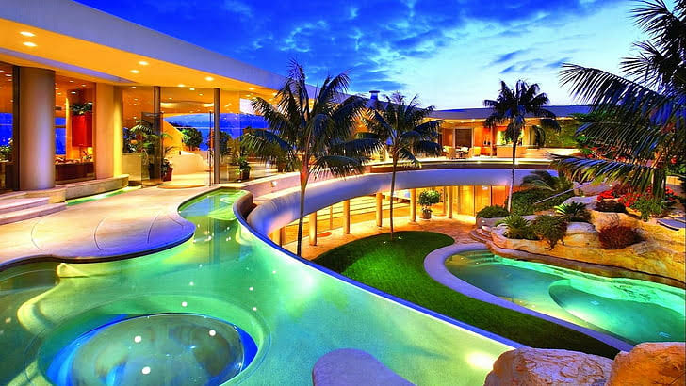
HOTEL BOOKING ANALYSIS USING PYTHON
- By Rashmi Singh

Slide 2
BUSINESS PROBLEM
In recent years, City Hotels and Resort Hotel have been confronted with high cancellation rates, resulting in a range of issues including reduced revenue and suboptimal utilization of hotel rooms. Both hotels must prioritize the reduction of cancellation rates to enhance their efficiency in generating revenue. In addition, we aim to provide comprehensive business advice to address this challenge. The report will primarily focus on the analysis of hotel booking cancellations, as well as other factors that do not impact the hotels' business and annual revenue generation. By identifying these factors, we will be able to provide valuable insights and recommendations to help the hotels mitigate the issue of high cancellation rates.
It is important to note that the reduction of cancellation rates will not only increase revenue generation efficiency but will also improve the overall reputation of the hotels. Therefore, it is crucial that the hotels take a proactive approach to address this issue and implement the recommended solutions to enhance their financial performance and customer satisfaction.

Slide 3
ASSUMPTIONS:
1. No unusual occurrences between 2015 and 2017 will have a substantial impact on the data used.
2. This information is still current and can be efficiently utilized to strategize and plan the hotel's future course of action.
3. Furthermore, there are no unanticipated negative consequences associated with implementing any recommended techniques.
4. However, it is noteworthy that the suggested solutions are yet to be adopted by the hotels.
5. The biggest factor affecting the effectiveness of earning income is booking cancellations.
6. Cancellations result in vacant rooms for the booked length of time.
7. Clients make hotel reservations the same year they make cancellations.

Slide 4
RESEARCH QUESTION:
1. What are the main factors that contribute to hotel reservation cancellations?
2. What measures can be taken to minimize hotel reservation cancellations and enhance the guest experience?
3. How can hotels be provided with guidance and tools to make informed decisions about pricing and promotions that optimize revenue and occupancy levels?

Slide 5
HYPOTHESIS:
1. It is important to note that cancellations occur more frequently when prices are higher.
2. Customers tend to cancel their reservations more often when there is a longer waiting list.
3. It has been observed that the majority of clients are making their reservations through offline travel agents.

Slide 6
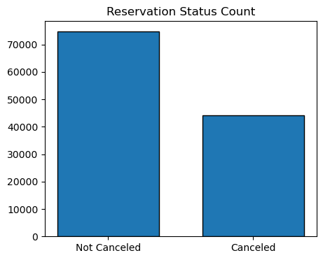
ANALYSIS AND FINDINGS 1 :
The bar graph accompanying this information depicts the percentage of reservations that have been canceled and those that have not. From the graph, it is clear that there are still many reservations that have not been canceled yet.
In particular, it is noticeable that 37% of clients have canceled their bookings, which considerably impacts the hotel's earnings.

Slide 7
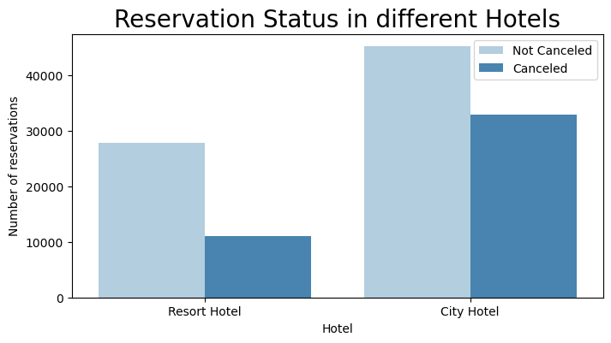
ANALYSIS AND FINDINGS 2:
In comparison to Resort hotels, City hotels have more bookings. It is possible that resort hotels are more expensive than those in cities.

Slide 8
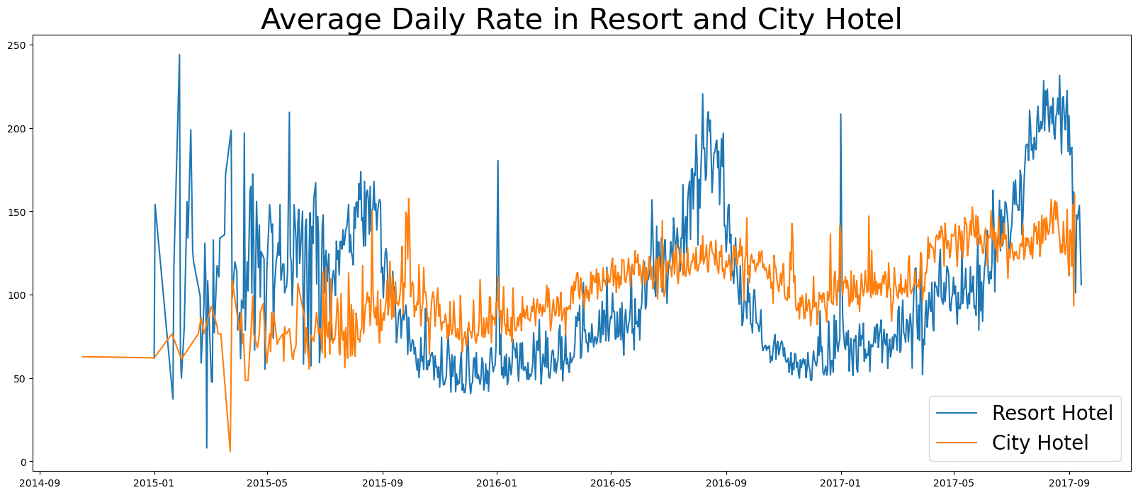
ANALYSIS AND FINDINGS 3:
The line graph shows that on certain days, the average daily rate for a city hotel is less than that of a resort hotel. And on other days, it is even less. Weekends and holidays may see a rise in resort hotel rates.

Slide 9
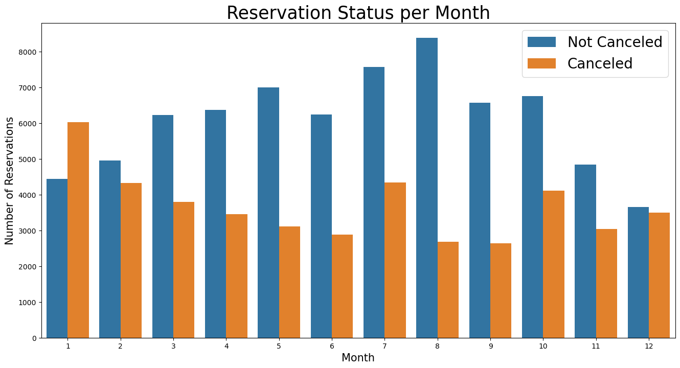
ANALYSIS AND FINDINGS 4:
We have generated a grouped bar graph to analyze the reservation status of different months. From the graph, it is observed that the month of August has the highest number of confirmed reservations as well as canceled reservations. On the other hand, January has the highest number of canceled reservations.

Slide 10
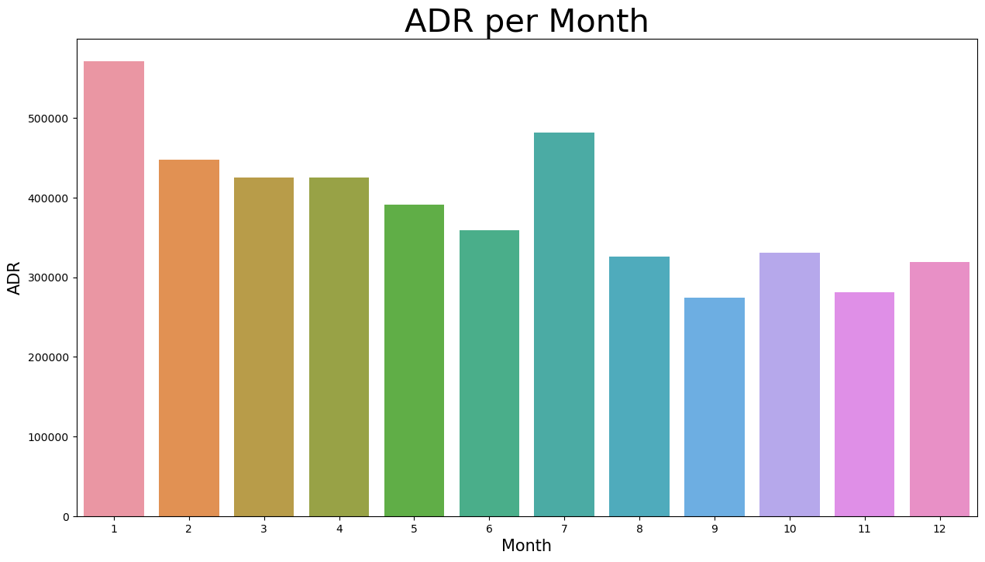
ANALYSIS AND FINDINGS 5:
The bar graph demonstrates that high prices correlate with more cancellations, while lower prices lead to fewer cancellations. Therefore, it seems that cost is the primary factor causing cancellations.

Slide 11
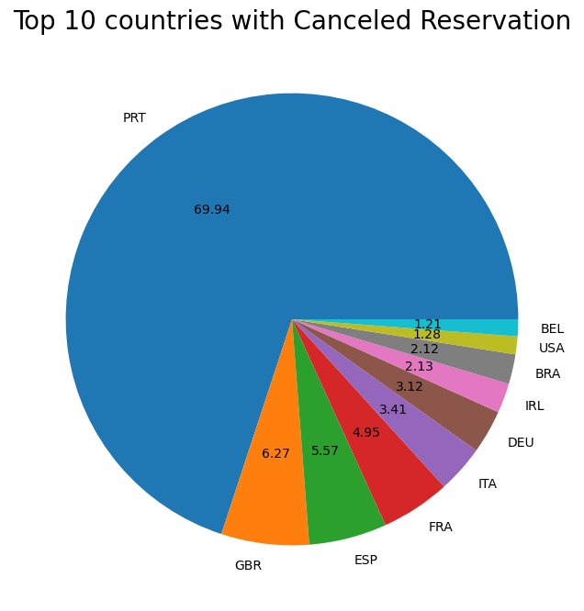
ANALYSIS AND FINDINGS 6:
Portugal has the highest number of cancellations with around 70% of reservations being canceled, as shown in the pie chart.

Slide 12
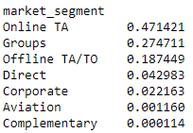
ANALYSIS AND FINDINGS 7:
The data indicates from where guests are visiting the hotels and making the reservations, whether it is coming from Direct Groups, Online Travel Agencies or Offline Travel Agencies(TA)? We can see around 47% of clients come from Online TA, whereas 27% come from Groups, 18% come from Offline TA and only 4% of clients book hotels directly by visiting them and making reservations.

Slide 13
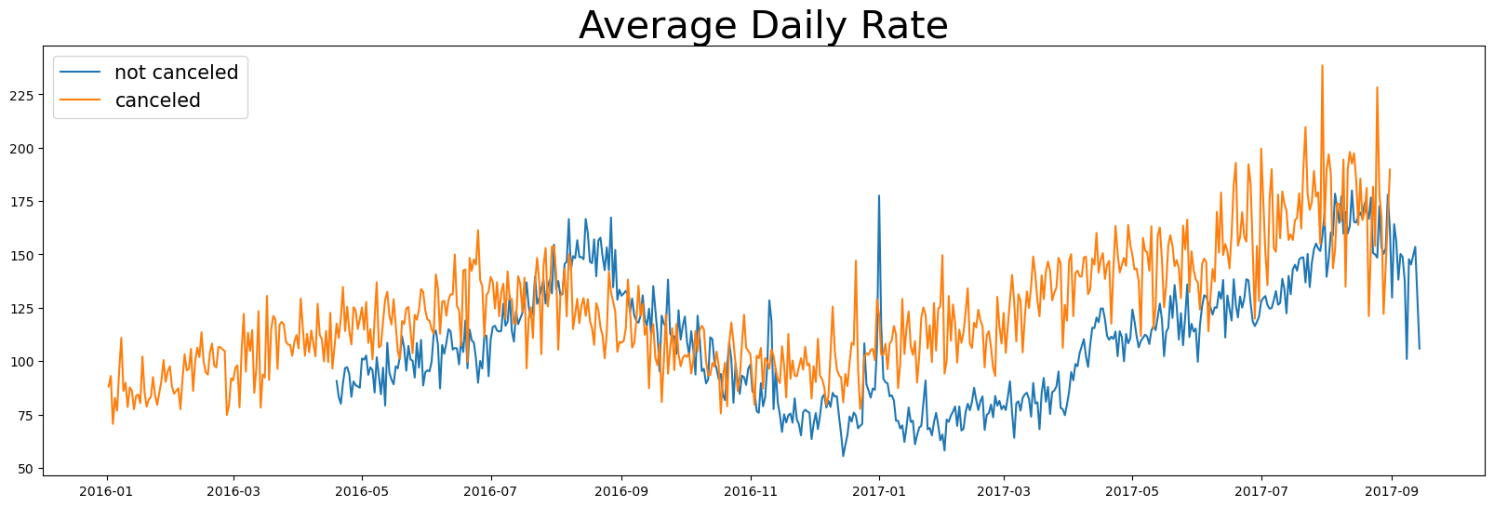
ANALYSIS AND FINDINGS 8:
The graph clearly indicates that there is a correlation between the average daily rate and the cancellation of reservations. It appears that a higher price leads to higher cancellations, based on the analysis provided.

Slide 14
SUGGESTIONS:
To address increasing cancellation rates, hotels can adjust pricing strategies by lowering rates for specific locations and offering discounts to consumers. This could lead to reduced cancellations and increased customer loyalty, ultimately resulting in improved revenue.
Resort hotels have a higher cancellation rate than city hotels. To reduce cancellations, hotels can offer discounts on weekend and holiday room prices. This can boost bookings, improve customer satisfaction, and increase revenue.
Hotels can increase revenue in January by running marketing campaigns with reasonable budgets as it's a month with a high cancellation rate.
Improving hotel quality and services in Portugal countries can reduce cancellation rates and increase customer satisfaction.

Slide 15
THANK YOU

