Slide 1
By:
Rashmi Gulhane
Akansha Gupta
Leveraging Linux Containers to Achieve High Availability for Cloud Services

Slide 2
Content
Purpose
achieving HA
holistic view of approach
Application Design
Architecture
The flow of detecting failures and recovering
.
Case Study:video streaming service using VLC
Advantage and Disadvantage of System:
Identified gaps,REference

Slide 3
Purpose
compensate the limitations of Linux containers in achieving HA
a novel approach using Linux containers and middleware technologies to achieve HA for cloud applications.
first work that addresses HA for cloud applications by integrating technologies of middleware and Linux containers

Slide 4
achieving HA
Redundancy
Monitoring
Checkpoint
Recovery management

Slide 5
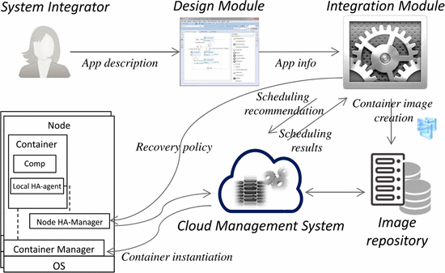
holistic view of approach

Slide 6
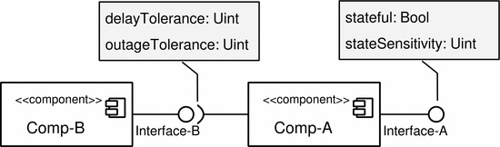
Application Design
HA-agnostic
HA attributes
Checkpointing strategies
recovery policy
scope of failure

Slide 7
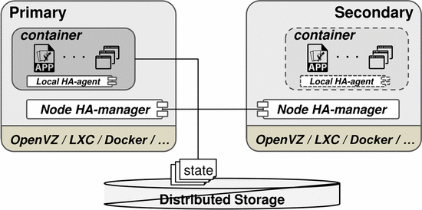
Architecture

Slide 8
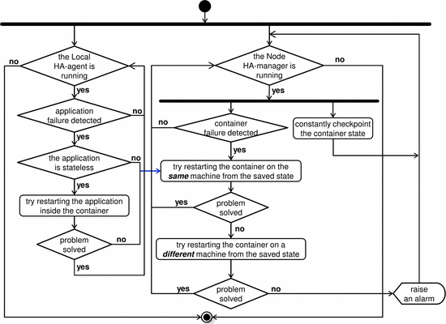
The flow of detecting failures and recovering.

Slide 9
Case Study:video streaming service using VLC

Slide 10
Advantage and Disadvantage of System:
zero-overhead HA solution does not exist
performance impact
efficiency of checkpoint procedure
the time interval of checkpoint
size of the container
if the application is not very state sensitive, then the HA overhead can be insignificant

Slide 11
Identified gaps:
1)Even if single application fails in multi application container,the whole container gets restarted.
2)HAManager is a single point of failure,if a HAManager fails there is no mechanism to identify it and hence no checkpointing for that container will take place
3)Checkpointing frequency is static.Mechanism should be included to change Checkpointing frequency on basic of MTTF,MTTR of that container.

Slide 12
Conclusion:
1)compensate the limitation of Linux containers in achieving HA
2 ) the application recovery time even in case of failover is negligible
3) By dynamically deciding the interval for checkpoint less overheat created.
4)Some more improvement in the existing system can make this System more efficent.
Reference:
Leveraging Linux Containers to Achieve High Availability for Cloud Services
Cloud computing lecture
http://criu.org/

Slide 13
Thank you

