Slide 1
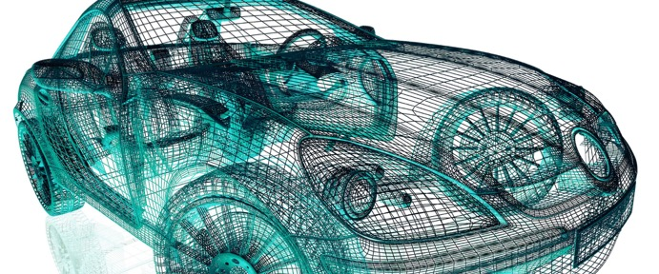
JARVIS FOR MBSE
PRESENTATION ON ARTIFICIAL INTELLIGENCE
Presented By
Adnan Manzoor
Rashmi Gupta

Slide 2
Agenda
Knowledge Graphs
Graph Databases
Neo4J and Cypher
Demo
MongoDB

Slide 3
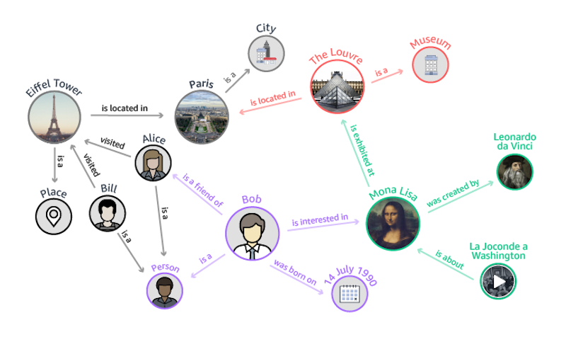
A Knowledge Graph
Ref: https://geomarketing.com/amazons-neptune-database-will-expand-the-knowledge-graph-heres-how
3
Notes:
Requirement gathering & Analysis: The requirements from the customer are gathered. Various questions like who is going to be the user of the product? What does the software do? What type of data is to be stored? Etc. helps in gathering the information from the customers. Once the requirement is gathered properly, it is then analysed and feasibility is checked to make sure if it a good idea to move forward with.
- Design: In this phase, the overall design of the product, i.e., the software and the system is prepared based on the study of the requirement gathered in the previous phase.
- Implementation/ Coding: The software is then coded according to the design made.
-Testing: The developed product is then tested for the desired result and output. Various test cases are applied on the software so developed to check if it gives the desired output in every test case.
-Deployment: Once the product undergoes the testing phase, it is deployed, i.e., delivered to the customer along with all the necessary documents such as user manual. This phase also consists of beta testing part. Beta testing is done by the users of the product.
-Maintenance: Once the software is deployed to the customer, the tech team along with the after sales team takes care of the software and any complaints from the user of the software.

Slide 4
Knowledge Graph Definition…..
“Knowledge graphs are large networks of entities, their semantic types, properties, and
relationships between entities.“ - Journal of Web Semantics
Entities: Real world objects (Things, places, people) and abstract concepts (genres, professions)
Relationships: describe how the entities relate
Semantic Description: types and properties with a well defined meaning
4

Slide 5
Why Knowledge Graphs?
We need a structured and formal representation of Knowledge
We are surrounded by entities, which are connected by relations
Natural way of representing entities and their relationships
Efficient Management
5

Slide 6
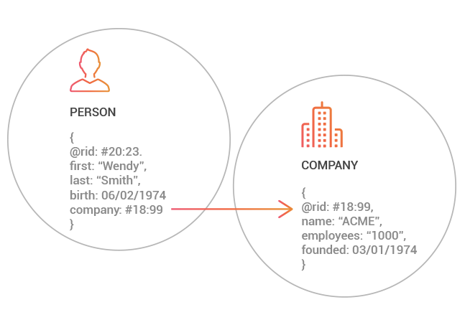
Graph Databases
Ref: https://orientdb.com/graph-database/
6
Notes:
Software specification (or requirements engineering): Define the main functionalities of the software and the constrains around them.
Software design and implementation: The software is to be designed and programmed.
Software verification and validation: The software must conforms to it’s specification and meets the customer needs.
- Software evolution (software maintenance): The software is being modified to meet customer and market requirements changes.

Slide 7
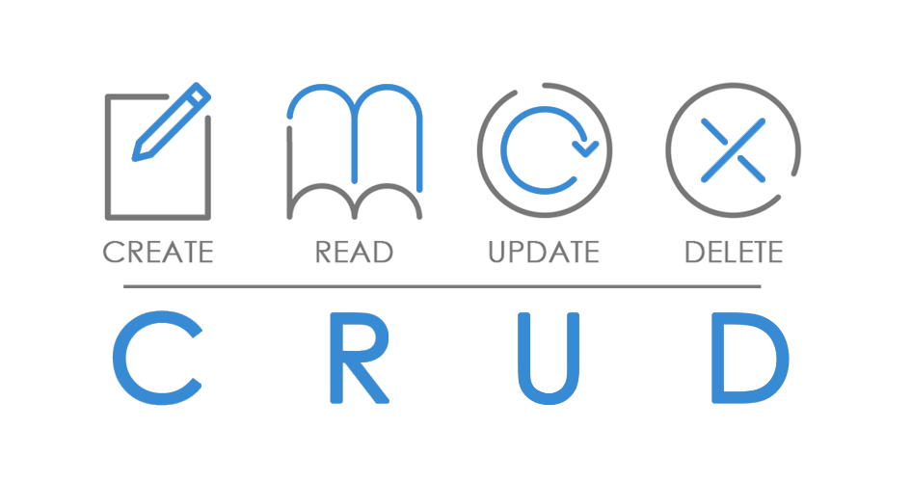
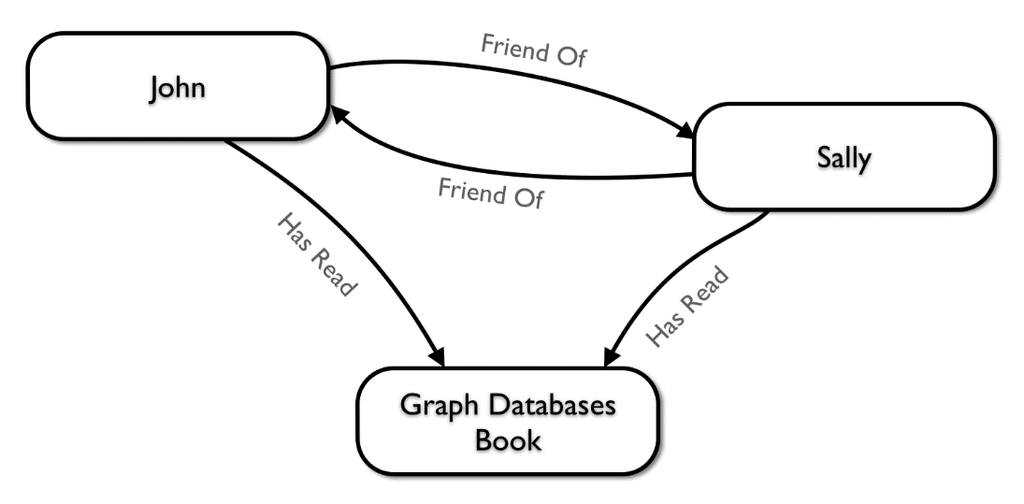
Graph Databases
An online database management system with Create, Read, Update, and Delete (CRUD) methods that expose a graph data model.
NoSQL databases which use the graph data model comprising of:
Vertices : Entities
Edges: Relationships
Ref: 1) Graph Databases by O’Reilly , 2) https://medium.com/ , 3) https://neo4j.com
7

Slide 8
Graph Databases
Relationships are first-class citizens of the graph data model.
No foreign keys needed to infer the connection between entities
Two properties to look for in a Graph Database:
The underlying storage:
native graph storage: optimized and designed for storing and managing graphs
serializing the graph data into a relational database or an object-oriented database,
The processing engine:
index-free adjacency:
connected nodes physically “point” to each other in the database
Ref: 1) Graph Databases by O’Reilly , 2) https://medium.com/ , 3) https://neo4j.com
8
Notes:
- The benefit of native graph storage is that its purpose-built stack is engineered for performance and scalability.
- The benefit of non-native graph storage, in contrast, is that it typically depends on a mature non-graph backend (such as MySQL)
whose production characteristics are well understood by operations teams.
- Native graph processing (index-free adjacency) benefits traversal performance, but at the expense of making some queries that don’t use traversals difficult or memory intensive.

Slide 9
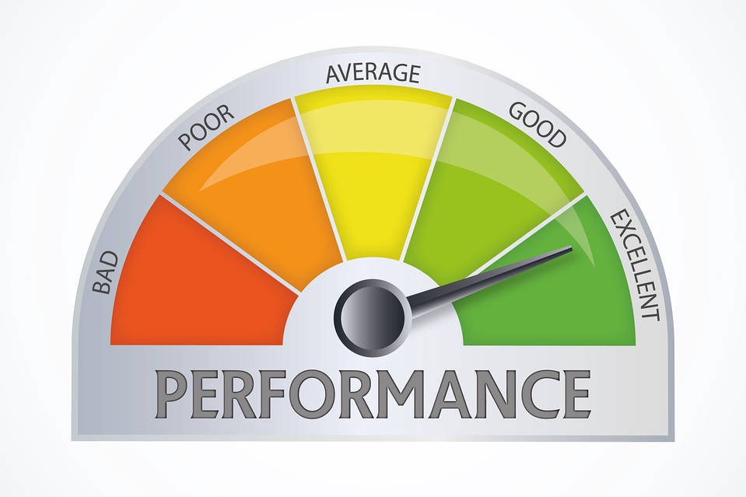
Why Graph Database?
They are intuitive
Performance:
In relational databases, join-intensive query performance deteriorates as the dataset gets bigger
Graph database performance tends to remain relatively constant, even as the dataset grows
Queries are localized to a portion of the graph to satisfy that query, rather than the size of the overall graph.
Ref: 1) Graph Databases by O’Reilly , 2) https://blog.usejournal.com/
9

Slide 10
Why Graph Database?
Flexibility:
Graphs are naturally additive
Add new kinds of relationships, new nodes, new labels, and new subgraphs to an existing structure without disturbing existing queries and application functionality
Don’t have to model our domain in exhaustive detail ahead of time – Good in case business requirements are constantly changing.
Perform fewer migrations, thereby reducing maintenance overhead and risks
Ref: 1) Graph Databases by O’Reilly ,
10

Slide 11
Why Graph Database?
Agility:
Modern graph databases equip us to perform frictionless development and graceful systems maintenance.
The schema-free nature of the graph data model, coupled with query language, empower us to evolve an application in a controlled manner.
Graph database development aligns well with today’s agile and test-driven software development practices, allowing graph database backed applications to evolve in step with changing business environments
Ref: 1) Graph Databases by O’Reilly ,
11

Slide 12
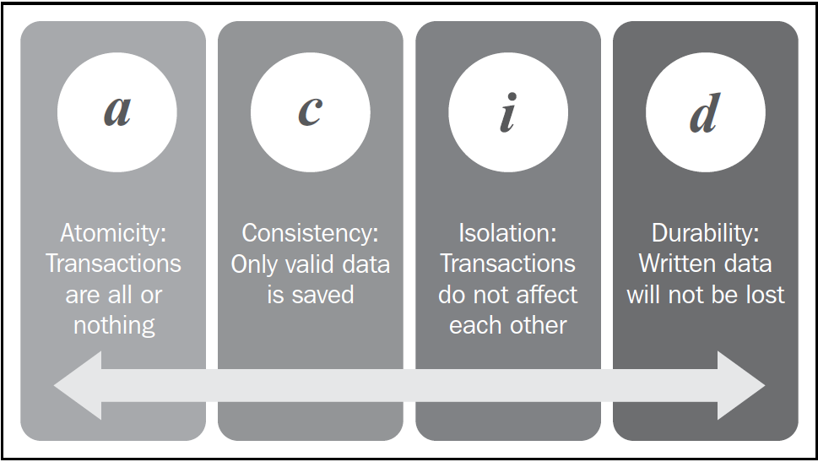
Neo4j
ACID-compliant database:
Ref: 1) Graph Databases by O’Reilly ,
12
Notes:
Atomicity : This means that changes in the database must follow an all or nothing rule. Transactions are said to be "atomic" if one part of the transaction fails, then the consequence would be that the entire transaction is rolled back.
• Consistency: This means that only consistent or "valid" data will be allowed to be entered into the database. In relational terminology, this often means that the schema of the database has to be applied and maintained at all times. The main consistency requirement in Neo4j is actually that the graph relationships must have a start and an end node. Relationships cannot be dangling. Aside from this, however, the consistency rules in Neo4j will obviously be much looser, as Neo4j implements the concept of an "optional" schema.
Isolation: This requires that multiple transactions that are executed in parallel on the same database instance would not impact each other. The transactions need to take their due course, irrespective of what is happening in the system at the same time. One of the important ways that this is used is in the example where one transaction is writing to the database and another is reading from it. In an isolated database, the read transaction cannot know about the write that is occurring "next to" it until the transaction of the write operation is complete and fully committed. As long as the write operation is not committed, the read operation will have to work with the "old" data.
• Durability: This basically means that committed transactions cannot just disappear and be lost. Persisted storage and transaction commit logs that are forced to be written to disk—even when the actual data structures have not been updated yet—ensure this quality in most database systems and also in Neo4j.

Slide 13
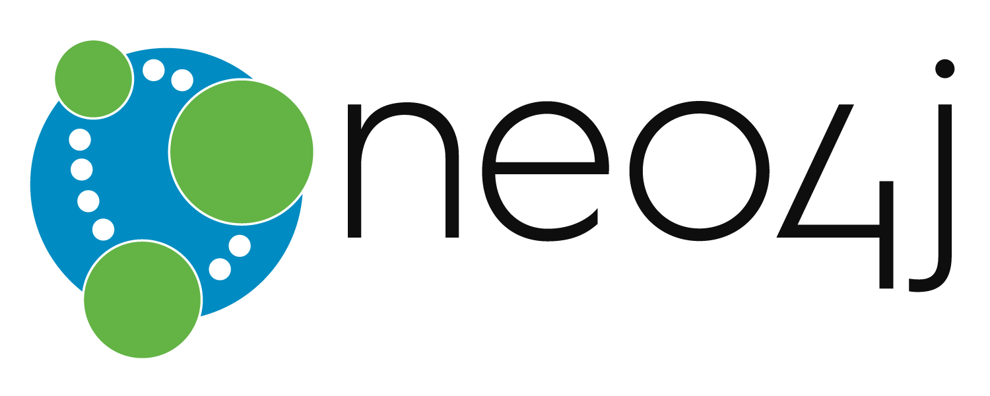
Neo4j
Designed for scalability :
In order to deal with the Online Transaction Processing workload, Neo4j provides:
critical scalability,
high availability,
fault-tolerance
Ref: 1) Graph Databases by O’Reilly , 2) https://neo4j.com
13

Slide 14
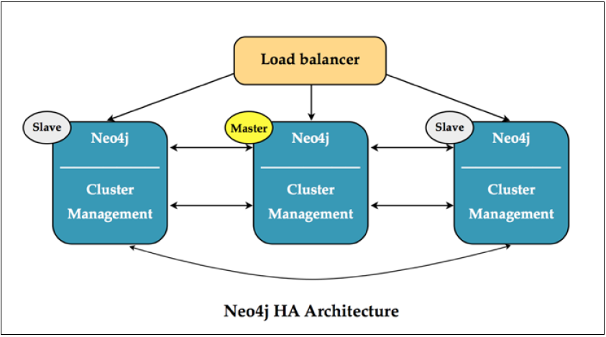
How Scalability?
Creating clusters of database server instances that work together to achieve the goals
Ref: 1) Graph Databases by O’Reilly ,
14
Notes:
Each Instance:
- Hold the entire dataset of the database. All servers hold the same data and therefore can respond to all query requests.
- Comply with a master-slave consistency scheme. This means that, in case of potential conflicting data in the database, the Master server instance will decide what would be right data to keep and persist. If at some point, the cluster would lose its master, the remaining cluster member instances would run a master election algorithm (in Neo4j's case, based on Paxos) that allows them to quickly choose a new master.

Slide 15
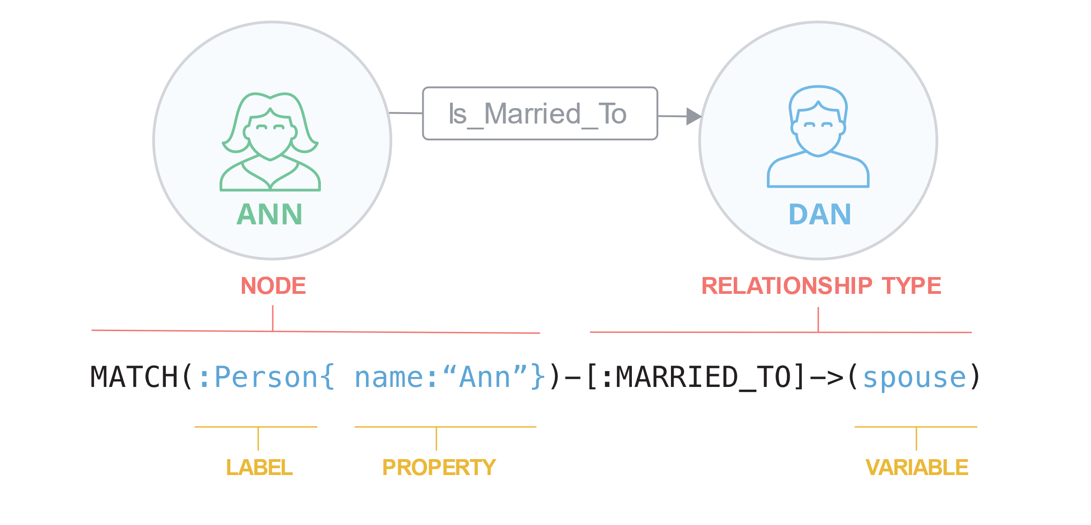
The Labelled Property Graph Model
Made up of nodes, relationships, properties, and labels.
Nodes contain properties:
store properties in the form of arbitrary key-value pairs.
the keys are strings
the values are the Java string and primitive data types, plus arrays of these types.
Nodes can be tagged with one or more labels. Labels group nodes together, and indicate the roles they play within the dataset.
Relationships can also have properties
useful for providing additional metadata for graph algorithms
and for constraining queries at runtime
Ref: 1) Graph Databases by O’Reilly ,
15

Slide 16
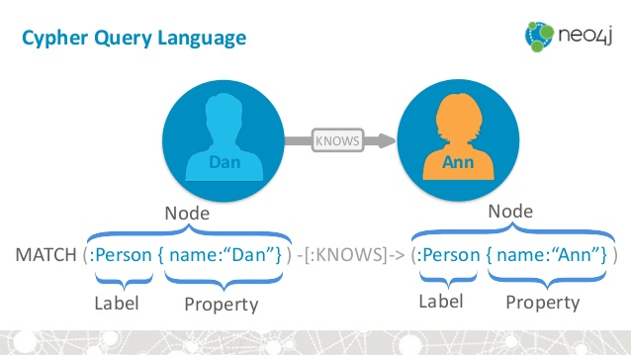
Cypher A declarative Query Language…
Ref: 1) https://www.slideshare.net/
16

Slide 17
Cypher
Cypher is a declarative, pattern-matching query language.
Allows to state what we're looking for, declare the pattern that we would like to see retrieved, and then let the database worry about how to go about retrieving that data.
easy-to-read query makes maintenance much easier
allows the database to use the information that it holds about the nature and structure of the data to answer questions more efficiently
allows query optimizations that you would never have known of or thought about in an imperative approach
Great for adhoc querying of database, without having to write complex software routines to do so.
Ref: 1) Graph Databases by O’Reilly ,
17

Slide 18
Queries
CREATE Clause
Multiple nodes with a label and properties
Relationship between them with properties
Return the Results
MATCH Clause
To retrieve specific nodes
WHERE Clause
Filtering the Result
Ref: 1) https://neo4j.com
18
Notes:
1)
CREATE (shakespeare:Author {firstname:'William', lastname:'Shakespeare'}),
(juliusCaesar:Play {title:'Julius Caesar'}),
(shakespeare)-[:WROTE_PLAY {year:1599}]->(juliusCaesar),
(theTempest:Play {title:'The Tempest'}),
(shakespeare)-[:WROTE_PLAY {year:1610}]->(theTempest)
Return shakespeare, juliusCaesar, theTempest
2)
Match (x)-[: WROTE_PLAY]->(n)
Return x,n
3)
CREATE (wordsworth:Author {firstname:'William', lastname:'Wordsworth'}),
(weAreSeven:Play {title: 'We are Seven'}), (wordsworth)-[:WROTE_PLAY {year:1798}]->(weAreSeven)
Match (x)-[: WROTE_PLAY]->(n)
Where x.lastname = "Shakespeare"
Return x,n

Slide 19
Queries
ORDER BY Clause
Arrange the results of a query in a certain Order
LIMIT Clause
Limits the number of results
SKIP Clause
Skip certain result rows
MERGE Clause
Merge a node with label
Merge a node with properties
Merge a node with relationship
Ref: 1) https://neo4j.com
19
Notes:
4)
CREATE(Ronaldo:player{name:"Cristiano Ronaldo", goals:658, country: "Portugal"})
CREATE(Messi:player{name:"Lionel Messi", goals:617, country:"Argentina"})
CREATE(Rooney:player{name:"Wayne Rooney", goals: 282, country:"England"})
CREATE(Muller:player{name:"Thomas Muller", goals:192, country:"Germany"})
CREATE(Ribery:player{name:"Frank Ribery", goals:149, country:"France"})
-
Match(n) Return n.name, n.goals Order By n.goals
5)
Match(n) Return n.name, n.goals Order By n.goals DESC LIMIT 3
6)
Match(n) Return n.name, n.goals Order By n.goals SKIP 3
7)
MERGE (Neymar:player{name:"Neymar", goals:"250", country:"Brazil"}) return Neymar
Create (foot:Sports{name:"Football"})
-
Match (a:player), (b:Sports{name:'Football'})
Merge (a)-[r:Plays]->(b)
return a,b

Slide 20
Queries
SET CLAUSE
Set properties
Remove properties
Set labels
REMOVE CLAUSE
remove properties and labels
DELETE CLAUSE
Delete a Node
Delete all Nodes
Ref: 1) https://neo4j.com
20
Notes:
8)
Create(Zlatan{name:"Zlatan"})
-
match(Zlatan{name:"Zlatan"}) Set Zlatan:player:Person
match(x:player{name:"Zlatan"}) Set x.name="Zlatan Ibrahimovic", x.goals = 300, x.country ="Sweden" x.ability="Self Praising" return x
9)
match(x:player{name:"Zlatan Ibrahimovic"}) Remove x:Person return x
match(x:player{name:"Zlatan Ibrahimovic"}) Remove x.ability return x
10)
match(x:player{name:"Zlatan Ibrahimovic"}) Delete x
match(n) DETACH DELETE n

Slide 21
MongoDB
A document database
To make scaling out easier
A row of a relational database replaced by a document
document: an ordered set of keys with associated values. Generally stored as JSON or XML
{"greeting" : "Hello World!"}
Key/value pairs in documents are ordered
A set of documents called a collection, equivalent to a table of relational database
A single instance of MongoDB can host multiple independent databases, each of which can have its own collections and permissions.
Ref: 1) MongoDB – The Definitive Guide by O’ Reilly
21

Slide 22
MongoDB
Schema Free
Documents within a single collection can have any number of different “shapes”.
A single collection can have both :
{"greeting" : "Hello world!"}
{"foo" : 5}
Where to Use:
Big Data
Content Management and Delivery
Mobile and Social Infrastructure
User Data Management
Data Hub
Ref: 1) MongoDB – The Definitive Guide by O’ Reilly
22

Slide 23
AGENDA
Sequence | List of Topics
1 | Representation of Knowledge Graph
2 | Graph Analytics
3 | Graph Algorithms
3.1 | Pathfinding Algorithms
3.2 | Centrality Algorithms
3.3 | Community Detection Algorithms
4 | Adding new node to the current graph

Slide 24
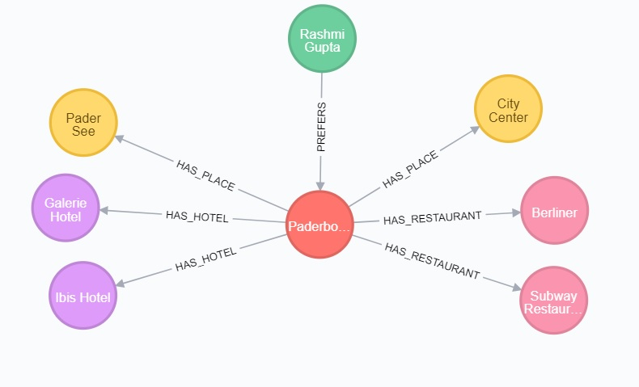
1. Representation of Knowledge Graph
References :1. https://neo4j.com

Slide 25
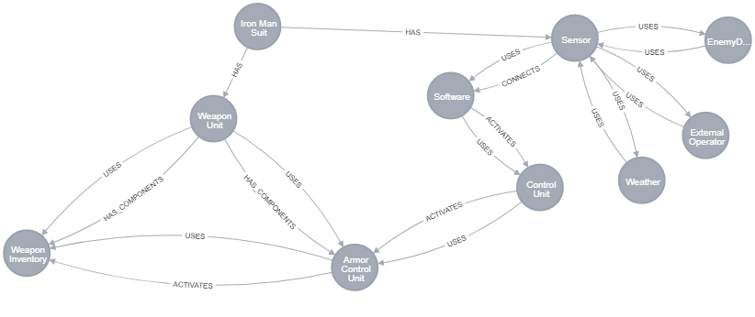
1. Representation of Knowledge Graph

Slide 26
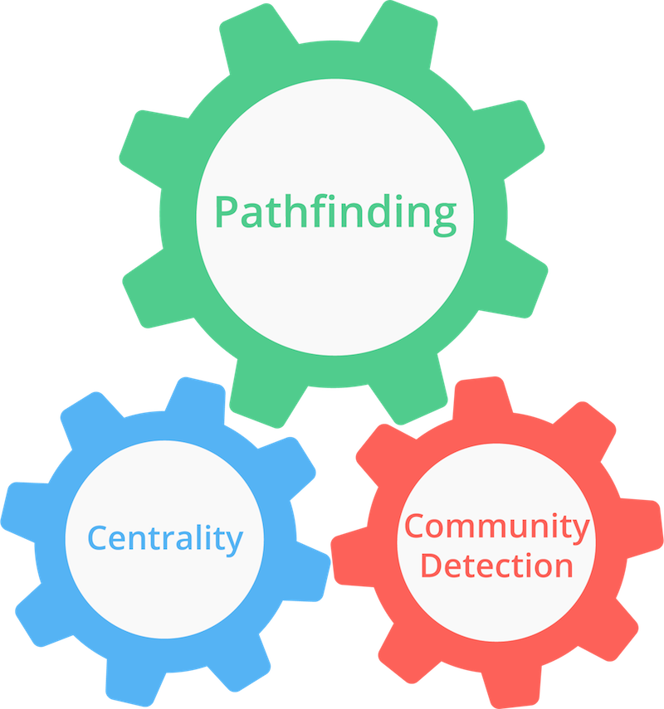
2. Graph Analytics
What is Graph Analytics ?
Understanding and visualizing relationships between nodes in a graph.
Why do we need Graph Analytics and what are the types of analytics ?
Pathfinding Analytics
Centrality Analytics
Community Detection Analytics
How can we do Graph Analytics ?
References :1. http://blog.algoscale.com/beginners-guide-graph-analytics/

Slide 27
3. Graph Algorithms
What are the types of Graph Algorithms ?
Traversal/Path finding Algorithms
Centrality Algorithms
Community Detection Algorithms
References :1. https://neo4j.com/blog/graph-algorithms-neo4j-15-different-graph-algorithms-and-what-they-do/

Slide 28
3.1 Path Finding Algorithms
Breadth First Search
Depth First Search
Shortest Path
Minimum Weight Spanning Tree
1
1
1
1
1
1
3
2
1
1
1
1
1
References :1. https://cs.uni-paderborn.de/is/teaching/courses/ws-201718/planning-and-heuristic-search/phs-1718-slides/

Slide 29
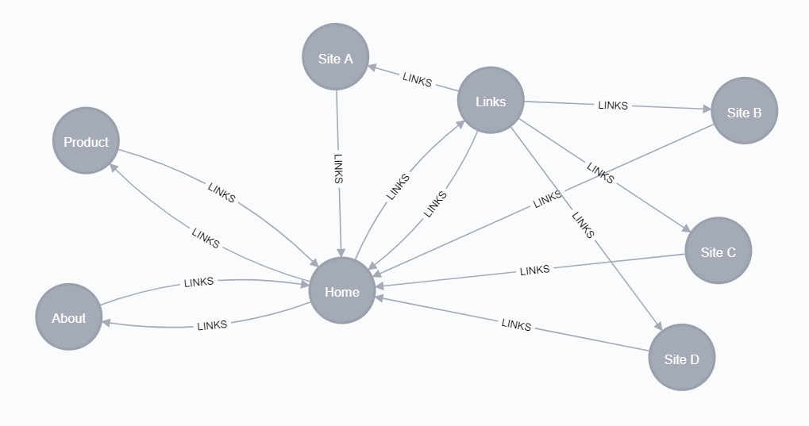
3.2 Centrality Algorithms
Page Rank Algorithm
Estimates a current node's importance from its linked neighbours and then again from their neighbours. A node's rank is derived from the number and quality of its transitive links to estimate influence.
Name | PageRank
Home | 3.232
Product | 1.059
Links | 1.059
About | 1.059
Site A | 0.328
Site B | 0.328
Site C | 0.328
Site D | 0.328
References :1. https://neo4j.com/docs/graph-algorithms/current/algorithms/page-rank/

Slide 30
3.2.1 Utilisation of Page Rank in our System
To identify the most utilised unit based on the relationship to reuse later.
Here , we can say that “Sensor” is the component that is most influential and has a strong dependency in the whole system
References :1. https://neo4j.com/docs/graph-algorithms/current/algorithms/page-rank/

Slide 31
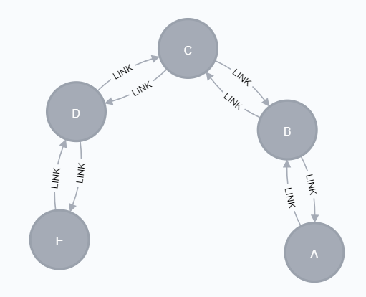
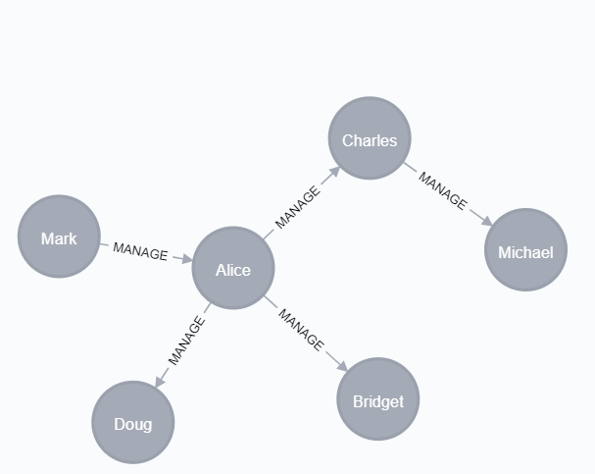
3.2 Centrality Algorithms
Closeness Centrality Algorithm
Detects node that can spread
information very quickly through the graph
In this graph, C is the best connected
node
Betweenness Centrality Algorithm
It is a way of detecting the amount of
influence a node has over the flow of
information in a graph.
In this graph, if Alice is removed all the
connections would be cut off.
References :1. https://neo4j.com/docs/graph-algorithms/current/algorithms/betweenness-centrality/
2. https://neo4j.com/docs/graph-algorithms/current/algorithms/closeness-centrality/

Slide 32
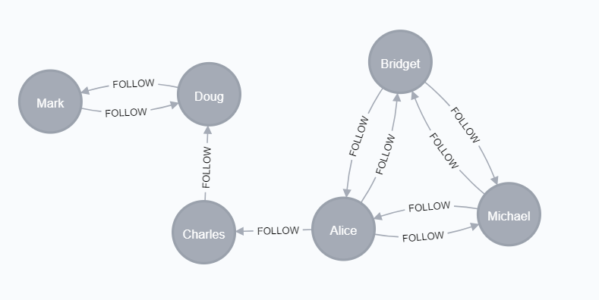
3.3 Community Detection Algorithms
Label Propagation :
Spreads labels based on
neighbourhood majorities
sequentially updates each
node’s label to a new one,
which is the most frequent label
among its neighbours at every
label propagation step (iteration).
References :1. https://neo4j.com/docs/graph-algorithms/current/algorithms/label-propagation/

Slide 33
3.3.1 Utilisation of Label Propagation Algorithm
Attach a label to the components that form a community to reuse them later.
While creating new system with same functionalities, so instead of traversing each component , we could use the whole community instead.
Here, Weapon Unit could be considered as a Community and we could use the same community at a later time.

Slide 34
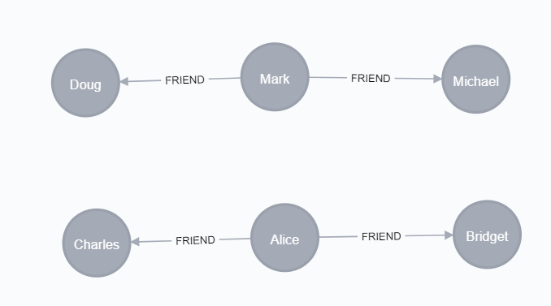
3.3 Community Detection Algorithms
Connected Components
To identify the components that are
connected and the ones that are not
Strongly Connected Components
To identify the components that are
strongly connected to each other
References :1. https://neo4j.com/docs/graph-algorithms/current/algorithms/strongly-connected-components/
2. https://neo4j.com/docs/graph-algorithms/current/algorithms/connected-components/

Slide 35
3.3.2 Utilisation of Strongly Connected Component Algorithm
We could find the community of nodes that are strongly connected in the system.
In this example, we have sensor that uses enemy detection, external operator and weather. We could consider this as a community and use the whole component later.

Slide 36
3.4 Adding New Node to the Current Graph
How to add a node ArmorSystem (meaning similar to Armor Control Unit) ?
Add Semantic Information while building the graph OR import Semantic information from other sources.
References :1. https://arxiv.org/pdf/1412.0691.pdf

Slide 37


