Slide 1
CLM / EMAIL ROUTING MOTIVATION
Specialize the router, not the entire language model
Goal: adapt to each team's taxonomy without a separate 8B model for every team.
THE ROUTING PROBLEM
Request
Shared encoder
Team head
Team-specific taxonomies
Changing category definitions
Independent model updates
Fallback for uncertain routes
Team ID
+ request text
>
Frozen
Qwen3-8B
>
~75 MB checkpoint
+ Choice taxonomy
CLM scores candidate actions; it does not generate text.
A confidence gate sends uncertain routes to a fallback.
Strategy: measure zero-shot first; train only the team head when quality falls short.
Sources: experiment.md; clm_email_classification_evaluation.ipynb | Saved results, not rerun
1 / 4
Notes:
Why this matters
The experiment plan asks how to route requests across teams with different, evolving taxonomies without maintaining a full language model per team. Teams need independent quality improvement, rollback, and an explicit fallback when the router is uncertain. The proposed design shares a frozen Qwen3-8B encoder and selects a small team-specific CLM projection-head checkpoint using the request's model field.
What CLM does
CLM is a scorer, not a text generator. It embeds the request state and candidate descriptions, applies learned state/action projections, and scores the candidates. A typed Choice question maps naturally to a routing taxonomy. The reference checkpoint is about 75 MB; it contains the projection heads, not the 8B encoder. The encoder must stay compatible with its trained heads.
Why test before training
The plan starts with zero-shot category descriptions and trains a team head only when that configuration misses its target. This avoids unnecessary training while making the quality gate empirical. The email notebook supplies one concrete six-class proof of concept; it does not test multi-team serving or prove all of the plan's hypotheses.
Hardware and scope
The plan assesses one 24 GB RTX 3090 as feasible for a prototype because only the small heads train on cached embeddings. Its 3090 memory, throughput, and timing estimates are planning assumptions, not measured notebook findings. The notebook does not establish production throughput, availability, or multi-team isolation. No backbone LoRA is used in the reported experiment.

Slide 2
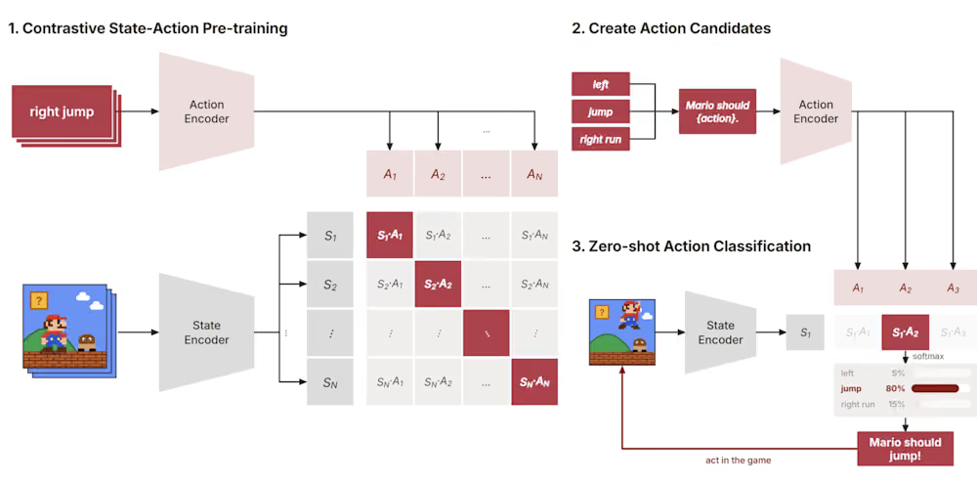
Contrastive Language Models
Source: https://contrastive-lm.notion.site/

Slide 3
CLM / EMAIL ROUTING EXPERIMENT DESIGN
A controlled test of head-only adaptation
One synthetic email taxonomy; a real CLM server; the encoder and request contract stay fixed.
FIT
DEVELOPMENT
PUBLISHED TEST
8,624
Trainer holds out 10%
for internal validation
2,156
Training-derived holdout;
three seeds checked here
2,697
Same emails before / after;
final checkpoint = seed 42
WHAT CHANGES
WHAT STAYS FIXED
Released CLM head & email-specific head
Warm start + supervised soft cross-entropy
Best validation checkpoint; early stopping
Frozen Qwen3-8B; subject + body state
Same six options and descriptions
Same test IDs; temperature = 1.0
Labels: forum | promotions | social_media | spam | updates | verify_code
Sources: experiment.md; clm_email_classification_evaluation.ipynb | Saved results, not rerun
2 / 4
Notes:
Dataset and request contract
The dataset is jason23322/high-accuracy-email-classifier on Hugging Face, a synthetic, highly regular email benchmark. The task is a closed six-way classification: forum, promotions, social_media, spam, updates, and verify_code. The notebook forms each state from subject and body and asks one typed Choice question. It validates a real CLM server, records the full probability distribution, checkpoints predictions by email ID, and reports failures and coverage.
Splits and selection
The 10,780 published training rows are divided deterministically, with stratification and seed 42, into 8,624 fit rows and 2,156 development rows. The trainer also reserves 10% of fit IDs for internal validation. The published test contains 2,697 emails, roughly 449 to 451 per class. ID-disjointness and file/ID hashes are checked. ID-disjointness is not the same as content independence; later duplicate checks identify substantial repeated content.
Controlled comparison
The standardized before/after comparison uses identical published-test IDs, state representation, six labels, instructions, candidate descriptions, and temperature 1.0. The changed component is the task-specific projection head. The encoder stays frozen. Seed 42 is the declared final model, while seeds 123 and 2026 provide development-only stability checks. The notebook reports that final checkpoint selection was not based on published-test performance.
Training recipe
Training warm-starts from the released head and optimizes the state/action projections and logit scale with hard-label soft cross-entropy. The recipe uses learning rate 5e-4, batch size 256, weight decay 1e-4, up to 30 epochs, and patience 5 on internal-validation accuracy. Seed 42 selects epoch 12. Training runs in Linux/WSL with the GPU environment; the Windows notebook is the evaluation client.
Temperature diagnostic
The original diagnostic at temperature 0.1 produced extreme confidence and log loss 19.3741. Raising temperature to 1.0 lowers log loss to 3.2873 but leaves accuracy at 26.88% and macro F1 at 0.1399. Temperature rescales a fixed set of logits and does not fix their ordering. Use the temperature-1.0 baseline for all headline pre/post probability comparisons.

Slide 4
CLM / EMAIL ROUTING MEASURED FINDINGS
Head fine-tuning resolves the zero-shot class collapse
Matched comparison on all 2,697 published-test emails at temperature 1.0.
TOP-1 ACCURACY
QUALITY BEYOND ACCURACY
Zero-shot
Tuned
Zero-shot
26.88%
Macro F1
0.1399
0.9759
Top-2 accuracy
42.23%
99.67%
Fine-tuned
97.59%
Log loss (lower is better)
3.2873
0.0707
10-bin ECE (lower is better)
0.3406
0.0070
+70.71 percentage points
Classes predicted
2 / 6
6 / 6
95% paired bootstrap interval: +69.78 to +71.60 pp
1,915 mistakes corrected; 8 new mistakes. All class recalls >= 95.56%.
Sources: experiment.md; clm_email_classification_evaluation.ipynb | Saved results, not rerun
3 / 4
Notes:
Headline outcome
On the same 2,697 test emails at temperature 1.0, accuracy rises from 26.88% to 97.59%, a gain of 70.71 percentage points. Macro F1 rises from 0.1399 to 0.9759; this metric gives every class equal weight. Top-2 accuracy rises from 42.23% to 99.67%. The tuned model makes 65 errors versus 1,972 for the zero-shot baseline.
Failure mode resolved
The zero-shot reference model predicts only promotions (1,966 rows) and updates (731 rows), leaving four classes with zero recall. The tuned model predicts all six classes, with recall from 95.56% for forum to 99.11% for social_media. Its largest remaining error pairs are forum to social_media and verify_code to spam, with 15 cases each.
Paired and calibration evidence
Fine-tuning corrects 1,915 baseline mistakes while breaking 8 previously correct predictions. The notebook's class-stratified bootstrap 95% interval for the paired accuracy gain is +69.78 to +71.60 percentage points, conditional on this balanced benchmark. Ten-bin expected calibration error improves from 0.3406 to 0.0070; multiclass log loss improves from 3.2873 to 0.0707. The McNemar result underflows numerical precision; do not interpret the displayed 0.0 as a literal zero probability.
Variance and latency
Development accuracy across three training seeds averages 98.42%, with sample standard deviation 0.37 percentage points on a fixed outer split. Seed 42 has development accuracy 98.28% versus test accuracy 97.59%, a 0.69-point gap. A separate same-email, warm-cache benchmark over 200 requests reports median latency 1.5 ms for zero-shot and 3.2 ms for tuned. This is not new-email, cold-start, end-to-end production, or p95 latency evidence.

Slide 5
CLM / EMAIL ROUTING INTERPRETATION AND NEXT GATE
Strong benchmark result. Not yet a production claim.
The evidence supports supervised specialization; generalization and architecture advantage remain open.
EVIDENCE THAT HOLDS UP
BEFORE A TEAM PILOT
Stable across three seeds
1 Validate on representative real email
Synthetic data; 51.1% exact body overlap
2 Compare simple supervised baselines
Use one group-deduplicated, frozen test
3 Add abstention + operational checks
Validation thresholds, drift, new-state p95
98.42% mean development accuracy; SD 0.37 pp
After exact body-overlap exclusion
96.74% accuracy on 1,318 test emails
Supervision matters; CLM is not proven unique
Frozen-embedding linear probe: 94.29% on development
Recommendation: proceed to real-data validation, not production rollout.
Sources: experiment.md; clm_email_classification_evaluation.ipynb | Saved results, not rerun
4 / 4
Notes:
What the evidence supports
Task-specific projection-head training can produce a strong classifier on this in-distribution six-class synthetic benchmark while Qwen3-8B remains frozen. This supports testing the plan's per-team specialization mechanism, not declaring a production-ready enterprise router.
Content-overlap caveat
Although IDs are disjoint, 229 test rows (8.5%) exactly match fit subject-plus-body content after normalization, and 1,379 (51.1%) exactly match fit bodies. Tuned accuracy is still 97.61% on the 2,468 rows without exact state overlap and 96.74% on the 1,318 rows without exact body overlap. Exact-match removal does not eliminate paraphrases, templates, or other near-duplicates.
Architecture control
Multinomial logistic regression on the same frozen Qwen state embeddings scores 94.29% development accuracy. This suggests supervision on the representation already solves much of the task. It is a development-only control, not a paired test comparison, and does not prove that CLM's projection architecture uniquely causes the gain. Do not compare this development number directly with the tuned test score as a fair architecture ranking.
Recommended next gate
Before production, assemble representative real team emails with privacy review and group-deduplicated, time-aware splits. Compare zero-shot CLM, tuned CLM, frozen-embedding linear classification, and a conventional text classifier under one frozen test protocol. Select per-team abstention thresholds using validation data, route uncertain inputs to a human or stronger model, test out-of-distribution and adversarial messages, and measure new-state p95 latency, throughput, drift, rollback, and isolation.
Measured versus proposed
This notebook measures zero-shot failure and supervised head adaptation for one taxonomy. Rich-description rewrites, raw-head ablation, one-vs-rest formulations, shared organization heads, shared-then-team heads, hard-negative and replay ablations, learning curves, hierarchy, taxonomy changes, and a tuned abstention policy are not established by these findings. Hardware figures in the plan remain feasibility estimates unless separately benchmarked.

