Slide 1


Vivekananda College of Engineering & Technology
DEPARTMENT OF ARTIFICIAL INTELLIGENCE & MACHINE LEARNING
“Industry Internship Presentation (BINT803B)”
LAPTOP PRICE PREDICTION AND RECOMMENDATION SYSTEM
Under the guidance of :
Prinston Smart Engineers
Presented By:
KRITHIKA D P - 4VP22AI028
RASHMI R - 4VP22AI045
SMRUTHI U - 4VP22AI055
YOGYASHREE K - 4VP22AI061

Slide 2
Contents
Abstract
Introduction
Company Profile
Problem Statement
Objective
Dataset
Libraries Used
Implementation (Code)
Outcome of the Project
Conclusion

Slide 3
ABSTRACT
This project presents a Laptop Price Prediction and Recommendation System developed using machine learning and web technologies. The process begins with installing required Python packages, followed by mounting Google Drive to automatically load the dataset. The data is then preprocessed and used to train a machine learning model for accurate price prediction based on key laptop features.
The trained model is deployed using a Flask API to enable real-time predictions. A public URL is generated using ngrok, allowing external access to the application. Finally, a simple HTML frontend is opened in the browser, where users can input specifications and receive predicted prices along with recommendations.
This system demonstrates an efficient integration of data science and web deployment, providing a user-friendly solution for informed decision-making.

Slide 4
INTRODUCTION
In today’s digital world, choosing the right laptop is challenging due to the wide variety of models, features, and price ranges available in the market. Users often find it difficult to compare specifications such as RAM, processor, storage, and brand to determine a fair price and suitable option.
This project introduces a Laptop Price Prediction and Recommendation System that leverages machine learning to estimate laptop prices based on user-defined specifications. By analyzing historical data, the system identifies patterns between features and pricing, helping users make informed decisions.
The solution integrates data preprocessing, model training, and web deployment using a Flask API, along with a simple frontend interface for user interaction. This approach not only simplifies the laptop selection process but also demonstrates the practical application of machine learning in real-world scenarios

Slide 5

COMPANY PROFILE
Name : Prinston Smart Engineers
Bangalore Office : Anthony Building,2nd Floor, Begur Main road, Bangalore – 560068
Phone : +91- 9513106196/ +91-9810188747
Email : Info@prinstonsmart.com prinston.smart@gmail.com
Contact Person: Mrs. Farheen Farhath (Project Head )
Year stand up : 2016
Company category : Engineering & Technology Services

Slide 6
COMPANY DESCRIPTION
In 2016, Prinston Smart Engineers Started Its Fascinating Journey.
Prinston Smart Engineers is Core Engineering and IT services company , under the skill development department they focused on providing industry-oriented training, internships, and project-based learning in emerging technologies.
At Prinston Smart Engineers, we are a forward-thinking engineering and IT services company committed to delivering innovative, reliable, and high-impact solutions that transform businesses and industries. By blending the precision of engineering with the power of information technology, we offer comprehensive services across various sectors, empowering organizations to achieve efficiency, scalability, and growth.
Prinston Smart Engineers works closely with colleges and institutions to bridge the gap between academics and industry. The company delivers hands-on internships, technical training programs, and real-world projects in domains such as Data Science, Machine Learning, Artificial Intelligence, Software Development, and Core Engineering. The organization emphasizes practical exposure, mentorship, and employability-focused learning.

Slide 7
PROBLEM STATEMENT
Problem Statement:
The project aims to predict the price of laptops based on various features such as brand, RAM, processor, storage, and display specifications using machine learning techniques.
Brief Explanation: A regression-based model is developed to estimate laptop prices accurately by analyzing historical data and identifying patterns.

Slide 8
OBJECTIVE
To develop a machine learning model for predicting laptop prices based on features like RAM, processor, storage, and brand
To preprocess and analyze the dataset for accurate model training
To deploy the model using a Flask API for real-time predictions
To design a simple user interface for input and displaying results
To provide reliable price predictions and basic laptop recommendations

Slide 9
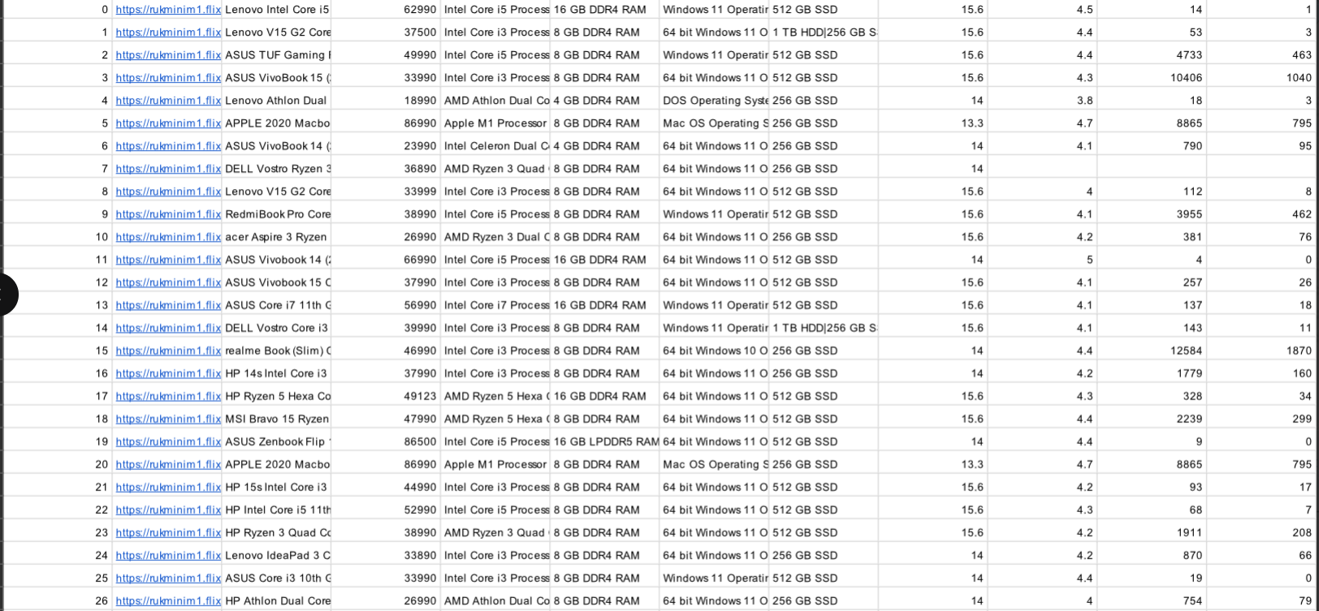
DATASETS

Slide 10
LIBRARY USED
NumPy – for numerical computations and handling arrays
Pandas – for data loading, cleaning, and preprocessing
Matplotlib & Seaborn – for data visualization and analysis
Scikit-learn – for building and training machine learning models
XGBost – for advanced and optimized prediction modeling
Flask – for creating the backend API to serve predictions
ngrok – for generating a public URL to access the local server

Slide 11
IMPLEMENTATION
Install Required Libraries :
!pip install flask flask-cors pyngrok scikit-learn pandas numpy --quiet
Mount Google Drive & Load Dataset :
from google.colab
import drivedrive.mount('/content/drive')
import pandas as pd
import numpy as np
import warningswarnings.filterwarnings('ignore')
DATASET_PATH = '/content/drive/MyDrive/laptops.csv'
df = pd.read_csv(DATASET_PATH)
print('Dataset loaded from Google Drive!')
print('Shape:', df.shape)
print('Columns:', df.columns.tolist())df.head(3)

Slide 12
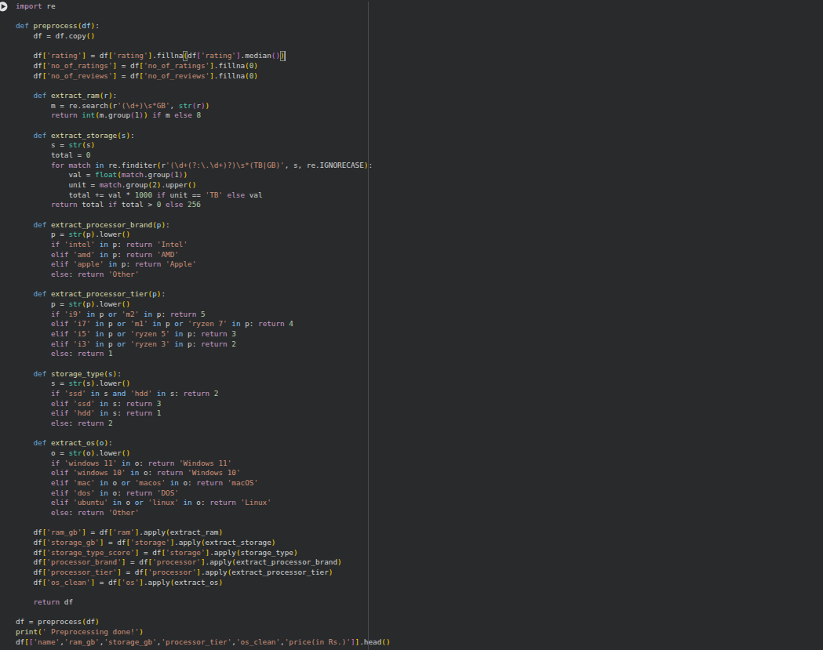
Data Preprocessing

Slide 13
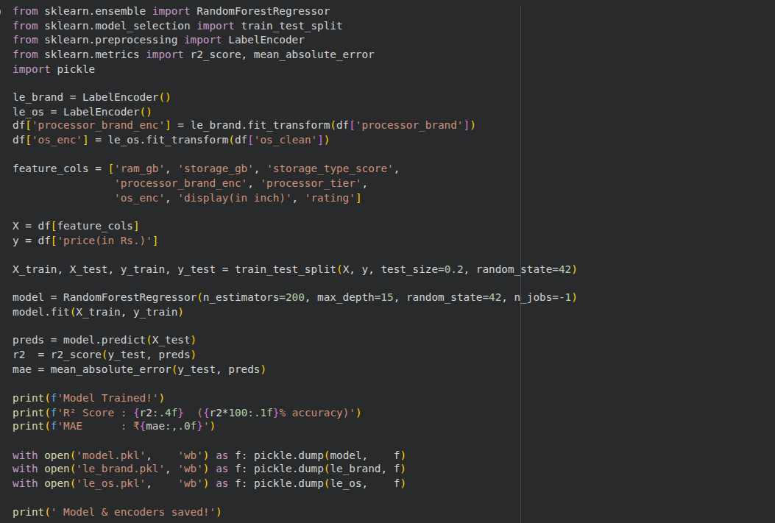
Train ML Model (Random Forest)

Slide 14
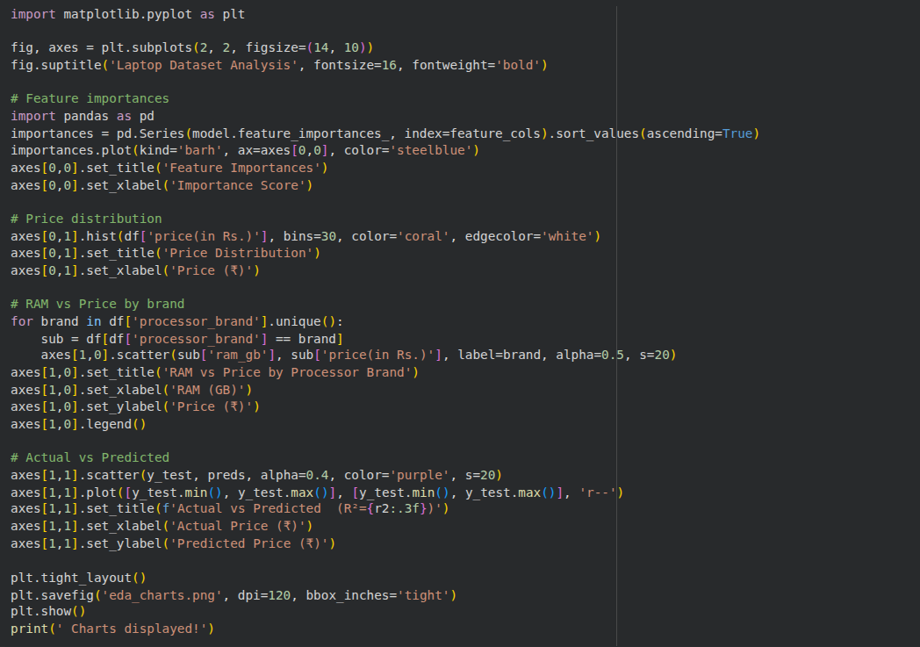
EDA Charts

Slide 15
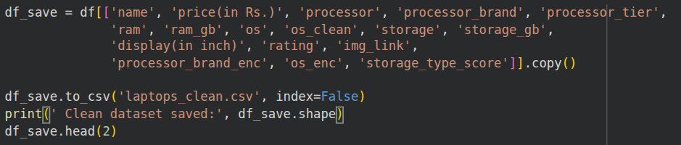
Save Cleaned Dataset

Slide 16
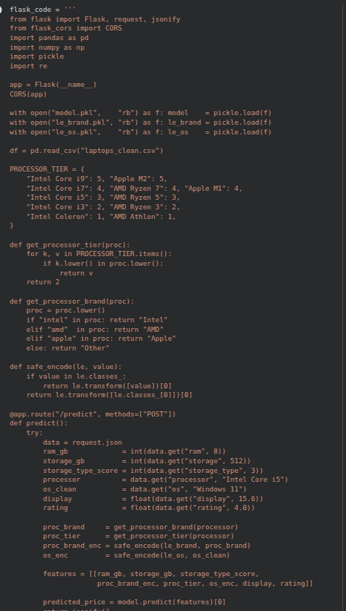
Write Flask API (app.py)

Slide 17
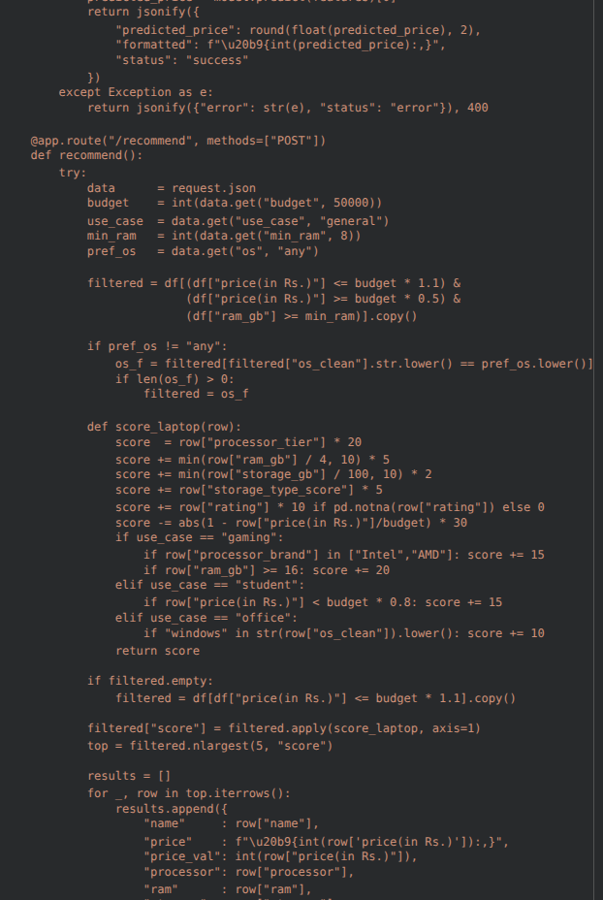

Slide 18
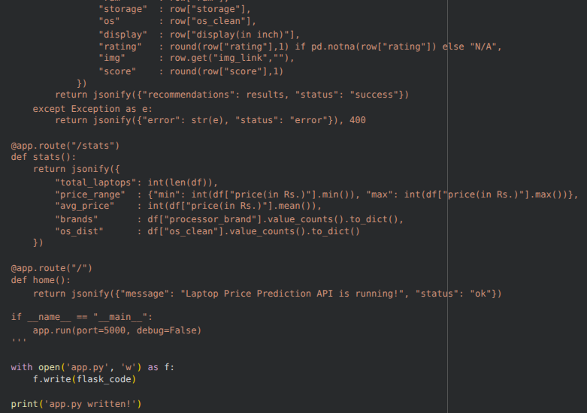

Slide 19
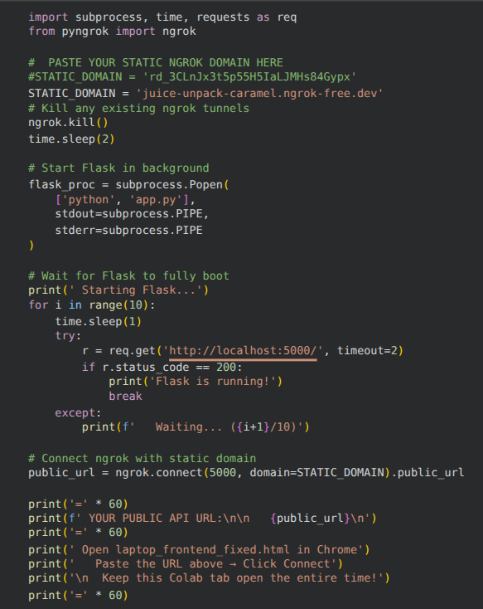
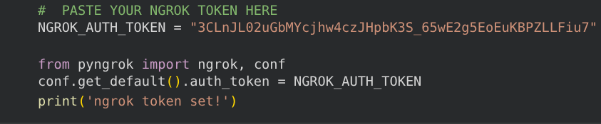
Set ngrok Auth Token
Start Flask + Get Public URL

Slide 20
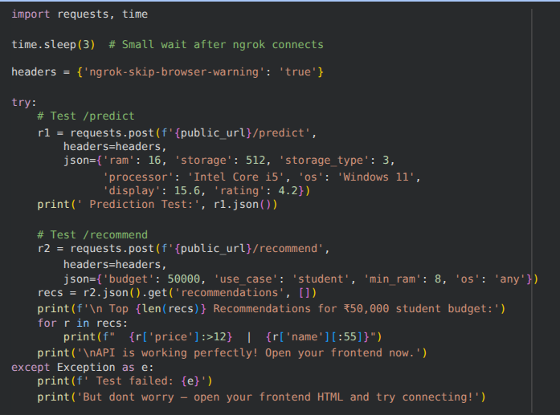
Test API

Slide 21
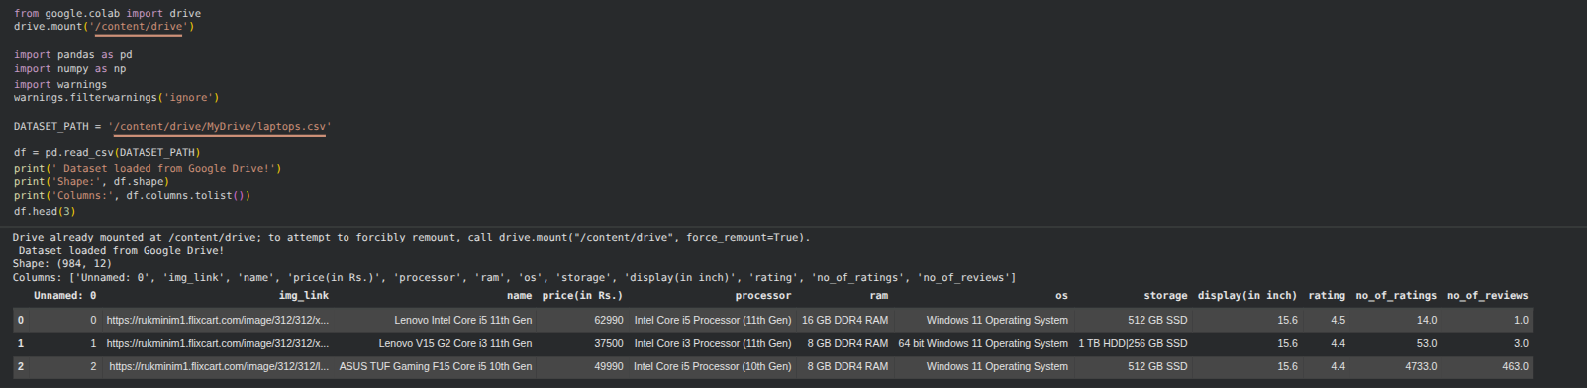
OUTCOMES/RESULTS

Slide 22
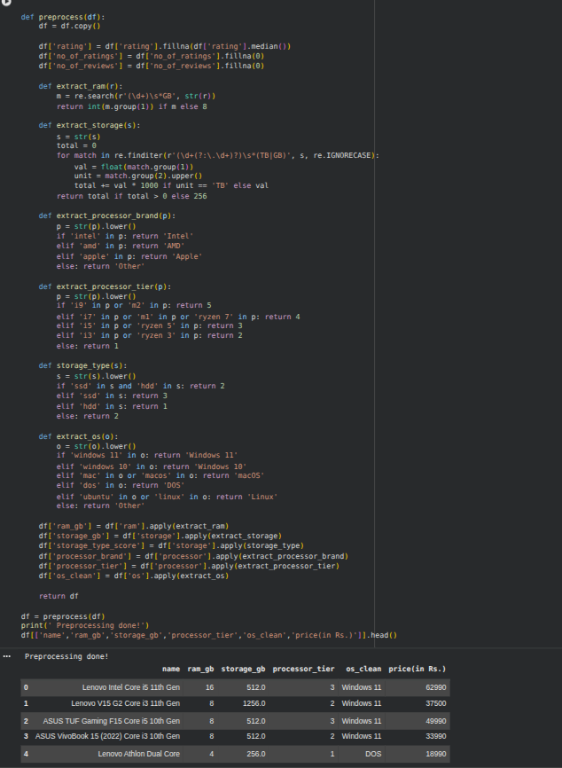
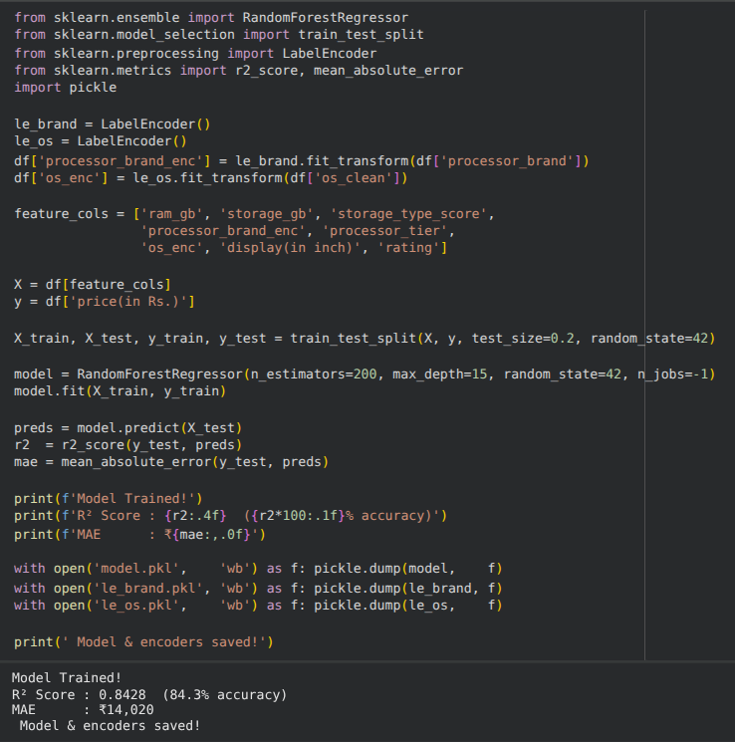

Slide 23
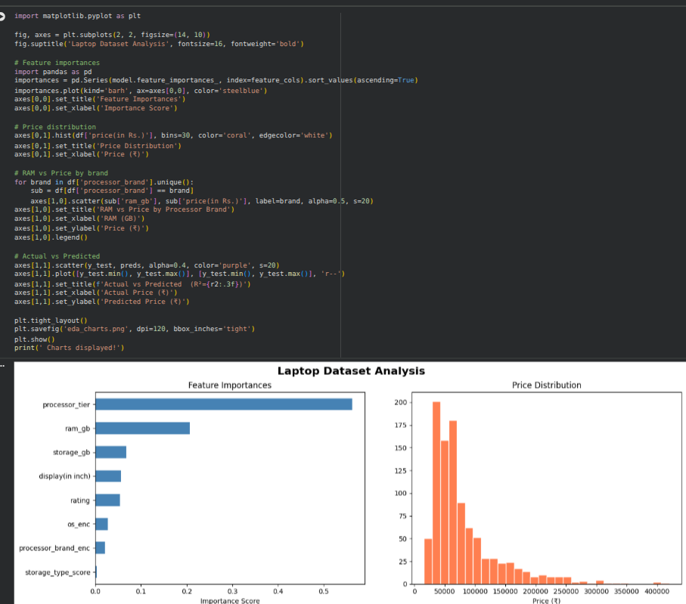
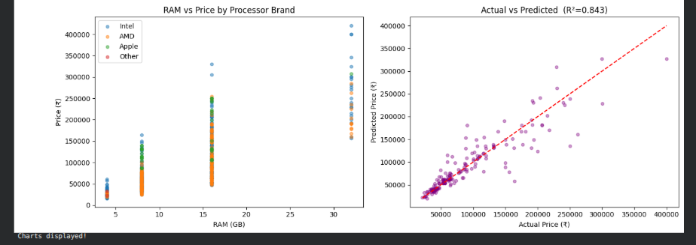

Slide 24
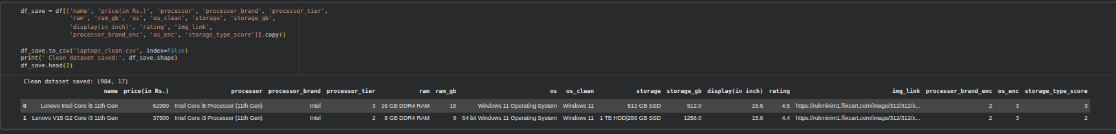

Slide 25
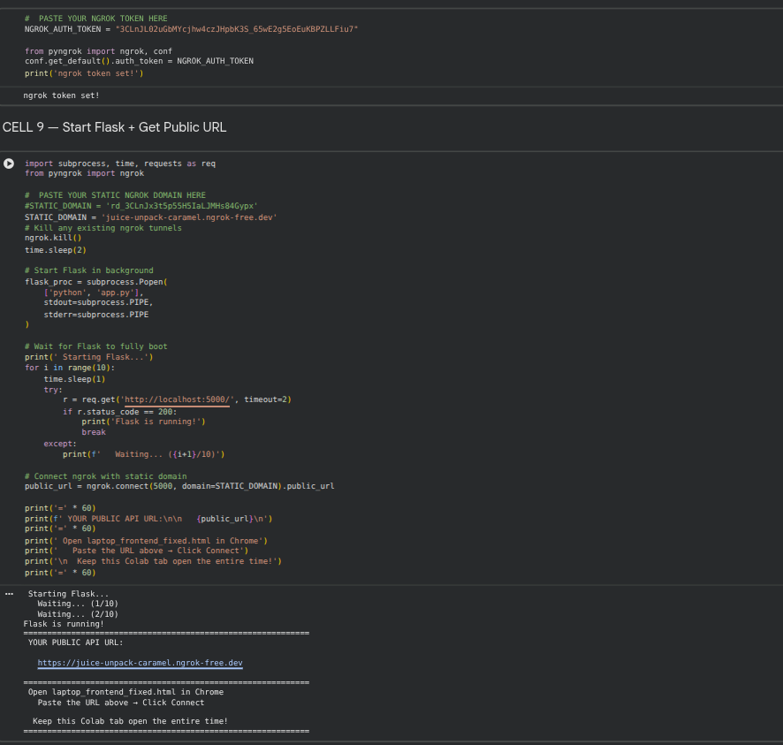
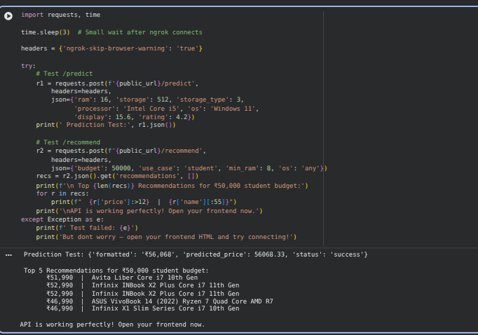

Slide 26
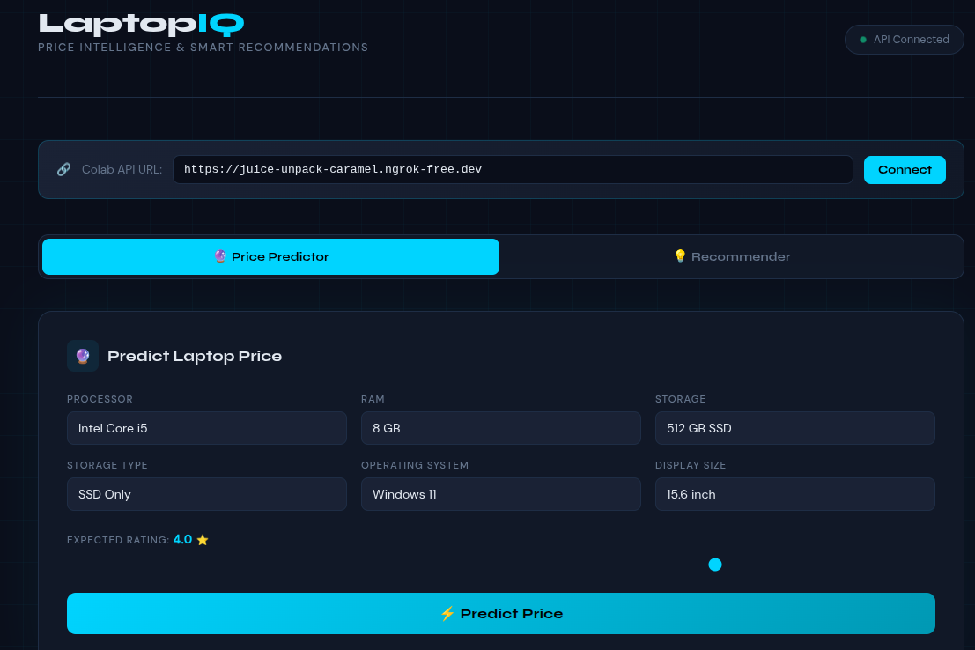
FRONT END VIEW

Slide 27
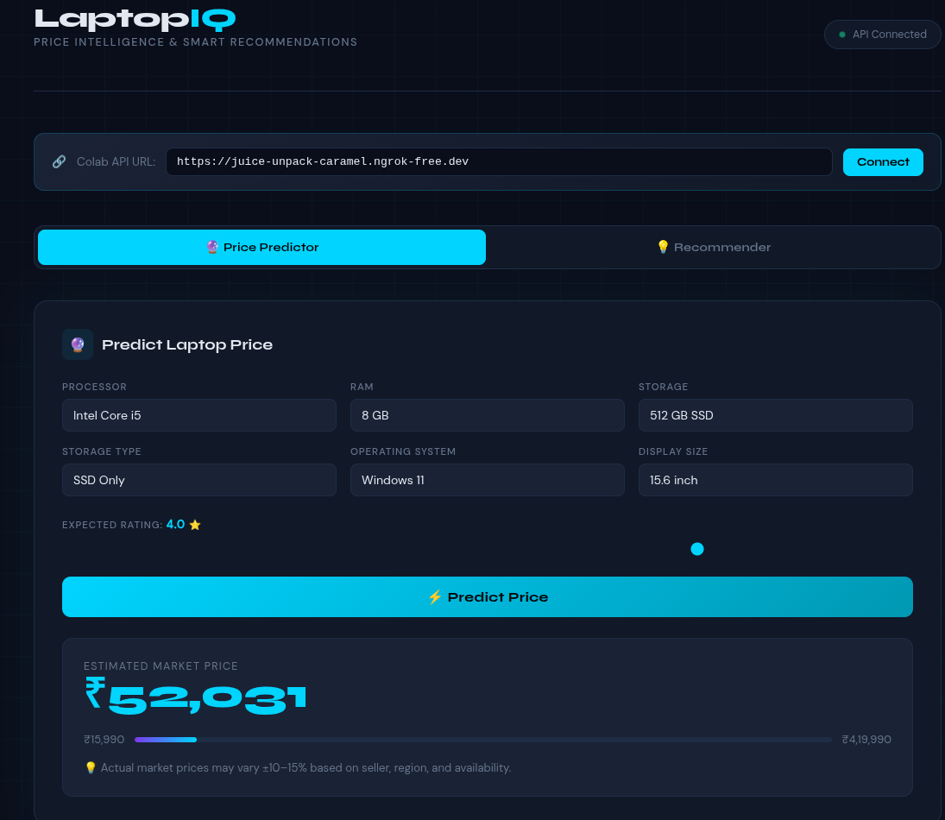
Price Prediction

Slide 28
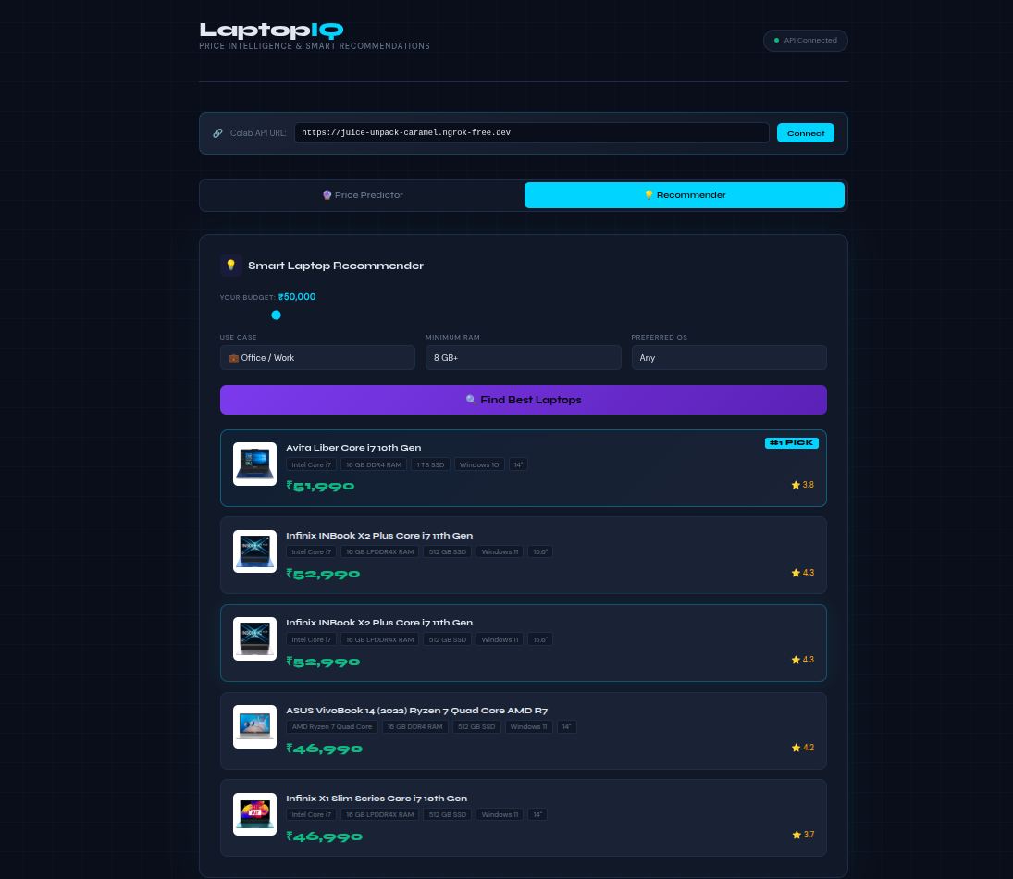
Price Recommendation

Slide 29
CONCLUSION
Successfully developed a machine learning model to predict laptop prices based on key features
Achieved accurate and reliable predictions through proper data preprocessing and training
Integrated the model with a Flask API for real-time predictions
Created a simple and user-friendly interface for easy interaction
Demonstrated a practical solution that can be further improved and scaled in the future

Slide 30
THANK YOU

