Slide 1

Notes:
Good morning. Thank you for the opportunity to present. Over the next twelve minutes I will take you through the strategic challenge facing Children's Health Queensland, the three options we developed, how we evaluated them, and the option we recommend to the Board, together with what it would take to deliver it. A full set of appendices sits behind the main deck for any questions on method, evidence and implementation detail.
Timing guide: title/opening 0:30; strategic challenge 1:20; analysis 1:30; options 1:20; evaluation 1:40; recommendation 1:40; value 1:20; implementation 1:30; close 1:10. Total ≈12 minutes. Appendices are for Q&A only.

Slide 2

Notes:
Together, three gaps create the core strategic challenge: how can CHQ extend the reach of its specialist expertise across Queensland while protecting the concentration of capability required for quaternary excellence? This is the question that drives our subsequent strategic analysis.

Slide 3
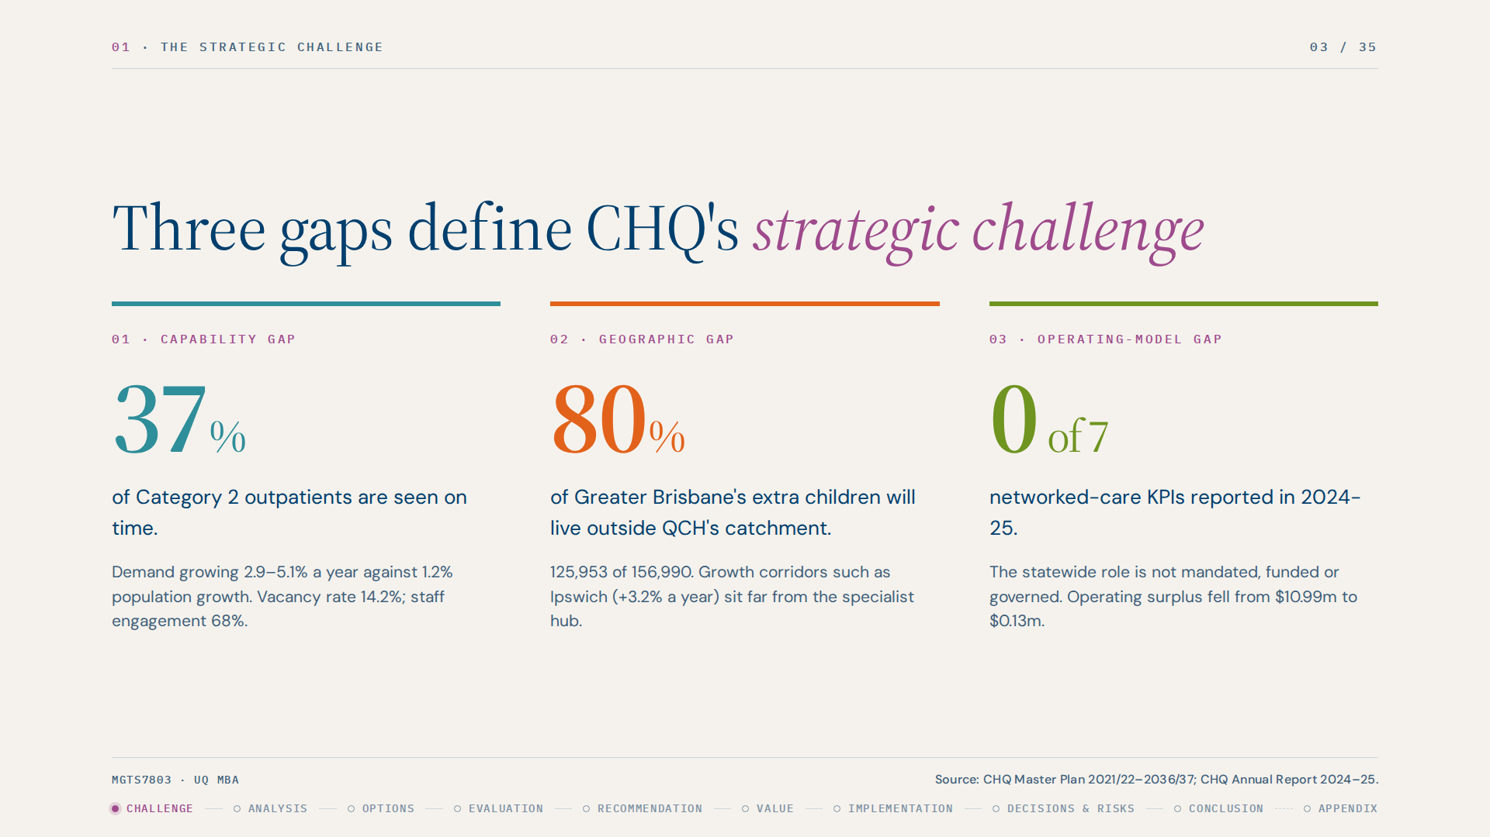
Notes:
We identified three key gaps in CHQ's current position. First, there is a capability gap: demand for specialised paediatric expertise may grow faster than the supply of specialist clinicians. Second, there is a geographic gap: specialist capability is concentrated in Brisbane, creating access challenges for regional and remote communities. Third, there is an operating-model gap: a hospital-centric model alone may not be sufficient to achieve CHQ's broader statewide ambition.
Justification: each gap is anchored in CHQ's own data (Annual Report 2024-25, Master Plan 2021/22-2036/37). Presenting the gaps as evidence-backed, not assumed, sets up the analysis and the evaluation criteria that follow.

Slide 4
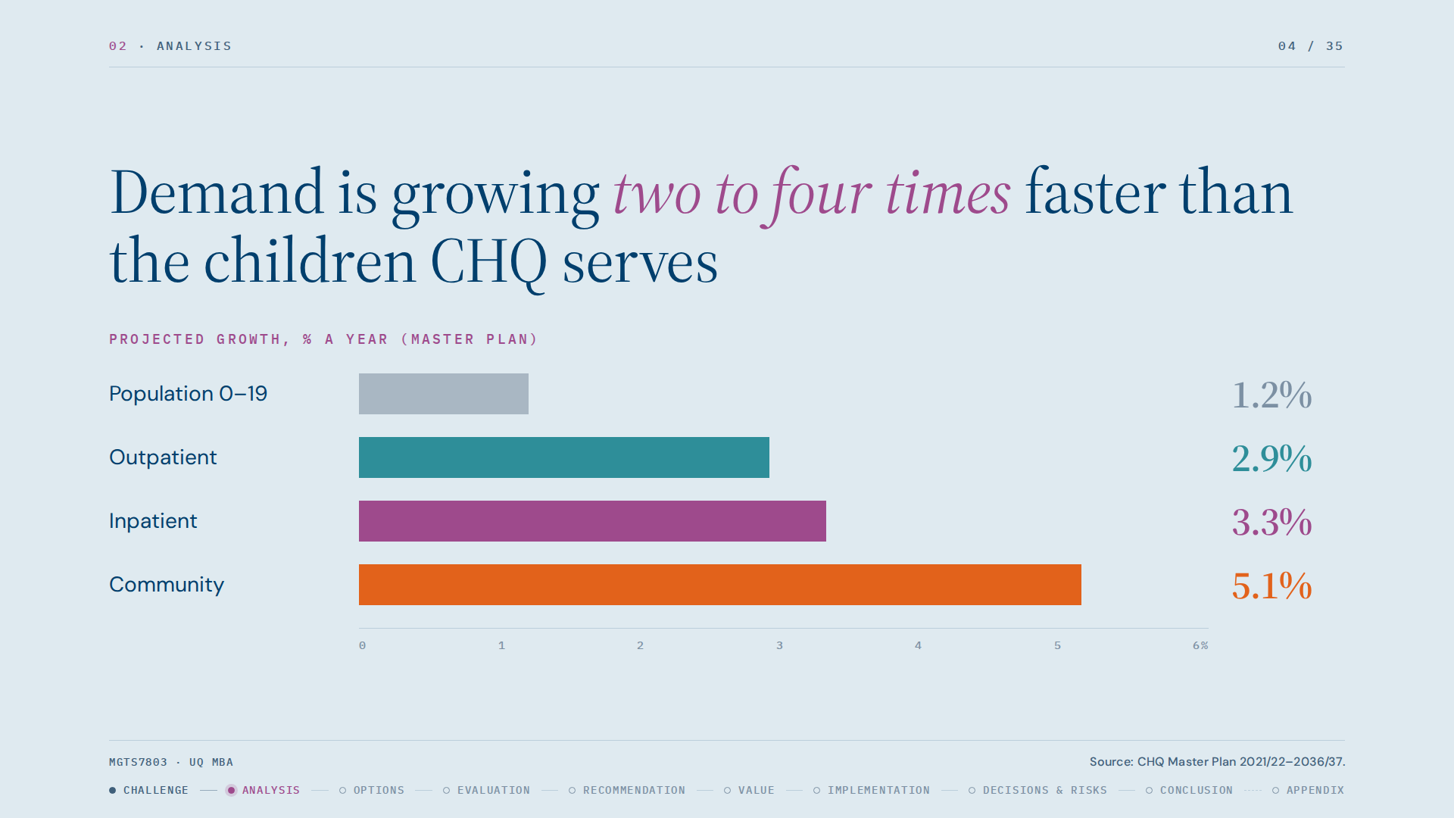
Notes:
Our external and internal analyses point to one conclusion. Externally, the PESTEL shows policy and demographic pressure to distribute care: Queensland Health wants equitable access and regional capability, and Queensland's child population is growing, mostly outside the QCH catchment. The chart shows demand for CHQ services growing two to four times faster than the population it serves.

Slide 5
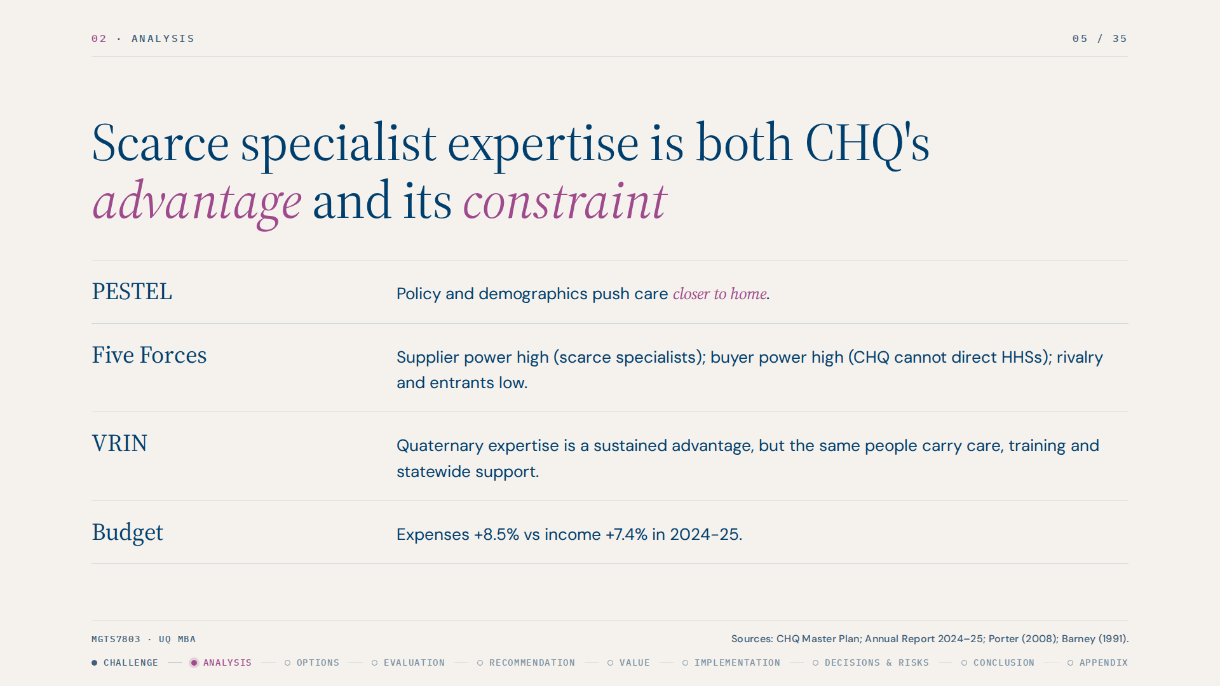
Notes:
Five Forces shows the strongest pressure is supplier power: specialist clinicians are scarce and slow to train. Buyer power is also high because CHQ cannot direct other Hospital and Health Services. Rivalry and new entrants are low, so the challenge is not competition, it is capacity.
Internally, the VRIN and value-chain work shows CHQ's quaternary expertise and concentrated exposure to complex cases are valuable, rare, costly to imitate and hard to substitute. But the same workforce is asked to deliver complex care, train others and build statewide capability. Financially there is no buffer: surplus fell to $0.13m.
Justification: sources are CHQ Master Plan pp.11, 34; Annual Report 2024-25 pp.41-45; Porter (2008); Barney (1991).

Slide 6
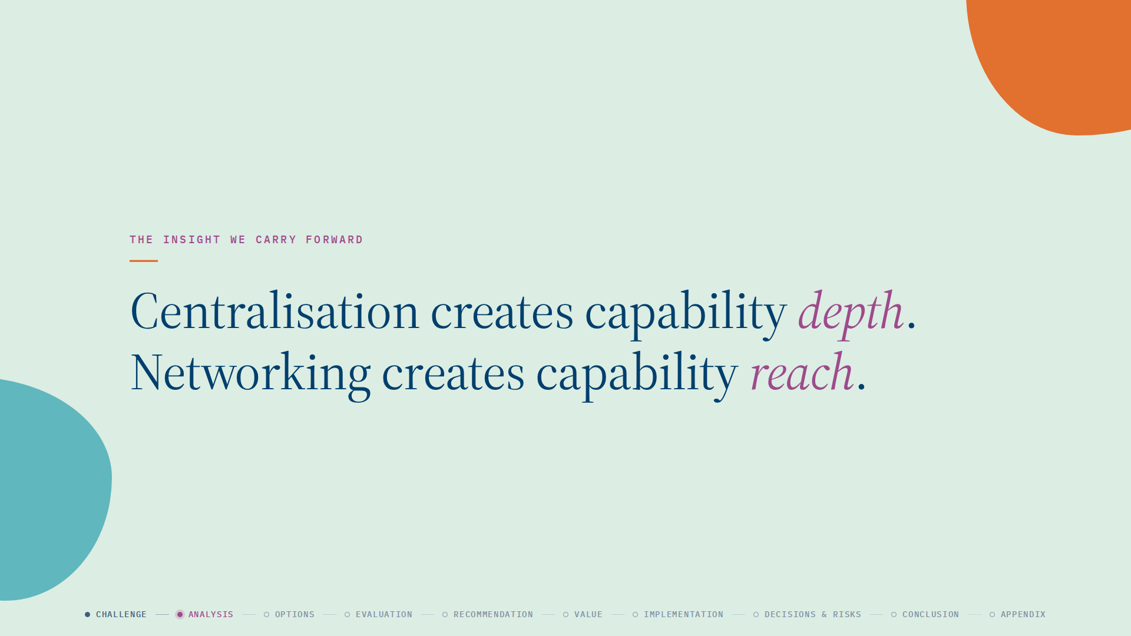
Notes:
The insight we carry forward: centralisation creates capability depth, networking creates capability reach. Any option must decide what stays concentrated and what can be safely extended.

Slide 7
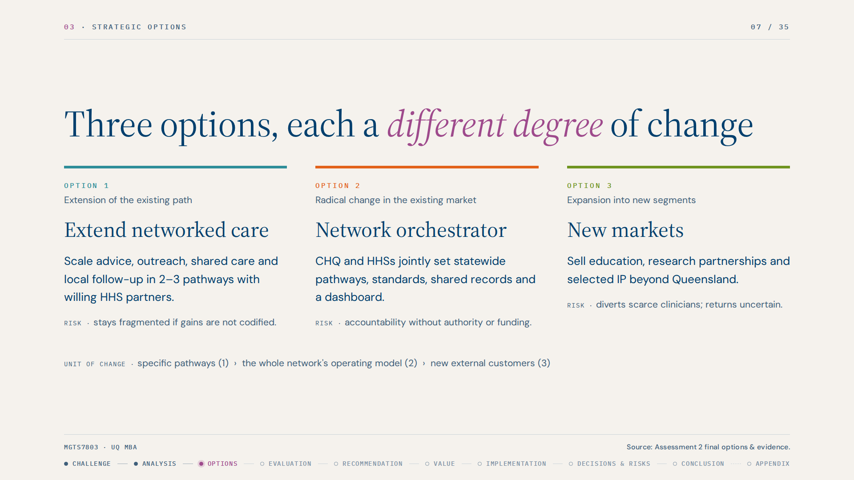
Notes:
We developed three options that differ in how far they move from CHQ's current path, as the brief required. Option 1 extends the existing path: it scales shared care, specialist advice, outreach and local follow-up in two or three selected clinical pathways with willing partner HHSs. It builds on what CHQ already runs, such as Specialist Online Advice, ECHO, and the Rockhampton and Townsville partnerships. Option 2 is a radical change within the existing market: CHQ becomes the network orchestrator, jointly setting statewide pathways, standards, shared records and a quality dashboard. Option 3 expands into new markets: packaging education, research partnerships and intellectual property for interstate, private and international buyers.
Justification: the three options cover the three strategic directions in the task brief. Each tackles the gaps differently, Option 1 through pathways, Option 2 through the operating model, Option 3 through new revenue. Each has a distinctive main risk, which drove the evaluation.

Slide 8
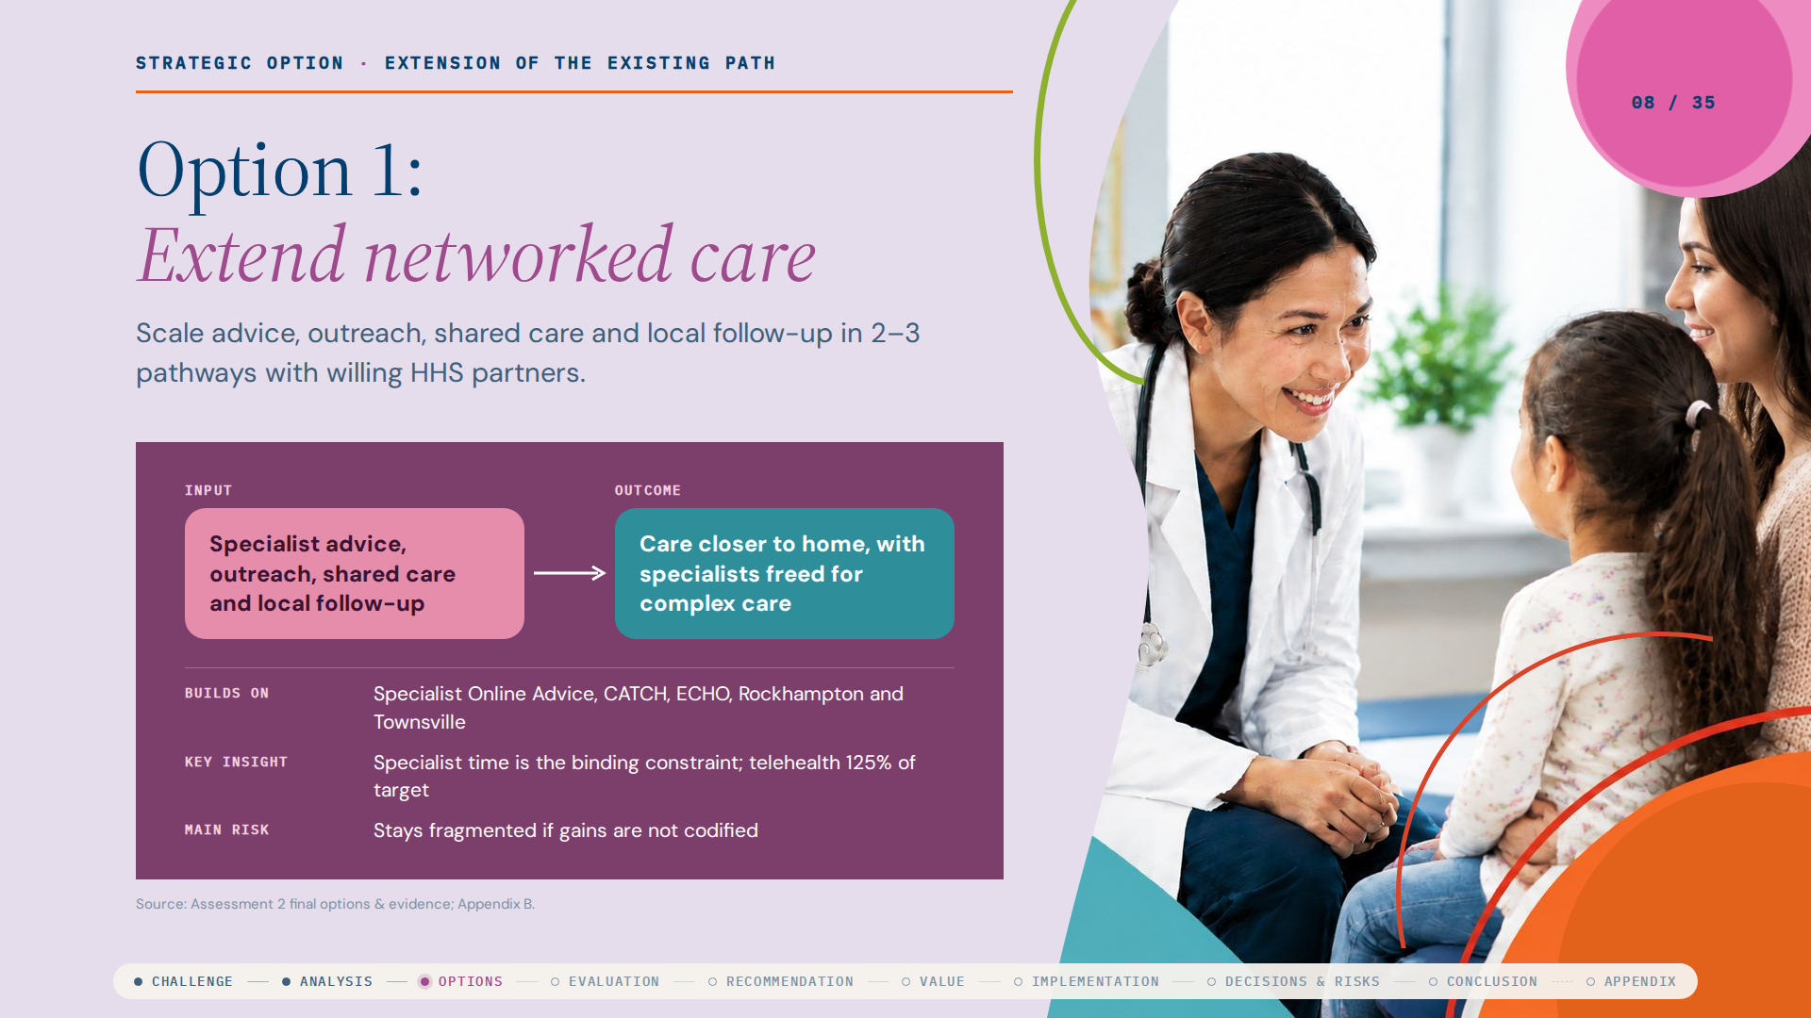
Notes:
Option 1 extends CHQ's existing path. It scales specialist advice, outreach, shared care and local follow-up in two or three selected clinical pathways with willing partner HHSs. It builds on what CHQ already runs (Specialist Online Advice, CATCH, ECHO and the Rockhampton and Townsville partnerships) and responds to our finding that specialist time is the binding constraint. Its main risk is that it stays fragmented if gains are not codified.

Slide 9
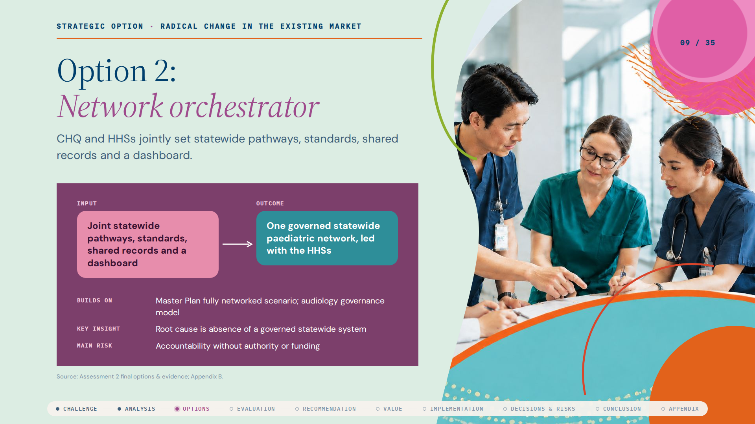
Notes:
Option 2 is a radical change within the existing market: CHQ becomes the network orchestrator, jointly setting statewide pathways, standards, shared records and a quality dashboard with the HHSs. It responds to the operating-model gap, because the root cause is the absence of a governed statewide system, but it assumes a mandate and data that do not yet exist. Its main risk is accountability without authority or funding.

Slide 10

Notes:
Option 3 expands into new markets: packaging education, research partnerships and intellectual property for interstate, private and international buyers. It leverages the VRIN finding that CHQ's expertise is rare and hard to imitate, but it ignores the capacity constraint. Its main risk is diverting scarce clinicians for uncertain returns.

Slide 11
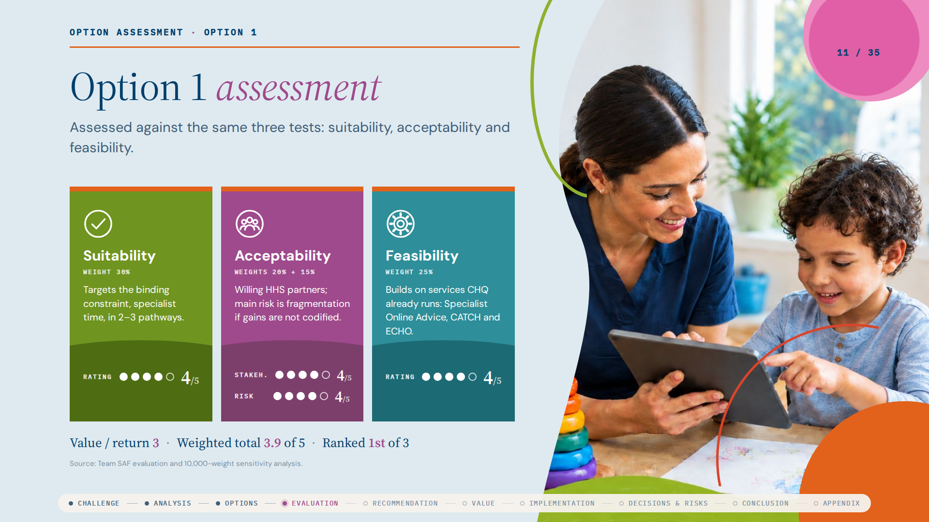
Notes:
Option 1 scores 3 or 4 on every test: suitability 4, feasibility 4, stakeholder acceptability 4, risk 4 and value 3, for a weighted total of 3.9. It is the only option with no weak test, and it ranked first in 97.8 percent of 10,000 random weightings.

Slide 12
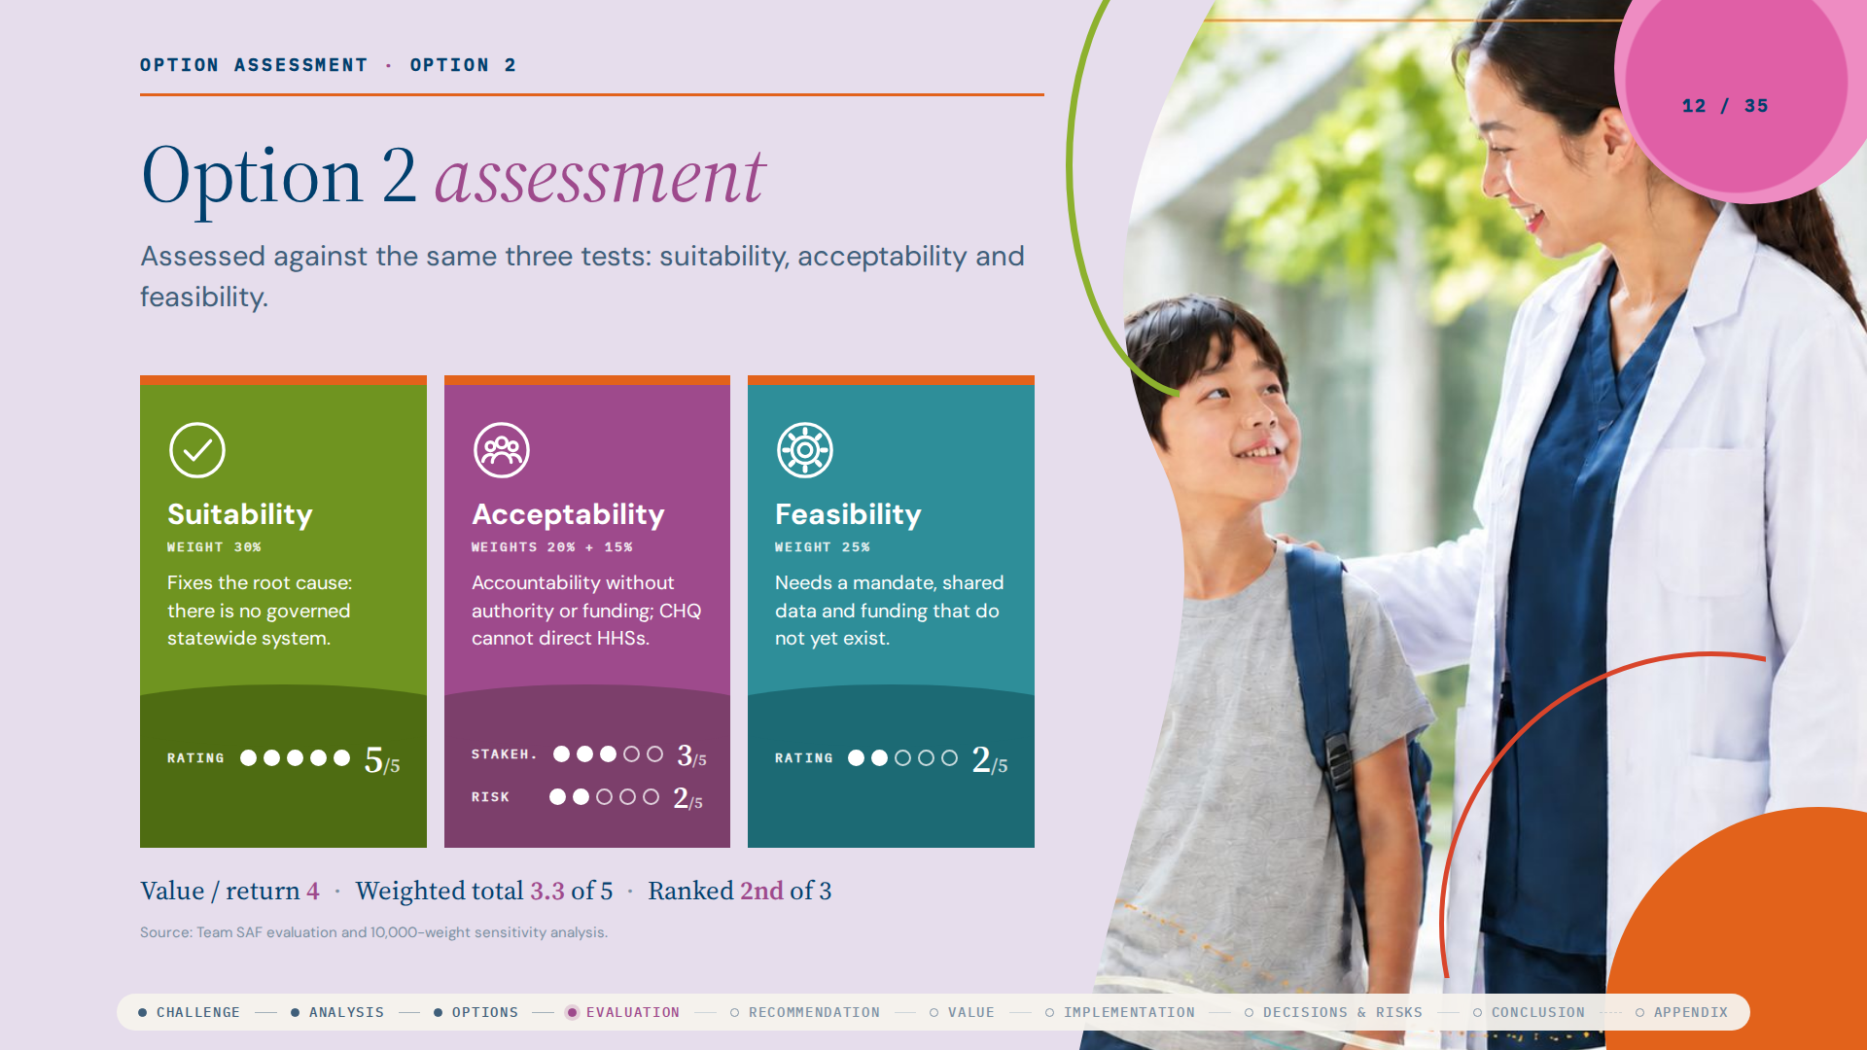
Notes:
Option 2 is the most suitable, scoring 5, but scores only 2 on feasibility and risk, with stakeholder acceptability 3 and value 4, for a weighted total of 3.3. It overtakes Option 1 only if its feasibility reaches 5 out of 5, which needs a mandate, shared data and funding.

Slide 13
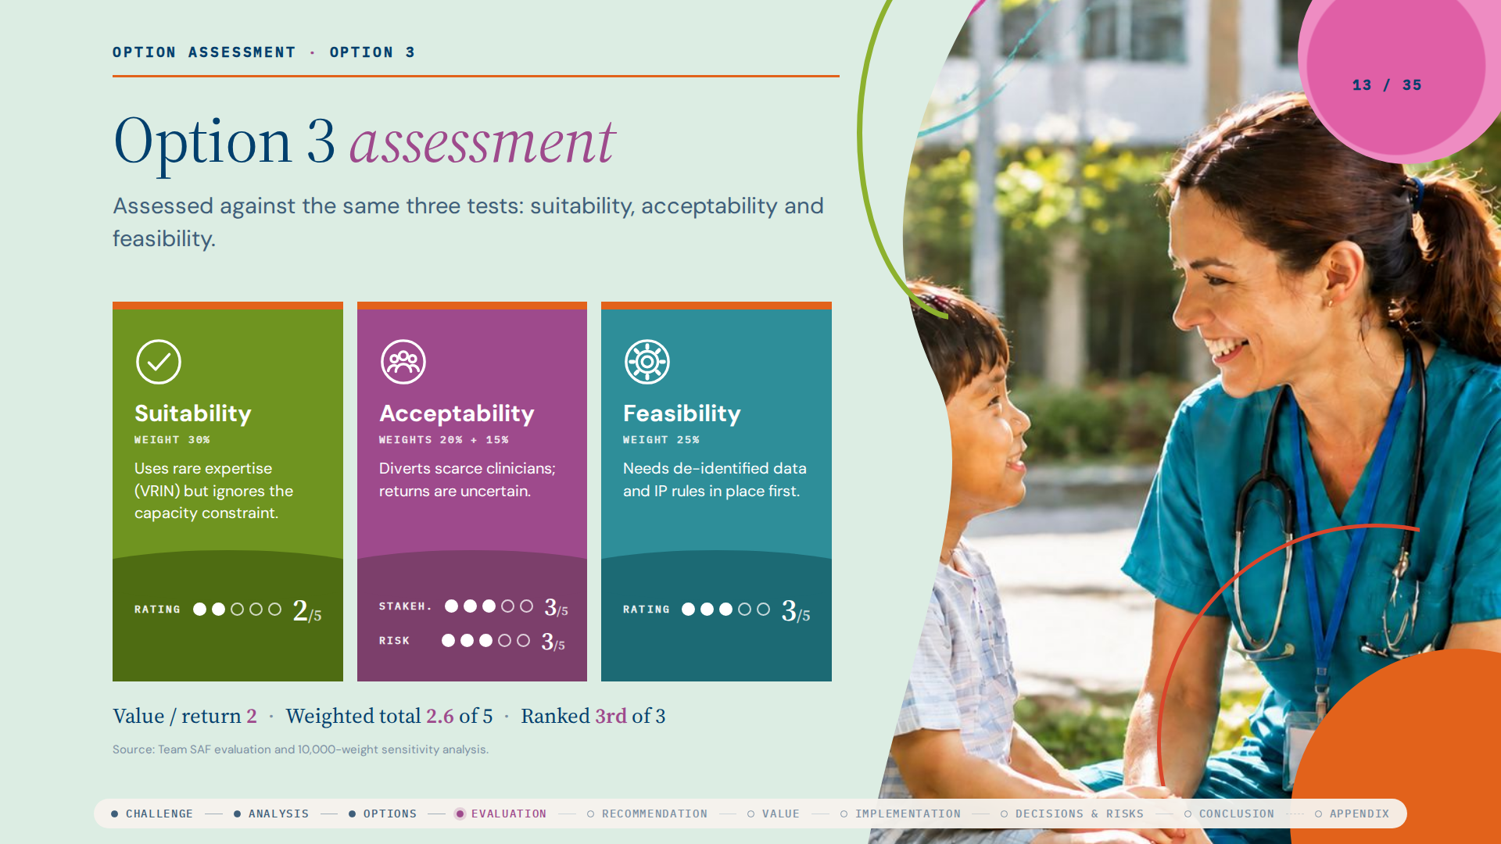
Notes:
Option 3 scores 2 on suitability and value, and 3 on feasibility, stakeholder acceptability and risk, for a weighted total of 2.6. It ranked first in none of the 10,000 random weightings.

Slide 14
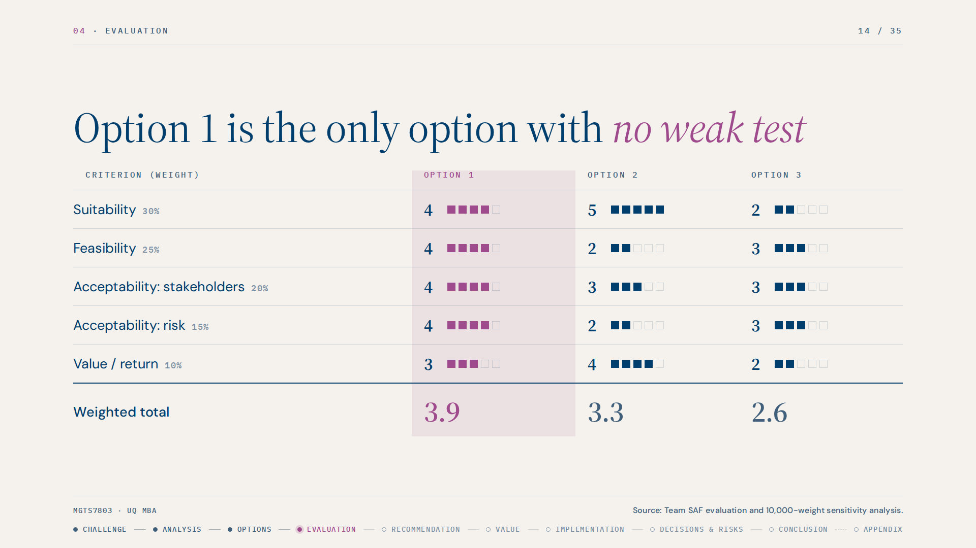
Notes:
We evaluated the options using the suitability, acceptability and feasibility tests from Johnson and colleagues, splitting acceptability into stakeholder acceptability and risk exposure and adding a value criterion. Weights reflect CHQ's circumstances: suitability 30 percent, feasibility 25, stakeholder acceptability 20, risk 15 and value 10. Feasibility and acceptability together carry 60 percent because CHQ cannot direct other HHSs and has almost no financial buffer.
Option 2 is the most suitable, scoring 5, but scores only 2 on feasibility and risk. Option 3 scores 2 on suitability and value. Option 1 scores 3 or 4 on every test, giving weighted totals of 3.9, 3.3 and 2.6.

Slide 15
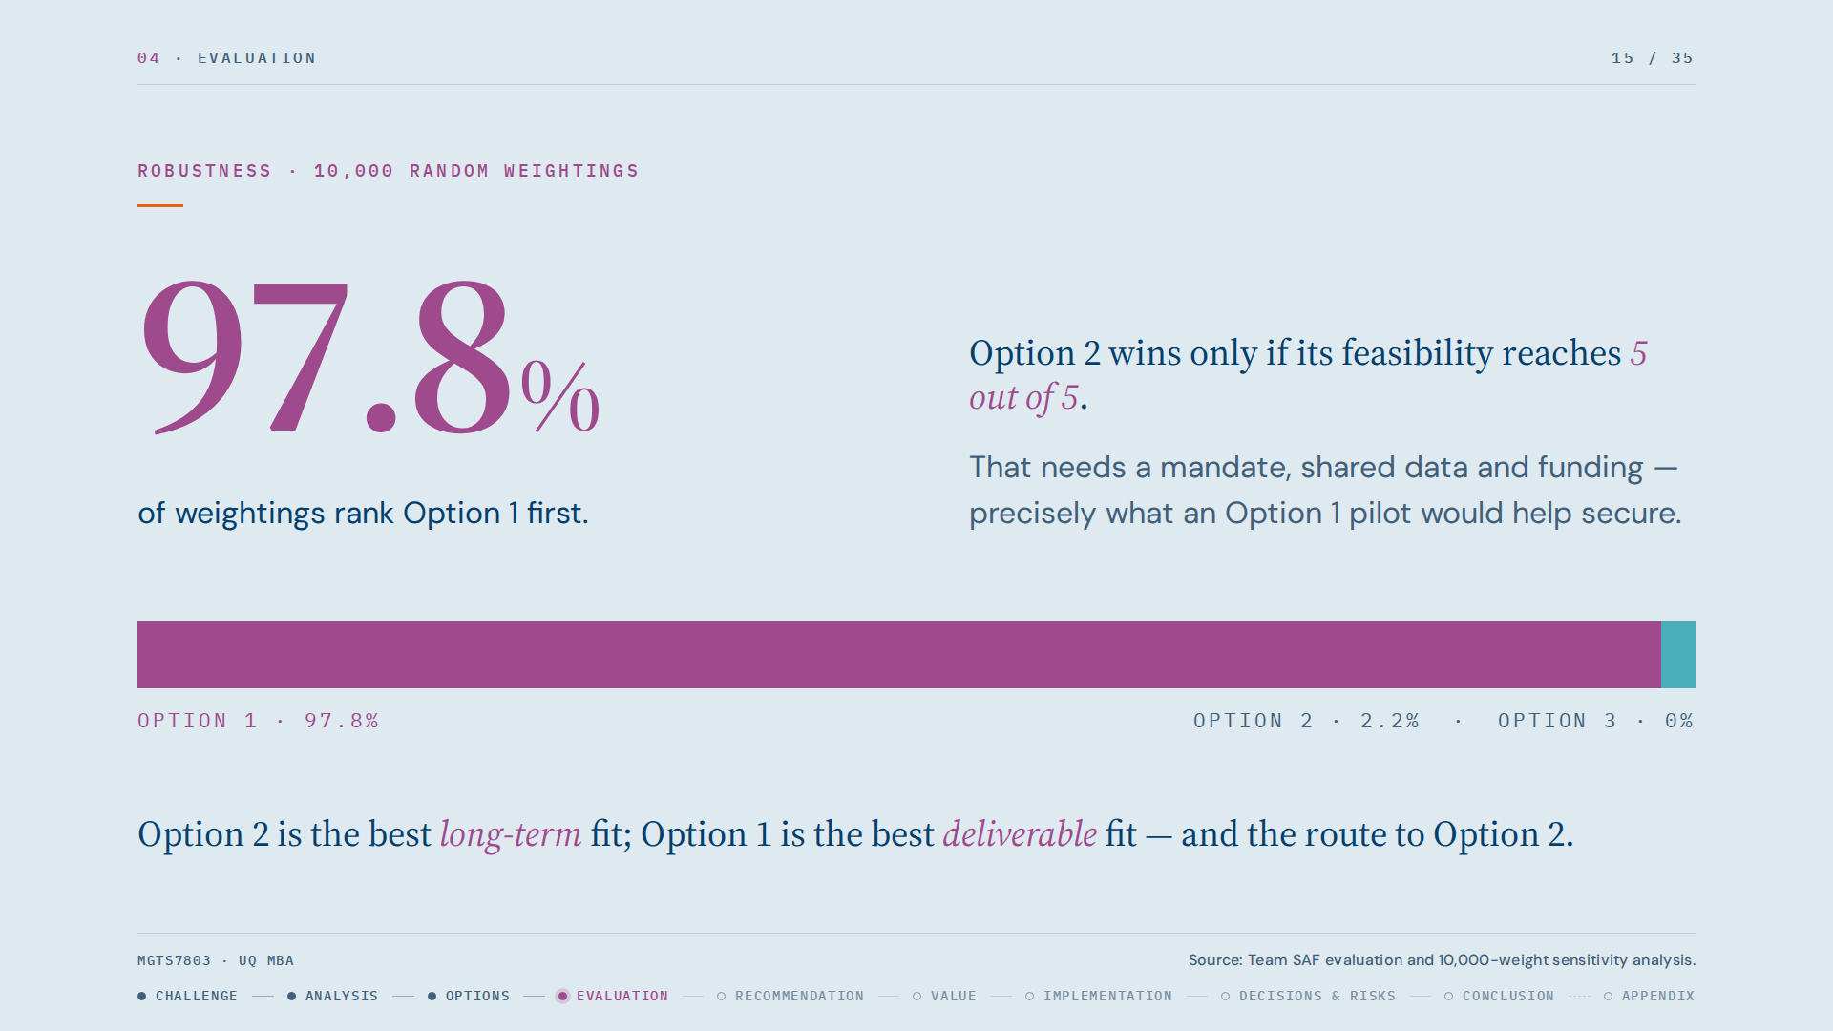
Notes:
We stress-tested the weights with 10,000 random weightings. Option 1 ranked first in 97.8 percent. Option 2 overtakes only if its feasibility reaches 5 out of 5, which needs a mandate, shared data and funding, precisely what an Option 1 pilot would help secure. The scores are team judgement from published evidence and executives should re-score with internal data.
Justification: a strategy that cannot be delivered does not create value, so we weighted deliverability heavily and tested that the result does not depend on our weights.

Slide 16
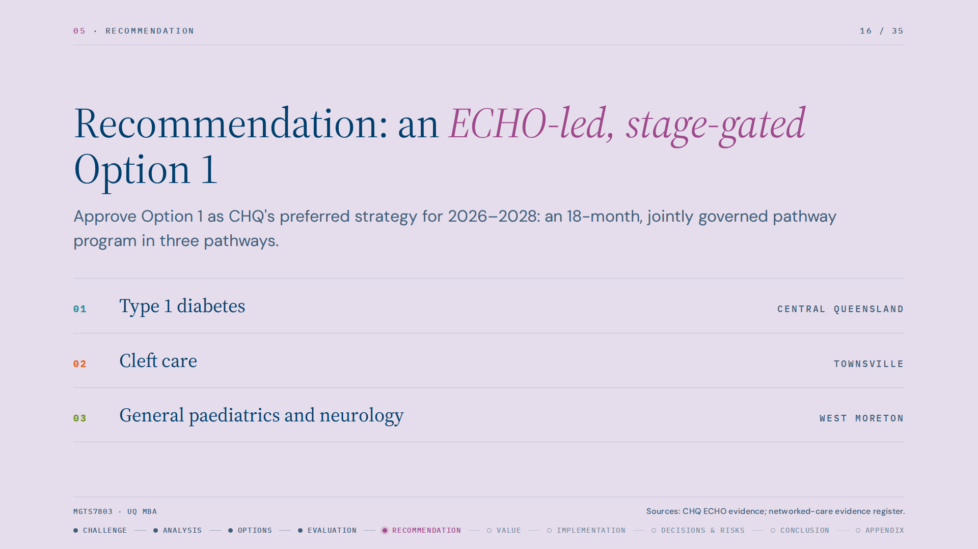
Notes:
We recommend Option 1, run as an 18-month, jointly governed pathway program in three pilot pathways: type 1 diabetes with Central Queensland, cleft care with Townsville, and general paediatric and neurology follow-up with West Moreton. This addresses the geographic gap.

Slide 17
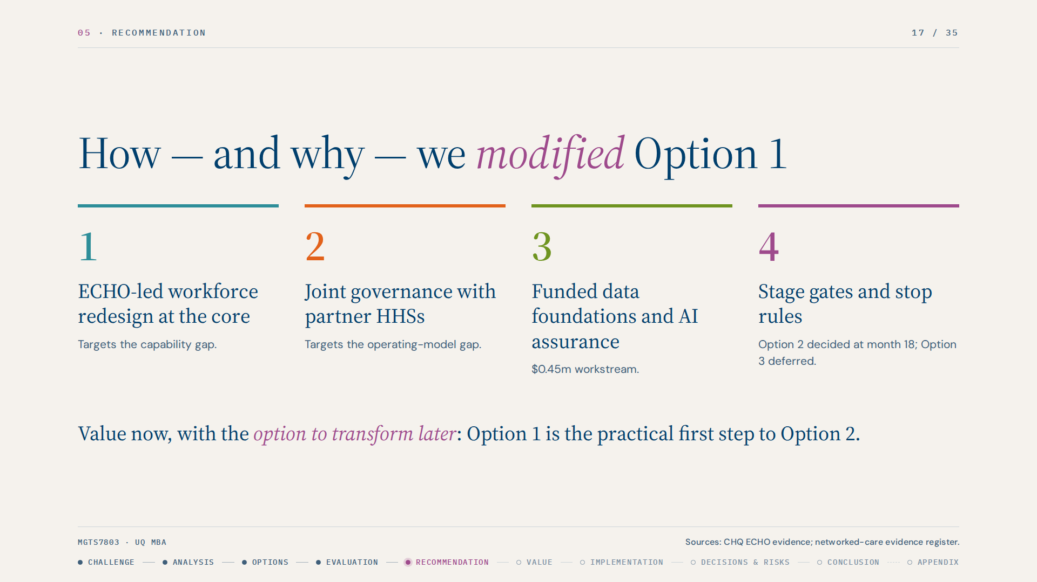
Notes:
We recommend Option 1, but we modified it in four ways to make it fit CHQ's constraints. First, the core is an ECHO-led workforce redesign. GPs, nurse practitioners, nurse navigators and advanced-practice allied health take on more triage and case management, backed by ECHO and consultant-endorsed protocols, so QCH specialists concentrate on quaternary care. This targets the capability gap directly. Second, it runs as a jointly governed program with partner HHSs. Third, we added a funded data foundations and AI assurance workstream, because our review found CHQ cannot yet measure networked care. Fourth, we made it a real option: capped spend, gates at 6, 12 and 18 months, and Option 2 deferred to a business case at month 18, while Option 3 goes to a six-month asset review with no revenue assumed.
Justification: the evidence is local. In CHQ's ADHD ECHO, GP self-efficacy rose from 2.6 to 5.4 out of 7; a GP-paediatrician trial cut high-referring GPs' referrals from 7.3 to 3.0 percent. Telehealth already runs 25 percent above target.

Slide 18
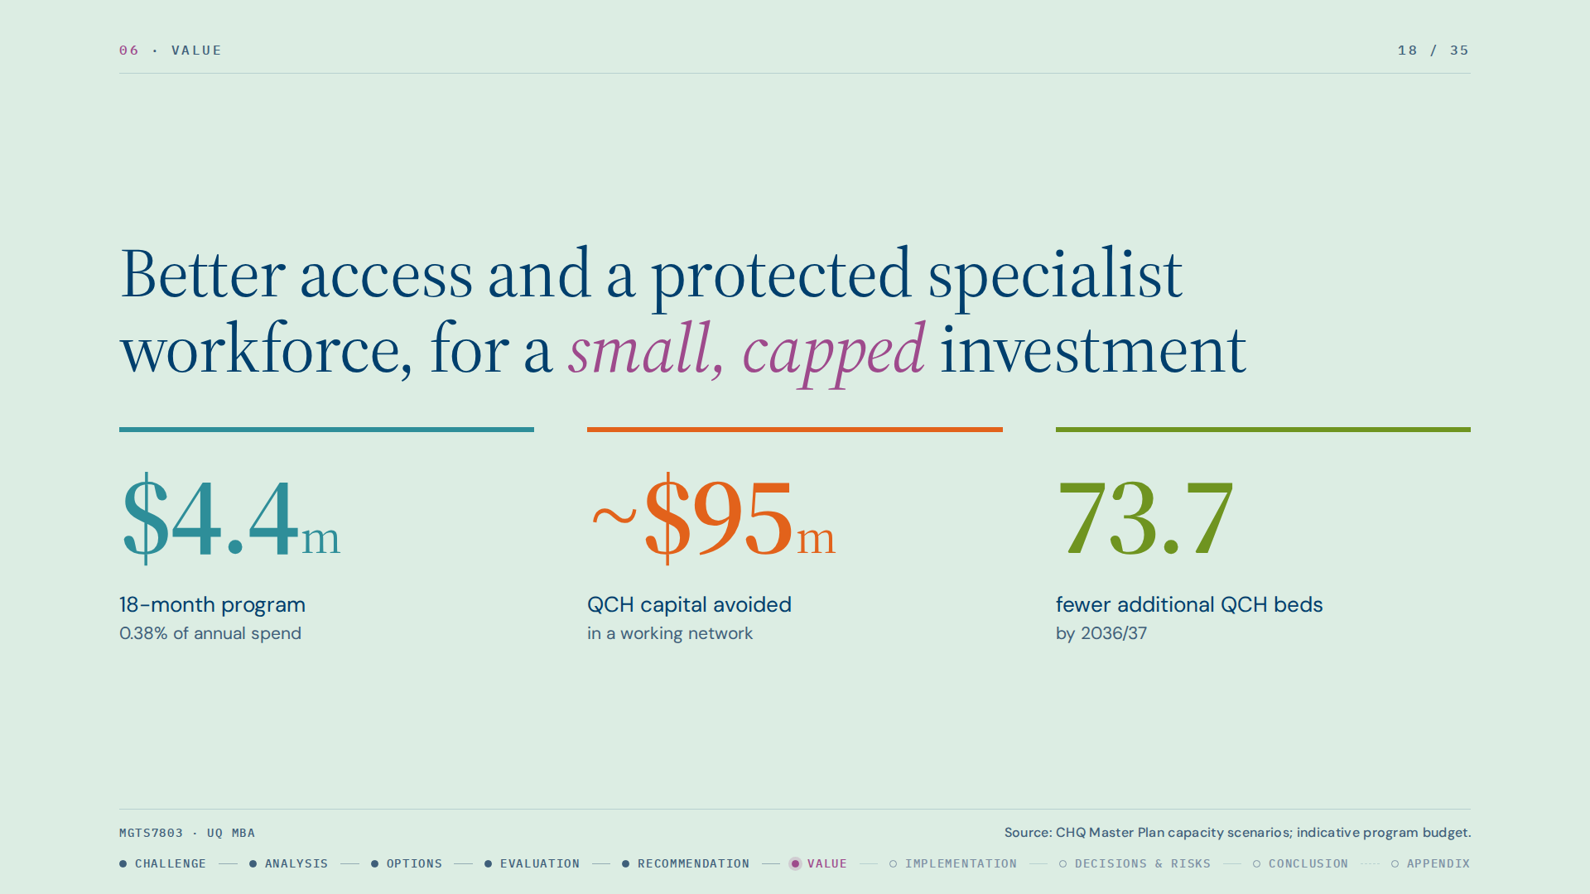
Notes:
The recommendation creates value for the organisation and for each key stakeholder. For CHQ, the program is about $4.4 million over 18 months, 0.38 percent of annual expenditure and about 5 percent of the precinct capital a working network could avoid. The Master Plan's fully networked scenario cuts additional QCH beds needed by 2036/37 from 95.7 to 22.0, and precinct capital from $229.1 million to $134.2 million. We are not claiming Option 1 delivers all of that; it tests whether the larger commitment is worth making.

Slide 19
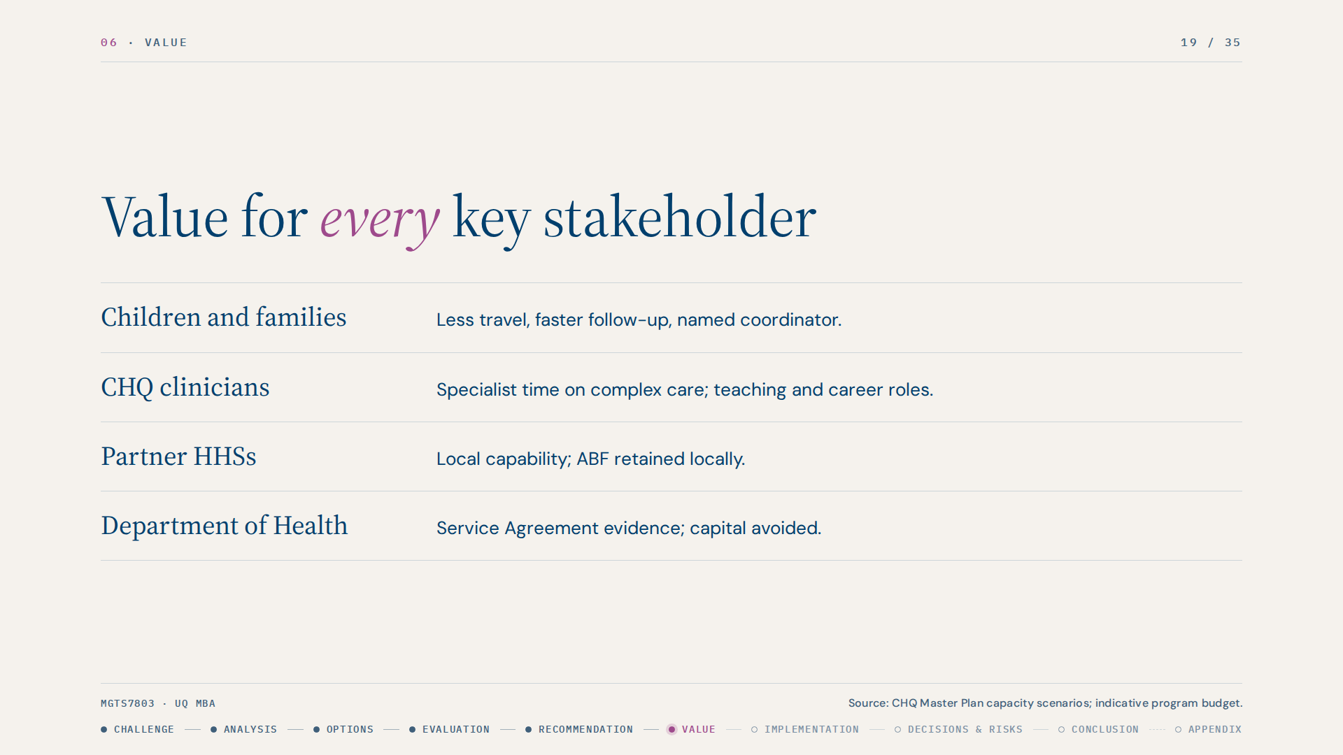
Notes:
For families, less travel, faster follow-up and a named coordinator. For CHQ clinicians, protected time for complex care, teaching roles that support retention, at a time when engagement is 68 percent. For partner HHSs, new local capability and ABF retained locally. For the Department of Health, evidence for the Service Agreement and avoided capital. For Aboriginal and Torres Strait Islander families, care on Country, building on Deadly Ears and IROC.
There are trade-offs. CHQ will lose some activity-based funding as follow-up moves locally. Our illustrative model shows about 80 percent is offset through telehealth funding and refilling freed slots, but this must be validated by CHQ Finance.

Slide 20
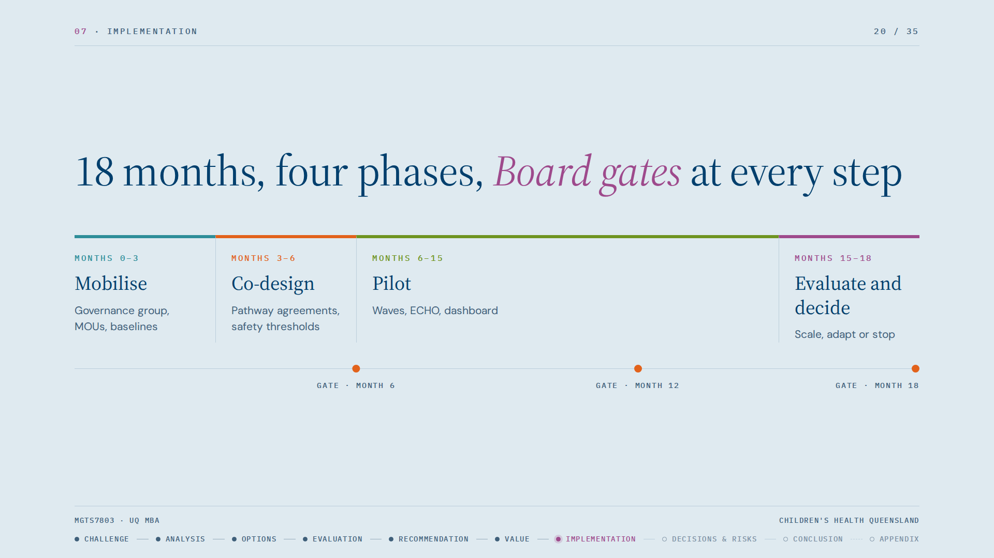
Notes:
Implementation runs in four phases with Board decision gates. Phase 0, months 0 to 3, mobilises: appoint an executive sponsor and clinical lead, form the Joint Pathway Governance Group, confirm the three HHS partners, and complete baselines and a data-readiness assessment. Phase 1, months 3 to 6, is co-design with clinicians and families, writing eligibility, escalation and return-to-CHQ criteria, and confirming credentialing under the Clinical Services Capability Framework. Phase 2, months 6 to 15, launches the pathways in waves with protected specialist advice sessions, ECHO cases linked to each pathway, and a monthly dashboard. Phase 3, months 15 to 18, is an independent evaluation and the Board decision to scale, adapt or stop, with an Option 2 business case only if the data-readiness gate is met.
Justification: we followed Kotter's sequence. With 68 percent engagement and 14.2 percent vacancies, this change must be co-designed with clinicians, not imposed. The staged design limits clinical, financial and relationship risk.

Slide 21
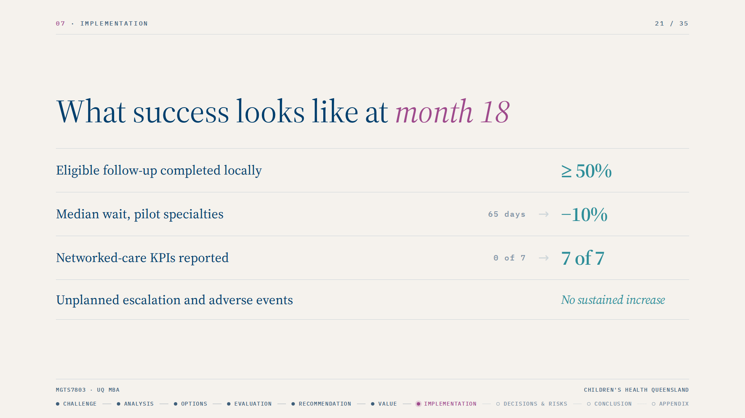
Notes:
The 18-month targets are: at least 50 percent of eligible follow-up completed locally, a 10 percent reduction in median wait, all seven networked-care KPIs reported, and no sustained rise in unplanned escalation.

Slide 22
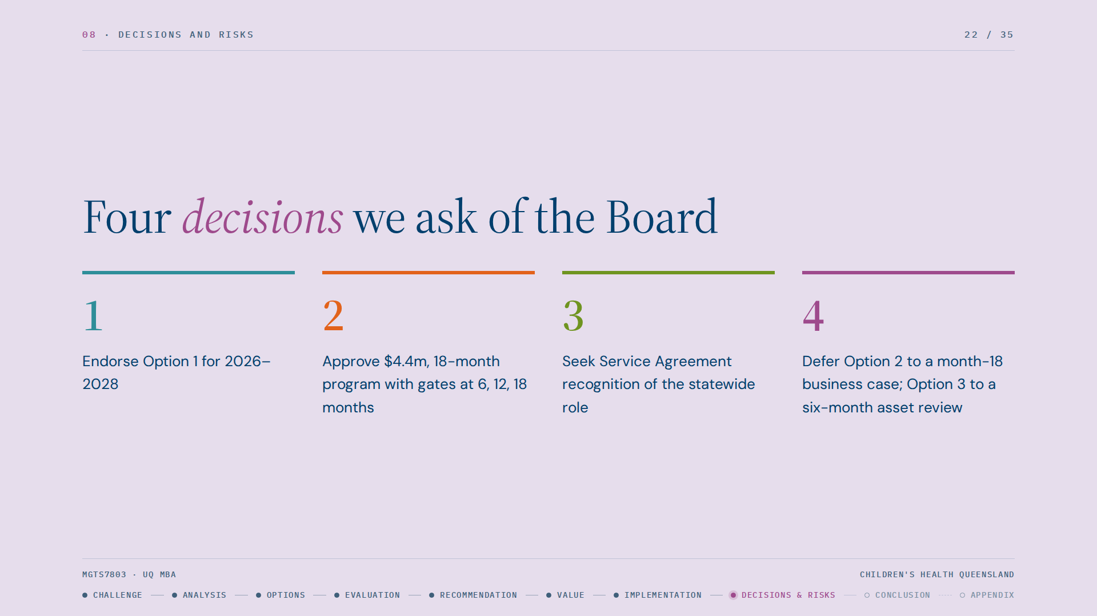
Notes:
To close, we ask the Board for four decisions. One, endorse Option 1 as CHQ's preferred direction for 2026 to 2028. Two, approve the indicative $4.4 million, 18-month program with gates at 6, 12 and 18 months. Three, seek Department of Health agreement to record CHQ's statewide networked role and funding in the Service Agreement, where it is currently a measure to be developed. Four, defer Option 2 to a business case at month 18 and Option 3 to a six-month asset review.

Slide 23
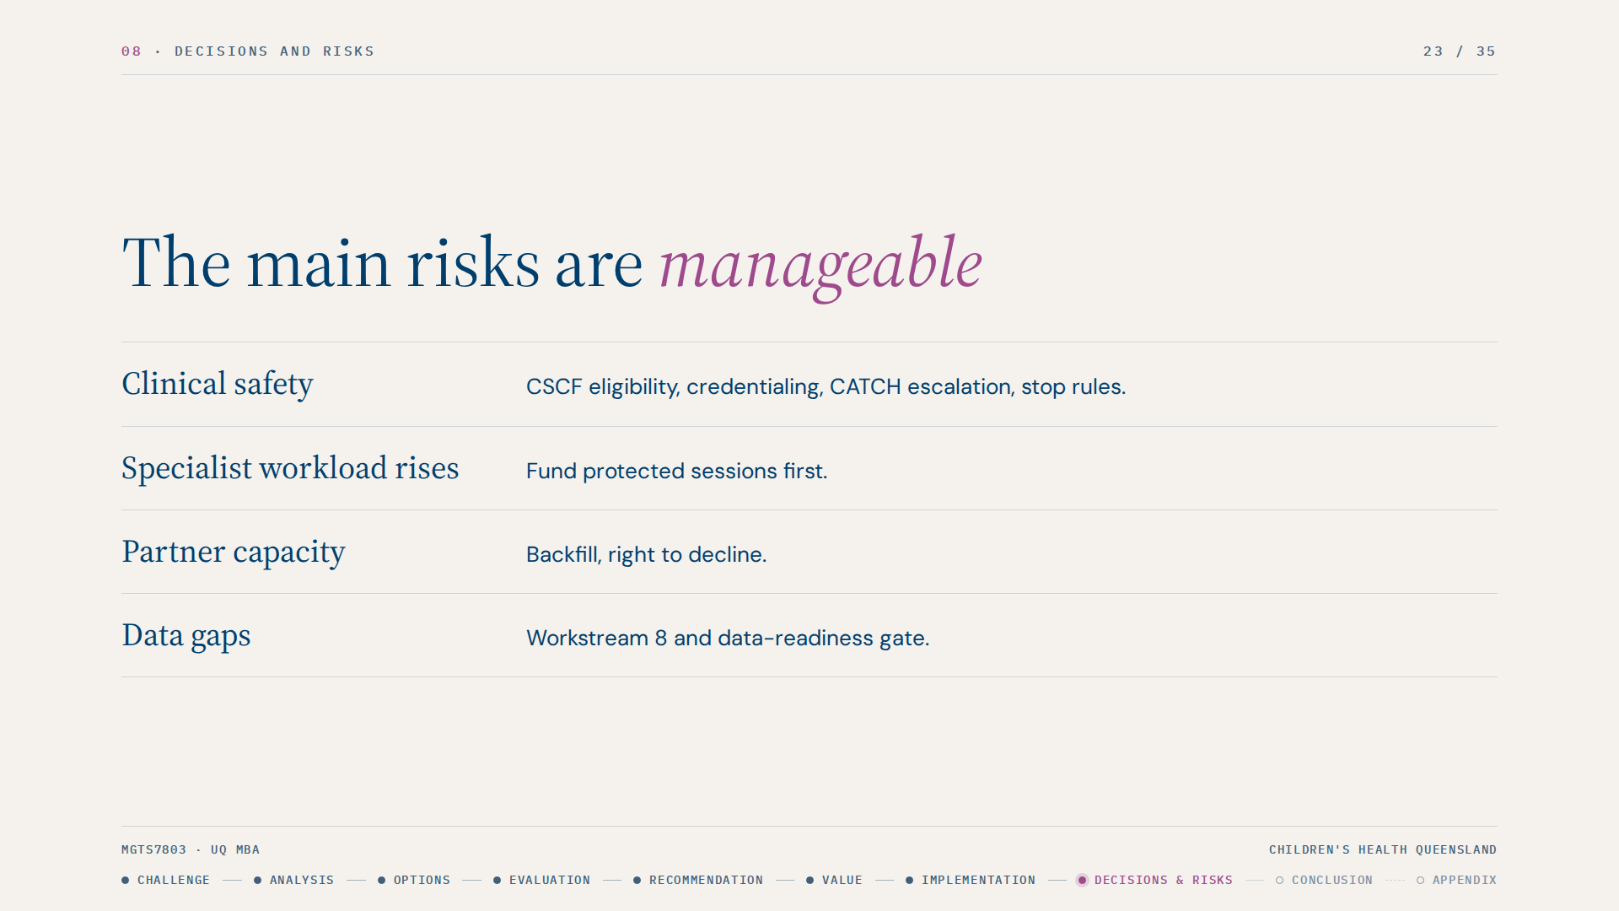
Notes:
The main risks are manageable. Clinical safety is controlled by CSCF-based eligibility, credentialing, 24/7 escalation through CATCH and stop rules. Rising specialist workload is addressed by funding protected sessions before any appointment moves. Partner capacity is handled through backfill and the right to decline. Data risk is addressed by Workstream 8 and a data-readiness gate before Option 2.
Our assumptions, including partner capacity, funding of advice time outside ABF, and the indicative budget, are stated openly for CHQ to validate.

Slide 24
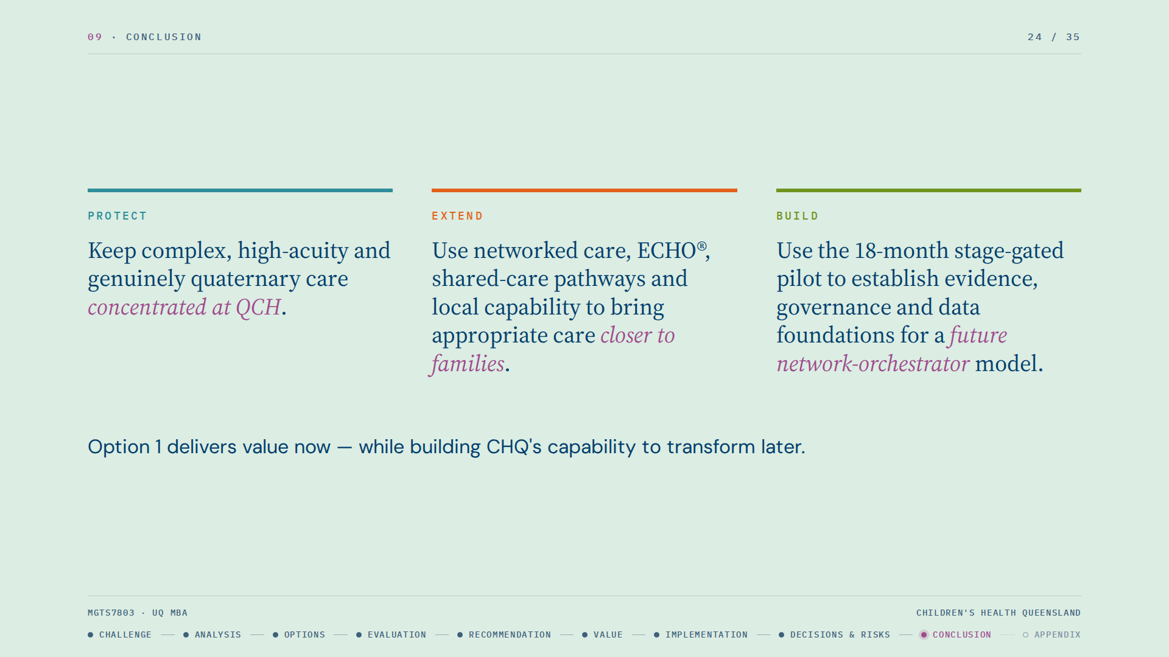
Notes:
To conclude, CHQ's strategic challenge is not a choice between statewide reach and quaternary excellence. It is deciding what must remain concentrated at QCH and what can safely be delivered closer to home.
Our recommendation therefore has three elements. First, protect quaternary excellence by keeping the most complex and high-acuity care at QCH. Second, extend CHQ's specialist expertise through networked care, ECHO®, shared-care pathways and stronger local capability. Third, build the evidence, governance and data foundations through an 18-month stage-gated pilot.
This is why Option 1 delivers value now while preserving the option to transform later. At month 18, CHQ can make an evidence-based decision on whether the conditions are strong enough to progress toward the network-orchestrator model.

Slide 25
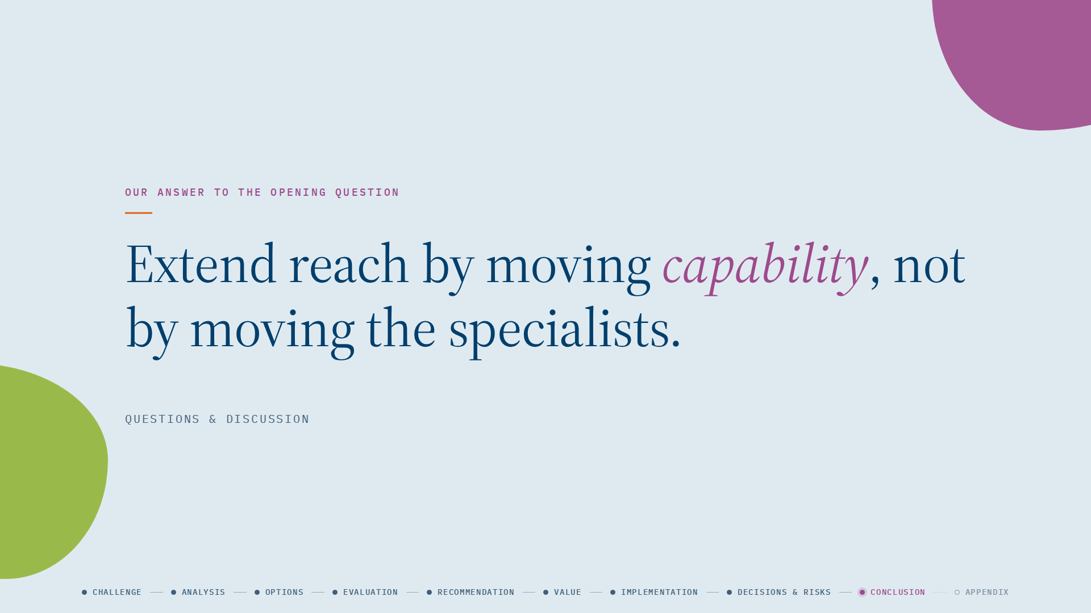
Notes:
Our answer to the opening question: extend reach by moving capability, not by moving the specialists. Thank you. We welcome your questions.

Slide 26
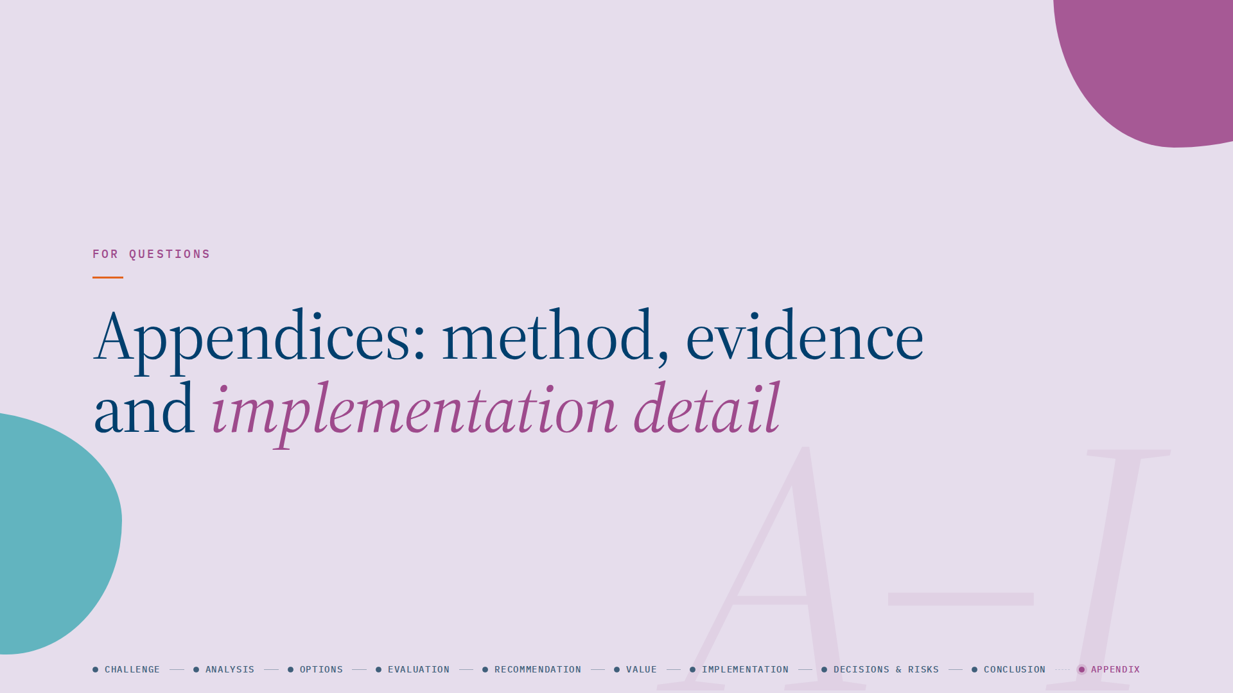

Slide 27
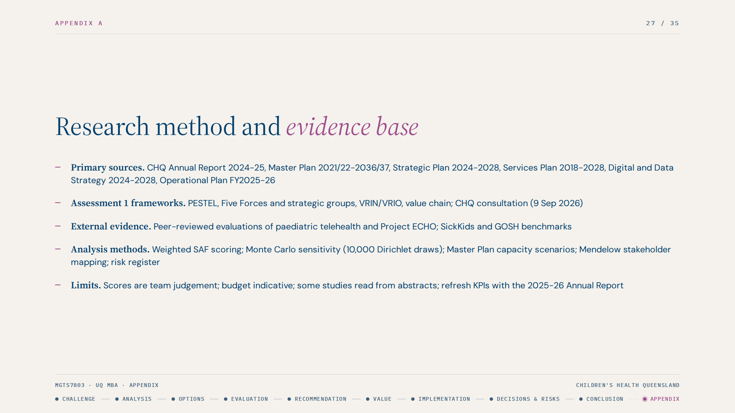
Notes:
Justification: the method combines CHQ's own published documents, our Assessment 1 frameworks and external evidence so each claim is traceable. Stated limits: scores are team judgement, the budget is indicative, some external studies were read from abstracts and should be checked against full texts, and the 2025-26 Annual Report may update the KPIs.

Slide 28
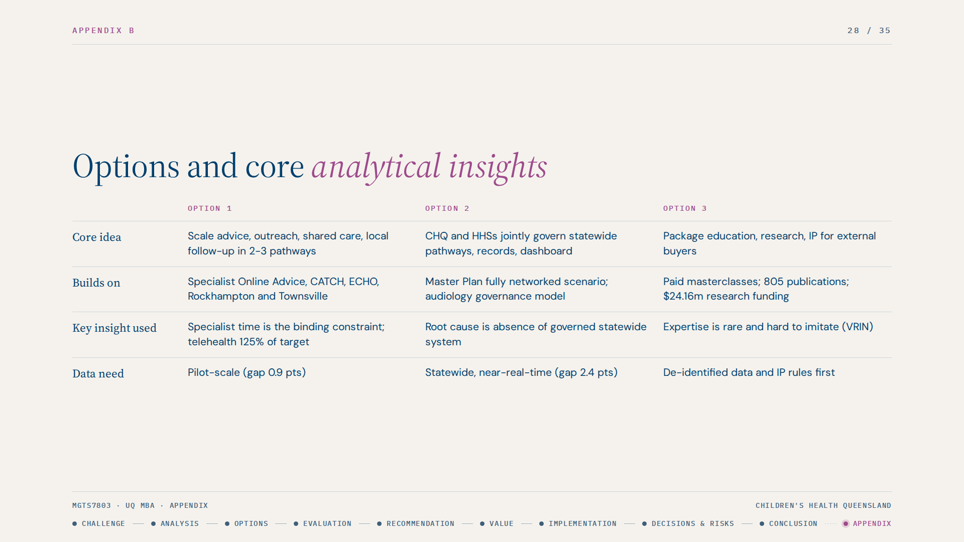
Notes:
Justification: each option maps to an insight from the analysis. Option 1 responds to the supplier-power and geographic findings and builds on assets CHQ already runs. Option 2 responds to the operating-model gap but assumes a mandate and data that do not yet exist. Option 3 leverages the VRIN finding on expertise but ignores the capacity constraint. The four mechanisms in Option 1 form a sequence along a child's journey: advice, outreach, shared care, local follow-up. Local follow-up moves the most responsibility and frees the most specialist capacity.

Slide 29
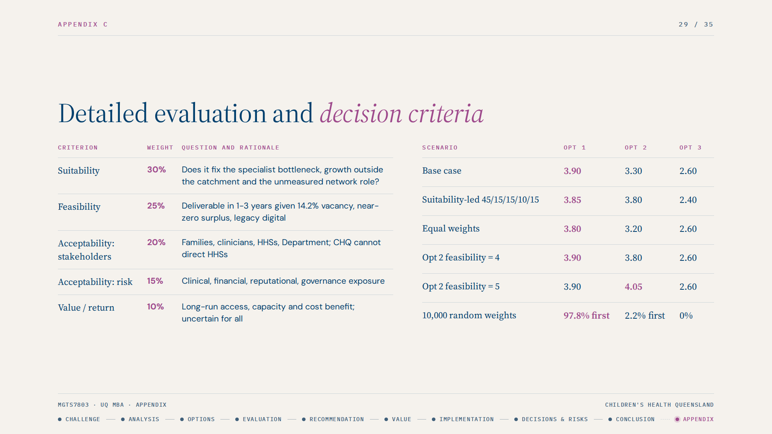
Notes:
Justification: the criteria follow Johnson et al.'s suitability, acceptability and feasibility tests, with acceptability split and value added. Weights are stated openly so the Board can test them. Sensitivity shows the ranking is robust: Option 2 wins only if its feasibility is lifted to 5, which the pilot is designed to test.

Slide 30
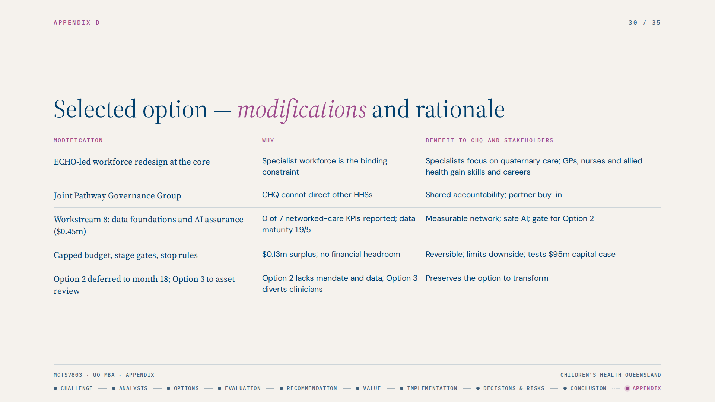
Notes:
Justification: the plain Option 1 would have left fragmentation, unmeasured performance and a workforce constraint untouched. Each modification closes a gap in the analysis. The benefit to CHQ is capacity: three advanced-practice clinicians could provide roughly 4,500 assessments a year (an illustrative assumption), about 1.8 times the 2,474 long-wait list. That releases consultant time for complex new patients, surgical lists and quaternary services.

Slide 31
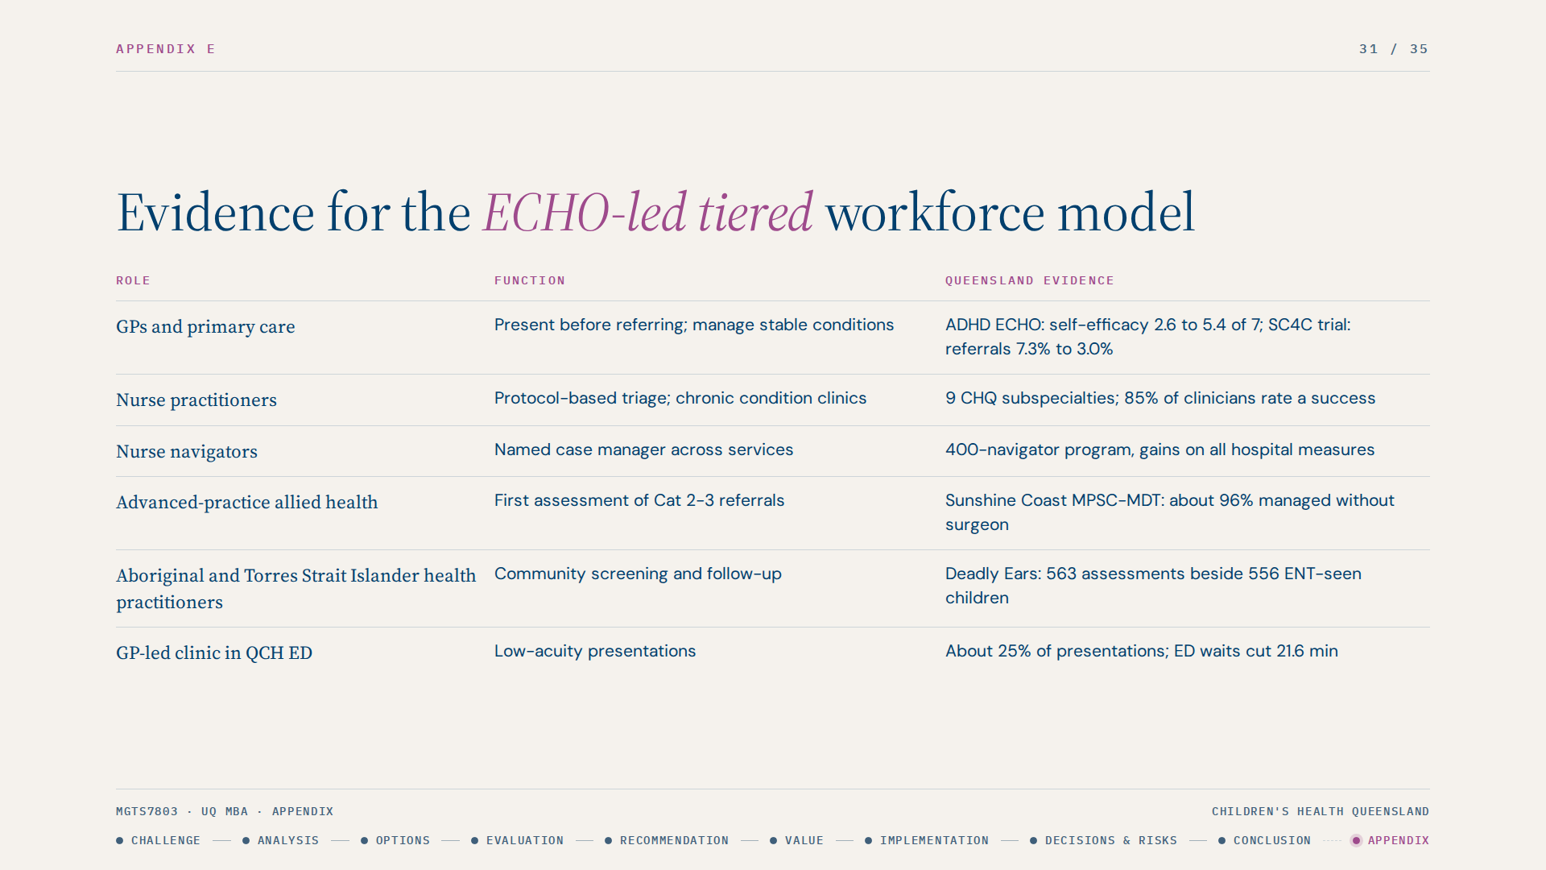
Notes:
Justification: every role in the tiered model already works in Queensland, including inside CHQ, so Option 1 scales proven local practice rather than importing an untested model. That is why it scores well on feasibility. Caveat: evidence on patient outcomes for ECHO and eConsult is weaker than evidence on clinician knowledge and practice change (McBain et al. 2019).

Slide 32
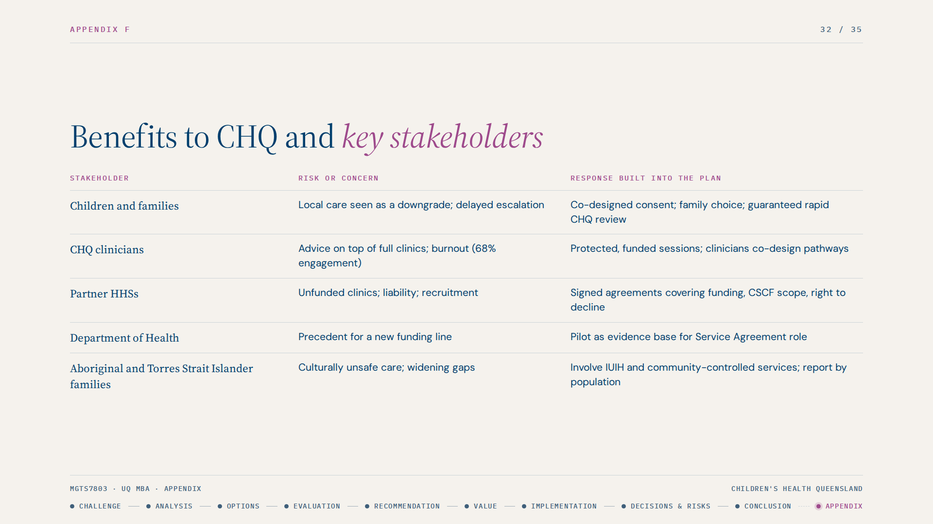
Notes:
Justification: stakeholders were mapped by power and interest (Mendelow 1991). The plan builds a response to each group's main concern. Conflicts are acknowledged: families want continuity while CHQ wants to release specialist capacity, so shared-care plans with scheduled CHQ reviews serve both. Partner HHSs and CHQ may want the same funded work, so CHQ accepts some ABF loss and asks the Department to recognise advice time.

Slide 33
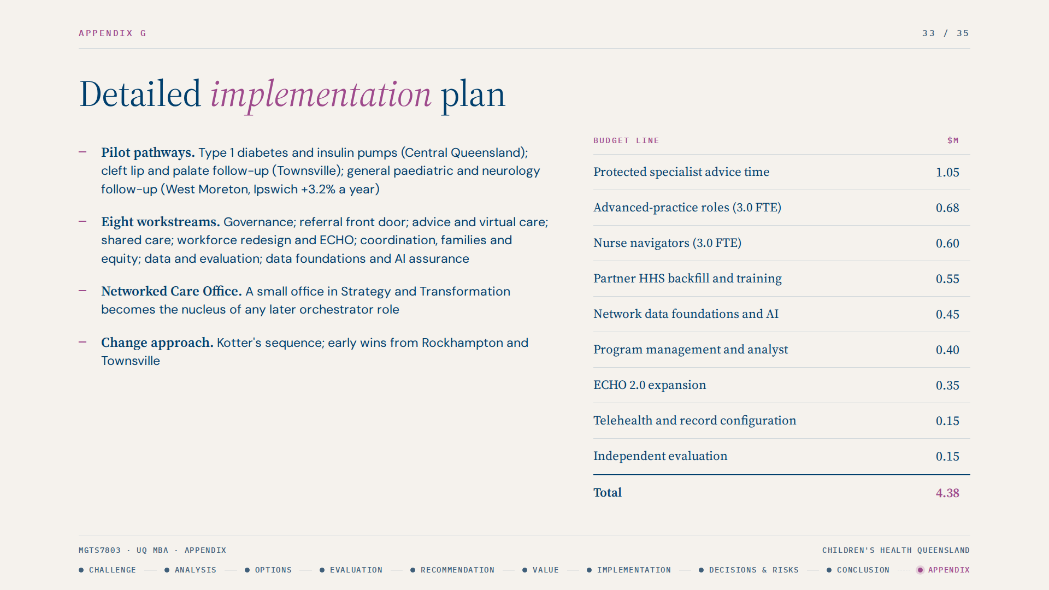
Notes:
Justification: the eight workstreams are each anchored in an existing CHQ commitment (Strategic Plan, Operational Plan, Master Plan, Digital and Data Strategy), so the program extends agreed direction. Pathways were chosen for volume, clear eligibility, an existing partnership and alignment with growth, and are to be validated with baseline data. The budget is an indicative $4.38m for CHQ Finance to validate; much of the advanced-practice cost is recoverable through ABF.

Slide 34
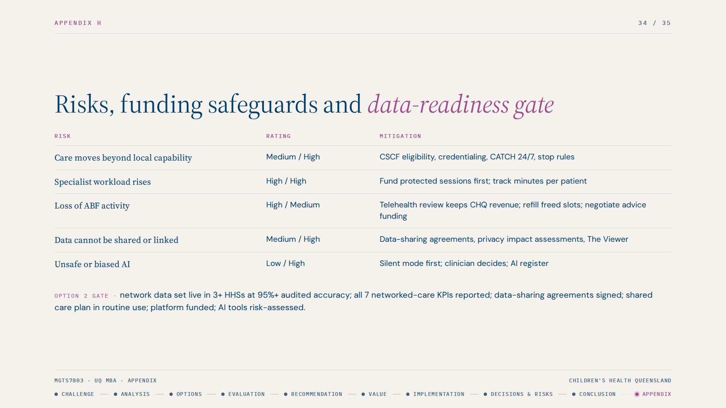
Notes:
Justification: the highest risks are specialist workload rising rather than falling and loss of ABF activity. Both are mitigated by design: fund protected sessions before appointments move, and use telehealth provider-end funding and refilled slots. In our illustrative model (3,000 events, 50% shifting, $450 per event) about 80 percent of the revenue impact is offset. Data readiness is 1.9 out of 5 today against 2.8 needed for Option 1 and 4.3 for Option 2, so Option 2 carries an explicit gate.

Slide 35
