Slide 1
DESIGN OF CLASSIFIER FOR DETECTION OF DIABETES USING SUPPORT VECTOR MACHINES(SVM)
National Conference On Emerging Trends in Engineering and Technology ,Vasai(VNCET-2012)
Nisha Saroha ,Gayatri Mundada, Arti Yadav and Preeti Singh
All India Shri Shivaji Memorial Society’s(AISSMS) College Of Engineering
(Department Of Computer Science) ,University of Pune,Pune,Maharashtra
VNCET-2012

Slide 2
ABSTRACT
This paper presents a classifier approach for detection of diabetes and shows how support vector machine(SVM) can be used for classification purpose.
Because of the chronic nature of diabetes, the relentlessness of its complications and the means required to control both diabetes and its complications; this disease is very costly, not only for affected individuals and families but also for the healthcare systems. The early detection is the best way to deal with a disease like diabetes.
Our system will consist of various stages which include preprocessing of clinical data ,data Normalization ,feature sub-selection and applying Sequential Minimal Optimization(smo) Training Algorithm. Further using test data we check the classifier which is used for the purpose of detection

Slide 3
INTRODUCTION:
Support Vector Machines is a machine learning method invented by Vapnik and co-workers (Boser et al, 1992).
SVM is based on two key concepts :
A maximal margin classifier.
The aim of SVM is to find the best classification function to distinguish between members of the two classes in the training data. For a linearly separable dataset, a linear classification function corresponds to a separating hyperplane f (x). SVM guarantees that the best such function is found by maximizing the margin between the two classes.
Thus,It is a linear classifier which constructs a separating hyperplane to maximize distance between data.
Maximizing the margin is an approximate implementation of Structural Risk Minimization Principle.
A kernel function:to map the data in a new space where they are separable (i.e. SVM is a kernel method).

Slide 4
RELATED WORK:
Artificial recurrent neural network (ANN),which predicts blood glucose level for specific patient. The predicted blood glucose level may then be used in neuro-fuzzy expert system to offer short-term therapeutic advice.
Principal component analysis and neuro fuzzy inference for diabetes data classification giving 78.21% classification accuracy.
Cascade learning system based on Generalized Discriminant Analysis (GDA) and Least Square Support Vector Machine (LS-SVM) for diagnosis of diabetes disease giving 79.16% of classification accuracy.
General regression neural networks giving an accuracy of 80.21%.

Slide 5
SUPERVISED LEARNING
Training set: A number of expression profiles with known labels which represent the true population.
Learning/Training: Find a decision rule which explains the training set well.
**This is the easy part, because we know the labels of the training set!
Generalisation ability: How does the decision rule learned from the training set.
Goal: find a decision rule with high generalisation ability.

Slide 6
TRAINING SET
We are given a dataset :
S = {(x1, y1…. (xm, ym)}
Here the data for a two class learning problem consists of objects labeled with one of two labels corresponding to the two classes,
we assume the labels are +1:Positive cases
-1 :negative cases
The notation xi will denote the ith vector in a dataset where yi is the label associated with xi.
The objects xi are called patterns or examples.

Slide 7
LEARNING/TRAINING:
Learning refers to the process of inferring general rules by observing examples.
In order to learn,the algorithm is given the training examples (X1, Y1), ..., (Xn, Yn), that is pairs of objects with the corresponding category label.
The goal is then to find a mapping f : X -> Y which makes “as few errors as possible”. That is, among all the elements in X, the number of objects which are assigned to the wrong category is as small as possible.
The mapping f : X -> Y is called a Classifier.
Thus,SVM is a classification algorithm (classification rule) that takes the training data as input and outputs
a classifier f.

Slide 8
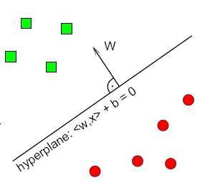
DECISION BOUNDARY/RULE
For a linear classifier,a pair (w,b) exists such that:
w^{t}.x+b>=1 for positive cases
w^{t}.x+b<=-1 for negative cases
Hence, the decision rule given by:
f_{w,b}(x)=sgn(w^{t}.x+b),where
w is the vector of weights for all attributes
b is a real number representing the y-intercept
The decision boundary is the set of points x
such that: w.x+b = 0
d is the distance between the decision boundary
and the margins and it is defined as d = 2/||w||

Slide 9
TASKS IN LEARNING
The task of learning a linear SVM consists of,estimating the parameters w and b
The first criterion is that all points in the
training data must be classified correctly:
w.xi+b>= 1 if yi = 1
W.xi+b<=-1 if yi = -1
This can be re-written as:
yi(w.xi+b)>=1 for 1<=i<=N

Slide 10
The second SVM learning criterion is that the margins should be as large as possible i.e.We want to minimize f (w) = 1/2||w||^{2.}
And thus an optimum separating hyperplane can be found by minimizing the squared norm of the separating hyperplane.
This minimization is set up as a convex quadratic programming (QP) problem where we have to :
Minimize f (w) = 1/2||w||^{2.}
Subject to, yi(w^{t}.x+b)>=1 for all 1<=i<=N

Slide 11
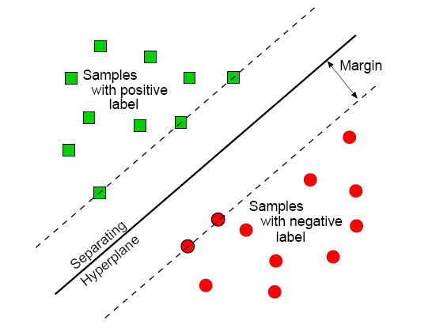
SEPERATING THE TRAINING SET WITH MAXIMAL MARGIN (OPTIMAL SEPERATING HYPERPLANE)
The points nearest to the separating hyperplane are called Support Vectors.
Only they determine the position of the
hyperplane.
All other points have no
influence!
Mathematically: the weighted sum of the
Support Vectors is the normal vector of
the hyperplane.

Slide 12
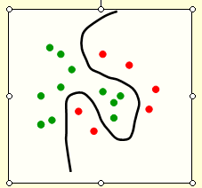
THE KERNEL TRICK
Fitting hyperplanes as separators is mathematically easy.
  The mathematics is linear.
By replacing the raw input variables with a much larger set of features we get a nice property:
  A planar separator in the high-dimensional space of feature vectors is a curved separator in the low dimensional space of the raw input variables.

Slide 13
For mapping the input vectors into a very high-dimensional feature space,the task of finding the maximum-margin separator becomes computationally intractable since,
  The mathematics is all linear,but the vectors have a huge number of components.
  So taking the scalar product of two vectors is very expensive.
So we use “the kernel trick”.

Slide 14
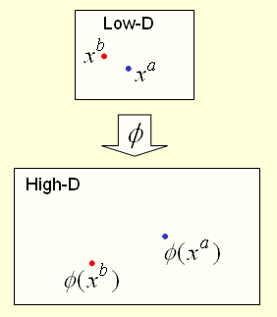
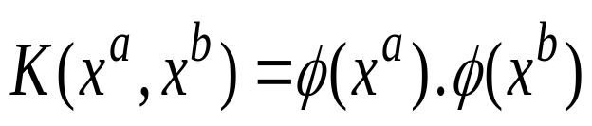
KERNEL TRICK-WORKING
For many mappings from a low-D space to a high-D space, there is a simple operation on two vectors in the low-D space that can be used to compute the scalar product of their two images in the high-D space.
Letting the kernel do the work
doing the scalar product in the obvious way

Slide 15
PROPOSED MODEL
DATA PREPROCESSING
DATA NORMALIZATION
SMO TRAINING ALGORITHM
TESTING FOR NEW VALUES

Slide 16
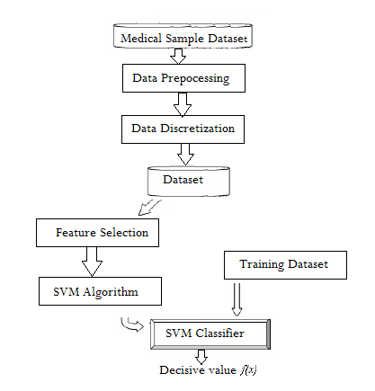

Slide 17
ATTRIBUTES FOR DIABETIC DATASET
The data set collects data about 768 patients with and without developing diabetes onset within five years.
The attributes in the data set are:
1) Pregnant: number of times pregnant
2) Plasma Glucose: the plasma glucose concentration measured using a two-hour oral glucose tolerance test.
3) Diastolic BP: diastolic blood pressure (mmHg)
4) Triceps SFT: triceps skin fold thickness (mm)
5) Serum Insulin: two-hours serum insulin (mu U/mt)
6) BMI: body mass index (weight in kg; height in m)
7) DPF: diabetes pedigree function
8) Age: age of the patient (years)
9) Class: diabetes onset within five years (0 or 1)

Slide 18
DATA PREPROCESSING
In order for make the data appropriate for the mining process it needs to be transformed. The actions comprised in the pre-processing of a data set are :
the removal of duplicate records
normalizing the values used to represent information in the database
accounting for missing data points and removing unneeded data fields.
All the inductive learning algorithms rely heavily on the product of this stage, which is the final training set.

Slide 19
DATA NORMALIZATION
The attribute data is scaled to fit in a specific range using Min Max Normalization ,which transforms a value A to B which fits in the range. It is given by the below formula
B = A/(maximum value of A-minimum value of A)

Slide 20
TRAINING DATASET
For training the support vector machine,we are using initially 3/4th of the data and the remaining is used for testing.
Say for eg,if we have PIMA INDIANS DATASET –we have total 760 entries,out of which for training we will use around 570 entries for training.

Slide 21
TRAINING ALGORITHM
Training a support vector machine requires the solution of a very large quadratic programming (QP) optimization problem. – for finding w and b
i.e Minimize f (w) = 1/2||w||^{2.}
Subject to, yi(w^{t}.x+b)>=1 for all 1<=i<=N
We are using SMO which breaks this large QP problem into a series of smallest possible QP problems.The amount of memory required for SMO is linear in the training set size, which allows SMO to handle very large training sets.

Slide 22
SOLVING THE OPTIMIZATION PROBLEM
Need to optimize a quadratic function subject to linear constraints.
Quadratic optimization problems are a well-known class of mathematical programming problems, and many (rather intricate) algorithms exist for solving them.
The solution involves constructing a dual problem where a Lagrange multiplier αi is associated with every constraint in the primary problem:
Find α₁…α_{N} such that
Q(α) =Σα_{i} - ½ΣΣα_{i}α_{j}y_{i}y_{j}x_{i}^{T}x_{j} is maximized and
(1) Σα_{i}y_{i} = 0
(2) α_{i} ≥ 0 for all α_{i}

Slide 23
SMO ALGORITHM
Sequential Minimization Optimization breaks up QP
program into small subproblems that are solved
analytically.
SMO solves dual QP SVM problem by examining
points that violate KKT conditions.
Algorithm converges and consists of:
Search for 2 points that violate the KKT conditions.
Solve QP program for 2 points.
Calculate threshold value b.
Continue until all points satisfy KKT conditions.
Convergence time depends on difficulty of classification problem and kernel functions used.

Slide 24
OPTIMIZATION PROBLEM SOLUTION
The solution has the form:
Each non-zero αi indicates that corresponding xi is a support vector.
Then the classifying function will have the form:
it relies on an inner product between the test point x and the support vectors xi
Thus, solving the optimization problem involved computing the inner products xi^{T}xj between all pairs of training points.
w =Σα_{i}y_{i}x_{i} b= y_{k}- w^{T}x_{k} for any x_{k} such that α_{k}≠ 0
f(x) = Σα_{i} y_{i} x_{i}^{T} x + b

Slide 25
LINEAR SVM-OVERVIEW
The classifier is a separating hyperplane.
Most “important” training points are support vectors; they define the hyperplane.
Quadratic optimization algorithms can identify which training points xi are support vectors with non-zero Lagrangian multipliers αi.
Both in the dual formulation of the problem and in the solution training points appear only inside dot products.
Find α₁…α_{N} such that
Q(α) =Σα_{i} - ½ΣΣα_{i}α_{j}y_{i}y_{j}x_{i}^{T}x_{j} is maximized and
(1) Σα_{i} y_{i} = 0
(2) 0 ≤ α_{i} ≤ C for all α_{i}
f(x) = Σα_{i} y_{i} x_{i}^{T}x + b

Slide 26
THE KERNEL TRICK
Fitting hyperplanes as separators is mathematically easy.
  The mathematics is linear.
By replacing the raw input variables with a much larger set of features we get a nice property:
  A planar separator in the high-dimensional space of feature vectors is a curved separator in the low dimensional space of the raw input variables.

Slide 27
For mapping the input vectors into a very high-dimensional feature space,the task of finding the maximum-margin separator becomes computationally intractable since,
  The mathematics is all linear,but the vectors have a huge number of components.
  So taking the scalar product of two vectors is very expensive.
So we use “the kernel trick”.

Slide 28
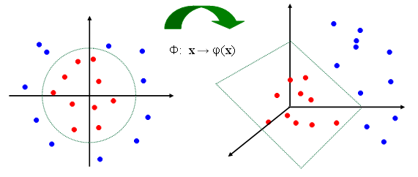
NON-LINEAR SVMS: FEATURE SPACES

Slide 29
KERNEL FUNCTIONS
The linear classifier relies on dot product between vectors K(x_{i},x_{j})=x_{i}^{T}x_{j}
If every data point is mapped into high-dimensional space via some transformation Φ: x → φ(x), the dot product becomes:
K(x_{i},x_{j})= φ(x_{i})^{T} φ(x_{j})
A kernel function is some function that corresponds to an inner product in some expanded feature space.
Example:
Linear: K(x_{i},x_{j})= x_{i} ^{T} x_{j}
Polynomial of power p: K(x_{i},x_{j})= (1+ x_{i} ^{T} x_{j})^{p}

Slide 30
NON-LINEAR SVM’s-MATHEMATICALLY
Dual problem formulation:
The solution is:
Optimization techniques for finding α_{i}’ s remain the same!
Find α₁…α_{N} such that
Q(α) =Σα_{i} - ½ΣΣα_{i}α_{j} y_{i} y_{j} K(x_{i}, x_{j}) is maximized and
(1) Σα_{i} y_{i} = 0
(2) α_{i} ≥ 0 for all α_{i}
f(x) = Σα_{i} y_{i} K(x_{i}, x_{j})+ b

Slide 31
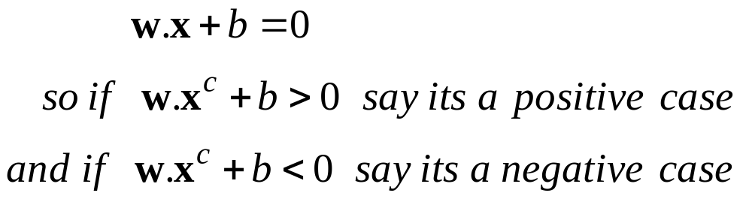
TESTING
Once the training set is achieved,and hyperplane i.e the seperator is defined for the set of points where

Slide 32
CROSS VALIDATION
One round of cross-validation involves partitioning the sample of data into complementary subsets, performing the analysis on one subset (called the training set)and validating the analysis on the other subset (called the validation set or testing set).
To reduce variability, multiple rounds of cross-validation are performed using different partitions, and the validation results are averaged over the rounds.

Slide 33
PERFORMANCE EVALUATION
Building a Confusion Matrix out of given data
Evaluation Metrics
Accuracy (percent correct)
Precision
Recall
For fare evaluation, as we have seen the
‘cross-validation’ scheme is used

Slide 34
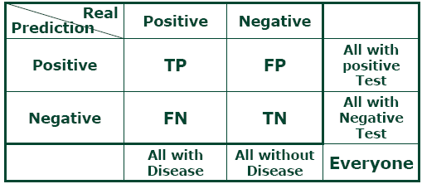
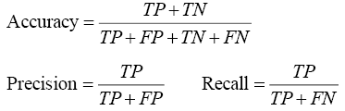

CONFUSION MATRIX:

Slide 35
ADVANTAGES OF SVM
The quality of generalization and ease of training of SVM is far beyond the capacities of these more traditional methods.
SVM can model complex, real-world problems
SVM performs well on data sets that have many attributes, even if there are very few cases on which to train the model Traditional neural networks do not perform well under these circumstances.

Slide 36


