Slide 1
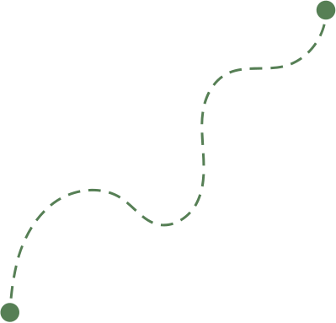
Hi Humaniser! Moment
A reminder to think beyond the plan and imagine what could get in the way.
What Could
Go Wrong?
Small habits shape how teams work together.

Slide 2
How to run this HH! Moment
(3-5 minutes)
When to use it
How it works
At the start of meetings where teams are discussing plans, decisions, projects, or new ideas.
It works especially well when people are moving quickly or working across different teams and perspectives.
Introduce the idea of anticipatory thinking
Encourage curiosity beyond immediate tasks
Invite people to consider possible blind spots
Why it helps
Tips
Teams naturally focus on delivery and immediate priorities.
This moment encourages people to step back briefly and consider risks, dependencies, or unintended consequences before problems emerge.
The goal is not to create fear or pessimism.
It’s simply to encourage broader thinking before moving forward.

Slide 3


What could go wrong?
Most teams spend a lot of time planning for success.
But many project problems only seem obvious once things start going wrong.
Worth thinking about...
What are we treating as “someone else’s problem”?
What are we assuming will happen smoothly?
If this failed in six months, what might the reason be?
Strong teams don’t only plan for success.
They also create space to explore risks, dependencies, and unintended consequences early.

